Slide 1
Why Cloud Partner Playbook for SMBs
July 2019
For Microsoft Partner use only. Not for customers.

Slide 2

Playbook overview
Understand the SMB cloud opportunity
Focus your pitch by problem solving
Win cloud-reluctant SMBs
Build your SMB cloud practice

Slide 3

Understand the SMB cloud opportunity

Slide 4
SMBs are loud, proud, and spending on cloud
17%
Plan to double
their spend
62%
Plan to grow their spend +20%
SMBs account for 60% of the global workforce¹
SMB cloud spend is growing²
¹ World SME Forum, http://www.worldsmeforum.org/about/.
²RightScale©, “2018 State of the Cloud Report™,” 2018.

Slide 5
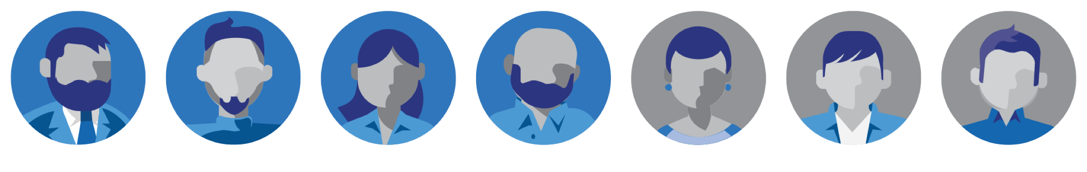

Some SMBs are more cloud-reluctant than others
Two-thirds of SMBs already use cloud
One-third of SMBs do not use cloud yet
54% expect to increase cloud investments
66% are considering it
Bredin, an SMB market research and content marketing agency.

Slide 6
Cloud-reluctant SMBs are not cloud adverse
2.5%
16%
Innovators
13.5%
34%
34%
Laggards
Early adopters
Early majority
Late majority
We’re in!
It seems expensive and risky
They just have concerns they need you to address
It’ll slow us down and cause disruptions
It’s more than I need / It feels impersonal

Slide 7
Developing your SMB cloud practice pays off
Improve your profitability by offering higher-margin services
Sell more to each customer with a clear upsell path for additional cloud services
Drive customer retention by establishing yourself as a trustworthy cloud advisor
65%
45%
Packaged IP
35%
60% of SMBs want a partner’s advice¹
Managed services
20%
Project services
Monthly licence subscription
¹ Bredin, an SMB market research and content marketing agency.

Slide 8

Focus your pitch by problem solving

Slide 9
Outdated cloud misperceptions haunt SMBs
Non-compliant with industry regulations
Limited to expensive security solutions
Increased security exposure
Security
Overcharged for
unnecessary junk
Migration SNAFUs
Loss of data
if we cancel
Too complex for our team
Hidden subscription fees
Random updates
Cost
Business disruption

Slide 10
Jumping in cloud first can trigger blockers
Listen and learn through business discovery
Earn the right to advise them by knowing them
Propose a solution that’s right for them
Balance addressable pain points with their cloud comfort
Shout the benefits, whisper the cloud
Focus on how the solution will help their everyday work
Address cloud concerns with empathy and facts
Spend time validating their concerns and unpacking them from buzz words

Slide 11
Listen and learn through business discovery
Listen for pain points
Processes undermine productivity
Systems dictate how we work
Security threats disrupt workflow
Limited systems drain our budget
Identify priorities
Functionality
Flexibility
Security
Savings
Sample business questions
Who are your clients? What do they need?
Where do your employees work?
How do you envision your company growing?
Sample technology-use questions
What is your company’s view of technology?
Do you have a dedicated IT person?
What do you wish you could do better?

Slide 12
Shout the benefits of modern email and office apps
Whisper the cloud
Ground the email and modern apps conversation in the larger story about the challenges their business faces today
Talk about how big their job is, how hard they work, and how ridiculous it is to hassle with email and outdated apps.
Explain how a business-class email solution and always-updated office apps will help address a problem they have
Don’t overwhelm your cloud-reluctant customer with all the possible capabilities—keep your pitch focused on a problem they face. This can include security or collaboration challenges.
Illustrate how their email solution and modern office apps will work in their environment
Help your customer visualize the solution in their environment through demos and guided trials.

Slide 13

Win cloud-reluctant SMBs with business-class email and modern office apps

Slide 14
Email and modern apps build trust for cloud-reluctant SMBs
Replace current technology with low-cost, high-value solutions
SMBs use email more than any other app or software today¹
Many still use in-house servers or free online email and need a business-class solution with the benefits of the cloud.
SMBs get more done with always-updated, modern apps
SMBs benefit when they take advantage of advanced security and collaboration features included in familiar apps. This builds cloud comfort to pave the way for more deals and additional projects.
¹ Bredin, an SMB market research and content marketing agency.

Slide 15
SMBs stand to gain a lot from the cloud
Functionality
Flexibility
Security
Savings
Get more done
Choose how you work
Help protect business
Keep costs in line
The cloud enables advanced capabilities for collaboration, productivity, and insight
The cloud makes it easier for SMBs to use the devices of their choice from anywhere
94% of small businesses report security benefits since moving to the cloud¹
Forrester Consulting estimated SMBs can save $20,975 a year on IT with
the cloud.²
¹ Microsoft, “Cloud Security, Privacy and Reliability Trends Study,” June 2013.
²“The Total Economic Impact™ Of Microsoft Office 365,” a commissioned study conducted by Forrester Consulting on behalf of Microsoft, November 2016.

Slide 16


Use compelling moments to inspire bigger changes

Slide 17
SMBs are overdue for change
Why sell cloud services?
Why sell a modern desktop?
$26K
$158K
74%
of SMBs plan to buy a new PC in the next 12 months.⁴
Average amount saved each year per full-time remote employee¹
Average cost of
a data breach²
More than
50%
of SMB customers run older versions of Windows on their PCs.⁴
Productivity
Cloud services enhance productivity of an increasingly mobile workforce. Employee productivity increases on average by 22% and employee turnover decreases by 50%.¹
Security
More than 50% of SMBs have suffered a data breach,³ disrupting trust and damaging bottom lines. Cloud-based security offers sophisticated protections.
The total cost of owning a 4+ year old PC is
CA $3,119
more than the cost of a newer PC.⁴
¹Small Biz Daily; 10 Small Business Trends; Remote Working Policies Can Benefit Small Business, Nov. 2017.
²TechRepublic; An average data breach will cost an enterprise $1.23M and an SMB $120K, here's why, May 2018.
³Small Biz Daily: 10 Small Business Trends 2018.
⁴ Source: TechAisle SMB PC Study for Microsoft, July 2018.
Notes:
We see SMB technology decision-makers moving away from a strategy of squeezing every spark of life out of IT assets toward a more strategic approach to technology adoption. As a result, Microsoft partners can capitalize on growing IT budgets and accelerated refresh cycles.
When SMBs do upgrade to Microsoft 365, they typically do so because they want the benefits of file sharing, remote access, and data security. SMBs who upgrade to Microsoft 365 cite multiple benefits, including ~45 hours of increased mobile worker productivity per mobile worker, 17% reduction on time spent on decision making, increased collaboration, reduced down-time and use of third-party software.
Many SMBs are also concerned about their ability to protect their business from cyberattacks and keep their data safe—but lack basic protection against the most common threats. A recent Microsoft survey of SMBs and found that 71 percent feel vulnerable to a cyberattack, jumping to 87 percent for businesses that have already experienced a breach. The advanced security features in Microsoft 365 offer a comprehensive solution to protect SMBs from cyberthreats and to safeguard sensitive information.
SMBs are also more likely to be open to a modern desktop, represented by a new PC running Windows 10 and Microsoft 365. In recent years, we’ve seen cost-conscious SMBs upgrade PCs only when productivity suffers. Aging hardware and software are now holding back many SMBs, including the large volume running Windows 7 and Office 2010. The total cost of ownership of these old systems is more than the cost of a new PC. SMBs appear to be acknowledging this, with a majority saying they will be buying new PCs within the year. A 2018 TechAisle SMB PC Study for Microsoft showed that 70% of the smaller SMBs state purchase intent and the number increases to 74% for the larger SMBs.

Slide 18


End-of-support deadlines raise the stakes and create urgency
69%
Windows 7
January 2020
of SMBs are not aware or only slightly aware of the end of support dates.
Office 2010
October 2020
Office 2013 and earlier
Office 365 connectivity
October 2020
Help customers avoid security risks caused by unsupported solutions
Start early to retain customers that are ripe for change
Notes:
Sellers understand the value of compelling moments –contract renewals or end-of-support deadlines are opportunities to help customers think through next steps that help them break with the past.
The big compelling moment ahead is end of support for Windows 7 and Office 2010, which will affect millions of customers.
You owe it to customers to alert them to end of support before your competition does and start the planning process. Getting off Windows 7 is a big step, and you can help your customers use the Windows 10 migration process to modernize the way they deploy and manage PCs in the organization.
Support for Windows 7 will end on January 14, 2020.
This means Microsoft will no longer provide security updates or technical support for devices running Windows 7 operating systems. For customers who need more time, Microsoft will offer paid per-device Windows 7 Extended Security Updates (ESU) through January 2023.
In October 2020, extended support for Office 2010 also comes to an end.
Furthermore, starting in October 2020, connection to commercial Office 365 services will no longer be supported through Office 2010 and 2013.
After October 2023, commercial connection will no longer be supported through Office 2016 or previous versions.
Customers on Windows 7 and/or Office 2010, 2013, or 2016 will need to migrate to a supported version/edition of Windows and/or Office before these dates in order to ensure they remain secure and compliant.

Slide 19
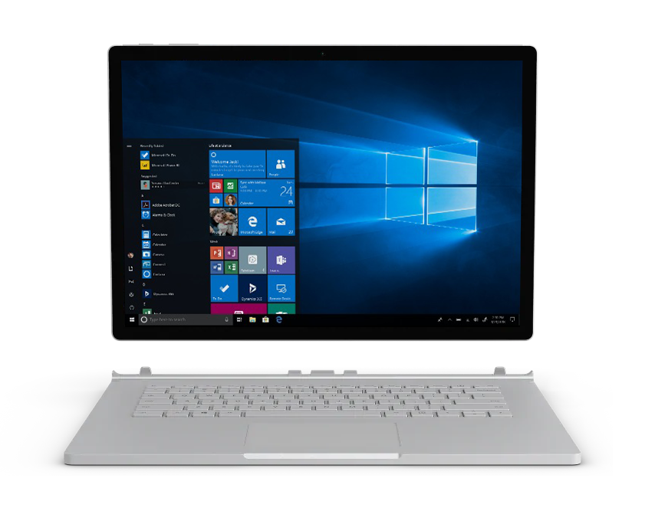
Raise the stakes
Sell a modern desktop with Microsoft 365
New and modern device running Windows 10 that has the Office desktop apps from Microsoft 365, with updates installed regularly.
SMB core scenarios | What to sell
Windows 7 and Office 2010 | New device with Windows 10 Pro and Microsoft 365 Business
Windows 7 and Exchange Online P1 | New device with Windows 10 Pro and Microsoft 365 Business
Notes:
What you sell depends on the customer environment. Success starts with a scenario-based discussion and the right approach: Cloud services first and new devices later, or start with new devices and add cloud services.
CSPs who understand cloud will likely start by modernizing the Office 2010 customers and then help them modernize their devices. The ultimate outcome is Microsoft 365 and Windows 10 in the customer environment.
For customers who love their on-premises apps, you are well positioned to lead the cloud discussion and can pitch the productivity, security, and cost benefits of desktop apps and regular updates.
If the customer is on Office 365 E1, the same discussion applies. Upsell them to Microsoft 365 Business to get end users on Outlook and the desktop apps they love with regular updates.
Partners that work with Full Packaged Products (FPPs) will want to learn how to attach Microsoft 365 to devices that they are modernizing. Because 74% of SMBs say they will purchase new devices in the next 12 months, the opportunity is huge.

Slide 20
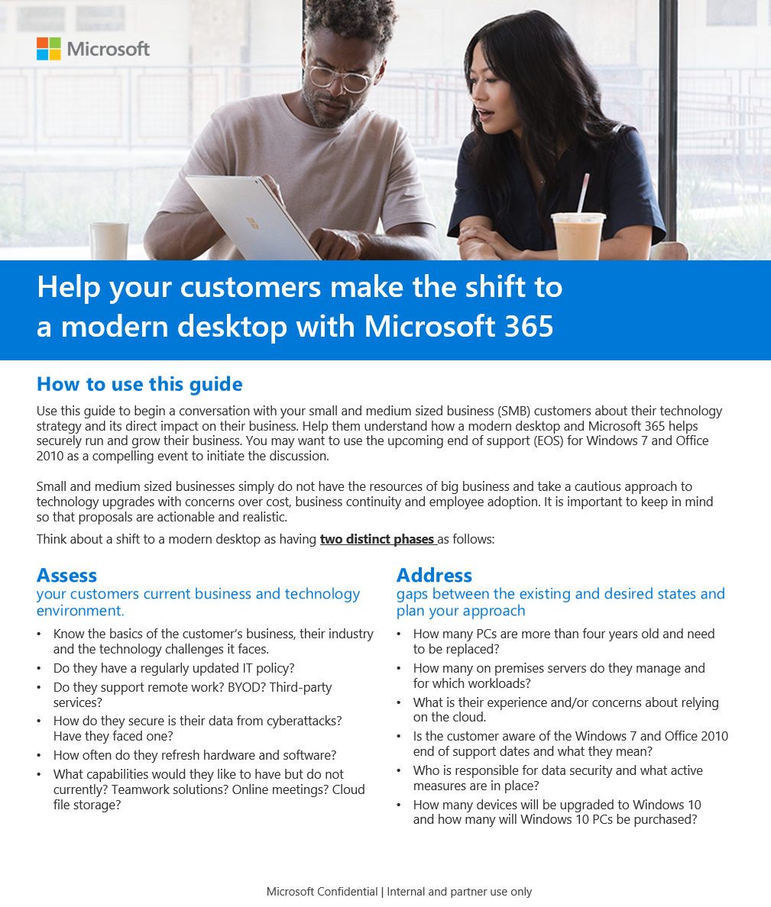
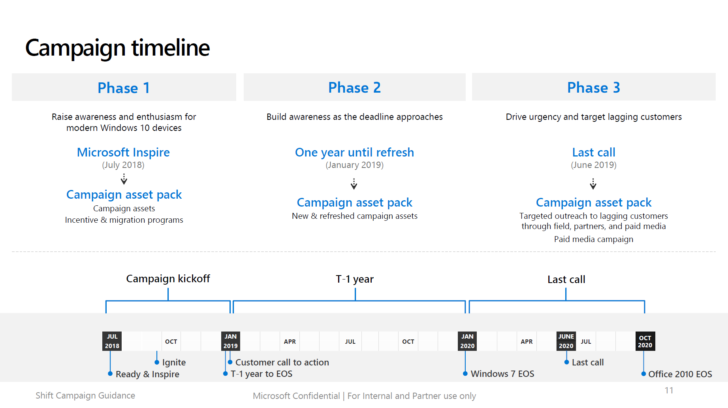
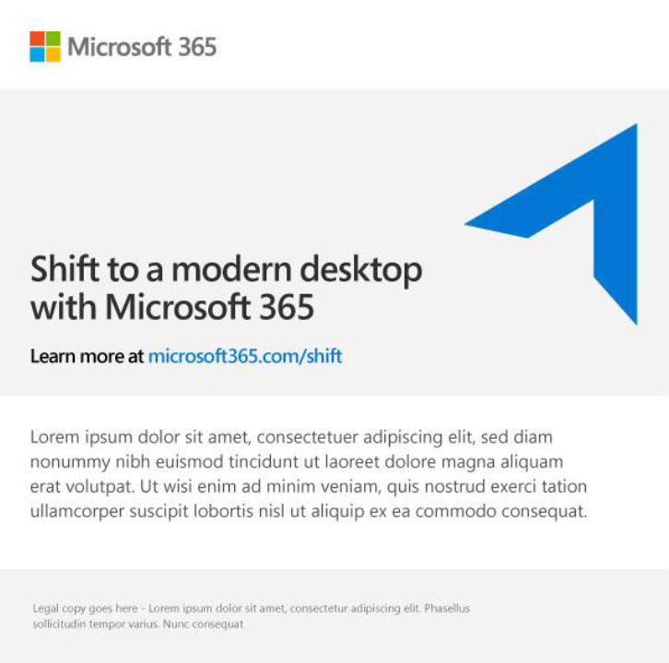
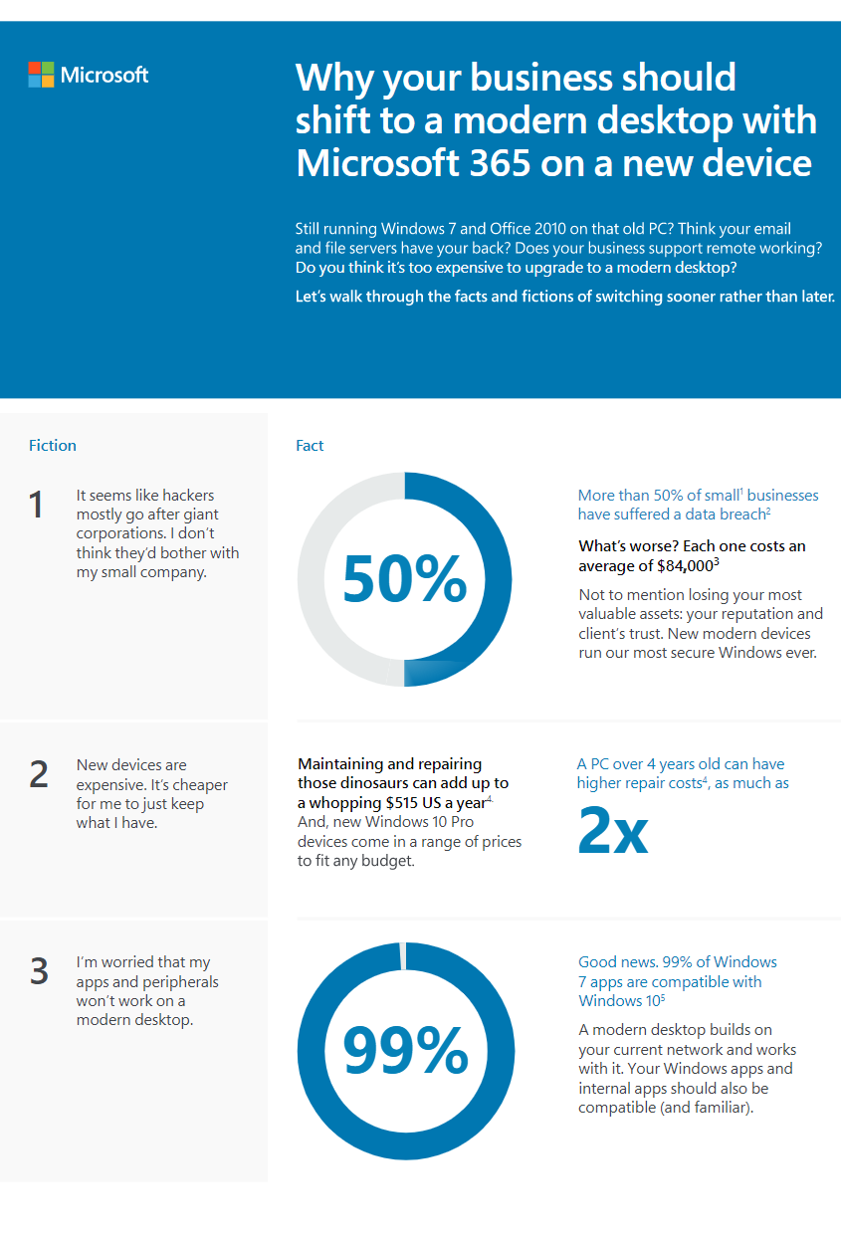
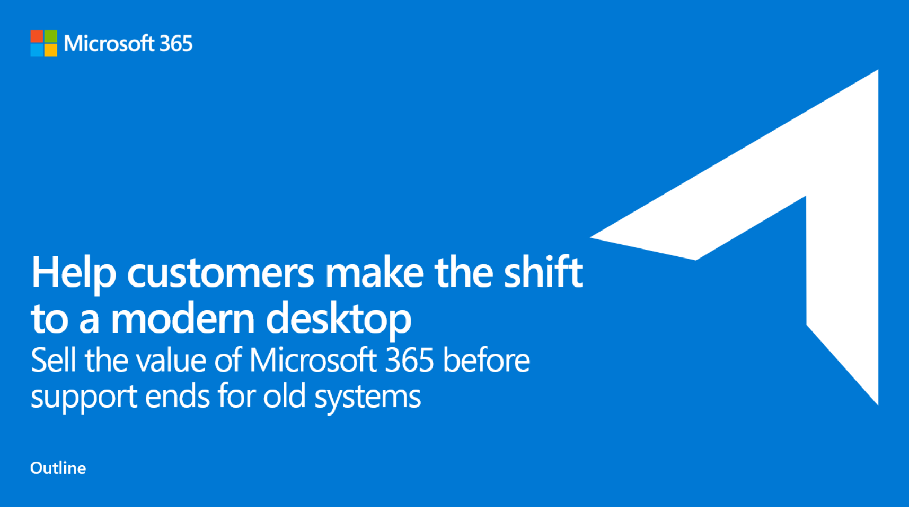
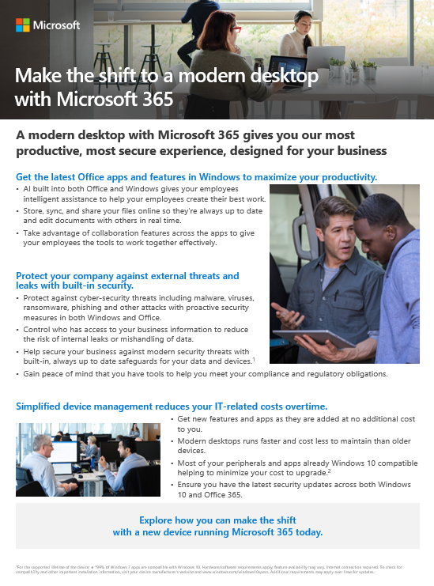
Create urgency:
Drive interest and sales with Make the Shift campaign assets
Learn
Market
Sales Guide
SMB Guidance
Connect with customers
Use email template
to send infographic
Activate campaign with display banners, social assets
c
c
c
c
c
Close and grow your business
Pitch
Use customer engagement to start planning process and close sale.
Look for what’s next and continue to build your practice and customer value.
Present using pitch deck
Follow up using email template and attach flyer
Use value-discovery workshops and CIEs where required to position value
Use demos on Microsoft.com to position a modern desktop
Marketing assets available @ aka.ms/m365bpartners
Notes:
Working with SMBs is a not a one-and-done operation, it’s a continuous cycle of learning, marketing, pitching, and selling.
Microsoft Shift campaign assets help you engage with customers to discuss the benefits of a modern desktop. Use the Shift campaign assets to Learn, Market, and Pitch to customers – this is how you create top down and bottom up awareness for businesses to update their software and hardware together and to move from on-premises solutions to an always updated experience powered by the cloud.
To get there, you can help shift perceptions among SMBs that shifting to a modern desktop experience is a benefit, versus a burden.​ Campaign assets help you focus on what customers gain by upgrading technology, with benefits clearly outlined and sales motions that align to SMB customers’ needs.
Here’s where you want to end up – Closing the sale and determining next steps to build more business.
Once partners have established interest and budget, many partners will conduct a short business assessment, technology strategy, and visioning engagement to educate customers and make next-step recommendations related to their productivity, security, and collaboration needs. This lays the foundation for the start of the customer adoption journey -- the deployment of Microsoft 365 Business.

Slide 21

Get started building your SMB cloud practice

Slide 22
Support materials for each of the 4 stages
Why Cloud Play materials
Learn
Playcard
Targeting guide
Conversation guide
Market
Email kit
Social assets kit
Flyer
Print ad
Postcard
Pitch
Elevator pitch
Customer pitch
Close
Customer offer
Proposal
SOW

Slide 23
Grow over time
Build profitability as you build practices with SMB marketing kits
Why Cloud?
Build a practice by using basic cloud offerings to acquire customers and capitalize on legacy opportunity
Extend
to devices
Bundle
migration
Start
with email
Company-wide data handling
Teamwork
Extend profitability of your existing Microsoft 365 practice and acquire at scale with a teamwork practice
Online meetings and conferencing
File storage
& sharing
Security
Maximize your profitability by enabling SMBs to safeguard their data with a security offering
Get and stay compliant
Secure data from accidental leaks
Protect from external threats
For more information, please contact MicrosoftBDM@synnex.com
Notes:
Microsoft has created three marketing kits for partners that want support to grow their business. Most partners will start with Why Cloud for SMBs that may be ready for an updated experience powered by the cloud, then integrate Teamwork and Security messaging into their discussions with the customer.
WHY CLOUD
Windows 7 and Office 2010 End of Support by 2020 – Modern Desktop Opportunity
Reactive approach (commodity, highly competitive) or Proactive approach (digital transformation)
Email: cost savings, simplified management, and increased capabilities.
Bundle Migration: in a single bill through the CSP Program
Device refresh opportunity
From Product/Licence to Solutions
TEAMWORK
Next step is easier access to business information and better collaboration tools.
“Me” product: OneDrive (syncing, sharing, simultaneous co-authoring)
“We” products: Microsoft Teams (new approach to collaboration and data management) that leverages SharePoint capabilities
SECURITY
Lastly, something that is becoming more and more important: security & compliance
43% of cyber attacks are targeted at SMBs. >60% go out of business within 6 months. SMBs need to be proactive
Australian NDB Notifiable Data Breach
External Threats
Accidental Leaks
Compliance
Microsoft Secure Score tool. Tasks that you can perform on behalf of your customers to ensure they are secure. Reporting and conversation starter to improve their security and compliance status.

Slide 24
Thank you!

