Slide 1
Microsoft Teams
The hub for teamwork in Office 365
{Partner Company Name}
{Date}

Slide 2

Teamwork is how work gets done
2x
50%
5x
Teams compared to 5 years ago
Increase in “collaborative” work
More likely to be high performing
Internal & External Members
People outside the firewall need
unfettered access
Geographically Distributed
Need varied ways to connect across locations and time zones
Diverse Workforce
Different expectations, preferences,
and tool demands
Notes:
Teamwork is core in M365 - and the reason is obvious - it's just the way work gets done now
Twice as many teams as 5 years ago
Average IW has seen increase time spent collaborating by 50%
Companies that invest in collab and teamwork are 5x more likely to be high performing
And it's not just the #s, it's also that the nature of teamwork has shifted
Internal and external members - beyond the firewall
Teams increasingly geo distributed
The workforce is increasingly diverse in many ways, including demographics - 5 different generations in the workforce at the same time, each with different expectations

Slide 3
Microsoft Teams momentum
392k
29
ORGANIZATIONS USE
LANGUAGES
181
120m
MARKETS
OFFICE 365 ACTIVE USERS
Notes:
Since out GA moment in March 2017, Microsoft Teams is now being used by 329k of our customers in 181 markets and 29 languages

Slide 4

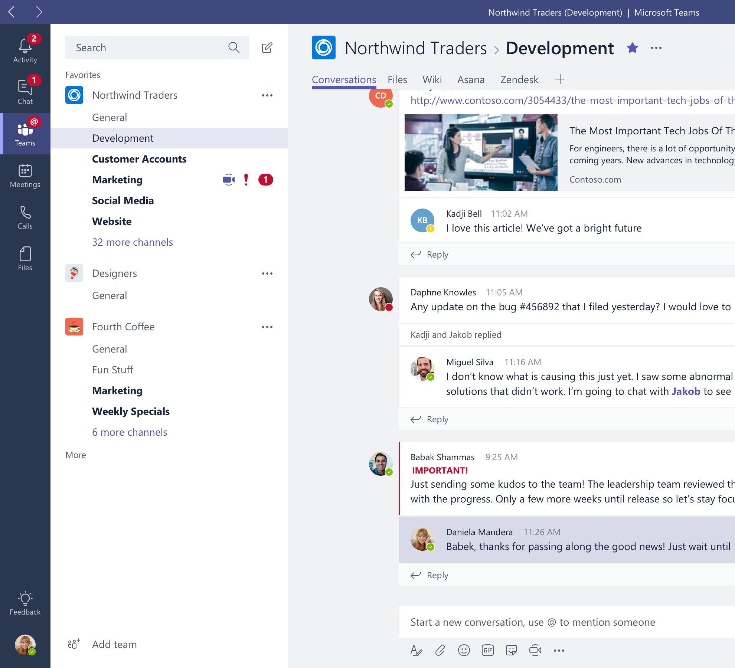
Microsoft Teams, the hub for teamwork in Office 365
Chat, calls, & meetings
for today’s teams
Integrated Office 365 apps
Customizable and extensible
Enterprise security, compliance, & manageability
Notes:
Talk track notes:
“Why we built Microsoft Teams” – in response to the evolution of collaboration in the modern workplace.
Microsoft Teams delivers on four core promises to create a digital workspace for high-performing teams.
First, Microsoft Teams is the hub for teamwork within Office 365. Microsoft Teams solves for the collaboration and communication needs of a diverse workforce. Since preview we have extended the capabilities to include chat, voice and video.
When it comes to chat, Microsoft Teams is fast, fluid, low-overhead, and instantly familiar, making it easier than ever to share information and accelerate decision making.
Since our preview moment, Microsoft Teams has evolved into a complete meetings experience that now includes chat, voice and video. Microsoft Teams will modernize your meetings experience. Before a meeting, team members can review conversations, during a meeting teams can share content and hold the meeting using a diverse array of communication mediums, including audio conferencing and video. After a meeting, team members can review history, access recordings and much more. Microsoft Teams supports private and group meeting capabilities, scheduling capabilities and free/busy calendar availability for team members.
The Office apps and services that people use every day - Word, Excel, PowerPoint, OneNote, SharePoint, the new Planner task management app, Stream video portal, even Power BI - are all built in, so people have the information and tools they need right within the context of Microsoft Teams.
Because every group is unique, team members can tailor their workspace to include apps and services for the team and organization. Microsoft Teams allows the ability to customize their workspace with tabs, connectors and bots. For our developer community, we have also created an extensible platform, to enable building apps with a rich set of capabilities to enable higher-performing teams.
Microsoft Teams comes with the enterprise grade security and compliance that you would come to expect from Office 365.

Slide 5
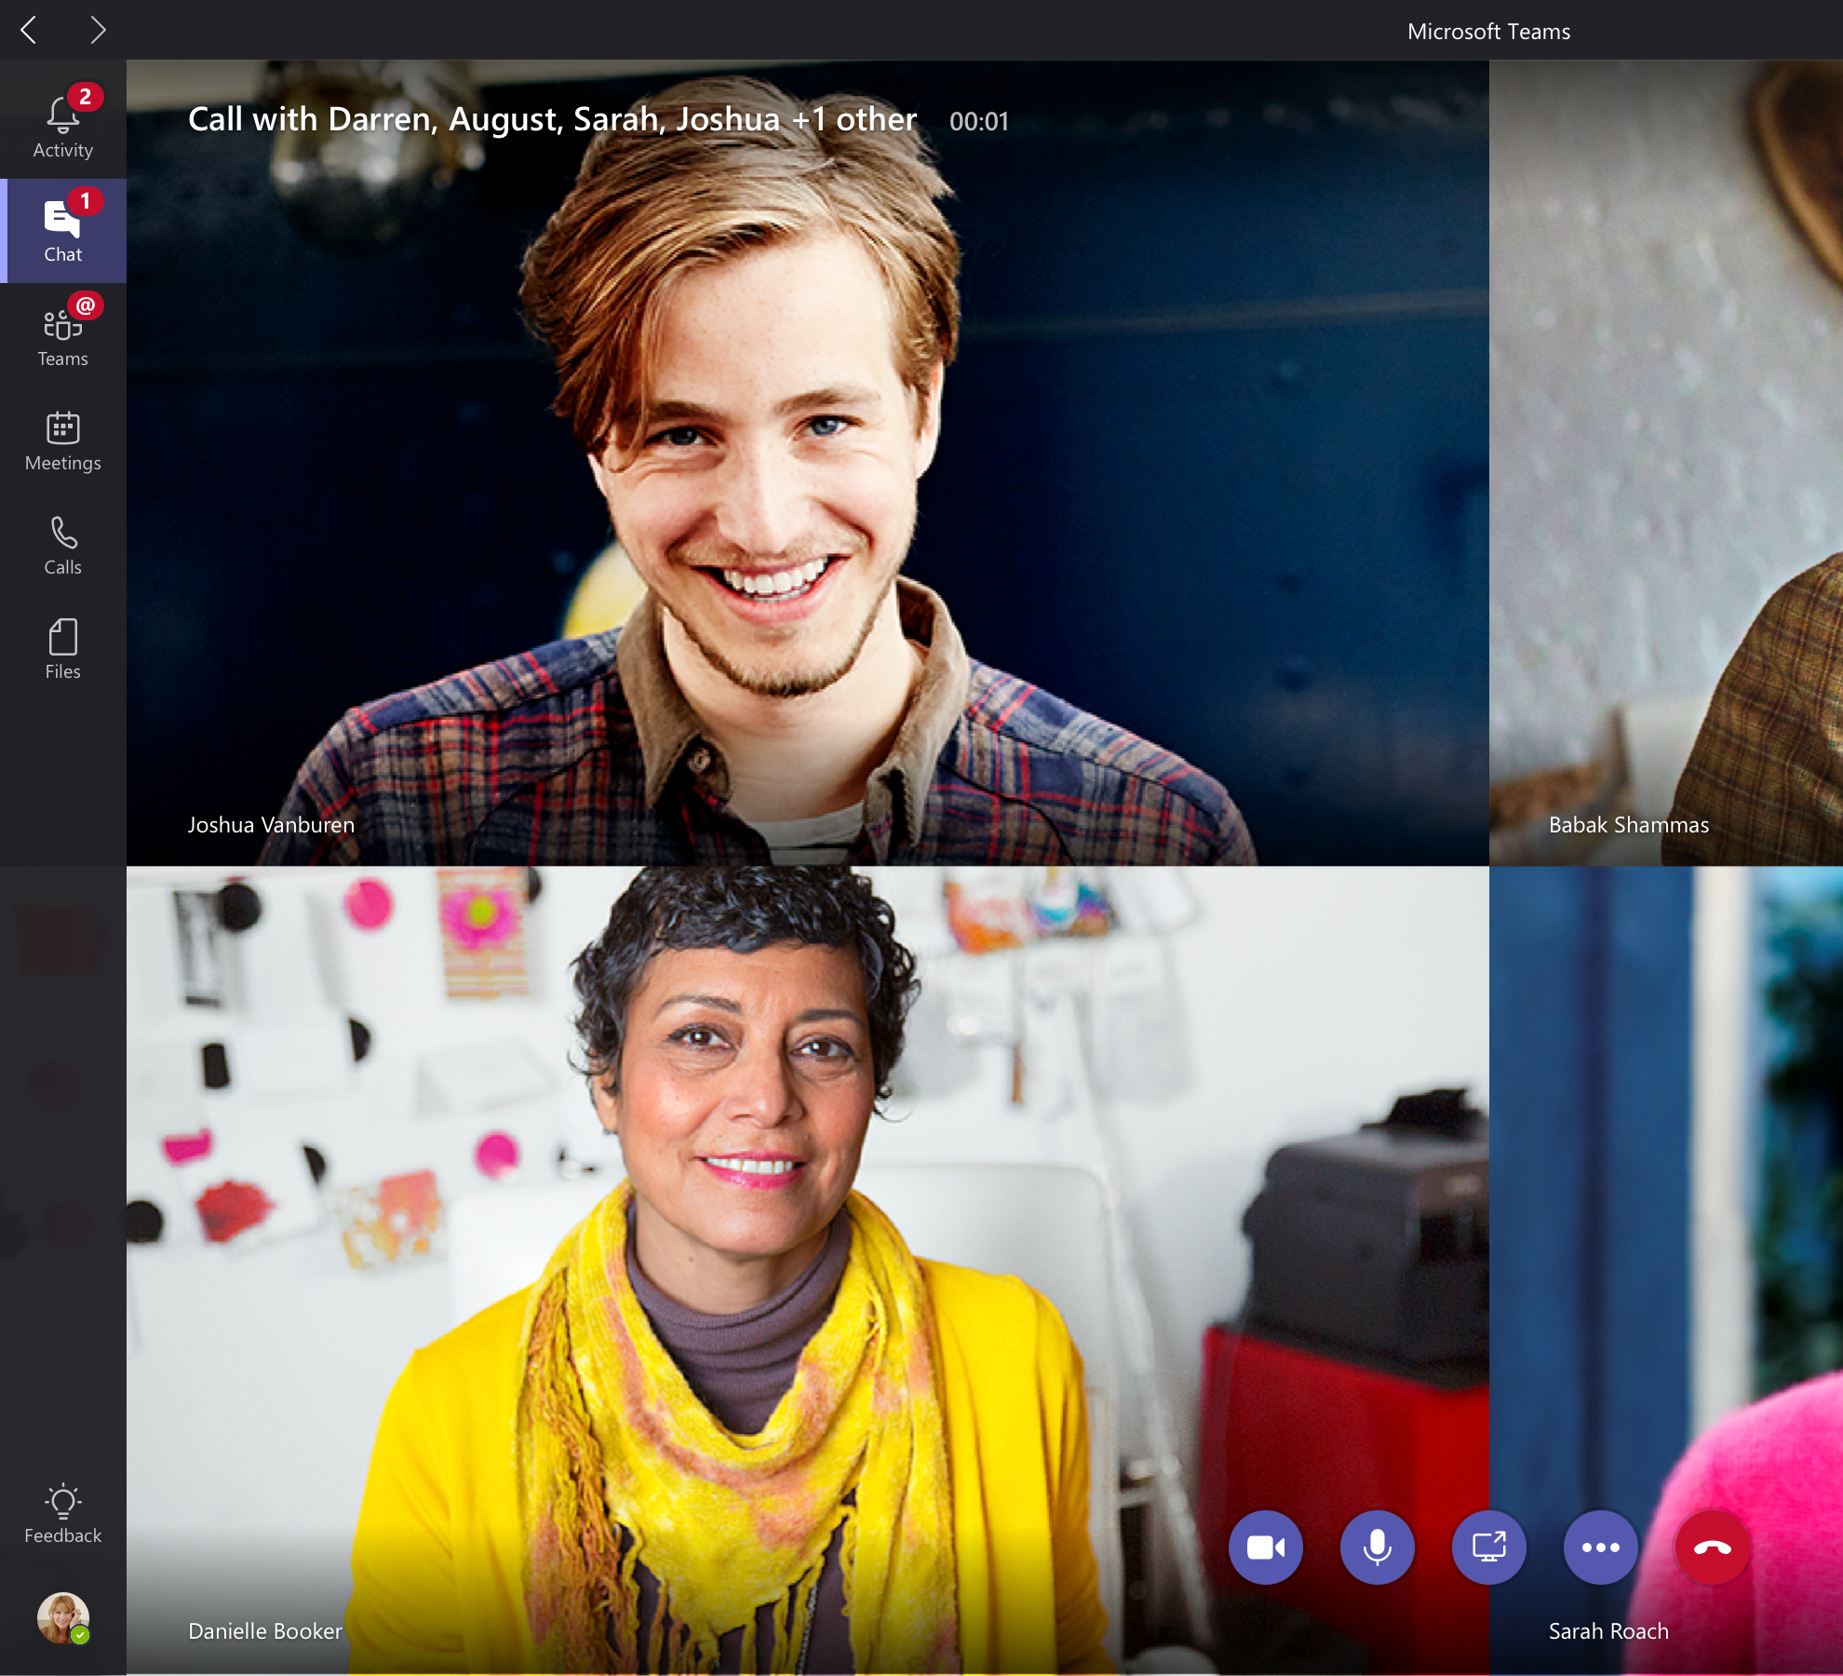
Chat, calls, & meetings for today’s teams
Communicate in the moment and keep everyone in the know
Chat, calls, meetings within your team and across organizational boundaries
Private chats for 1:1 or small group conversations
Schedule and join online Skype meetings with HD video, VoIP, and dial-in audio conferencing options
Have a dedicated phone number with advanced features
Available across mobile, desktop, and browser; integrated with meeting-room devices
Notes:
Microsoft Teams is the hub for teamwork in Office 365 and provides a shared workspace in which teams inside and outside of an organization can communicate in the moment and keep everyone in the know.
We’ve recently added additional communications capabilities within Microsoft Teams, including voice and video experiences powered by Skype.
Now you can chat, call and have meetings with everyone on your team, whether they’re inside your organization or are an outside partner.
Team members can engage in private 1:1: chats or in group conversations that are visible to the entire team. This modern conversations experience supports persistent, threaded chats to keep everyone engaged. Team conversations are open by default, and of course there is the ability for private discussions, too. People can include emojis, memes and other fun graphics in their messages, which allows team culture to shine through.
Now let’s talk about meetings….Microsoft Teams offers a complete meeting solution supporting sharing, video and audio conferencing. This will enable an organization to transform an ordinary meeting into a modern meeting in the following ways:
Before a meeting- team members can share and review information and conversation history on the subject matter, without having to leave Microsoft Teams.
During a meeting: team members can share their desktop, meeting attachments or a PowerPoint deck. The meeting can take place in either audio conferencing or video, and can be recorded
After a meeting: team members can review recorded meetings and view previous meeting details in conversation history, giving them complete context
Users have a dedicated phone number and advanced calling features and support such as blind and consultative transfer, delegation and support for emergency calls.
Finally, Teams is available across mobile, desktop and browser and integrated with communications and meeting room devices

Slide 6
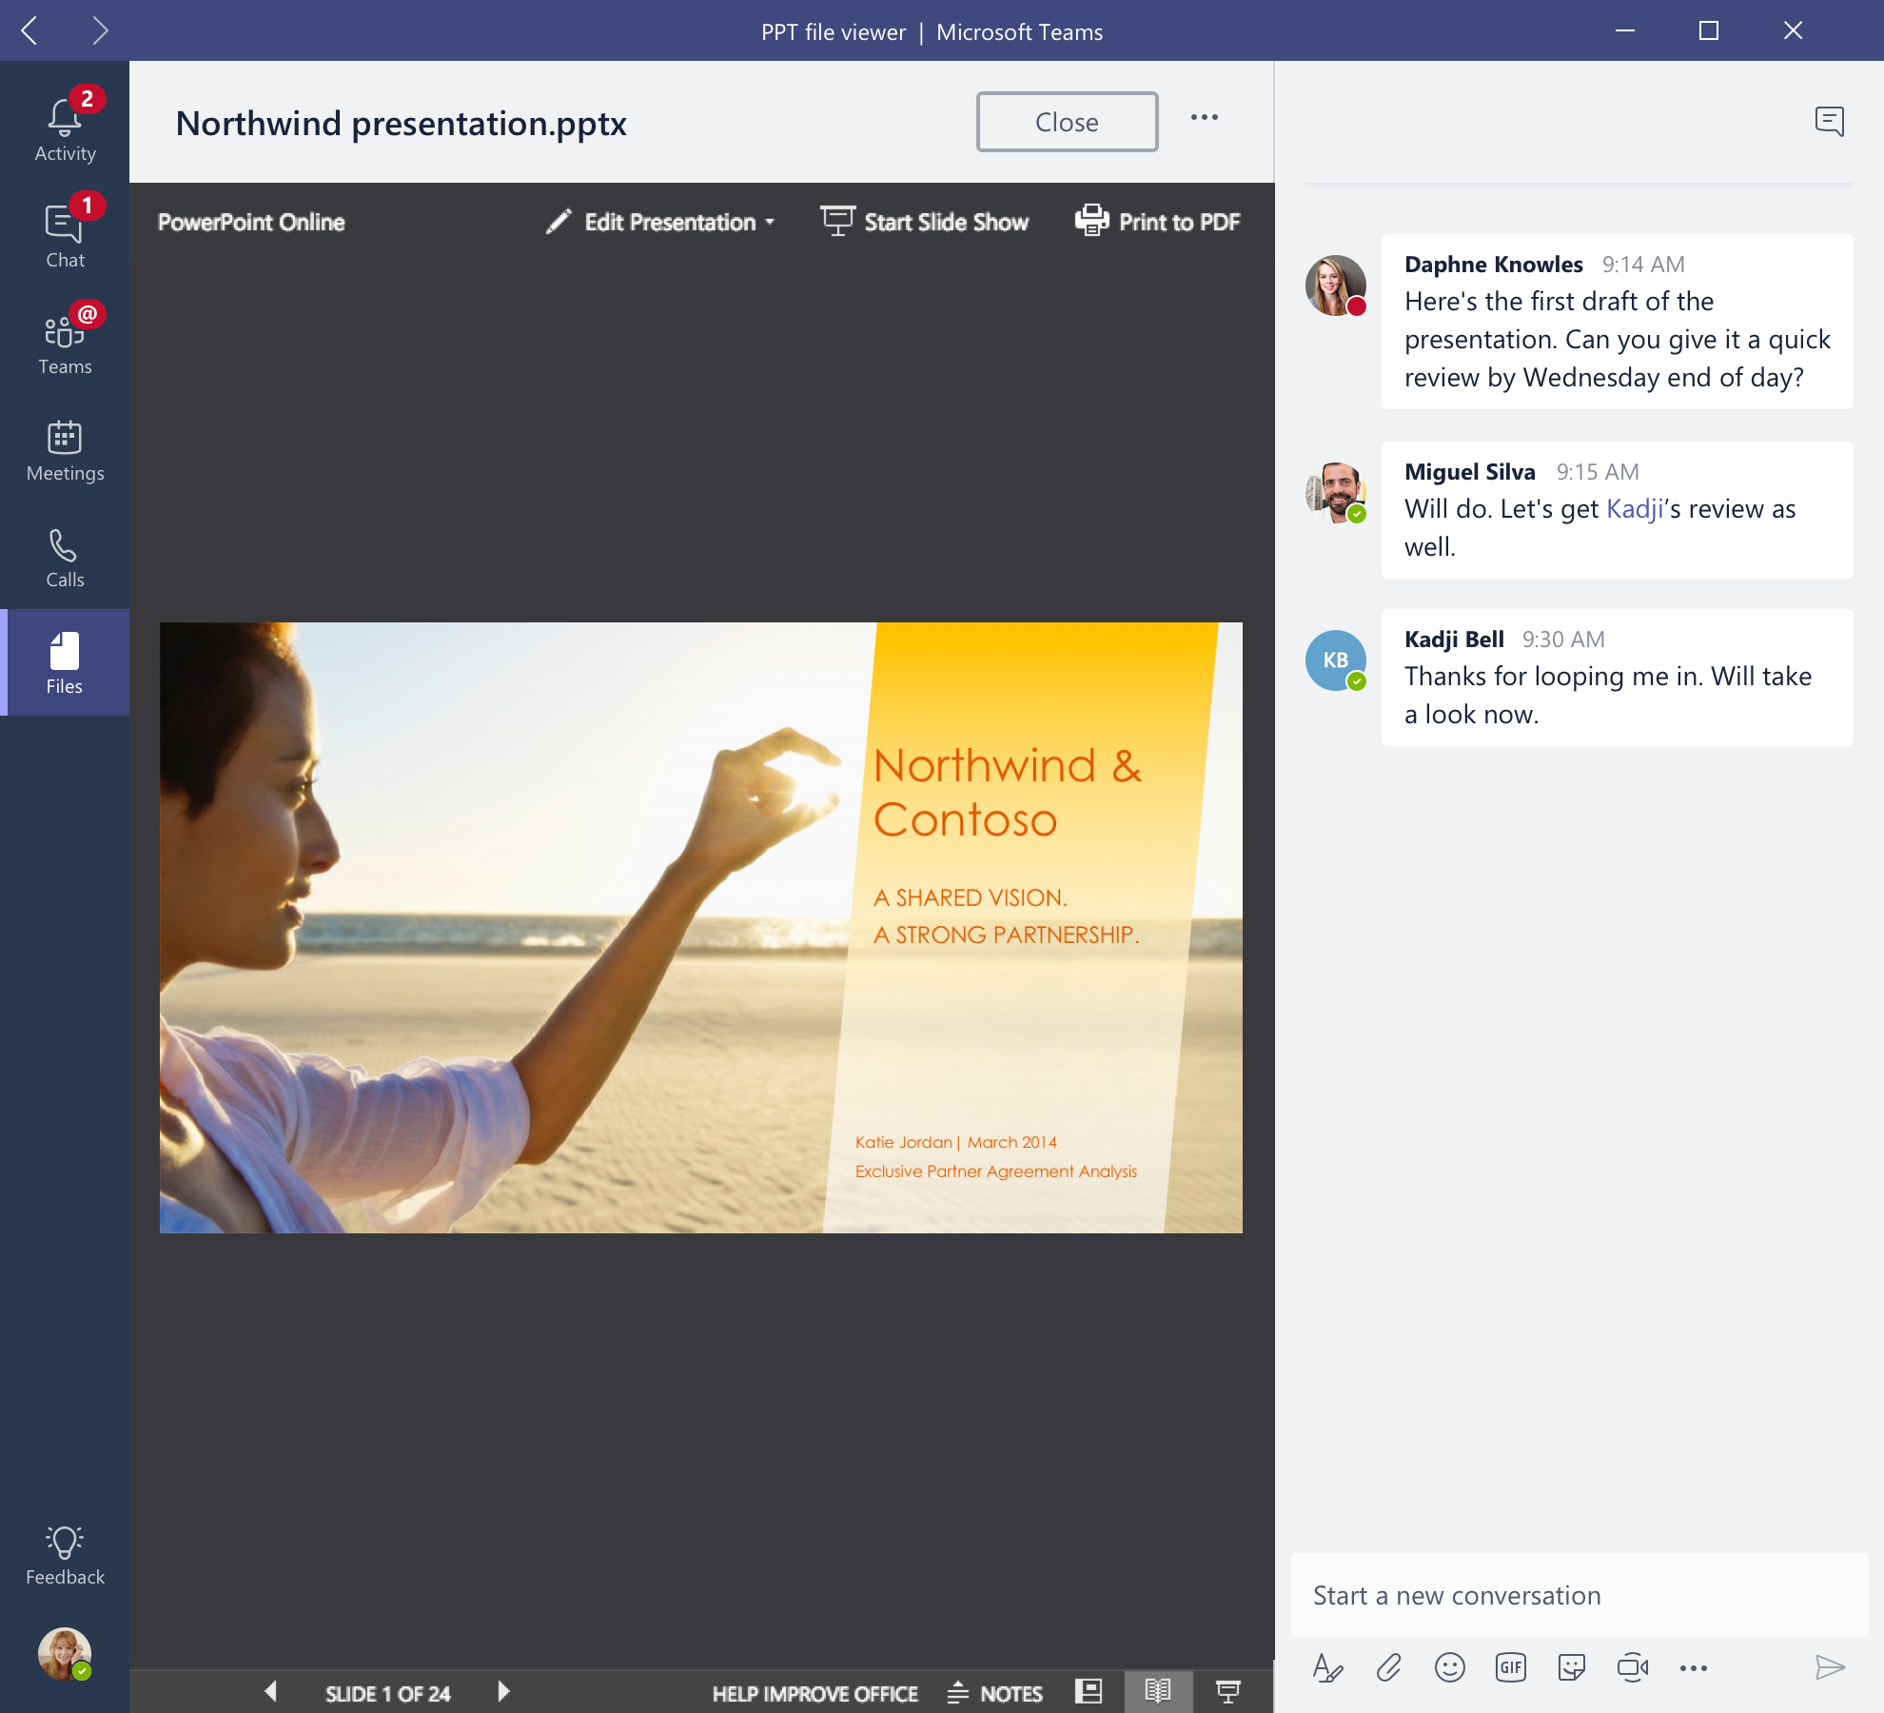
Integrated Office 365 apps
Give your team quick access to information they need right in Office 365
Conversations, files, and tools live in a team workspace
Co-author and edit with Office and other files right in the app
Integrated with Skype, SharePoint, OneNote, Power BI, and Planner
Search across people, files, and chats with intelligence from Microsoft Graph
Email integration to keep the whole team in the loop
Notes:
Microsoft Teams also means more time for productivity as team members do not have to toggle between different apps. Instead, they can access and act on information right within the Microsoft Teams experience.
The Office apps and services that people use every day - Word, Excel, PowerPoint, OneNote, SharePoint, even Power BI - are all built in, so people have the information and tools they need right within the context of Microsoft Teams.
Users can co-author and edit with Office and other files right in the app
Microsoft Teams is also integrated with Skype, SharePoint, OneNote, Power BI and planner, so teams can work in a central place with all the necessary tools in order to pursue team objectives.
Microsoft Teams leverages the intelligence capabilities of the Microsoft Graph. A team member can access information on organization reports and do searches for contacts within an organization.
We’ve built integration with email so users can forward an email message into a Team’s channel for further discussion and sharing.

Slide 7
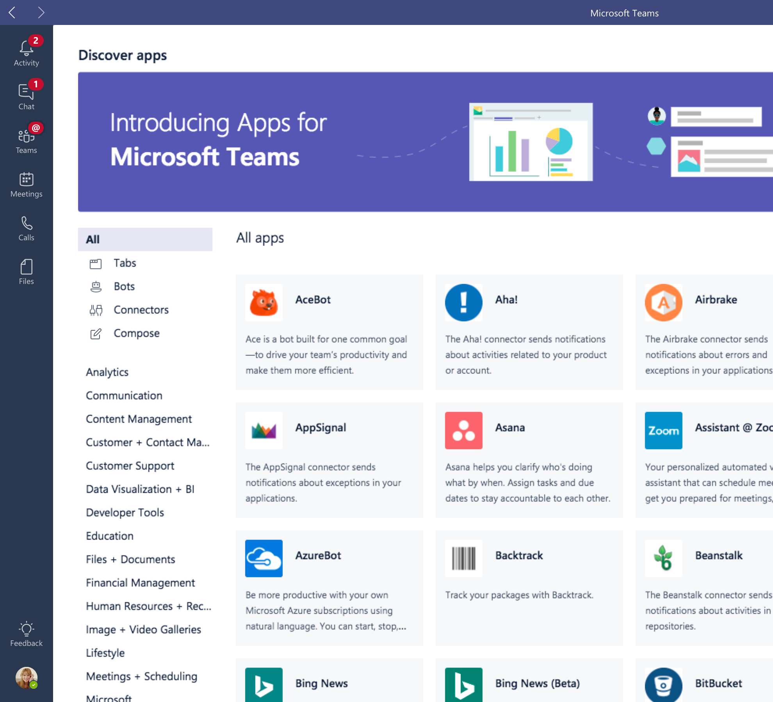
Customizable and extensible
Tailor your workspace to include apps and services for the team and organization
Pin important files for easy reference in the workspace
Add bots that work on a team’s behalf
Integrate cloud services, explore data, and get updates from the apps your team uses every day
Use the Teams developer platform to build integrations to existing business process
Manage trusted apps for employees and the organization
Notes:
Every group is unique, so we have made it easy for teams to tailor their workspace to include apps and services which are relevant to their team or organization.
For example, you can pin important files for quick reference so the whole team can access them in just one click.
You can set up your channels so that conversations on certain topics happen in designated spaces.
You can add intelligent bots to interact with Microsoft Teams. Bots can answer natural-language questions and perform lightweight tasks such as FAQs.
You can bring in cloud services to explore data and get updated from the apps a team uses daily. Where third-party services are included, notifications can be customized so the team never misses a beat.
To bring our users a breadth of customization options, we’re working with more than 150 partners.
We have also created an extensible platform, to enable building apps with a rich set of capabilities to enable higher-performing teams. The Microsoft Teams developer platform enables integrations to existing business process. IT can also manage trusted apps for the employees and the organization.

Slide 8

Enterprise security, compliance, & manageability
Get the enterprise-level security and compliance features you expect from Office 365
Served from our global hyper-scale cloud, including ability for local data residency
Compliance leadership with EUMC, HIPAA, & more
Built-in information protection with eDiscovery and audit
Multi-factor authentication and secure guest access
PSTN connectivity in Office 365 with advanced call management
Notes:
Finally, Microsoft Teams benefits from the Office 365 hyper-scale, enterprise-grade cloud, delivering the advanced security and compliance capabilities customers expect.
Data encryption at all times, at-rest and in-transit.
Ability to have local data residency for core customer data at rest, plus failover and disaster recovery (see public Office 365 Roadmap for locations)
Human back-up via on-call support engineers standing by 24×7
Multi-factor authentication for enhanced identity protection.
It supports key standards including SOC 1, SOC 2, EU Model Clauses, HIPPA, and more. Since preview, we’ve added mobile management with Microsoft Intune and new features for compliance and litigation support, including audit log search, eDiscovery and legal hold for channels, chats and files.
PSTN connectivity in Office 365 with option for connecting existing on-premises investments in the future
Advanced call management including call routing, auto attendant, call queues, and reporting
Easily manage users, usage, and settings in the Office 365 Admin Portal
IT controls to manage trusted apps for employees/the organization
While security and compliance capabilities are critical for enterprise customers, our responsibility at Microsoft goes beyond this. Our mission talks about empowering every person to achieve more. With that in mind, we’re focused on building an inclusive experience for the entire group, including support for those who use screen readers, high contrast, and keyboard-only navigation, to enable the collective brainpower and potential of everyone.

Slide 9
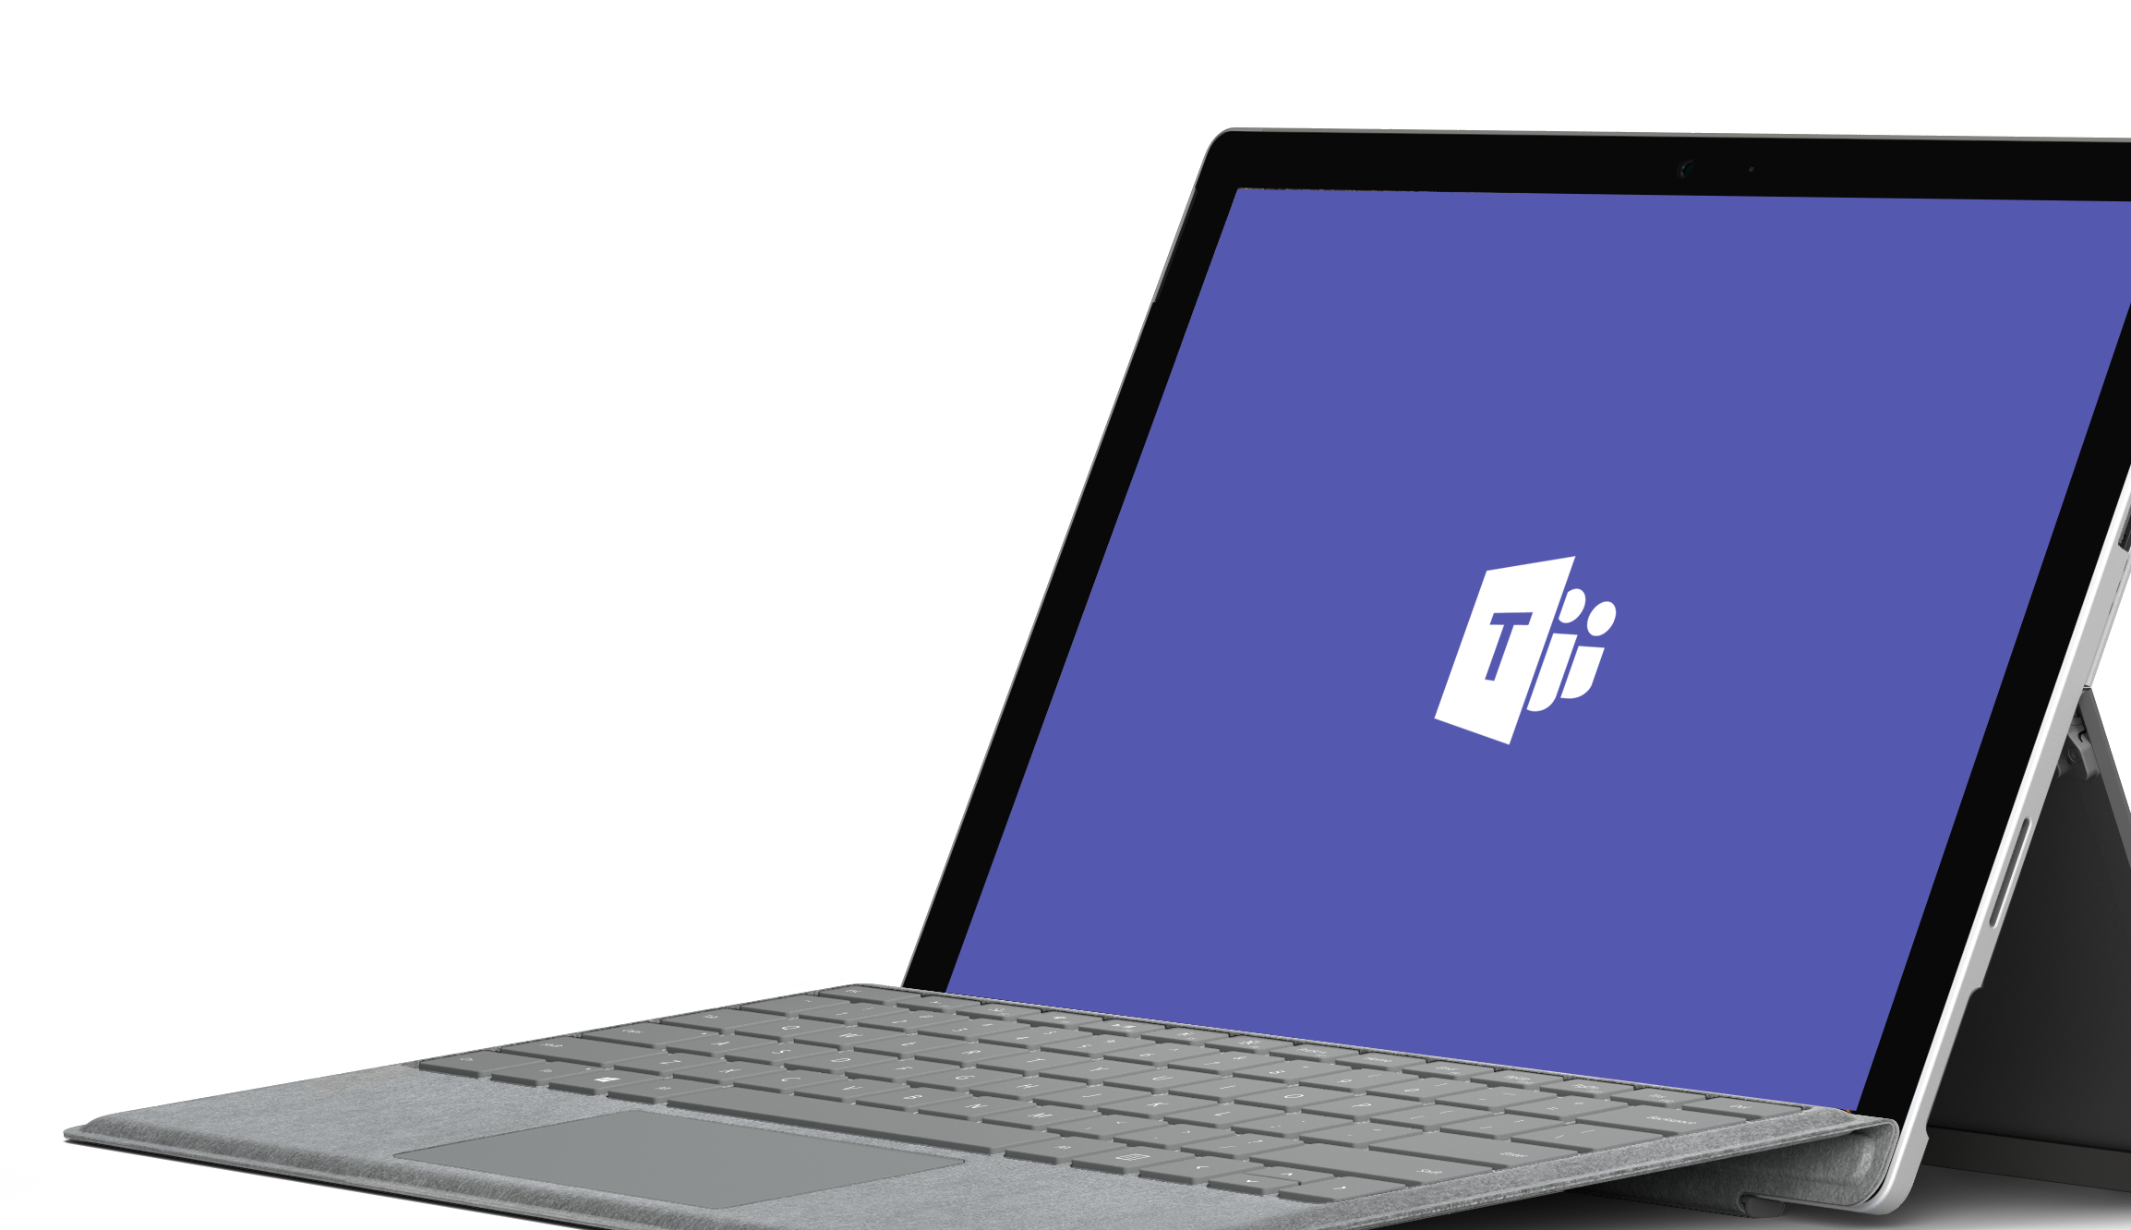
Demo

Slide 10


Microsoft Teams use cases for each department
Customer Support
Enable continuous knowledge-sharing between shifts
Provide visibility into customer escalations
Search for solutions across conversations
Speed up issue resolution with various subject-matter experts
Engineering
Enable continuous discussion across a distributed team
Discuss ideas and requirements, gather inputs in the open
Store standard documentation and files
Integrate with developer tools like Jira
Finance
Prepare earnings release with cross-functional stakeholders
Streamline data consolidation and analysis
Store budgeting documentation and files
Share economic trends and news
Human Resources
Drive alignment on job descriptions and streamline interview processes
Plan and prepare new employee onboarding
Engage distributed employees in training
Share department resources and documentation
Marketing
Coordinate campaigns and event tasks
Share the latest content drafts for feedback
Get automated reports from analytics tools
Prepare marketing launch across multiple stakeholders
Sales
Get quick answers from PMs and Sales Ops
Share key customer wins
Get lead notifications and deal mentions
Share latest company, product, and competitor news
Share files and collaborate on deliverables
Get new project members up to speed quickly
Operations & Project Management
Streamline project communication and tools
Provide status updates, get feedback, coordinate tasks
Get guidance on these and other scenarios in the FastTrack Productivity Library
Notes:
Talk track notes:
Teams come in all shapes and sizes.
Microsoft Teams is particularly well suited for teams where team members are highly engaged, iterating on shared deliverables. There are such scenarios across Sales, Marketing, HR, Finance, Engineering, Operations and Project Management and Customer Support.

Slide 11
Microsoft 365: Universal Toolkit for Teamwork
Outlook
SharePoint
Yammer
Office Apps
Teams
Email & Calendar
Intranets &
Content Management
Connect Across
the Organization
Co-Author
Hub for Teamwork
Office 365 Groups
Single team membership across apps and services
Microsoft Graph
Suite-wide intelligence connecting people and content
Security and Compliance
Centralized policy management
Notes:
Objective: Reinforce our teamwork position - Microsoft 365 meets the diverse needs of teams with an integrated solution that is secure
We’ve designed Microsoft 365 to meet the unique needs of every group.
For each of those categories of teamwork, Microsoft 365 includes a purpose-built application.
Teams as a hub for teamwork where groups that actively engage and are working on core projects can connect and collaborate
Yammer for people to connect across their company, sharing ideas on common topics of interest
Outlook where teams can communicate in a familiar place, and can easily create modern distribution list with groups in Outlook
SharePoint for keeping content at the centre of teamwork, making files, sites and all types of content easily shareable and accessible across teams
Office Apps – enabling co-authoring in familiar apps like Word, Excel, and PowerPoint
With these tools coming together in Microsoft 365 – teams get a holistic solution.
What’s unique about teamwork in Microsoft 365 is that all of these applications are built on an intelligent fabric - suite-wide membership service with O365 Groups; suite-wide discovery and intelligence with Microsoft Graph, and suite-wide security and compliance.
Office 365 Groups - A membership service providing a single identity for teams across Office applications and services
Microsoft Graph - Suite-wide intelligence that maps the connection of people and content to surface insights
Security and Compliance - Proactive security that simplifies IT management with intelligence built in

Slide 12

Next steps
Start using Microsoft Teams today
  Pick one project and do 100% of your team meetings, chats and files in Microsoft Teams
  Download the desktop and mobile apps so you can collaborate on the go
  Put frequently used websites, files, and dashboards right in the channel by pinning them to a Tab
Contact your partner if you need help with your deployment of Microsoft Teams
Give us feedback in-product

Slide 14
Teams developer opportunity
Extensible platform: build apps with a rich set of capabilities to enable higher-performing teams
100M Office 365 commercial monthly active users
Teams is available in all business and enterprise SKUs in 181 markets, 19 languages
More than 150 integrations available and coming soon
Reach your users in their chats, channels, notifications, and personal workspace
Available now
Available in Developer Preview
Tabs
Surface rich content within Teams
Bots
Help users get tasks done in conversations
Connectors
Post rich updates to channels
Actionable Messages
Add rich interaction to your connector cards
Activity Feed
Engage users via feed notifications
Compose Extensions
Allow users to query and share rich cards in conversations
Office store
Drive engagement by submitting your app to the Office Store
Join the Office Developer Program

Slide 15
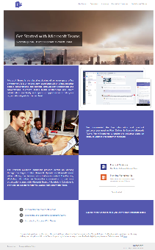
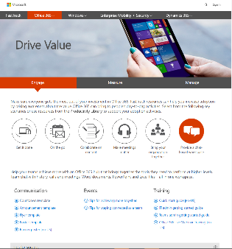
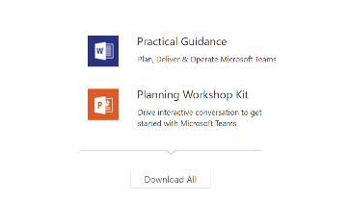
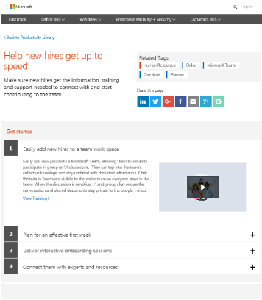
Resources to help you get started
Success with Teams
www.successwithteams.com
Practical guidance
Plan-deliver-operate framework
Checklists, pre-reqs, adoption guides, tools
FastTrack
Fasttrack.microsoft.com
Deployment guidance
Best practices, tools, resources, experts
Updated for Microsoft Teams

Slide 16
Customer Evidence
Library

Slide 17


Trek
Trek Bicycle
Use case
Teams around the world
Chat + files in one place
Video meetings
How they’re using Microsoft Teams:
“Insights from Microsoft Power BI have been a game changer for us. It has enabled us to be more productive, as well as better allocate our time and resources—and when combined with the rest of the Microsoft solutions, it’s helping Trek break out further from the pack.”
David Peterson, Enterprise Collaboration Manager
Trek Bicycle
Trek Bicycle Case Study
Notes:
Talk track notes:
Trek Bicycles was one of our launch customers. They are a global manufacturer of bicycles. These scenarios are especially important to them.
Video: https://www.youtube.com/watch?time_continue=3&v=glMfn6alMyY

Slide 18


J. Walter Thompson
Use case
Distributed workforce
Single, shared workspace
Intuitive interface
How they’re using Microsoft Teams:
“Our employees have been surprised and delighted with the intuitive interface and the ability Microsoft Teams gives them to mobilize people in a way we’ve never seen before. It’s easy to onboard people midproject, and it works well on a Mac. And like all the other Office 365 apps, we get the structure and security that makes us comfortable with Microsoft cloud solutions.”
Jamie McLellan, Chief Technology Officer
J. Walter Thompson
J. Walter Thompson Case Study
Notes:
J. Walter Thompson
Global teams
Power of files and chat all in one place – persistent so can review at any time
UI mirrors how we work as humans
Case study: https://customers.microsoft.com/en-ca/story/jwt-professional-services-microsoft-teams
Video: https://www.youtube.com/watch?v=oZrynUTuyf0&feature=youtu.be

Slide 19


Dentsu Aegis Network
Use case
Virtual teams across regions
Viral adoption
Open work culture
How they’re using Microsoft Teams:
“We used Power BI to pull data from each group and combine it into one view. This is a lot more efficient than our previous process … once we finish creating automatic import functions to move data from Microsoft Excel into a Power BI dashboard, we’ll reduce the time it takes to prepare the reports by approximately 60 percent—up to four or five days a month.”
Sunil Yadav, President, Amplifi Asia Pacific
Dentsu Aegis
Dentsu Aegis Network
Notes:
Dentsu Aegis Network
Fast rollout - “With minimal internal promotion and after just three months, we have 600 employees in 20 different digital and media brands working in Microsoft Teams collaboration hubs.”
Open communication drives increased collaboration - Previously, brands tended to work in silos, but today, they have one space where they can coordinate deliverables for the same client with real-time chat, shared files, and OneNote notebooks
Case study: Dentsu Aegis Network

