Slide 1
Microsoft SMB Teamwork Opportunity for Partners
Bring new customers to the cloud
with business-class email and Teams

Slide 2
Build your business with SMB practices
Acquire: Teamwork
Bring new customers to the cloud with business-class email and Teams.
Upsell: Get Modern
Offer best-in-class Office apps on a new Windows 10 device to replace end-of-support solutions.
Maximize: Advanced Security
Maximize recurring revenue by helping SMBs protect against threats.
Marketing and sales content available @ aka.ms\mwsmb
Notes:
Microsoft has created three marketing kits for partners that want support to grow their business. Depending on the market segment the partner wants to approach, partners can use Teamwork or Get modern play kits to acquire customers.
The Teamwork play offers opportunity for acquiring new customers new to Microsoft or new to cloud.
TEAMWORK
This play is perfect for customers new to Microsoft. You can help customers make work better. Use play kit to move customers off freemium products to business class email and a chance to try out Office 365.
“Me” product: OneDrive (syncing, sharing, simultaneous co-authoring)
“We” products: Microsoft Teams (new approach to collaboration and data management) that leverages SharePoint capabilities.
GET MODERN
This play is aimed at customers running legacy products reaching end of support by 2020, including Windows 7 and Office 2010. Use play kit to offer modern applications with high customer value, that provide both an online and offline experience.
Email: cost savings, simplified management, and increased capabilities.
Bundle Migration: in a single bill through the CSP Program
Device refresh opportunity
SECURITY
Help valued customers protect themselves against cyberthreats and improve compliance. The 2018 Ponemon study found that 58% of breaches took place at small businesses. Help protect customers against malware and phishing with advanced security offerings built in Microsoft 365 Business.
Add additional value with security training and monitoring services. Use Microsoft Secure Score tool. Tasks that you can perform on behalf of your customers to ensure they are secure. Reporting and conversation starter to improve their security and compliance status.

Slide 3
2x
Small companies are twice
as likely to hire remote employees¹
Shifting landscape
52% of the global
workforce works from home at least once per week¹
SMBs need to make
work better
6x as many small businesses agree that dynamic team structures will become the norm²
1 Owl Labs survey, March, 2019
2 Upwork Future Workforce Small Business Report, 2018
Notes:
Teamwork is core to both Office 365 and Microsoft 365 - and the reason is obvious - it's just the way work gets done now
While companies are all unique and have their own identities, we are seeing common trends affecting the culture of work and employee’s expectations on what a modern work environment provides.
More geo diversity. In addition to an increase in the amount of collaboration, there are other characteristics that are different about how we’re working together today. There’s a greater need to enable communications and collaboration – regardless of geography.
Most employees juggle their jobs with busy personal lives. People are increasingly looking to work remotely and adjust their hours and schedules as needed (without compromising either their personal wellbeing or work productivity).
Teams are increasingly geo distributed.
People on teams are a mix of employees and outside vendors.
Teams with remote workers have unique challenges. Because they're not in the office with their team, remote workers often feel less engaged and connected to their company, which can hurt productivity and performance.
More collaboration. There is a movement towards transparency and inclusivity in how decisions are made. Organization structures are becoming more flat. And those teams are dynamic. It's rare that people don’t change on a multi-month project. And when someone leaves, the first step is for all to go through their e-mail to find the information needed to get the new person up to speed.
Being on more teams has also led to a dramatic increase in the amount of collaboration.
Companies that allow remote work experience 25% less employee turnover than companies that do not allow remote work. (Owl Labs) and small companies are twice as likely to hire remote employees. (Owl Labs.
Agile teams will become the norm in SMBs. According to Upwork 6x as many small businesses agree – versus disagree -- that dynamic team structures will become the norm.
We see demand from customers who want to embrace these workplace trends and use technology to empower employees to do their best work

Slide 4
What does teamwork look like for SMBs today?
Increased on-boarding time
Lack of centralized hub for information
Increased IT
support
workload
Dispersed
resources
Delays in development and implementation of content and ideas
Unreliable version control
Tools used inconsistently across the organization
Disjointed
collaboration
and
file sharing
Difficult to access and share files remotely
Hard to integrate vendors and contractors
No multi-factor authentication
Inefficient co-authoring and file sharing
Cloud storage accessible by hyperlink
Solutions
for mobile workforce
Third-party
apps create
security
concerns
Difficult to involve outside contributors
Bring Your Own Devices
Need to involve a growing remote workforce
Unsecured chat
Challenging to access conversations and notes across platforms or devices
Shared files outside IT control
Notes:
Getting to a teamwork-based organization, however, is full of technical and cultural challenges.

Slide 5
SMBs need technology to enable teamwork
56%
SMBs collaboration challenges²
Ability to get work done from anywhere
(affects remote and mobile workforce)
Document version control and co-authoring
(affects internal and external sharing)
Reasons SMBs cite to buy technology²
Make it easier for our team to do their jobs
Improve employee productivity
Improve data security
of younger managers cite lack of technology/tools as reason why they do not have a remote workforce¹
¹ Upwork survey, Future Workforce 2019: How Younger Generations are Reshaping the Future Workforce
² Microsoft SMB research report by Bredin, March, 2019
Notes:
What’s keeping organizations from embracing collaboration? Lack of tools.
What do SBMs want? It’s all here.

Slide 6
Office 365 helps partners build lasting customer relationships
Mobile worker support
Easily support SMBs that want to work anywhere from any device.
External collaboration
Help SMBs look more professional as they engage in email and online with customers, coworkers, suppliers.
Enterprise-grade security
Enable access to those who need it and keep out those who don’t.
Real-time teamwork
Enable SMBs to work together in one solution with shared docs and online meetings.
1
2
3
Offer solutions to known pain points: Business-class email and file sharing. | Show how best-in-class, integrated solutions improve the customer experience. | Show how SMBs can reduce costs by replacing other collaboration tools.
Notes:
And it all comes together with Teamwork built into Office 365.

Slide 7
Grow your business with Teamwork
How will this help
your customers?
Why add Teamwork
services?
What to do next
Notes:
So what are we doing to help accelerate the transformation for you and your customers?

Slide 8
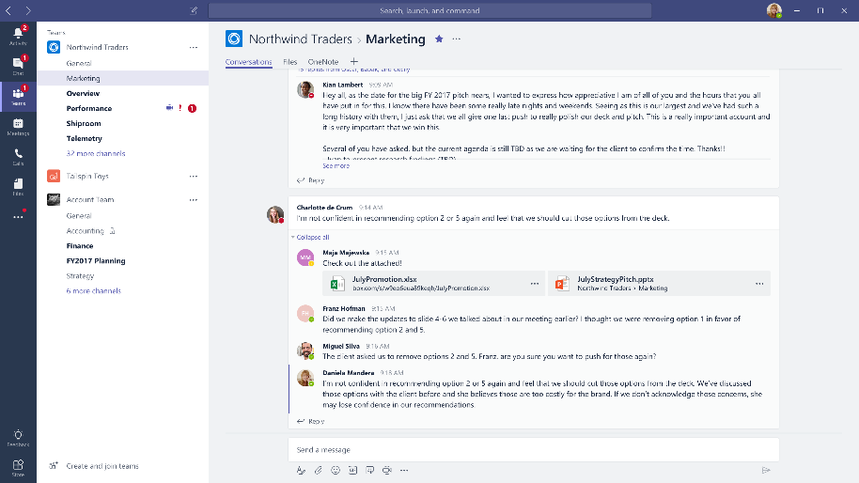
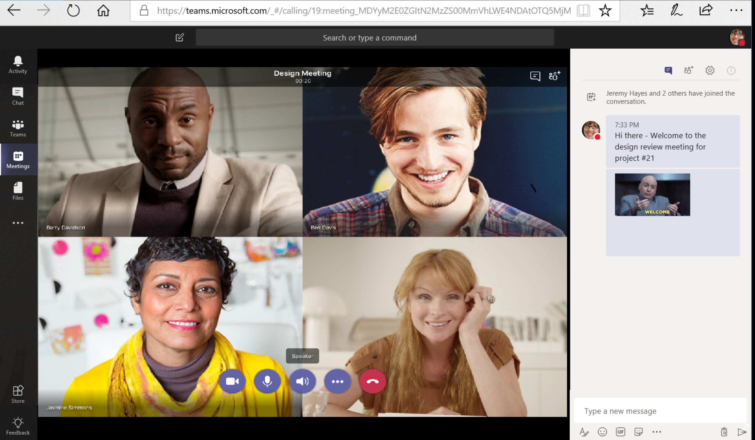
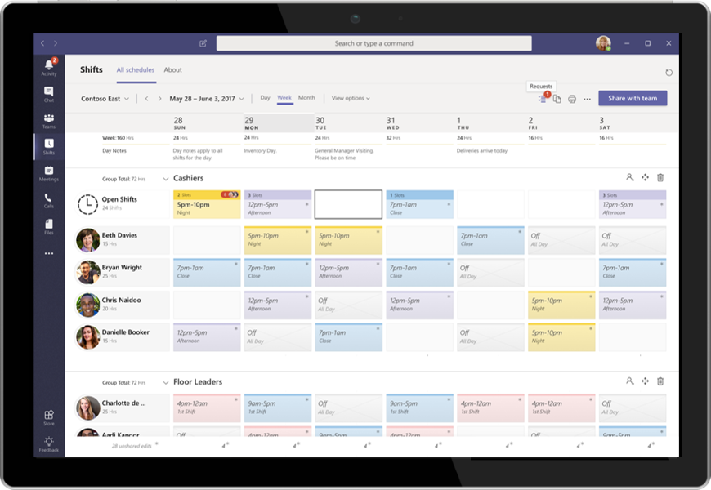
Help SMBs work better with low-cost, high-value solutions
1. Build trust with business-class email
2. Add value with best-in-class collaboration tools
SMBs use email more than any other app or software today¹
Many still use in-house servers or free online email and need a business-class solution with the benefits of the cloud.
Better teamwork, better tools to help SMBs work from anywhere
Compelling moment:
End of Support for Office 2010
and Office 2013 Office 365 connectivity
is October 2020
Online file sharing for real-time collaboration
Online meetings Shift management
¹ Bredin, an SMB market research and content marketing agency.
Notes:
First and foremost, get SMB customers collaborating more securely and efficiently with business-class email. Business-class email also helps SMBs look professional.
The next stage is selling in Teams and associated adoption services to help SMBs use the collaboration tools. Partners surveyed in a recent Forrester TEI survey say that Teams is viewed as a replacement for other Office 365 solutions by both customers and partners.
--Many Skype for Business users have seen it be subsumed into Teams and are making the switch.
--Partners see Teams-centric teamwork solutions replacing SharePoint portal projects and look favorably upon this. One interviewee said, “We are starting a lot of Teams journey for our large customers. This is resulting in less SharePoint work, which is a good thing since SharePoint has become a race to the bottom with intranet in a box solutions.” This partner said that Teams-centric work really took off last November and is already 20% of all their teamwork revenues. They expect it to be at 50% within a year.
Microsoft Teams is a hub for teamwork that brings together a team’s chats, meetings, files, and apps making it easier for SMBs to collaborate and keep track of group projects involving your co-workers, customers and suppliers.
Online file sharing. With state-of-the-art co-authoring capabilities, SMBs can share and edit your files in real-time with your team from anywhere any device.
Online meetings. They can host online meetings to get work done in real time. With one click, anyone inside or outside the company can join the online meeting. Meetings tools enable people to record meetings, use the whiteboard, to draw out ideas and work together to solve challenges.
Shift management. The Shifts app in Microsoft Teams keeps Firstline Workers connected and in sync. Use it for team time management and communication. Shifts lets Firstline Workers and managers can use mobile devices to manage schedules together.
By providing SMBs with a central hub, Microsoft Teams greatly simplifies and enhances group collaboration. It helps increasing efficiency and helps SMBs look more professional.

Slide 9

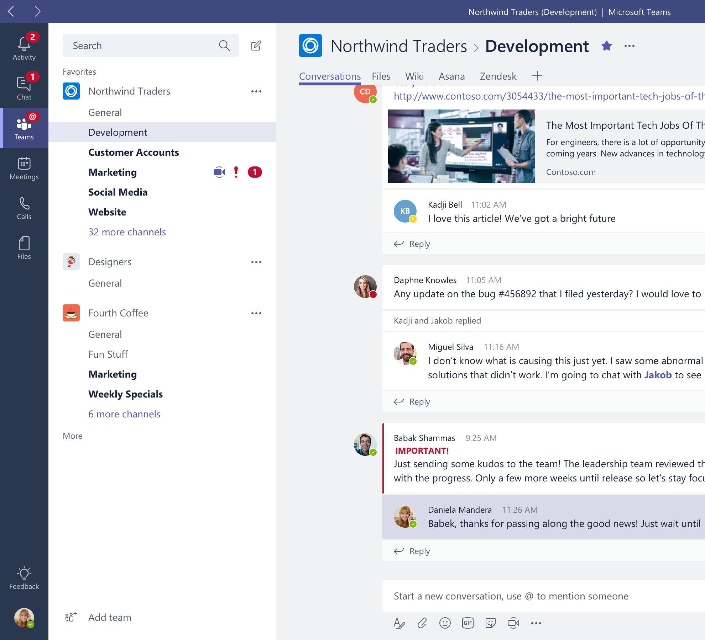
Online file storage, document sharing, co-authoring
Offer SMBs tools for real-time collaboration. Keep everything in one shared workplace.
Access and share
content from anywhere with Microsoft Teams desktop, web, and mobile apps
Connect and work together
across multiple projects and get important notifications in real-time
Coauthor files simultaneously
with popular Office 365 apps, like Word, Excel, and PowerPoint.

Slide 10

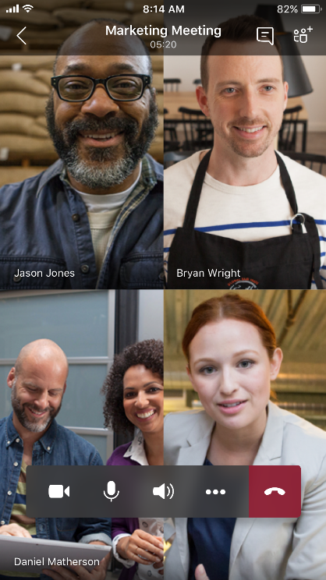
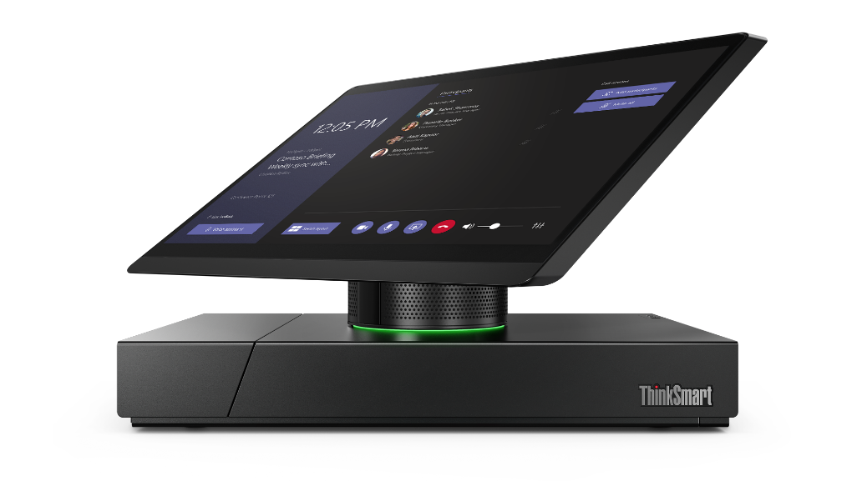
Chat and online meetings
Help SMBs to stay connected with an intelligent meeting solution using HD video, content sharing, digital whiteboard, notes, voice and chat – using any device
Work from anywhere
by holding online meetings with anyone inside or outside the organization
Make work easy
using the meeting scheduling assistant, sharing screens, and collaborative note taking as part of online meetings and having context and content at your fingertips
Speed innovation
Stay in the know with meeting recordings with transcription and translation, indexed for searching
Notes:
[MAIN POINT TO LAND]
Microsoft Teams offers a complete meeting solution supporting sharing, video and audio conferencing that enables you to meet from anywhere. It is so easy for me to be able to jump from a call on my phone, to a call on computer. You can use Teams for all types of meetings – spontaneous, scheduled and formal with internal and external users.
_______________________________________________________________________________________________________________________________________________________
This also includes large 1:many meetings.
All meetings provide a contextual experience so that you have the context and content you need right at your fingertips before, during and after a meeting including conversation history, files and meeting notes.
And no worries if you miss a meeting – team members can access recordings with transcribed and translated text that is indexed so that people can search for content relevant for them. You can also translate them with a simple click.
Teams supports a range of intelligent devices and services which can understand the spoken, and even unspoken nuance of meetings even when we’re not in the room, carry those insights into our broader team experiences, and create opportunities for everyone to collaborate in more immersive ways. Teams allows you to schedule and join a meeting with others without technology getting into the way.

Slide 11



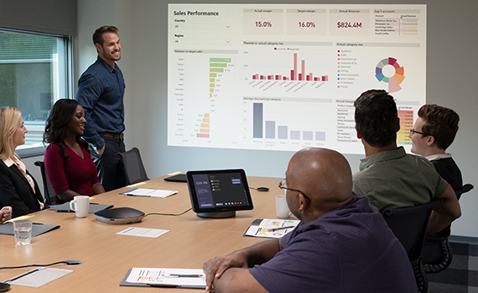









Teams devices for every need
  Spaces
Personal workspace
Mobile workspace
Shared collaboration spaces
Small or large conference rooms
  Personal devices
  Shared devices
Interactive whiteboard
Headset
Desk phone
Mobile phone station
Speaker puck
Mobile phone
Conference Room Phone
Microsoft Teams Rooms
Interactive whiteboard
Notes:
Choose from a comprehensive range of Teams-enabled devices, designed and engineered to meet the needs of the modern workforce. They're created with the security and quality you expect from Microsoft and built on the foundation of Graph, AI, and Cortana to bring intelligent communications to every call and meeting.

Slide 12
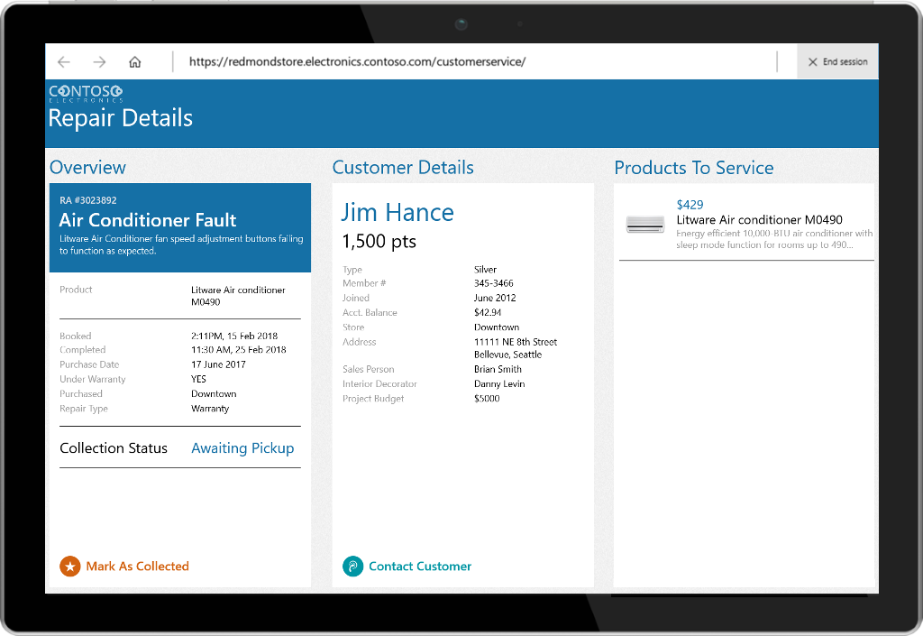
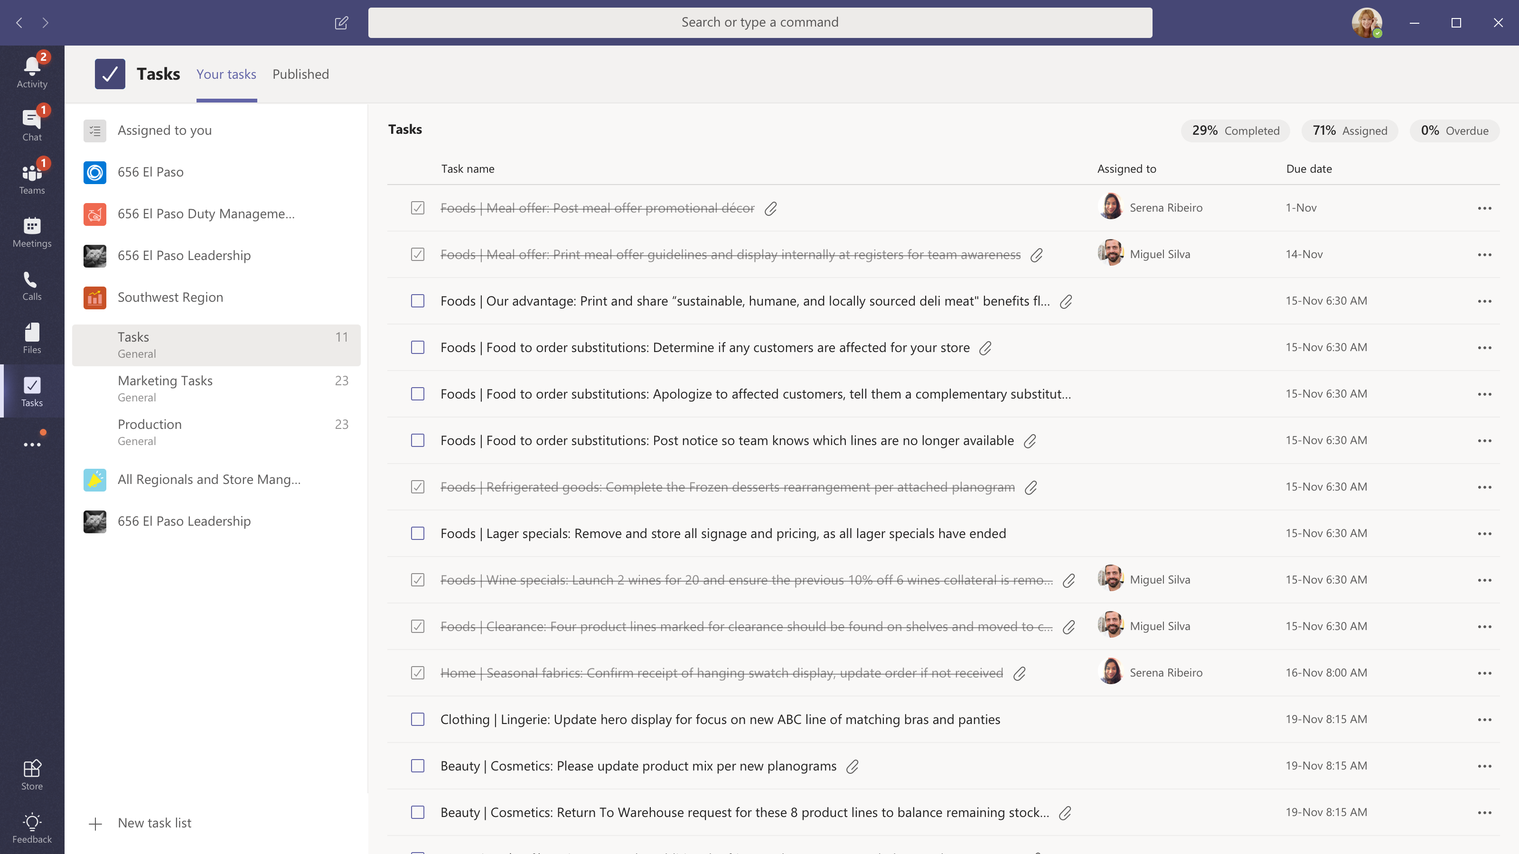
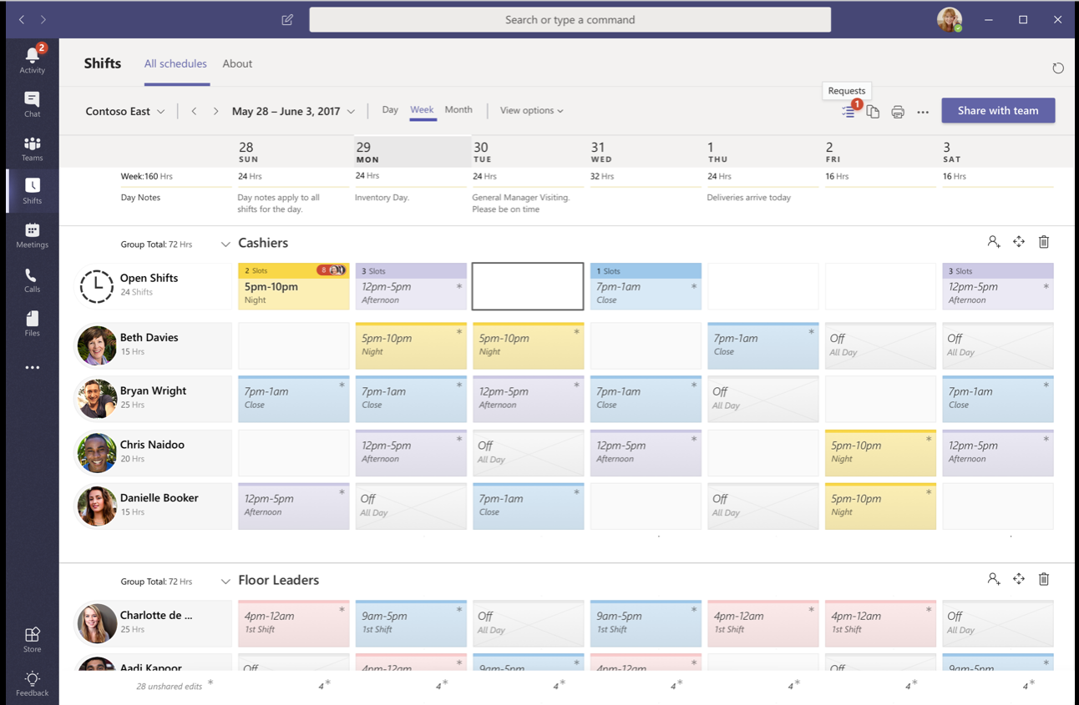

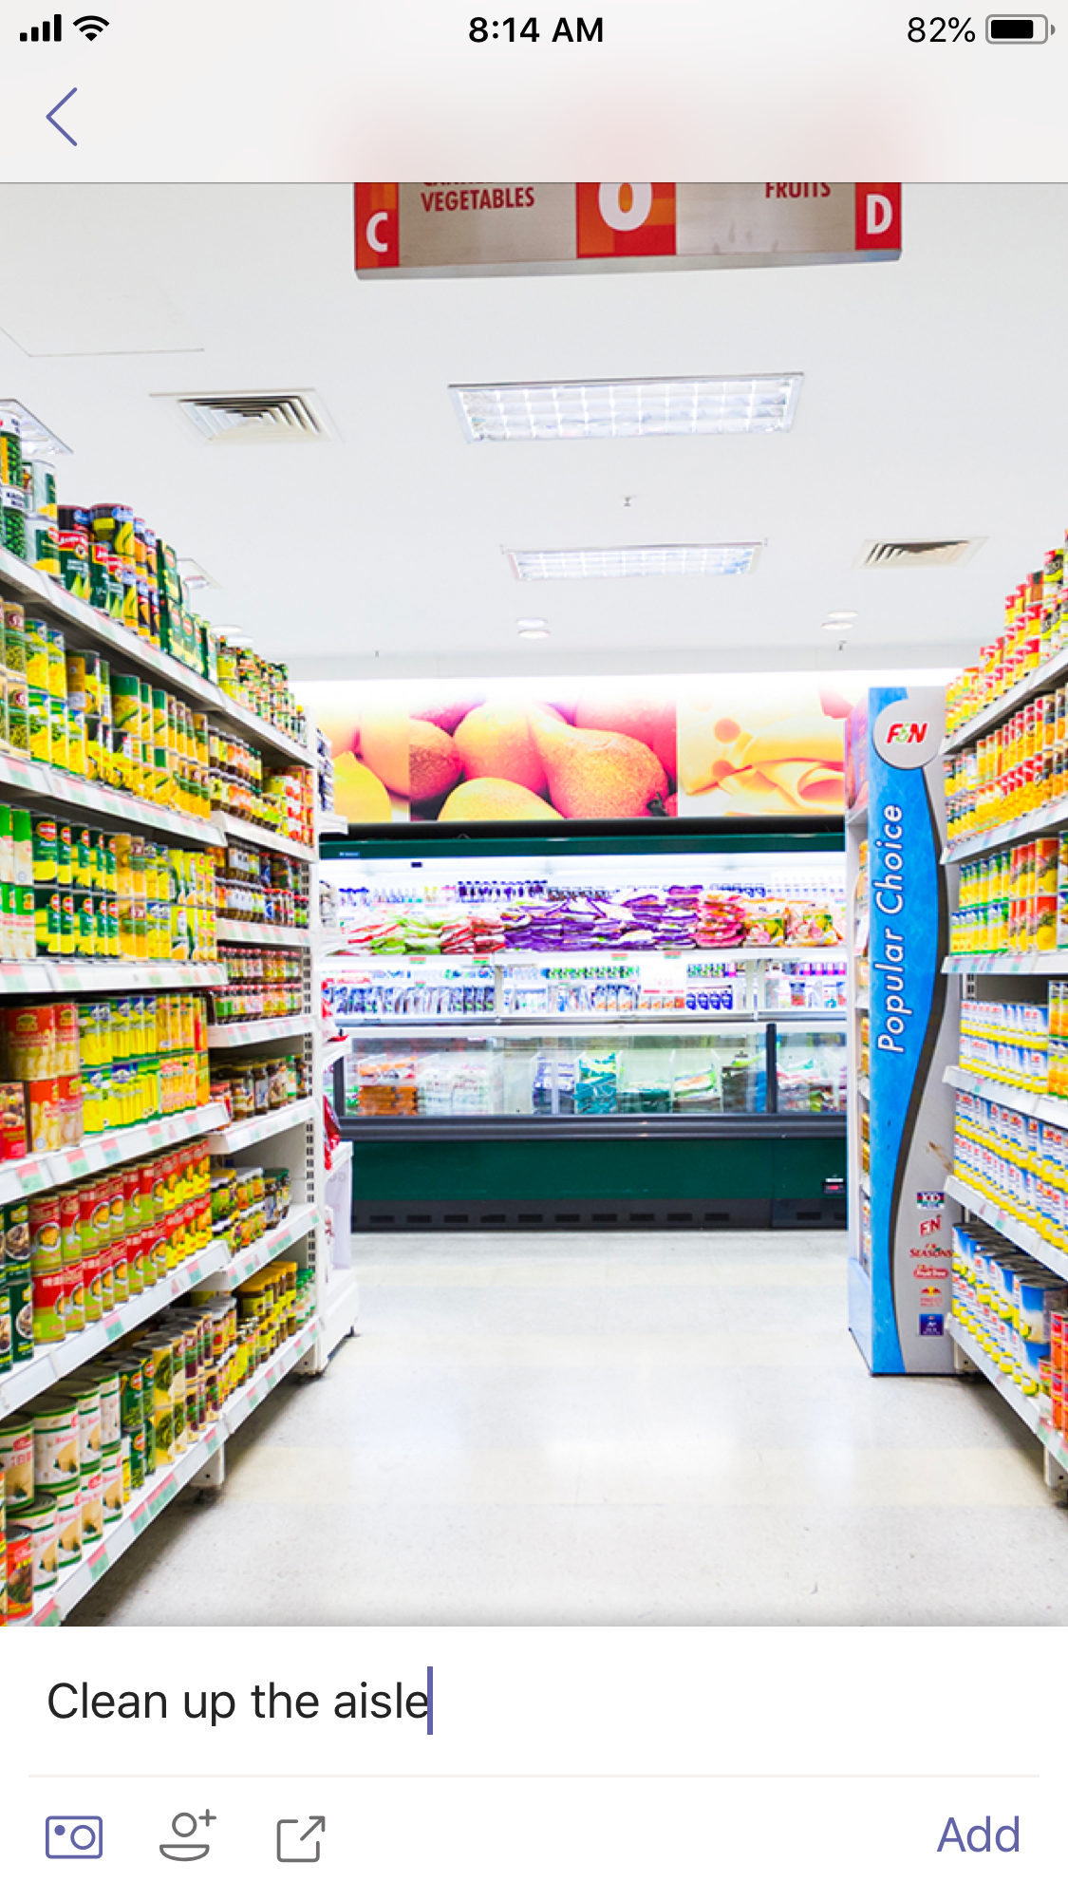
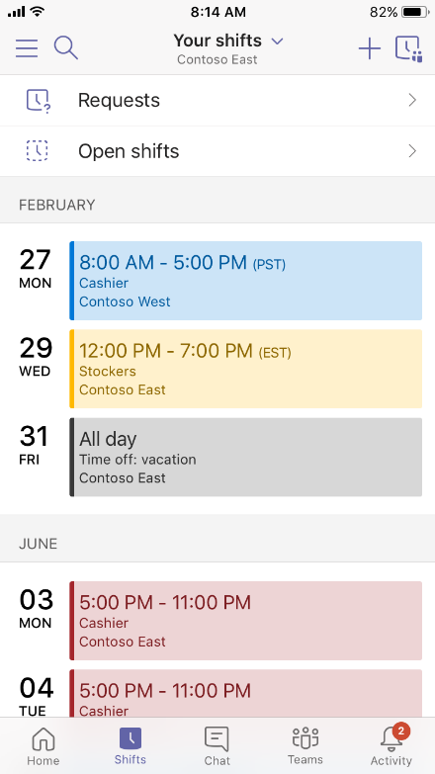
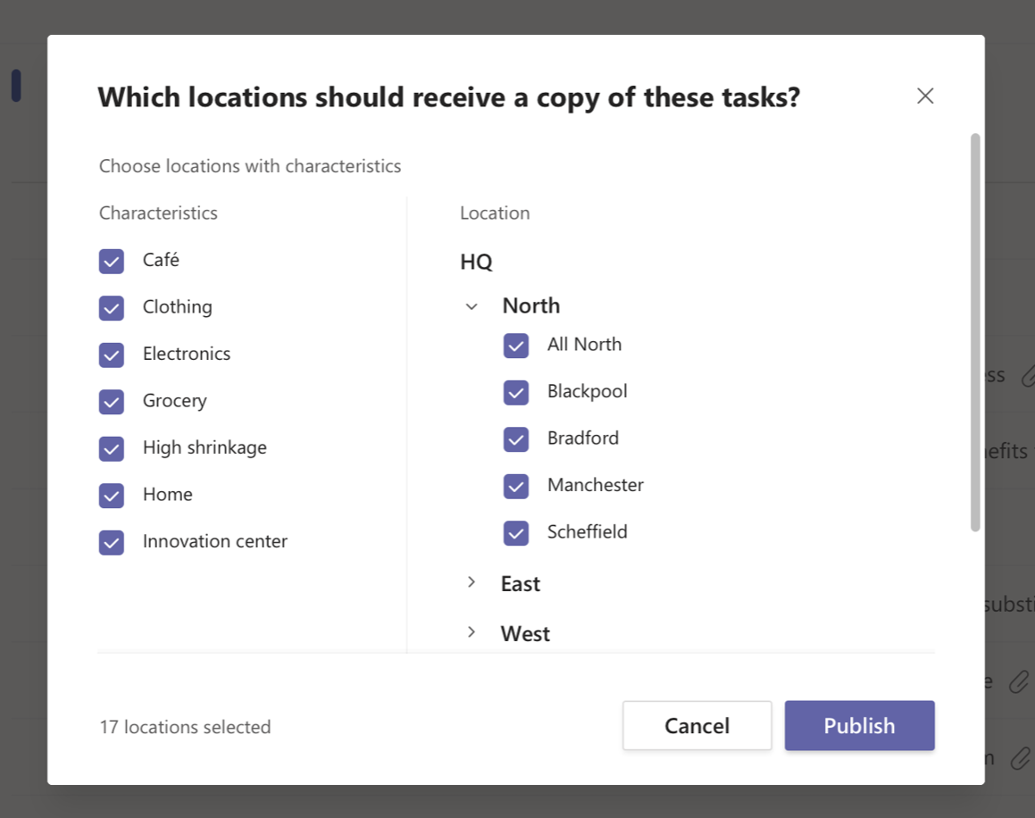

Shift and task management
Automate everyday activities with PowerApps and Flow
Create and manage schedules and tasks with Shifts
Notes:
Office 365 and Microsoft 365 apps and services empower Firstline Workers across the organization:
Automate everyday activities with PowerApps and Flow.
Create and manage schedules and tasks.
Connect a distributed workforce with Microsoft Teams.
Work efficiently with intelligent apps.
<Click>
The Shifts app in Microsoft Teams keeps Firstline Workers connected and in sync. It's built mobile first for fast and effective time management and communication for teams. Shifts lets Firstline Workers and their managers use their mobile devices to manage schedules and keep in touch.
Managers create, update, and manage shift schedules for teams. They can send messages to one person ("there's a spill on the floor") or the entire team ("the regional GM is arriving in 20 minutes"). They can also send policy documents, news bulletins, and videos.
Employees view their upcoming shifts, can see who else is scheduled for the day, request to swap or offer a shift, and request time off.
It's important to know that Shifts currently doesn't support guest users. This means that guests on a team can't be added to or use shift schedules when Guest access is turned on in Teams.

Slide 13
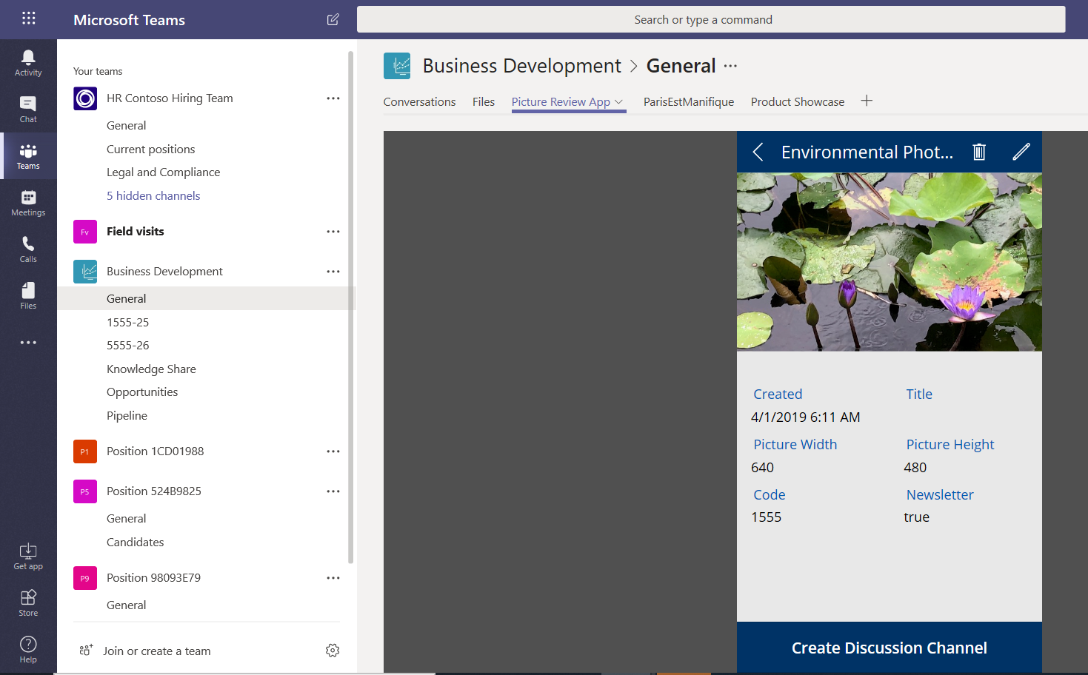
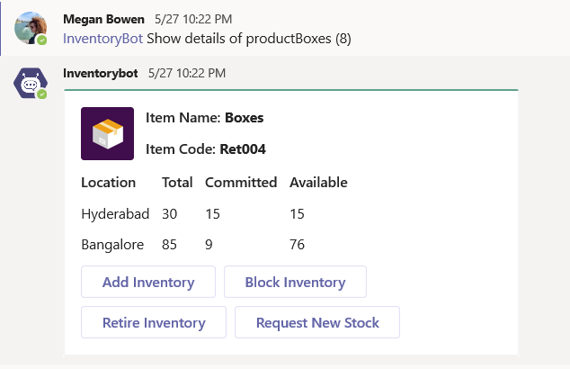
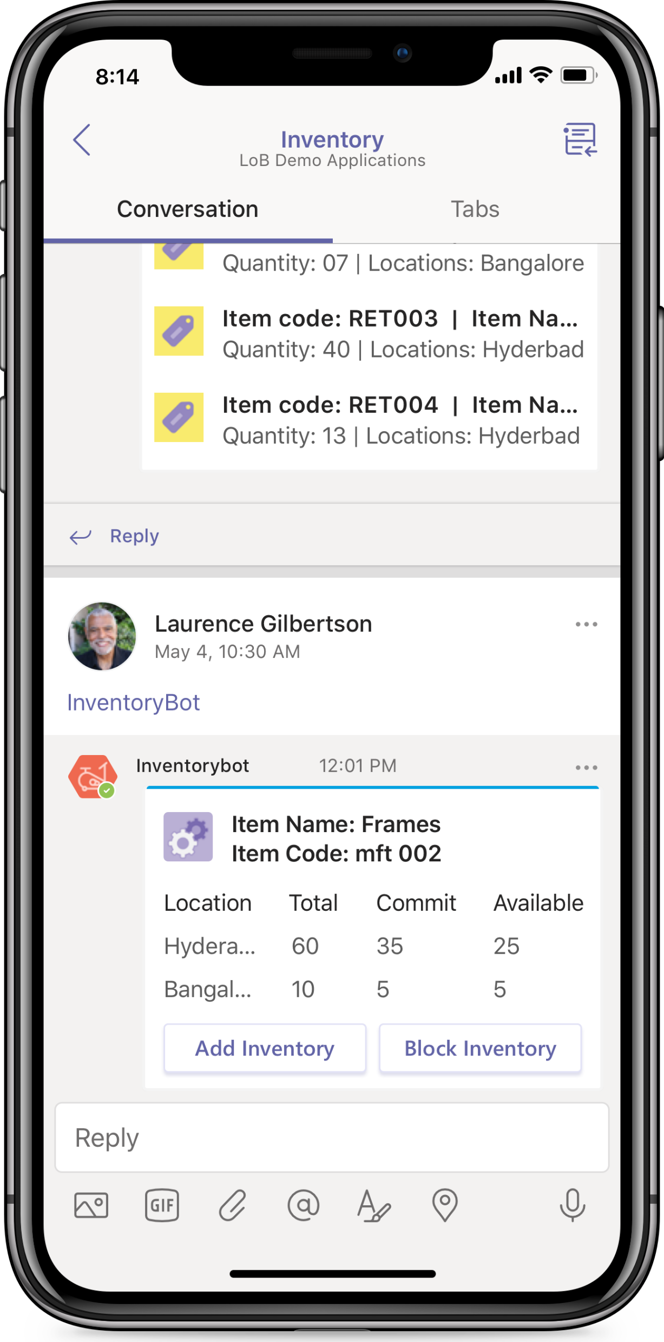
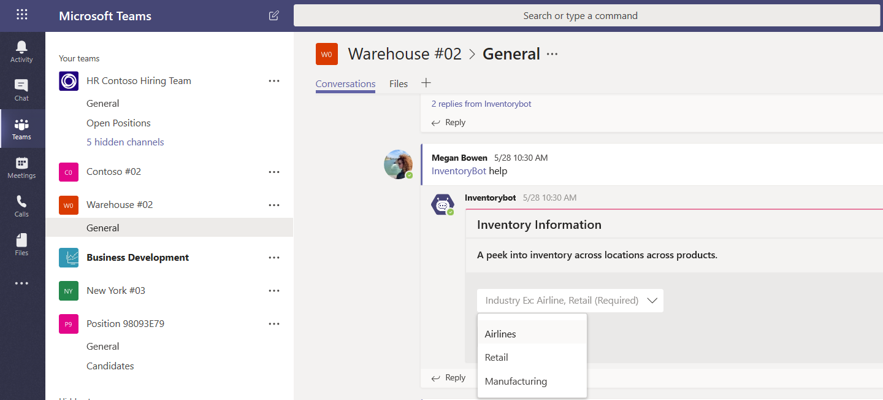
Teams custom solution example
Picture Review PowerApp
Inventory Bot

Slide 14
Simplify SMB technology investment
Office 365 Business Essentials
A single, integrated solution to help SMBs securely run and
grow their business
Business-class email
Anti-spam, anti-malware
$4
Shared online calendar
$4
Teamwork
Productivity apps and file storage
$8
Chat-based workspace, meetings
$13.50
Surveys and forms
$8
$5 monthly
Team planner
$10
Monthly cost of 3rd party solutions
>$45
Notes:
This is all about simplifying technology investment. Point solutions are costly and create fragmentation
Integrated solution enables SMBs to have all their productivity and security needs in one package. It reduces licensing costs and enables more room for you to monetize with managed services (higher margin).

Slide 15
Grow your business with Teamwork
How will this help
your customers?
Why add Teamwork
services?
What to do next
Notes:
So what are we doing to help accelerate the transformation for you and your customers?

Slide 16



Build Teamwork offerings to drive profitability
$16.75/ user/ month* of partner opportunity in SMB
Teamwork basics
Email, chat and collaboration
Meetings management
Package meetings services and devices
Teams solutions
Secured light-weight business solutions
Adoption and change management services
Enable end user adoption and success
*The Microsoft 365 Partner Opportunity, A Forrester Total Economic Impact™ Study Commissioned By Microsoft, July 2019
Notes:
The per-user-per-month opportunity of $16.75 comes from the July 2019 Forrester TEI survey on the Microsoft 365 Partner Opportunity.
Partners surveyed said that work usually started with properly setting up ‘identity’ at smaller companies. Most new deployments were around Teams setup and SharePoint migrations with the necessary identity setup and modern desktop components. Deployment services cost $310 per user over three years, which equates to $8.60 per user per month. The anticipated revenue opportunity with current attach rates was $8.60 per user per month.
Managed Services
Managed services were the single biggest revenue area and the one in which partners were making the most investments and focusing on for future growth, at $9.45 per user per month. Smaller companies usually lack the internal resources to fully support IT solutions and users. Partners are offering fully managed meeting solutions, for example.
Business Solutions (custom solutions)
Like the enterprise space, partners were creating pre-packaged IP solutions to make the customer more effective. Some of these were small, low-cost widgets that had a high margin. One example a partner shared was a graphic image management tool to ensure that usage rights were not being violated. Partners were also creating prepackaged workflows, such as expense reporting and vacation scheduling in Microsoft Flow, that they sell on a subscription model. Templated, vertical solutions which work with Teams and meeting and calling solutions are another area of focus. One example that demonstrates the breadth of opportunity is a partner who built industry-specific business solutions for SMB customers in the dairy industry. Many partners talked about creating healthcare business solutions for smaller medical practices. Partners also created repeatable IP to streamline provisioning and the delivery of their services. For these smaller customers, there was little to no custom integration work being completed. These add-on IP offerings attached at 25% on average, and IP designed to streamline delivery was used in all deployment efforts. Business solutions brought in revenues of $6.50 per user per month with attach rates applied.
Advisory and Adoption Services
Smaller customers did not require as much adoption and change management services as enterprise customers. Instead, advisory and adoption services were more about providing basic training to users – both onsite and ongoing, online training. Nonetheless, most partners want to attach these services, and some will only sign new customers if advisory and adoption services are included. Attach rates ranged between 60% and 75%. These services were worth $4.25 per user per month with attach rates applied.

Slide 17
Teamwork basics
Helps SMBs organize and share information
Services | Description
Migrate | Help SMBs start their journey in the cloud through migrating email, files and identity
Set up | Standardize the organization on Teams for collaboration. Move files to channels
Integrate | Integrate other Microsoft services into Teams experience
Notes:
Managed services help SMB partners stay engaged with customers. Many customers will not want to manage their Teams environment. According to one partner quoted in the July 2019 Forrester TEI survey on Teamwork”
“During deployment they ask, ‘Can you just operate the whole thing for me?’”
From July 2019 Forrester TEI survey on Teamwork
Managed services opportunities have grown for partners in both the SMB and enterprise spaces. This can include anything from basic user support to outsourced IT management of teamwork solutions to white-glove meeting room management services. This is becoming more important as many partners deliver value as services and attempt to create longer-lasting, more strategic relationships with customers. Managed services can provide better margins than project-based work once scale is achieved. It also delivers predictable, recurring revenues, which make it easier to invest in the business.

Slide 18
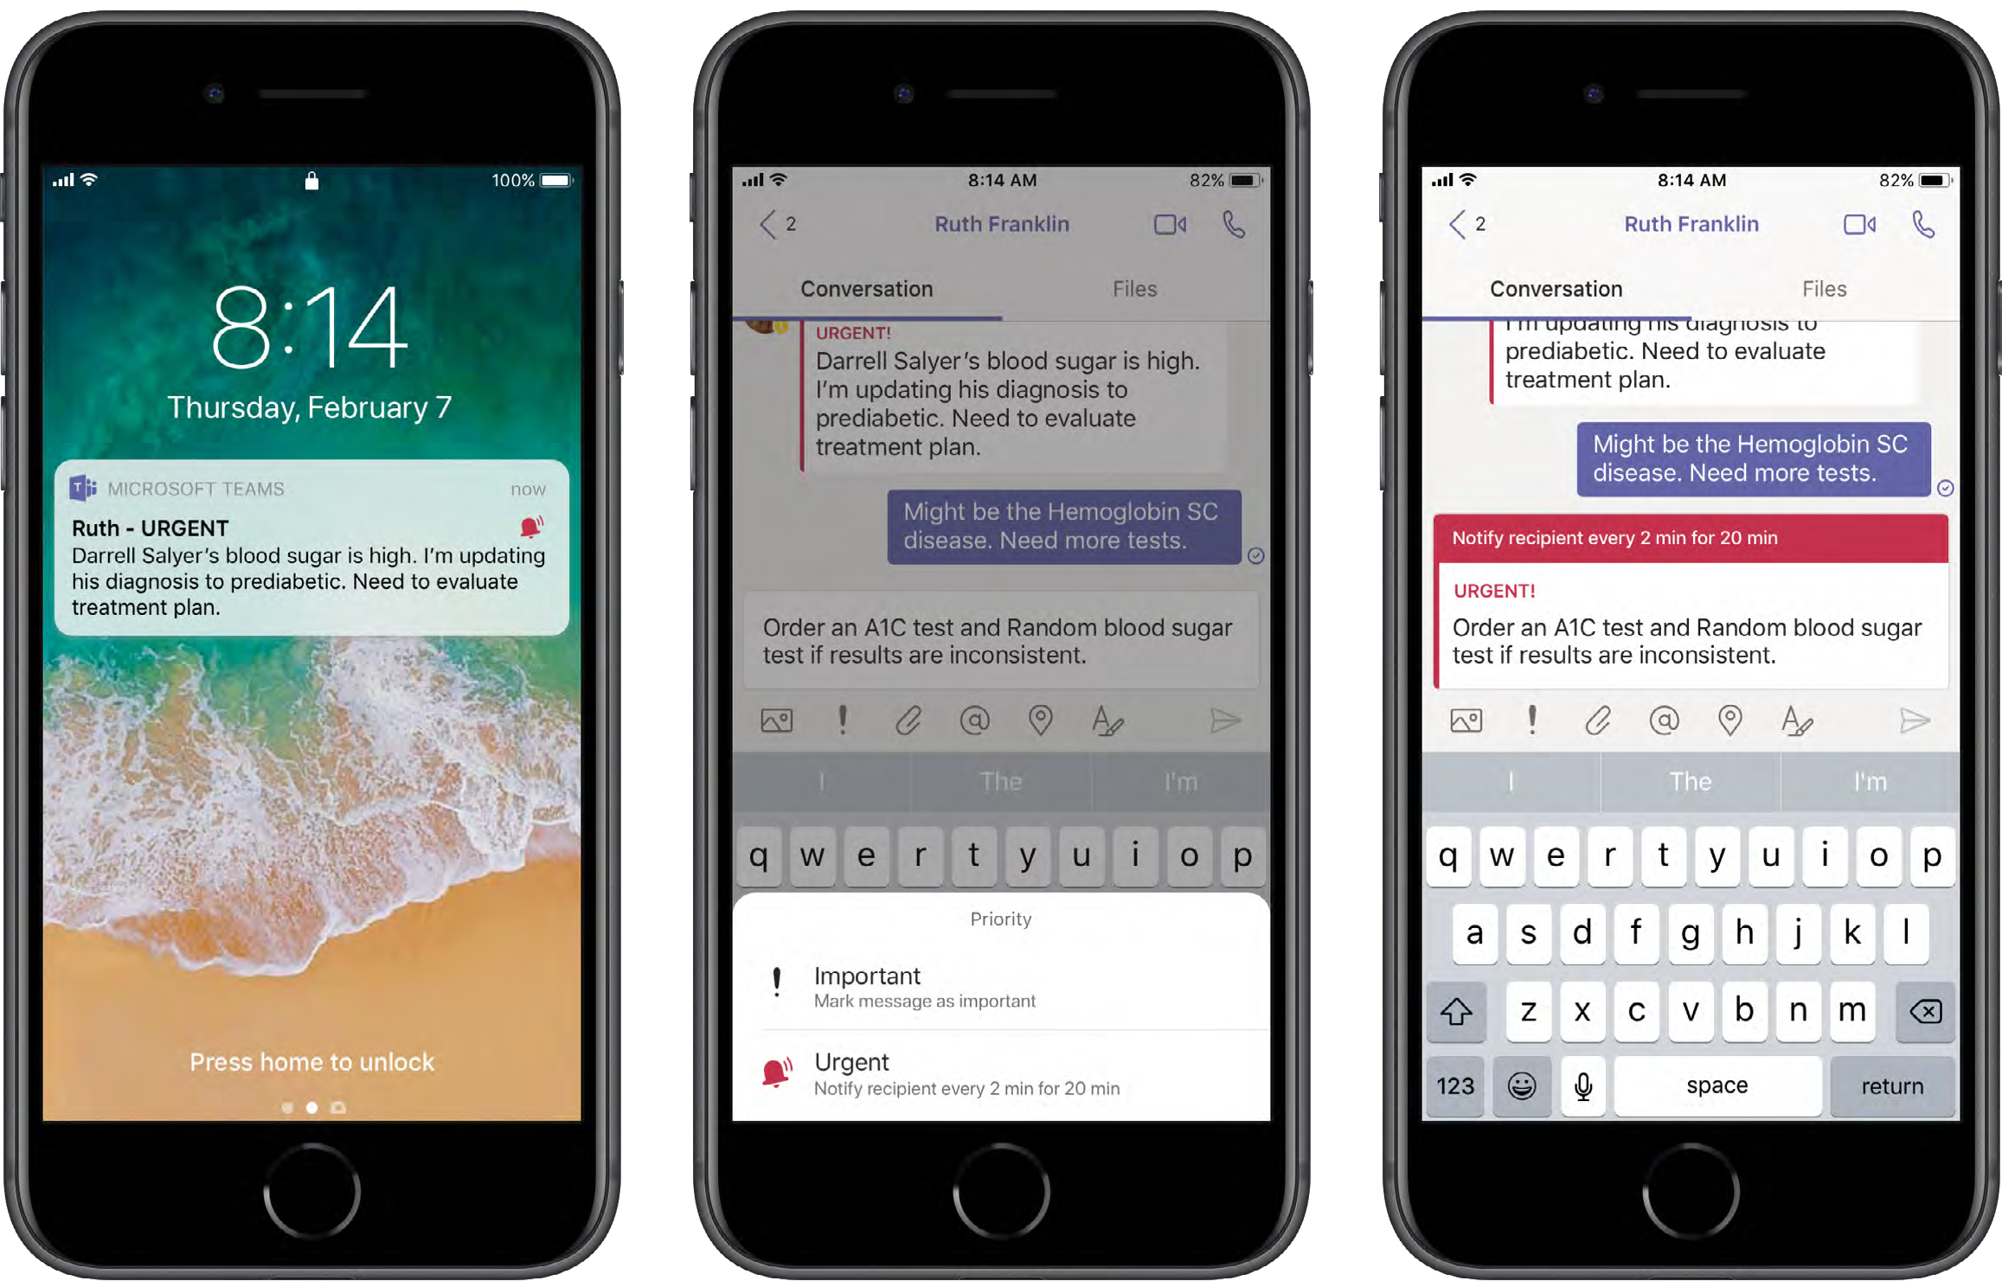
Adoption and change management
Accelerate end-user adoption and value with value-added one-time and ongoing services
Services | Description
Onboarding | Offer in-person workshops to get familiar with Teams and transition from email
Engagement | Create digital learning paths for end users with on-demand training resources
Track | Agree on metrics and track usage to refine offerings and roadmap
Notes:
When partners sell teamwork, they are increasingly attaching adoption and change management (ACM) services, according to a July 2019 Forrester TEI survey on Teamwork. This is because deploying the technology is no guarantee of adoption, when people first need to change the way they work. Adding people-oriented services can help customers use technology to work better.
ACM services are typically a combination of customer self-directed activities and partner services, both one-time and ongoing. ACM is important to factor into teamwork programs from the very beginning, and partners often begin by understanding how users are currently working and the company culture. A person-based approach makes ACM planning and success easier.
For SMBs, change management typically involves user training and other related business consulting opportunities. These include selling some training days and providing a training portal where users could learn more about how to use the teamwork solutions.
(For larger companies, ACM activities are very heavy initially and often include ongoing services to monitor usage and change how solutions are configured. Managed services of many different kinds are put in place as solutions go live to ensure that users and IT organizations are properly supported and the teamwork solutions deliver the promised value.)

Slide 19
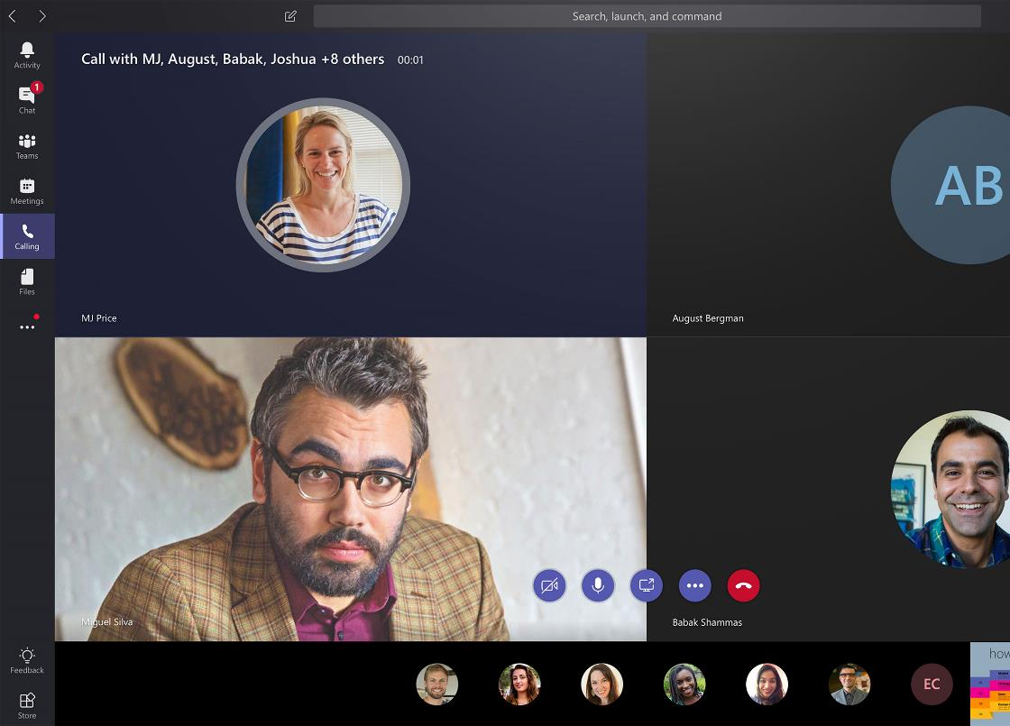
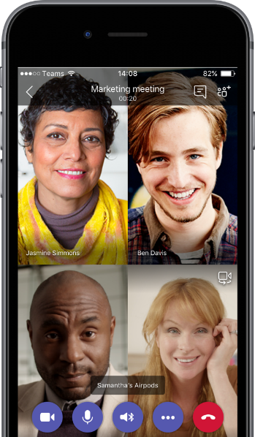
Meetings management
Package services and devices for a managed meeting experience and ongoing revenue
Service | Description
Assessment | Conduct an assessment to determine user needs for meetings solution
Devices | Add Teams certified devices and Teams Rooms for a seamless experience
Manage | Monetize with ongoing service on meetings management
Notes:
An important aspect of user experience is having everything that a user needs in one place. This is where partners can add a lot of value and make a lot of money.
“Everyone having the same experience is what customers want,” one partner said in a July 2019 Forrester TEI survey on Teamwork. “It’s easy to create a meeting in Teams, but what is the experience? Agendas are not attached, notes are not attached, true collaboration is not taking place. Partners who say ‘Teams provides the meeting’ are missing the point. Teams gives you video chat. Online meetings are about being able to communicate and collaborate with all the information and not losing it afterwards. There is a lot of money to be made there.”
Given the breadth of solutions involved with online meetings, the Forrester survey findings stated that partners now need to have expertise in many more areas, and these include networking technologies like routers and firewalls. According to the Forrester survey, some SMB partners lack this breadth of skills and indirect partners like distributors are stepping up to augment partners’ technology capabilities in both sales and delivery.
From July 2019 Forrester TEI survey on Teamwork: Business solutions are especially important in the meeting and calling space. A good meeting room experience requires scheduling solutions, usage and trouble monitoring solutions, meeting room design, and custom development to create seamless experiences when moving from the meeting room to Teams on a mobile phone. For calling, one partner said “We have built a lot of IP on top of various vendor solutions in the Microsoft ecosystem. 20% of our revenues are non-recurring doing the initial custom development, and 80% is recurring revenue from ongoing usage fees.”
“We provide the most basic level of helpdesk support, things like password reset, for $2 to $4 per user per month depending on the helpdesk hours. Margins are high on this.”
“Our premium teamwork outsourcing includes tier one through three support, usage monitoring and recommendations, and solution upgrades. We sell that for $45 per month.”
“We often sell managed services as part of a meeting room rollout. We manage the hardware and monitor room utilization and system performance. This is done as per room pricing depending on the size and nature of the room, and margins are in the 40% to 50% range. If something breaks, we charge additional fees to fix it.”

Slide 20
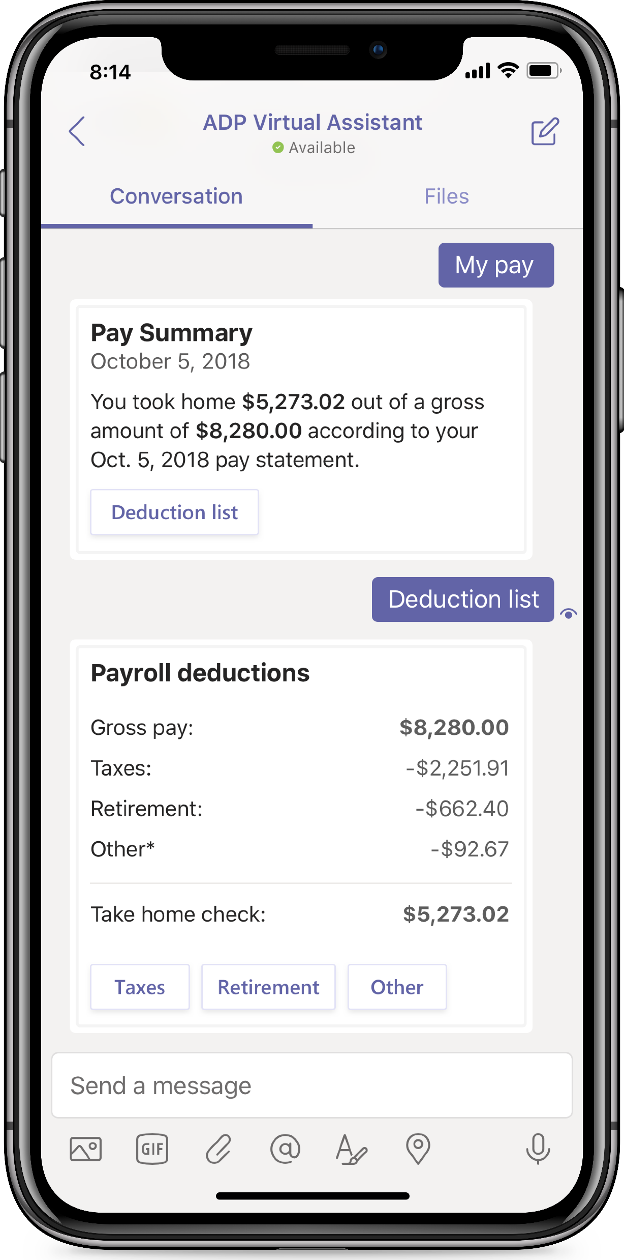

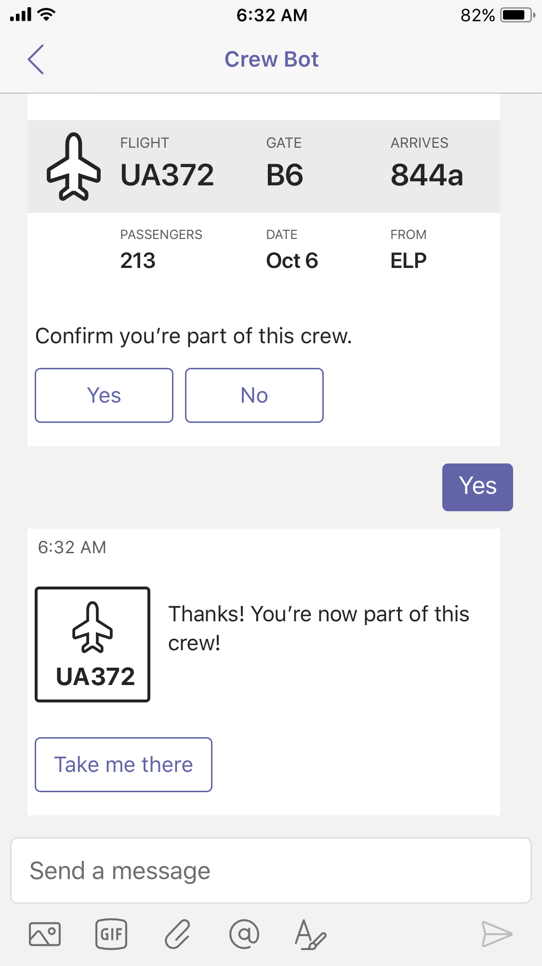
Teams custom solutions
Meet your customers’ unique Teamwork needs with secured, repeatable solutions
 | Offerings
Integrate | Extend existing productivity solutions into Teams using the app gallery
Modernize | Modernize and integrate LOB experiences into Teams
Automate | Build low code solutions using PowerApps to meet industry customer needs
Notes:
These are from the July 2019 Forrester TEI survey on Teamwork
“We are creating a lot of reusable vertical solutions. Our biggest industries are healthcare, manufacturing, and finance.”
“We have created some bots that we have integrated into Teams. We plan to do much more of this in the future.”
“We have created components that plug into Teams. They include better ways to schedule, invite people to meetings, and storing and retrieving notes. Users can select templates that pull everything into one place.”

Slide 21
Teams custom solution example
Picture Review PowerApp
Inventory Bot

Slide 22
Bringing it together: driving profit with Teamwork
+$115
+$310
Deepen relationships
Standardize on Teams and grow the lifetime value through differentiated services
Attach services
Add high-value, easy-to-sell
services based on deployment
of Office 365 Business Essentials
$180
+
  Standardize collaboration on Teams
  Move intranets to SharePoint Online
  Customize with Teams solutions
  Modernize and integrate LOB apps
  Monetize with Teams enabled devices
  Continuing services
  24*7 Support
  Change management services
Win the foundation
Sell Office 365 Business Essentials
+
  Migrate files to OneDrive
  Establish meetings on Teams
  Package meeting room services
  Bundle adoption services
  Continuing services
  24*7 Support
  Email migration
  Set up users on Office
  24*7 support
3-6 months
6-12 months
Three-year average revenue per SMB seat from Office 365 Business Essentials
Source: The Microsoft 365 Partner Opportunity, A Forrester Total Economic Impact™ Study Commissioned By Microsoft, July, 2019
Notes:
The SMB landscape and Microsoft are focusing on solutions that enable teamwork– this is an opportunity to reframe your business and add people-oriented services that help customers use technology to work better. As one partner stated in a July 2019 Forrester TEI survey on Teamwork: “Teamwork projects are less focused on technology and more on the user and their experience. It’s all about how they can best collaborate. This also includes governance, connectivity, and overall system performance.”
Managed services is the area where partners see the greatest opportunity and are making their largest investments. Managed services provide partners with recurring, predictable revenue which makes longer-term planning and investing possible. Partners also feel that the managed services margins are, or will be, higher than those for project consulting engagements.
Most of these partners are experiencing sizeable upticks in the number of leads and opportunities they are receiving from the SMB space as a result of their Microsoft solutions and go-to-market programs.
1-Win. Stage 1, which includes licenses and associated deployment and project services brings in standard margins. The first step for many customers not already using Outlook client is to enable it. Office deployment sets the stage for a successful teamwork program because of the upfront visioning and planning activities, according to a July 2019 Forrester TEI survey on Teamwork. Selling Office 365 Business Essential
2-Grow by attaching services. Pull-through project offerings vary significantly across partners, but generally fall into three categories: security and compliance; business intelligence and analytics; and change management and adoption. Engagement sizes range from $5,000 to $20,000 and see attach rates of between 20% and 35% of license deals. Partners can build margin on these projects.
3-Partners deepen relationships when they differentiate with managed service and IP services. Given the need for simplicity and pricing transparency within the SMB space, partners are rapidly creating robust portfolios of managed services tiers to meet the diverse business needs of SMB customers. SMB partners report that SMB customers are very receptive to outsourcing IT support, solution updates, training, and security monitoring, management, and remediation to a trusted third-party partner, particularly since many have limited or no IT staff within their own organizations. These services build the bottom line and deepen relationships.
Given the breadth of solutions involved with online meetings, partners now need to have expertise in many more areas, and these include networking technologies like routers and firewalls. According to the July 2019 Forrester TEI survey on Teamwork, some SMB partners lack this breadth of skills and indirect partners like distributors are stepping up to augment partners’ technology capabilities in both sales and delivery.
Microsoft’s most advanced partners are building out resalable and proprietary software solutions aimed at common vertical or horizontal business challenges identified across their customer bases. Partners resell these proprietary offerings to their SMB clientele, with some horizontal solutions, such as packaged SharePoint intranet solutions, achieving attach rates as a high as 50% to 60%.

Slide 23
Grow your business with Teamwork
How will this help
your customers?
Why add Teamwork
services?
What to do next
Notes:
So what are we doing to help accelerate the transformation for you and your customers?

Slide 24
Target SMBs that need Teamwork tools and services
 | Acquisition | Upsell
Target audience | On-premises customers ready for business-class email Non-Microsoft customers with business need for increased collaboration due to expanding remote/mobile workforce | Exchange Online customers ready for an upsell
Customer opportunity | One out of every three SMBs still has not adopted cloud services.¹ | Millions of SMB customers on Exchange Online
Compelling events | End of support for Windows 7 and Office 2010 Exchange Online users seeking cloud-based collaboration | Expanding remote/mobile workforce Shift to multi-generational workforce Defined need to streamline multiple teamwork tools that don’t talk to each other
Conversation starters | Unsecured file sharing No collaboration tools or too many Version control issues | Inefficient meetings, unnecessary travel time Version control issues Single sign on across multiple apps
GTM tools (see detail in next few slides) | Acquire new customers with Teams CSP 6-month trial SMB Teamwork Workshop Sales & Marketing Play assets for acquisition | Upsell with Teams CSP 6-month trial SMB Teamwork Workshop Sales & Marketing Play assets for upsell
1. Bredin, an SMB market research and content marketing agency.
Notes:
1. Important to target high propensity customers first to gain momentum, focusing on medium size SMBs in professional services. Value prop is a fully integrated teamwork solution with enterprise-grade security. The central hub for teamwork offers SMBs flexibility and choice in how they connect, share, and communicate.
2. Win the pitch through associating your pitch with compelling events that are top of mind for the customer.
Scenarios:
Support needs of a multi-generational workforce.
Support collaboration needs of a remote/mobile workforce.
Streamline multiple teamwork solutions that don't talk to each other.
Reduce inbox clutter.
Approach:
If not already in place, sell the value of business-class email. This offers them an inexpensive, low-risk and high-value cloud experience. SMB customers can learn the new solution quickly and easily.
Add value by best-in-class collaboration tools, offering a free 6-month trial as needed.
Extend customer conversations to include the added benefits of your related apps and services, including how you and the SMB can work together to change behavior.
Build and present an example offer using the Offer builder tool.
Engage the right team, including the top executives who can identify key scenarios for change.
Conduct an assessment to understand needs and build awareness within the company with the help of internal champions.
Perform cost justification – the cost for Office 365 Business Essentials is often less than the standalone cost of third-party products they’d replace.
Discuss managed services and IP-based services based on SMB. Emphasize regular reporting that will help justify business value.

Slide 25
Build sales readiness with Teamwork resources
Learn
Market
Sell
Deploy
Teamwork play card
Guided tour
Teamwork demo environment
Teamwork product training
Conversation guide
Email kit
Day-in-the-life infographic
Social assets kit
Flyer
Offer builder
SMB Teamwork Workshop
Teams CSP 6-month trial
Customer pitch deck
SOW and Proposal
Welcome to Teams
Adoption library
Market and Sell content available @ aka.ms\mwsmb
Notes:
Working with SMBs is a not a one-and-done operation, it’s a continuous cycle of learning, marketing, pitching, and selling. Teamwork play assets from Microsoft help you engage with customers to help them modernize their workplace.
Use the multi-channel, multi-touch assets to build top down and bottom up awareness for businesses to update their software and hardware together and to move from on-premises or freemium solutions to an always updated experience powered by the cloud.
Examine Learn assets to help prepare yourself to sell Teamwork solutions. Marketing campaign assets help you focus on what customers gain when the adopt new technology, with benefits clearly outlined and sales motions that align to SMB customers needs. Additional resources help you Sell and Deploy with confidence.

Slide 26
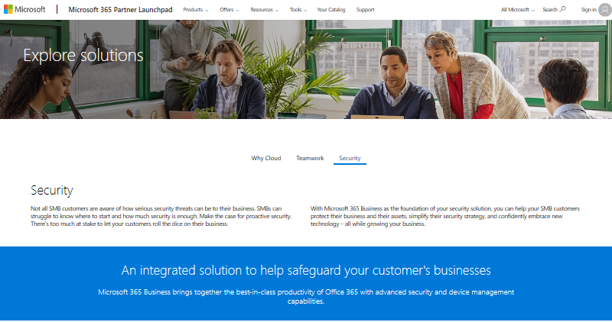
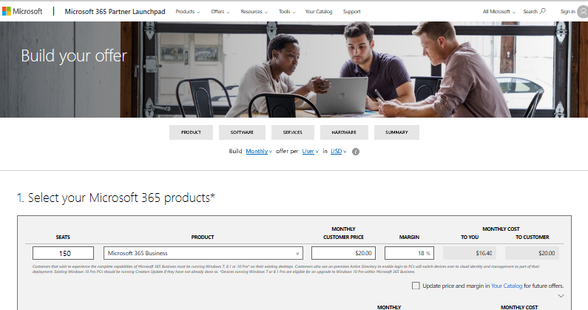
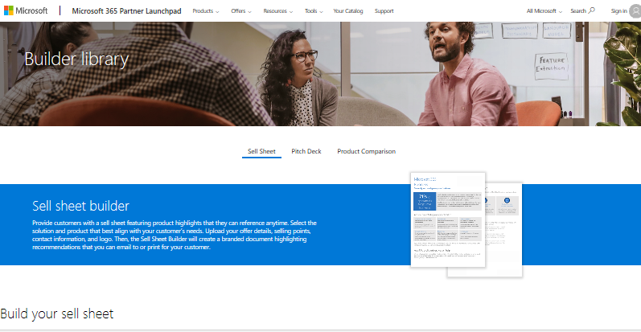
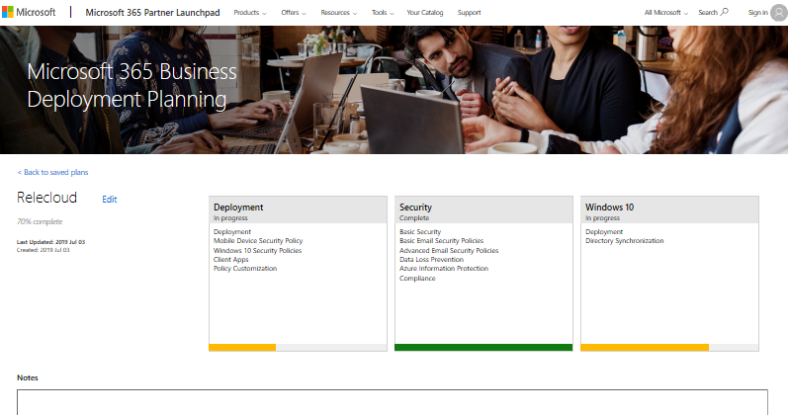
Sell smarter with Launchpad
Streamline and simplify the SMB sales process
  Discover solutions
  Build offers
  Customize resources
  Plan deployment
Available @ aka.ms/partnerlaunchpad
Notes:
We have also built a custom tool, just for our partner network to help build holistic SMB offers, aligned to the SMB practices with Microsoft 365 Launchpad. We released Launchpad last year for the first time and we currently have over 3,000 partners using it every month!
It follows a simple four step process:
Discover the base MSFT solution that is right for your customers and for your offer
Build and cost out your offer, based on any of the practice areas, through adding the deployment & managed services as well as devices you plan to include ontop of your base solution. Cost out your offer and understand the profitability of the offer for your average customer over a three-year period with an exportable excel
Customize sales resources such as customer one pagers to market and sell your offer effectively to customers
Lastly and a new addition is deployment planning. Once the offer is sold- plan your deployment of Microsoft 365 with the deployment tool.
I’d encourage you to check Launchpad out as you build you Teamwork or Security practice in FY20 at aka.ms/partnerlaunchpad

Slide 27


Help SMBs evaluate Teams with a CSP Partner-led trial
Partners can initiate a 6-month trial for SMB customers at no additional cost
Give SMBs the opportunity to experience the
power of Teams in their everyday work lives.
Full Free Teams product functionality for customers not on Office 365
Use trial as a driver to paid products
Potential to earn incremental accelerators of up to 10% post-conversion to paid
Grow Wallet Share with existing customers by consolidating customer communication portfolio and reducing shadow IT.
Reduce complexity of multi-vendor integration
Attain greater share of total spend and grow monthly seat revenue 2x
“Teams is a really useful way of attracting customers and getting more deeply embedded.”
Sr director, infrastructure services – unified communications
“Consulting services increase our average deal size by 25% to 35%”
President and founder
Announced on July 1 | Available on August 1
Learn more about Partner-led CSP trial
Notes:
The CSP "Partner Led Teams Trial" provides partners with an outstanding opportunity to win new customers, and grow revenue from existing customers.
This trial is a 6-month partner initiated CSP trial that enables customers to use Teams with its full capabilities. Partners will be able to initiate this trial through the CSP portal. This will be available starting August 1st.
Partner Messaging
The trial gives customers new to Microsoft a chance to enjoy the Teams collaboration experience in their everyday work lives.
The trial includes full-featured functionality of Teams, and provide a natural on-ramp to transition the participants to paid SKUs that include Teams, such as Business Premium, E3, and E5.
As part of the FY20 CSP Incentives shift, we have increased the accelerators for new customers and strategic products to 5% each.
That means partners can earn up to 10% in incremental accelerators when a new customer purchases the paid version of the product.
For existing customers, there is the opportunity to grow share of wallet by helping customers consolidate their communications stack.
Relieve the headaches customers currently have juggling integration and payments to vendors such as Zoom and Slack, with a robust consolidated hub for all of their communication needs.
Not only will your customers save time and money, you will see a monthly seat revenue double from Exchange-only and E1 customers from ~$3 to $5/seat/mo after they move to a more premium SKU.
Additional point:
If you are a partner who offers Managed Services such as Training, Adoption, or Change Management, this is a great opportunity to generate revenue with these services, by bundling them with the Free Trial
Attach rates for these services range between 60% and 75%. These services were worth $4.25 per user per month, and can grow the deal size by a third. (Source: 2019 Forrester Study)
Here’s the guidance to offer IT
“Microsoft Teams is the hub for teamwork that brings together chat, meetings, calling, and Office 365, all-in-one. And it’s built on the trust of Microsoft security & compliance that’s crucial for today’s businesses. The Microsoft Teams Trial enables end-users to start using Teams at no additional cost and allows users to evaluate if Microsoft Teams meets their needs.
As admins, you will see this trial license like any other license in the Admin Portal, as well as be able to see the number of people who have claimed it. This allows you to engage with the groups or individuals, understand their needs, and get involved in a pilot.
Your Office 365 administrators in your organization have several admin tools to manage the Teams Trial. Unlike tools like Slack, that find their ways into the organization without the knowledge of IT or without tools to manage it.”
Here’s the pitch to business leaders or end users
“Are you interested in trying Microsoft Teams with your department, team or project team? You can start using Microsoft Teams today with a one-year trial. This enables you to evaluate if Teams is the right tool for your team to work across organizations, speed up communication, improve transparency, include remote workers, etc.
Go to Teams homepage and sign in with your work email address to get started.”

Slide 28

Use a Teamwork workshop to get your foot in the door
SMB Teamwork Workshop
Duration: 2-4 hours*
Customize kit to work with your
SMB customer by:
Identifying business objectives and challenges
Assessing current technology capabilities
Providing recommendations and best practices
Creating an actionable plan
Available @ aka.ms/SMBTeamsworkshop
*Customize timing based on customer size and business needs.

Slide 29


Partner example: PTG
Scalable formula for acquiring with Teamwork
Ready phase: introduce Teams, focus on files and meetings
Set phase: create internal champions, introduce more advanced functionality
Go phase: measure business impact, provide change management
“We are positioning ourselves to be less about 'fixing' things that are broken and more about how we can help the customer work better.”
-Reed Wilson: Founder & CEO

Slide 30




What others are saying
Reducing email overload
"We’ve been a lot more productive through chat on Teams. We don’t see long email chains anymore, and employees collaborate across departments more frequently because the persistent chat gives them the context to pick right back up with a project, even if they had other priorities for a few days."
  -Joey Bitton
  Communication Specialist at The PUR Company
Delivering business value
“ We use Teams to simplify onboarding…. It’s easier for them to be part of the team than it is through Messenger, where you have to share your personal profile on Facebook, or through SMS, where you don’t see them
at all. "
-Emma Trygg
CFO at Movement Group Nordic
Fostering collaborative cultures
“ What I love about Teams is that it separates our internal chatter from official client email communications. Our sales and admin people are inundated with emails all the time. Having everything pertaining to a project in one place for the team to collaborate really reduces the pressure."
-Josh Young
Cofounder at Detroit Wallpaper
Notes:
How does Microsoft Teams benefit our customers?
What we hear from our customers:
Microsoft Teams helps them to enable new ways or working. It helps teams to be more collaborative, work in the open with everybody in the know, democratizing information and decision making.
It helps them to accelerate decision making. In Microsoft Teams, information is shared in the moment and with context, enabling people to quickly make an informed decision.
Microsoft Teams is also a driver of digital transformation by helping our customers to modernize business processes and align them with how people work in the modern workplace.
Case study: https://customers.microsoft.com/en-us/story/jwt-professional-services-microsoft-teams
Video: https://www.youtube.com/watch?v=oZrynUTuyf0&feature=youtu.be

Slide 31
Get started building business with SMB Teamwork
  Lead with a SMB Teamwork Workshop to qualify new Teamwork opportunities with your customers
  Provide SMB customers the opportunity to experience Teams with 6-month CSP Trial
  Demo Microsoft Teams to your customers, utilizing the Microsoft Demo platform or Guided Tours
  Learn more about Teams by earning Microsoft 365 Fundamentals certification and a deeper dive with the Teamwork Administrator certification
  Gain insight into building your deployment and managed services with latest Forrester TEI studies

Slide 32
Thank you
© Copyright Microsoft Corporation. All rights reserved.

