Slide 1



Microsoft Education | 2019
CSP for Education Partner Guide

Slide 2

Transformation in Education
We live in a time of great change and
tremendous educational potential.
We need to provide better tools that give
every student equal learning opportunities.
We need to amplify the creativity of students, teachers, and administrators.
We need to create more efficient classrooms
and maximize learning time.
We need to teach students the skills they need
for a rapidly transforming future.

Slide 3

Contents
  Education Product Offerings
  CSP Advantage
  Student Use Benefit
  Partner Opportunity Model
End-Customer Ready Links

Slide 4
Education Product Offerings

Slide 5
Microsoft Education
Empowering every student to create the world of tomorrow
Better learning outcomes
Saves teachers time
Affordable, easy to manage devices
Microsoft provides personalized learning tools and immersive, intuitive experiences that help increase reading and language skills, ignite interest in STEM, and spark creativity.
Microsoft is helping teachers work more efficiently with tools to help them stay organized, easily locate and distribute content, and monitor student progress.
Microsoft offers affordable devices that are simple to set up and manage, helping educators give more students access to technology.
MICROSOFT CONFIDENTIAL for Microsoft Education partners only

Slide 6


What Makes Microsoft
Different?

Slide 7
Future Ready Skills
Collaboration
Platform used in careers
Powerful STEM software
Minecraft: Education Edition
Real time editing and sharing
Create communities with Teams
Online and Desktop versions of Office apps
Inclusion
Modern Classroom Management
Learning Tools & Immersive Reader
Integrated Language Translation
East set up and management with Intune for Education
Set up in less than an hour
Manages Windows, MacOS, iOS and Android

Slide 8

Future Ready Skills
Minecraft: Education Edition
A platform to build new worlds and 21st century skills
Minecraft: Education Edition
The world’s most popular computer game and video game franchise adapted into a collaboration, and problem-solving platform with integrated learning plans
Implement STEM Learning through Coding
Students learn creative coding with Code Builder and MakeCode for Minecraft
Learn New Underwater Worlds
Dive in to new project-based experiences with Update Aquatic
Explore Science and Experimentation
Mix and develop new solutions with the Chemistry Resource Pack
Cross Platform Support
Exclusively for Windows 10 and iOS Systems

Slide 9
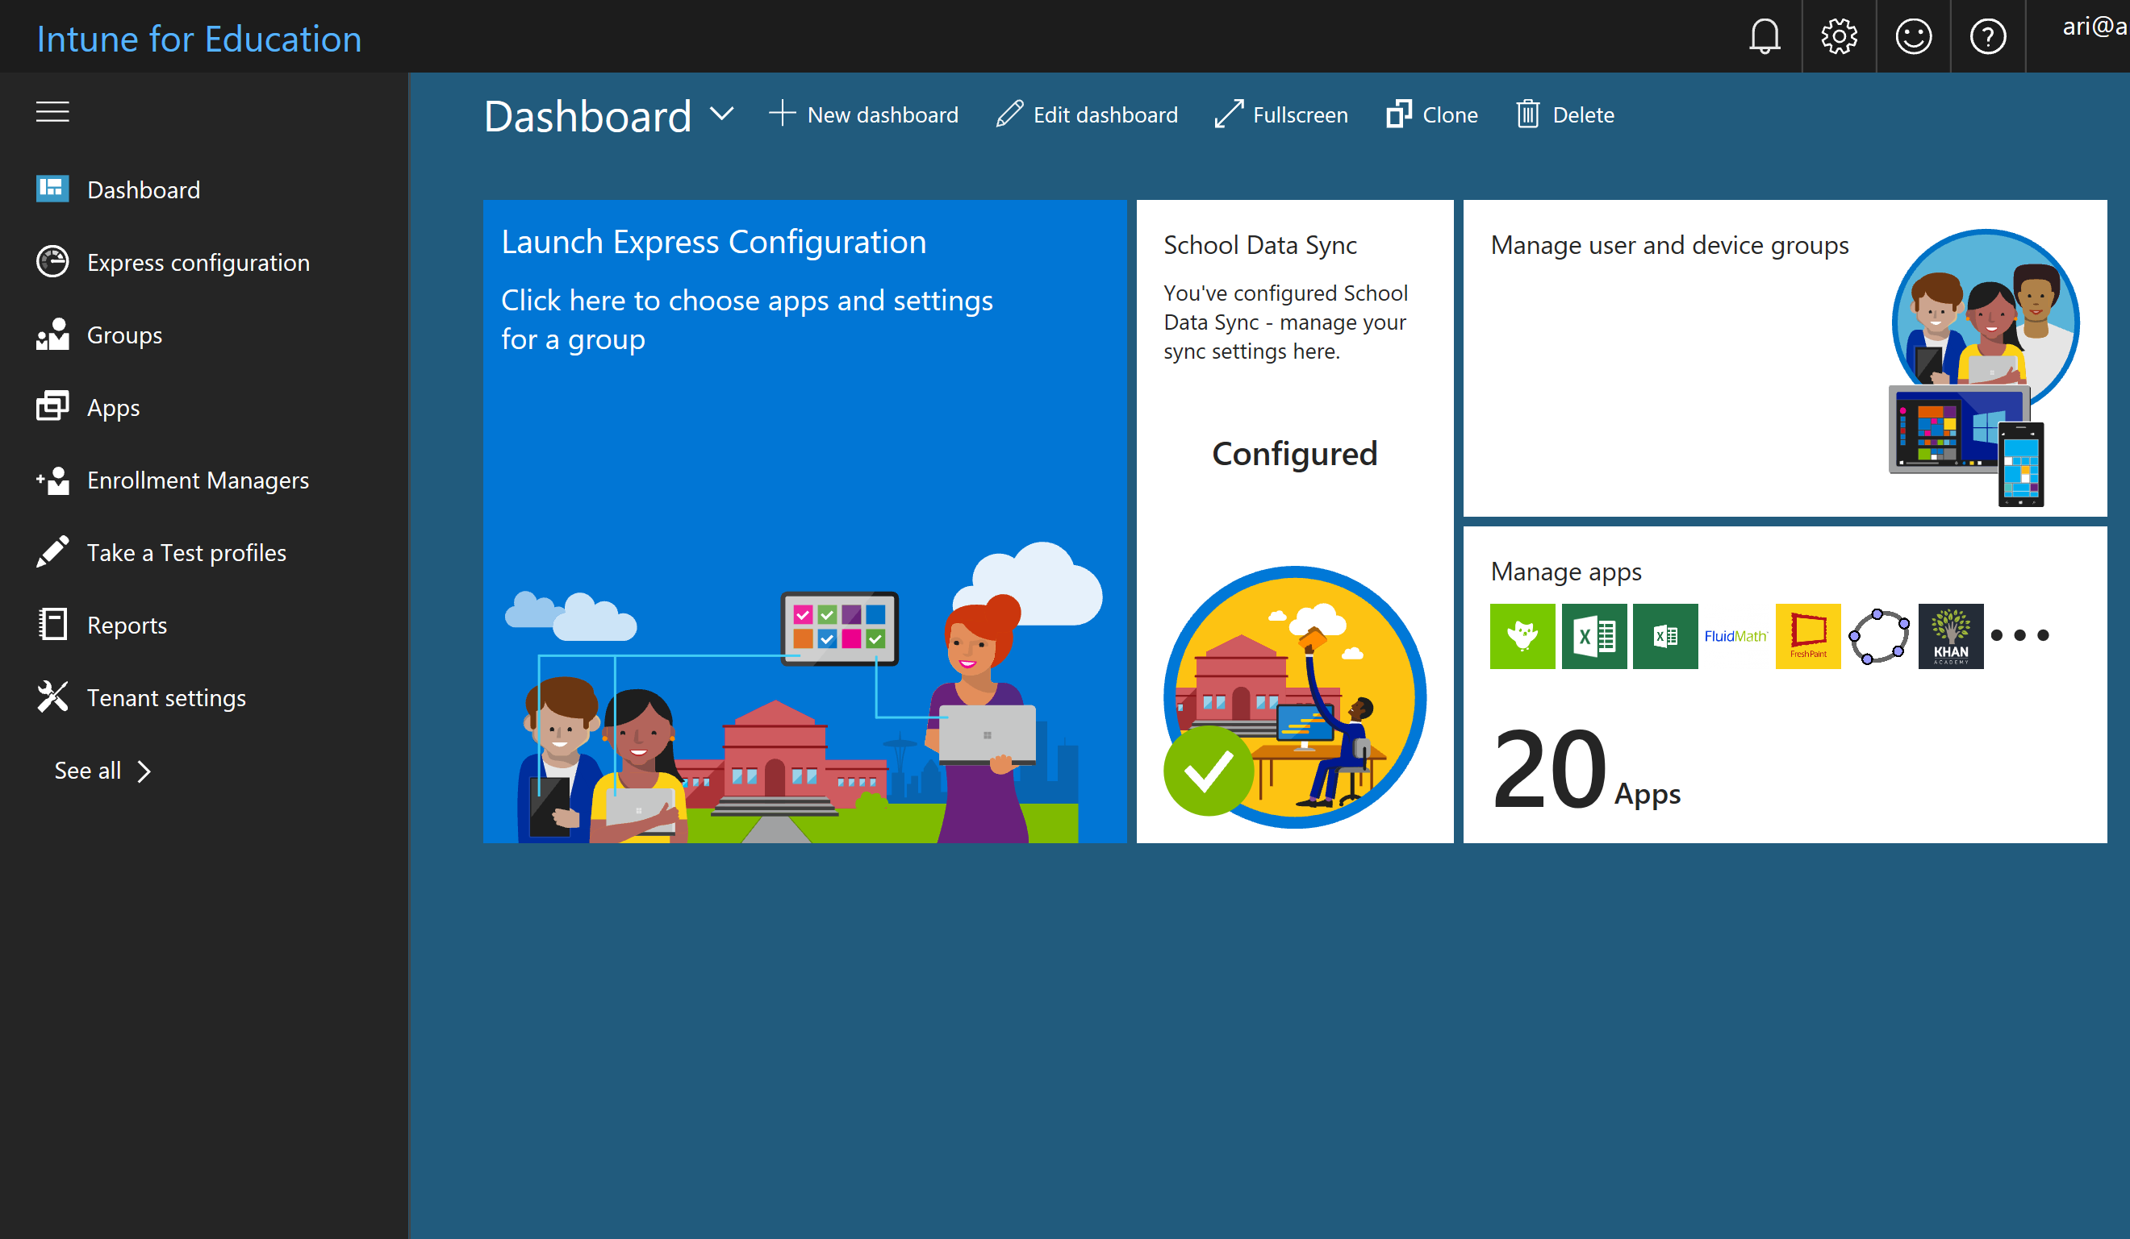
Intune for Education
Modern Classroom Management
A simpler way to deploy and
manage classroom devices
Fast enrollment and streamlined deployment easily brings Windows 10 devices and apps under management
Zero-touch management to change apps and settings applied by default to each enrolled device through
the cloud and Azure AD
Import school, student and teacher info quickly with School Data Sync to automatically create classes and keep student data up-to-date
Designed for education to address common school scenarios and settings, such as shared devices where user gets different settings and apps
Scales to your environment and is easy for part-time IT staff, yet includes rights to the full enterprise-grade Intune console for cross-platform management and integrates with SCCM via co-management – transitioning to modern management iteratively

Slide 10
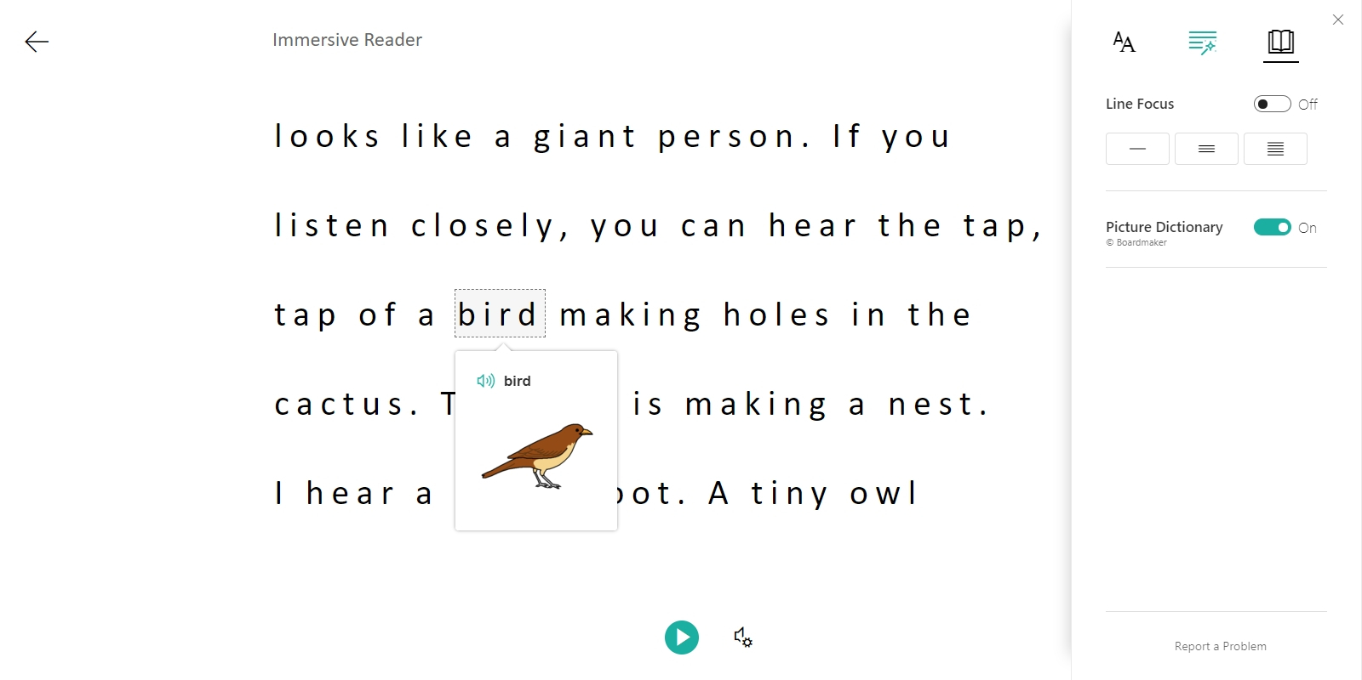
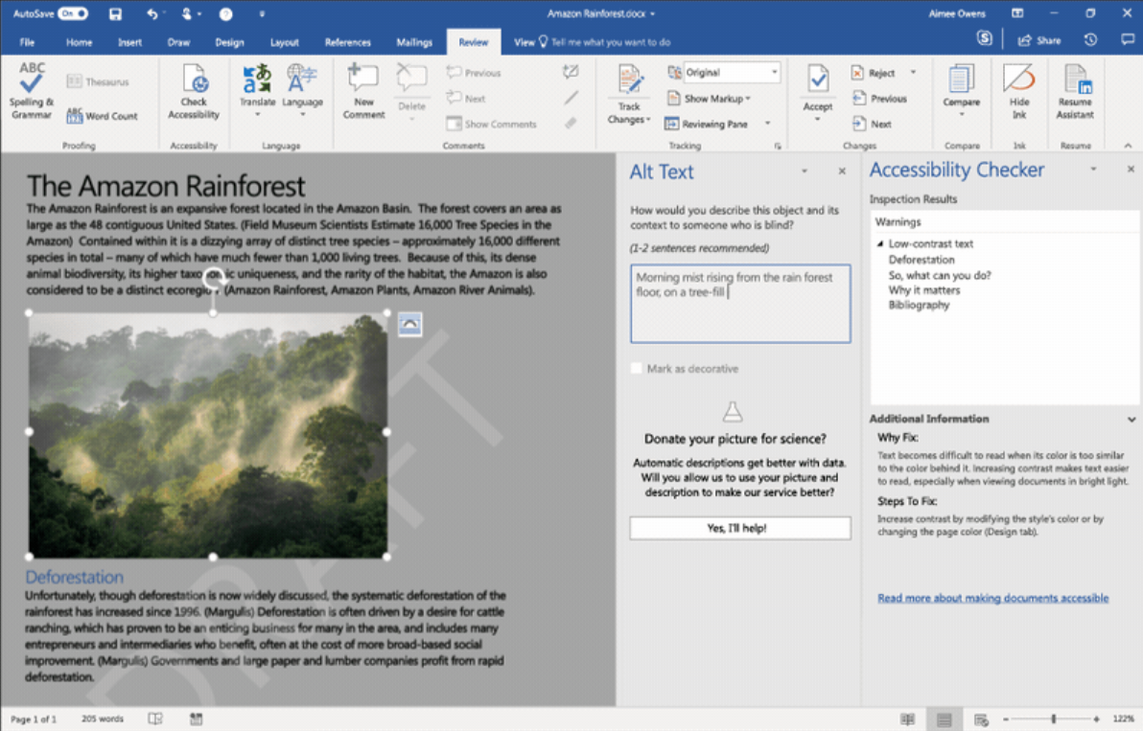
Inclusion
Immersive Reader
Enhance independence, efficiency, and engagement
Consume content independently with assistive technologies, ease of access settings and Learning Tools in Office, Windows to aid usability and comprehension
Students create confidently and efficiently with intuitive controls such as Windows 10 keyboard shortcuts, voice with Office Dictate, Tell Me, Researcher, Editor, and Designer
Staying organized becomes efficient and paperless with Office Lens and OneNote, now enhanced to support students with learning or visual challenges
Collaborate inclusively using Accessibility Checker and Automatic alt-text to help create accessible content, automatic translation/captions with Skype and screen-friendly
co-authoring features

Slide 11
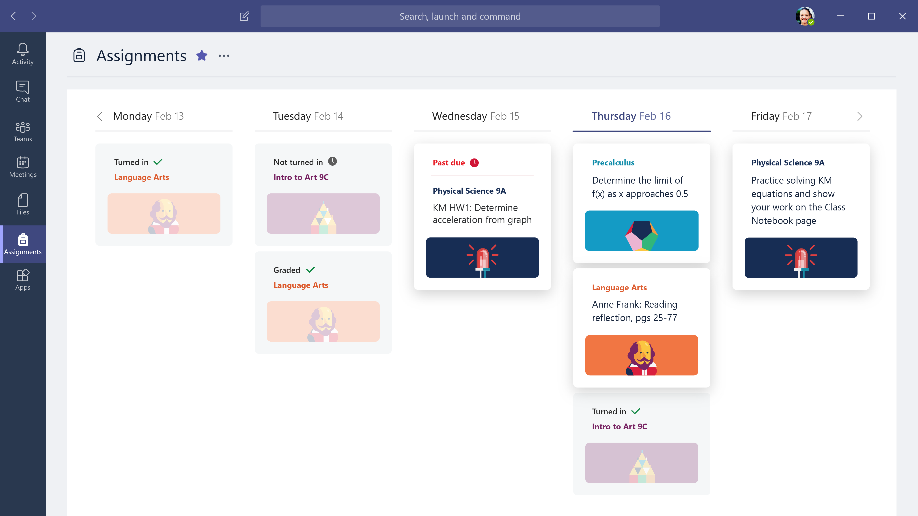
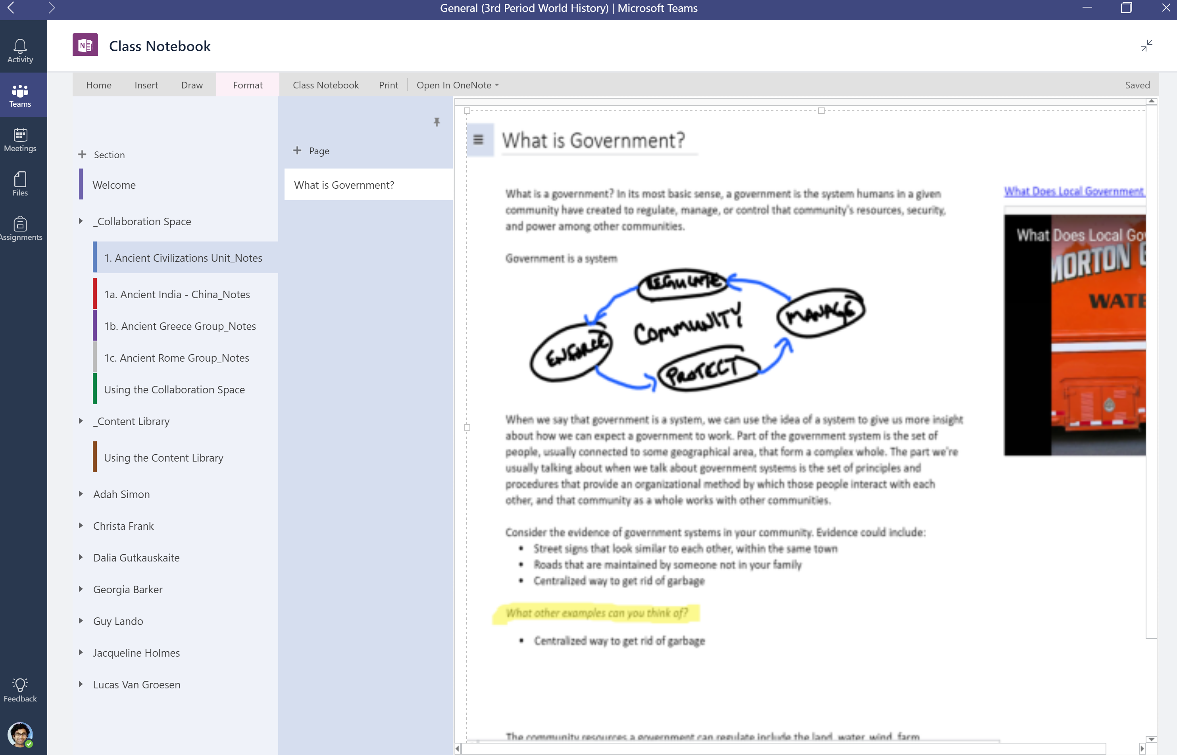
OneNote and Teams
Collaboration
Powered by OneNote and Assignments Integrations
Create assignments with options for individual assignments to allow for personalized learning
Grade and provide continuous feedback using point values, written feedback, and edits on the assignment itself
Stay organized with a digital binder for lesson plans, handouts, and more
Create or deliver interactive lessons to some or all students

Slide 12

Introducing Microsoft 365 Education
Empower educators with a single, affordable and safe solution for better learning outcomes​
Office 365
Windows 10
Enterprise Mobility
+ Security (EMS)
Includes Minecraft: Education Edition with Code Builder
Cloud-first
Modern licensing for education
Designed for K-Higher Ed
Valuable student use benefits
For more information see the Microsoft 365 BOM on MPN
MICROSOFT CONFIDENTIAL for Microsoft Education Partners only

Slide 13


The Hero Offer
M365 A3 includes:
Desktop applications in O365 ProPlus
Minecraft: Education Edition
Intune for Education
Single sign-on capabilities
Student use benefit opportunity
M365 A3
M365 A1
(Device Offer)
M365 A3
(User Based)
The device-based A1 offer does not have a step-up to M365 A3

Slide 14
Microsoft’s Education Portfolio
Microsoft 365 Education Offers
Microsoft 365 A3
Microsoft 365 A5
Office 365 A3
Office 365 A5
Windows 10 Education A3
Windows 10 Education A5
Microsoft Education A la carte Offers
Device offer – M365 A1
EMS E3
EMS E5
Office 365 A1
Office 365
A1
Minecraft: Education Edition
Minecraft: Education Edition
Office 365
A1
Intune for Education
(per device)
Extend access to students with student use benefits when your institution purchases Microsoft 365 for faculty and staff†
† Student use benefit: Purchase Microsoft 365 for all faculty and staff and include students at no additional cost
14

Slide 15
Microsoft 365 Component Map |  | Services & Features | A1 | A3 | A5
Office | Collaboration & Learning | Exchange Online (email and calendar), Teams/skype, Yammer (social) | ✓ | ✓ | ✓
 |  | OneDrive for Business and SharePoint Online (files and sharing) | ✓ | ✓ | ✓
 |  | Groups (shared spaces) and Planner (work management) | ✓ | ✓ | ✓
 |  | Office Online web-based editing (Word, Excel, PowerPoint, and OneNote) | ✓ | ✓ | ✓
 |  | Office ProPlus Client (Word, Excel, PowerPoint, Outlook, OneNote) |  | ✓ | ✓
 | Classroom Tools | Microsoft Teams Classroom, PLCs, and StaffHub | ✓ | ✓ | ✓
 |  | OneNote Class Notebook, Sway | ✓ | ✓ | ✓
 | More Inclusive Classrooms | Learning Tools, Accessibility Checker, Office Lens | ✓ | ✓ | ✓
 | Compliance | Legal Hold, eDiscovery | ✓ | ✓ | ✓
 |  | Advanced eDiscovery, Customer Lockbox, Advanced Data Governance |  |  | ✓
 | Management & Security | Exchange Online Protection, DLP, Azure Rights Management, Message Encryption, School Data Sync | ✓ | ✓ | ✓
 |  | Office 365 Cloud App Security |  | ✓ | ✓
 | Advanced Security | Office 365 Advanced Threat Protection, Threat Intelligence |  |  | ✓
 | Analytics | Power BI Pro, MyAnalytics, Delve |  |  | ✓
 | Voice, Video, and Meetings | Microsoft Teams, Skype for Business | ✓ | ✓ | ✓
 |  | Bookings, Meeting Broadcast, Office 365 Video with Stream |  | ✓ | ✓
Windows | Operating System | Windows 10 Upgrade License (Education Edition, Enterprise, Enterprise LTSB, & Pro) |  | ✓ | ✓
 | Management and Security | Windows Defender Antivirus |  | ✓ | ✓
 |  | Device Guard, Credential Guard, Exploit Guard |  | ✓ | ✓
 | Advanced Security | Windows Defender Advanced Threat Protection |  |  | ✓
Enterprise Mobility + Security | Management and Security | Azure Active Directory P1 (SSO, MFA, SSPR, Conditional Access, Dynamic Groups) |  | ✓ | ✓
 |  | Azure Information Protection P1 (document classification, tracking, and revocation) |  | ✓ | ✓
 |  | Advanced Threat Analytics |  | ✓ | ✓
 |  | Intune (MDM and Mobile Application Management (MAM) without the need for device enrollment) | ✓ | ✓ | ✓
 | Advanced Security | Azure Active Directory P2 (Identity Protection and Privileged Identity Management) |  |  | ✓
 |  | Azure Information Protection P2 (automated classification and hold your own key) |  |  | ✓
 |  | Microsoft Cloud App Security |  |  | ✓
Additional M365 Benefits | Student Benefits | Intune for Education, Azure Active Directory P1, Azure Information Protection P1, Advanced Threat Analytics Office 365 Cloud App Security, Minecraft for Education |  | ✓ | ✓
 |  | Azure Active Directory P2, Azure Information Protection P2 |  |  | ✓
 | Game Based Learning | Minecraft for Education |  | ✓ | ✓
 | Server Access | Client Access Licenses (CALs) for Exchange, SharePoint, Skype for Business, etc. |  | ✓ | ✓
 |  | Windows Server Client Access Licenses (CALs) |  | ✓ | ✓
 |  | System Center Configuration Manager Client Management Licenses (CMLs) |  | ✓ | ✓
 |  | System Center Endpoint Protection |  | ✓ | ✓

Slide 16






Choose the Right Windows 10 Device
Windows 10 devices come in a wide array of form factors and price points. We can help you find affordable devices that fit your needs and budget.
Laptops start at $189 and 2-in-1s at $279.¹
¹Estimated retail price; actual prices may vary.
Lenovo 100e
HP Stream
  Lenovo 300e
HP x360
1:1 Deployments
Ruggedized Clamshell
4/64 GB
$189
1:1 Deployments
Ruggedized Clamshell
4/64 GB
$234
2-in-1 Touch
Convertible 360 hinge
Pen option
4/64 GB
$279
2-in-1 Touch
Convertible 360 hinge
Pen option
4/64 GB
$314
Notes:
Partner: add your specific recommendations—and the reasons for them—for this customer.
Important: Whenever mentioning specific devices you should:
Add disclaimer “Estimated retail price; actual prices may vary.”
Ensure that all devices shown support the features and functionality highlighted in the deck

Slide 17
CSP Advantage

Slide 18
CSP is the only way education customers with fewer than 1,000 EQU can license M365 A3
  EQU = Education Qualified User

Slide 19
Showcasing the features of Office A1, Microsoft A3, & A5
Microsoft 365 A3
Microsoft 365 A5
Office 365 A1
Office 365 A3
Office 365 A5
Office Online
Exchange Online
SharePoint Online
Skype for Business Online
Office 365 apps: Sway, Forms, Teams etc.
Azure Active Directory Basic for Education
Office 365 A1 +
Office 365 ProPlus
Skype Meeting Broadcast
Office 365 Cloud App Security
Office 365 A3 +
Advanced Threat Protection
Threat Intelligence
Advanced Compliance
MyAnalytics
Power BI Pro
Audio Conferencing*
Phone System
Free product
Windows 10 Education A3
Windows 10 Education A5
Windows 10 Education A3 +
Windows Defender Advanced Threat Protection
ERP - USD per user/month*
Students are no charge with full fac/staff coverage
EMS E3
EMS E5
Intune/Intune for Education
Azure Active Directory Premium Plan 1
Azure Information Protection Premium Plan 1
Advanced Threat Analytics
EMS E3 +
Azure Active Directory Premium Plan 2
Azure Information Protection Premium Plan 2
Microsoft Cloud App Security
 | Faculty | Student
M365 A3 | $ 5.75 | $ 4.25
M365 A5 | $ 10.75 | $ 8.00
Minecraft: Education Edition
Minecraft: Education Edition
*Pricing as of Jan 2019 – subject to change

Slide 20

Special Use Rights for CSP Education Products
Office 365 A3/A5
  Standard and Enterprise CALs for:
    Exchange Server
    SharePoint Server
    Skype for Business Server
EMS E3/E5
  Windows Server and Windows Server ADRMS CALs
  Advanced Threat Analytics CML
  System Center Configuration Manager CML
  System Center EndPoint Protection SL
Microsoft 365 Education A3/A5
  Rights as individual suites
  No rights to install productivity server products
  No rights to install Office Professional Plus instead of Office 365 ProPlus, or any downgrade rights
  No rights to downgrade Windows 10
Notes:
Talk Track:
Let’s take a look at what special use rights customers who buy the education products through CSP get
First of all, licenses for Office 365 A3 and A5 (click) give rights to Standard and Enterprise CALs for Exchange, SharePoint and Skype for Business Server. It’s important to note though that these CAL rights give access to server that is already licensed with a server license
Then EMS E3 and E5 (click) give rights to the Windows and System Center components of the Enterprise CAL Suite
If we were to look at Microsoft 365 Education A3 and A5 then these licenses give use rights as per the individual products (click). There are extra rights available in EES – listed here – and these are NOT available for CSP customers. Exchange, SharePoint, and Skype for Business Server are not available in CSP and thus there are no rights to install those products. Office Professional Plus 2016 or earlier versions or Windows 8.1 are not available either, and thus the rights to install those products are not included in licenses acquired through CSP
As usual, it’s the Microsoft Cloud Agreement that controls exactly what use rights are available when licenses are acquired through CSP

Slide 21




Selling Education Products through CSP
Direct Partners and Indirect Resellers can sell education products if they attain Authorized Education Partner (AEP) status
1
2
3
4
https://www.mepn.com
Complete Application Form, Review Terms & Conditions of Certification
Validate your MPN ID
Study the Training Material
Complete the Test Module
Notes:
Talk Track:
All CSP partners, whether Direct Partners or Indirect Resellers, can only sell education products through CSP if they attain Authorized Education Partner, or AEP, status
And how is that done? (click) It’s very straightforward – you need to be a member of the Microsoft Partner Network, and then to study some training material since you’re required to pass a licensing exam, and then accept some terms and conditions
The terms and conditions are important since this is where you confirm that you will only sell education products to education customers, and that you’ll sell them in the right way, following the rules, so that your customers remain compliant
The link where this is done is shown on the slide

Slide 22

The Student Use Benefit

Slide 23
Student Use Benefit Requirements
Requirements
  License all Education Qualified Users with qualifying products to qualify for relevant $0 student licenses via the Student Use Benefit
        Ratio Maximums:
        If the qualifying product is purchased via a suite/bundle the supported faculty:student ratio is up to 1:40
        If the qualifying product is purchased as a standalone the supported faculty:student ratio is up to 1:15
Education Qualified User
  An Education Qualified User is any employee or contractor (except Students) who accesses or uses an Education Platform Product
Education Platform Products:
  Microsoft 365 A3 or A5
  EMS E3 or E5
  Office 365 ProPlus
  Office 365 A3 or A5
Education Platform Products (EP) are defined in the Product Terms
Notes:
Talk Track:
One of the benefits of CSP is that customers can buy what they want when they want – there are no minimums or long term commitments involved. However, the student use benefit allows customers to make a certain level of commitment and get benefits in return for doing that
Let’s take a look at how it works
First of all, what commitment is required? (click) Institutions are only eligible for student use benefit licenses if, in common with the other programs, they license ALL of their Knowledge Workers, and then you proceed as with the other programs ordering the relevant $0 SKUs for the student use benefit licenses
What’s a Knowledge Worker? (click) Here’s the definition (which is the same for other programs). This definition is included in the Product Terms document
Let’s look now at what the qualifying licenses are

Slide 24
Student Use Benefit Advantage
Students are no charge when institution covers all faculty/staff (EQU)
ERP - USD per user/month*
 | Faculty | Student
M365 A3 | $ 5.75 | $ 4.25
M365 A5 | $ 10.75 | $ 8.00
 | Faculty | Student
M365 A3 | $ 5.75 | $ 0.00
M365 A5 | $ 10.75 | $ 0.00
Savings per student per year:
$ 51.00
$ 96.00
*Pricing as of Jan 2019 – subject to change

Slide 25
Student Use Benefit (CSP)
Student use benefit licenses available January 2019**
Qualifying Products | Ratio* | Office 365 ProPlus | Office 365 Cloud App Security | Office 365 Advanced Threat Protection | Azure Active Directory Premium Plan 1 | Azure Active Directory Premium Plan 2 | Advanced Threat Analytics | Intune/ Intune for Education | Windows 10 Education A3 | Minecraft: Education Edition
Microsoft 365 Education A3 | 1:40 | ✓ | ✓ |  | ✓ |  | ✓ | ✓ | ✓ | ✓
Microsoft 365 Education A5 | 1:40 | ✓ | ✓ | ✓ |  | ✓ | ✓ | ✓ | ✓ | ✓
Office 365 A3 | 1:40 | ✓ | ✓
Office 365 A5 | 1:40 | ✓ | ✓ | ✓
Office 365 ProPlus | 1:15 | ✓
EMS E3 | 1:40 |  |  |  | ✓ |  | ✓ | ✓
EMS E5 | 1:40 |  |  |  |  | ✓ | ✓ | ✓
Office 365 Cloud App Security | 1:15 |  | ✓
Office 365 Advanced Threat Protection | 1:15 |  |  | ✓
Intune/Intune for Education | 1:15 |  |  |  |  |  |  | ✓
Windows 10 Education A3/A5 | 1:40 |  |  |  |  |  |  |  | ✓
Qualifying products
* Ratio of total EQU (faculty) licenses to eligible student use benefit licenses
** Refer to the Product Terms for exact use rights for student use benefit licenses

Slide 26
Partner Opportunity Model

Slide 27
The sales opportunity
Start with Microsoft Education momentum and customer interest
Assess for upgradability
2
Upsell
3
Attach partner services
1
4
Microsoft Education delivers better learning outcomes.
Identify PCs and User workloads that can benefit from Microsoft Education Solutions
Upsell to Office 365 Education A3/A5
Transactional project services (testing, deployment etc.)
Transforms Classroom Time
Identify opportunities to Attach Office 365 A1 (free to students and teachers) and companion devices
Cross-sell Azure services
Recurring managed services (cloud management, MDM etc.)
Affordable and easy to use technology
Identify opportunities to attach accessories
and peripherals to enable new features
Cross-sell Minecraft Education: Edition
High-margin custom or packaged IP solutions (LOB apps etc.)
Microsoft Confidential – For Partner Use Only

Slide 28

Partner with SYNNEX and maximize your
Microsoft Education profitability
PARTNER MANAGED RECURRING
REVENUE IS PRIMARY GROWTH DRIVER
IP AND NEW INDUSTRY/ FUNCTION SCENARIOS
PROJECTS
Device and Productivity
renewal
Microsoft Education momentum/
customer
interest
OFFICE 365, Intune, AZURE AD, IMPLEMENTATION AND RECURRING REVENUE
30–40% project margin
40–60% IP margin
MANAGED SERVICE (DESKTOP+) MONTHLY RECURRING REVENUE
30–40% margin
NEW M365 Education PROJECTS, SECURITY, LIFECYCLE MANAGEMENT
DEVICES & ACCESSORIES
HW/SW RESALE
40–50% margin
POC, PILOT, SCCM PREP & DEPLOYMENT PROJECTS
30–40% margin
5–15% margin
20–30% margin bundled as monthly managed service
PARTNER REVENUE BUILT ON Microsoft 365 Education Foundation
20–30% margin

Slide 29
Education Licensing Fundamentals
It is the responsibility of AEPs to validate that education customers meet the Qualified Educational User criteria before transacting Microsoft education offers.
Detailed usage information for each Microsoft product can be found in the Product Terms.
Microsoft Confidential: Microsoft Education Partner use only
Notes:
AEP’s are Authorized Education Partners

Slide 30
Get Started

Slide 31
Customer Ready Resources
Education Resources
  Why Microsoft 365: https://www.microsoft.com/en-us/whymicrosoft365/
  Intune for Education trial: https://aka.ms/intuneforedupage
  Microsoft Education Solution Overview: https://www.youtube.com/watch?v=yDl01v1l01c&t
Intune for Education
  Overview: https://docs.microsoft.com/en-us/intune-education/what-is-intune-for-education
  Introduction: https://www.youtube.com/watch?v=ukrnCwcLvV8&t
  Live Intune setup: https://aka.ms/backtoschoolintune
  Training videos: https://aka.ms/intuneedudeploymenttraining
  World of tomorrow ad: http://aka.ms/intuneeduteaservideo
  Resources: https://aka.ms/intuneforeduresources
  Case studies: Port Alberni, Escola Bosque, French American School of Puget Sound, Calvert County School District, Davidson Academy
SYNNEX for Education Partners
  SYNNEX for Microsoft Education: http://resources.synnexcorp.com/Index-CSP-EDU-Education.html
  Resource Hub: http://resources.synnexcorp.com/CSP-for-EDU-Resource-Hub.html
  Windows 7 EOS for Education Campaign: http://resources.synnexcorp.com/Windows-7-EDU-Resources.html
  Microsoft 365 for Education Campaign: http://resources.synnexcorp.com/M365-Education-Product-Page.html
Notes:
Talk Track:
Let’s take a look at what special use rights customers who buy the education products through CSP get
First of all, licenses for Office 365 A3 and A5 (click) give rights to Standard and Enterprise CALs for Exchange, SharePoint and Skype for Business Server. It’s important to note though that these CAL rights give access to server that is already licensed with a server license
Then EMS E3 and E5 (click) give rights to the Windows and System Center components of the Enterprise CAL Suite
If we were to look at Microsoft 365 Education A3 and A5 then these licenses give use rights as per the individual products (click). There are extra rights available in EES – listed here – and these are NOT available for CSP customers. Exchange, SharePoint, and Skype for Business Server are not available in CSP and thus there are no rights to install those products. Office Professional Plus 2016 or earlier versions or Windows 8.1 are not available either, and thus the rights to install those products are not included in licenses acquired through CSP
As usual, it’s the Microsoft Cloud Agreement that controls exactly what use rights are available when licenses are acquired through CSP

Slide 32


SYNNEX GOVSolv: your trusted resource for reaching education customers
STEM (science, technology, engineering, and math) skills are critical requirements for the 2.6 million projected STEM-related job openings from 2014 to 2024—and some sources estimate there won’t be enough qualified candidates to fill them.*
The SYNNEX GOVSolv program provides resources to help educators address this knowledge gap and prepare K–12 and higher-education students for success. These include training materials to guide educators in creating their curriculums,
as well as resources to help them select the right IT devices and solutions.
Building a STEM practice in schools
STEP 1:
Augment physics or
math curriculums
3D printers
Circuit/coding kits
Charging station/cart
Audio-visual equipment
Document cameras
Headphones
STEP 2:
Develop a STEM
curriculum
Creative apps
Robotics
Digital microscopes
Virtual reality sets
Standalone career-tech courses
After-school club and STEM camps
STEP 3:
Offer trade certifications
and community programs
HP Sprout
HP Zvr
Augmented reality
Drones
Laser cutters
Workstations
*U.S. Bureau of Labor Statistics. “STEM occupations: past, present, and future.” January 2017.

Slide 33


Questions
Have questions about Microsoft for education?
Please contact Shannon Decken at:
ShannonDe@synnex.com

Slide 34



