Slide 1
Upgrading from
Skype for Business to Microsoft Teams

Slide 2
How to use this deck
Intended audience
Present this deck to customers who have interest and intent to adopt Microsoft Teams within their organization and have an understanding of the value proposition of Teams.
Pitch guidance
When discussing the upgrade from Skype for Business to Microsoft Teams, always lead with the value that Teams can provide their organization, directly linking the successful adoption of Teams with the customer’s business results.
Never frame the conversation as “You need to upgrade to Teams to move off of Skype for Business” as this undercuts the value of Teams. Successfully landing Teams adoption within an organization will often spark the upgrade conversation with customers asking when they are able to shut off Skype for Business Online in order to streamline on a single application.

Slide 3
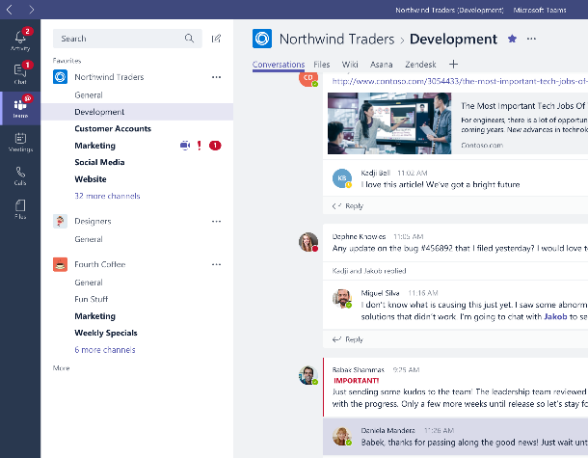
Microsoft Teams
The hub for teamwork in Office 365

Slide 4
Why upgrade to Teams?
Teams is used in
500,000+
companies
  Advanced features and capabilities
    Teams can do more than Skype for Business Online
    Rapid innovation based upon a rich Intelligent Communications roadmap
91
of Fortune 100
  Modern user experiences
    State-of-the-art cross-platform and mobile experiences
    Collaboration across Teams and Channels
60 companies with 10,000+ users
  Performance by design
    Re-imagined client built on cloud infrastructure
    Teams provides improvements in quality and operational metrics
Teams is the fastest growing business app in Microsoft history
Notes:
Rapid innovation delivering our rich Intelligent Communications roadmap - We have delivered on our published Skype for Business to Microsoft Teams roadmap, first shared at Microsoft Ignite 2017
Teams is the fastest growing business app in Microsoft history.
At Ignite 2018 we shared the latest usage numbers that show the accelerated use and adoption of Teams.
Since bringing in Skype for Business workloads for meetings and calling, Microsoft Teams has become the single communications and collaboration application in Office 365.
As we look to transition Skype for Business Online organizations over to Microsoft Teams, it’s important to note the value that Microsoft Teams can bring to organizations—big and small , such as:
Broader communication and collaboration functionality
Modern user experiences across platforms and devices
Cloud infrastructure for improved performance and operational metrics

Slide 5
Skype to Teams Roadmap: delivered
Bold items represent features previously only found in Skype for Business Server
 | Available today
 | 1:1 to Group Call Escalation with Teams, Skype for Business, and PSTN participants Anonymous Join Audio Conferencing in over 90 countries Blind Transfer Boss and Delegate Support Broadcast Meetings (preview) Call Blocking Call Forwarding Call Queues Call Park Caller ID Masking Cloud Recording | Consultative Transfer Direct Routing (Hybrid connection to Teams) Distinctive Ring Do not Disturb breakthrough e911 Support Enable Existing Calling Plan Support Extension Dialing Federated Meetings Forward to Group Group Call Pickup Hide/Share/Mute Chat Hold | Improved Device Selection Interactive Troubleshooting Large Meeting Support (~250) Lobby for PSTN callers Lobby Support Location-Based Routing (preview) Multi-call Handling Mute Other Participants Organizational Auto-Attendant Out of Office Support Participant Management Persistent 1:1 and Group Conversations Private and Channel Meetings | PSTN Fallback Safe Transfer Schedule in Outlook & Teams Shared Line Appearance Simultaneous Ringing Speed Dial Suggested Contacts Team + Channels for Teams Productivity Transfer to PSTN Call User Facing Diagnostics Voicemail
 | Application Sharing Conversations | Desktop sharing Enable Meeting Lifecycle with Pre/During/Post | Give and Take Control in Sharing Immersive Meeting Experiences | PowerPoint Load and Share Whiteboard and Meeting Notes
 | Contact Groups Federated Chat between Teams and Skype for Business | Guest Access for External Users Import Contacts from Skype for Business | SfB-Teams Calling Skype for Business Interop with Persistent Chat | Teams-SfB 1:1 Chat Interop Unified Presence
 | Cloud Video Interop services Edge, Chrome Browser Support for meetings | iOS and Android support Skype Room Systems Support Surface Hub Support | Support for existing certified SIP Phones Trio 1 Touch Teams Meeting Join | TTY Support USB HID control
 | Call Quality Diagnostic Portal eDiscovery/Hold/Archiving of Messages Enable Call Quality Analytics | Message Retention Policies Messaging Interop IT Policies | Messaging User-Level Policies SfB-Teams Interop Policies | Tenant Policies User-Level Meeting Policy
Enterprise grade
Collaborative meetings
Skype for Business Interop and federation
Platform and devices
IT Pro

Slide 6

“
Teams has a real impact
“Teams is helping people to work more efficiently and establish relationships with colleagues around the world. The potential of this tool coupled with the desire of our team to build strong partnerships and simplify the way we work is a powerful combination that will surely enhance collaboration on a global scale.”
“The new way our packaging solutions teams in Mexico and Texas are working together is a perfect example of how Teams can simplify cross-regional collaboration. By using Teams to chat they can communicate in their preferred language and the recipient can translate the message with a click of a button.”
“[Teams] has improved the way we do a lot of things, including managing projects, but the biggest advantage is streamlining process confirmations. I estimate that by having the process confirmation form accessible to everyone in a centralized, online location, the 20-minute process has been reduced to a few minutes.
”

Slide 7
Charting your journey to Teams.

Slide 8

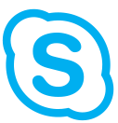



Journey from Skype for Business to Teams
For organizations already using Teams
ROUTE
1
Plan your upgrade to Teams Only
Upgrade to Teams Only
Coexistence
+
1
2
“Islands” mode (side-by-side) when:
Teams Collab or Collab+Meetings when:
Skype for Business Online and most on-premises (recommended path)
Desire to quickly move to Teams
Users can handle two-client setup
More complex organizational environment (on-premises and hybrid)
Expect a long co-existence period
Wish to avoid overlapping UC features
Third-party integration points
Notes:
If your organization is already using Teams alongside Skype for Business, whether in Islands Mode, Skype for Business with Teams collaboration, or Skype for Business with Teams collaboration and meetings, you’re close to making the upgrade to a Teams Only, single-client experience.
Coexistence is the presence of both Skype for Business and Teams in the Journey from Skype for Business to Teams.
Supported coexistence configurations for Skype for Business and Teams
Skype for Business or Teams Only
Skype for Business and Teams – Islands
Combination (but no overlap) of functions across both
Customer deployments can involve multiple modes at different times

Slide 9
Journey from Skype for Business to Teams
For organizations not yet using Teams
ROUTE
2
Envision teamwork for your organization
Pilot Teams
Deploy Teams
Coexistence
Adopt Teams
Plan your upgrade to Teams Only
Upgrade to Teams Only
+
1
2
3
4
5
6
“Islands” mode (side-by-side) when:
Teams Collab or Collab+Meetings when:
Skype for Business Online and most on-premises (recommended path)
Desire to quickly move to Teams
Users can handle two-client setup
More complex organizational environment (on-premises and hybrid)
Expect a long co-existence period
Wish to avoid overlapping UC features
Third-party integration points
Notes:
URL on modes: https://docs.microsoft.com/en-us/microsoftteams/migration-interop-guidance-for-teams-with-skype
If you’re still planning your organization’s journey from Skype for Business to Teams, we’re here to help take the guesswork out of your upgrade journey. We’ve employed a proven success framework for driving change, incorporating guidance, tips, and resources throughout.
Coexistence is the presence of both Skype for Business and Teams in the Journey from Skype for Business to Teams.
Supported coexistence configurations for Skype for Business and Teams
Skype for Business or Teams Only
Skype for Business and Teams – Islands
Combination (but no overlap) of functions across both
Customer deployments can involve multiple modes at different times

Slide 10






Planning for a successful upgrade
A proven framework for driving technical and behavioral change
+
Project Stakeholders
Project Definition
Technical Readiness and User Readiness
Deployment and Implementation
Operational Excellence
Gather the right sponsors and project team
Define your project scope, goals and timeline
Assess network readiness; test for quality
Assess user acceptance and design readiness
Implement pilot, coexist and upgrade strategy
Drive value through optimization and adoption growth
Learn more at aka.ms/SkypeToTeams
Notes:
Enlist your project stakeholders
Any successful project begins by bringing together the right stakeholders: the individuals who have a "stake," or need to be involved in planning and execution. Ensure your upgrade project team includes Executive Sponsors representing Business and IT, as well as designated IT Pro, Admin and User Readiness leads.​
Define your project scope
Taking time to define key project logistics including scope, business goals, success metrics, risks and timeline will help ensure all stakeholders are aligned and working towards the same priority outcomes.
Plan for technical and user readiness
The ideal upgrade approach addresses two critical planning areas: technical readiness and user acceptance.
​By confirming that your environment is set up for success with Teams, you help ensure consistent, high-quality experiences. Through the understanding of your user communities and designing the right readiness plan, you help facilitate the desired behavior change, accelerating adoption and increasing value realization for both users and the organization as a whole.
Implement your upgrade
You have flexibility in how and when you upgrade your organization to Teams. By piloting Teams, running Skype and Teams together in your environment, and then moving users fully to Teams in a manner that best fits your use cases and goals, you ensure the best experience with minimal business disruption for users.
Maximize your long term success
An operations strategy that includes regular network monitoring and user satisfaction measurement is the best way to ensure consistent quality experiences, sustained adoption growth, and maximum business value realization. Ongoing optimization of your environment will ensure you build upon your upgrade success and enable users to explore additional use cases in Teams.

Slide 11

Identify champions and critical stakeholders
Understand the impact of change
Assess impact to the organization, reflect in adoption plan
Build user engagement into your communications plan
Use cases and role-specific benefits help users understand the value of Teams
Pilot before rolling out broadly
Identify early adopters and evangelists to champion deployment and provide feedback
Target users and departments with unique needs and edge-case requirements
Evaluate awareness building, training, and support – iterate based upon feedback and analysis
Focus on driving sustained results
Frequently communicate project progress, to-dos, and next steps
Consider devices as part of your overall strategy, including personal computers, meeting room systems, and peripherals
Notes:
Plan for the human aspect of change as well
Though it’s an obvious statement, for organizations to realize value from Teams, users must actually use it. But getting users to change the way they work isn’t always easy. Taking time to understand your users and design the right readiness plan can help facilitate change and accelerate adoption of Teams.
of awareness, training, and support activities, your readiness plan should address these activities should be completed in parallel with your technical readiness preparation:
Assessing organizational change readiness: This includes understanding who your users are, how they’ll use the new technology, and how readily they adapt to change. This is also an opportunity to identify specific user profiles who would benefit from focused onboarding.
Preparing a user readiness plan: Consisting ss both your broad user base and targeted profiles, as identified in the assessing change readiness article.

Slide 12
Teams upgrade paths.

Slide 13
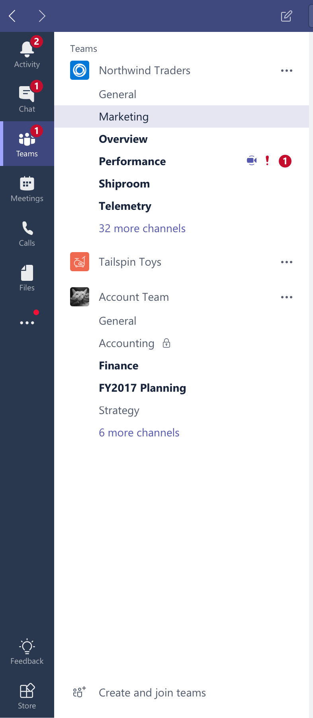
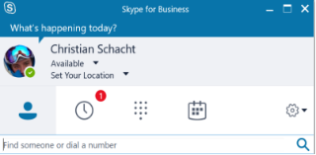

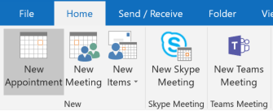

Islands mode: Teams and Skype for Business run side-by-side
  Chat and Calling
    Users can initiate calls and chats from either client
    Incoming VOIP calls and chats land in same client as originator
    Presence is separate
    No interoperability
    Meetings
Users can schedule meetings from either client
Outlook shows both add-ins
End user can join meetings from the respective clients
Skype for Business Online customers should start with Islands mode so users can experience the full functionality of Teams at their speed. Once organization adoption of Teams hits 100% saturation, move to Teams-Only mode.
Notes:
Skype for Business Online customers should start with Islands mode so users can experience the full functionality of Teams at their speed. Once organization adoption of Teams hits 100% saturation, move to Teams-Only mode.

Slide 14
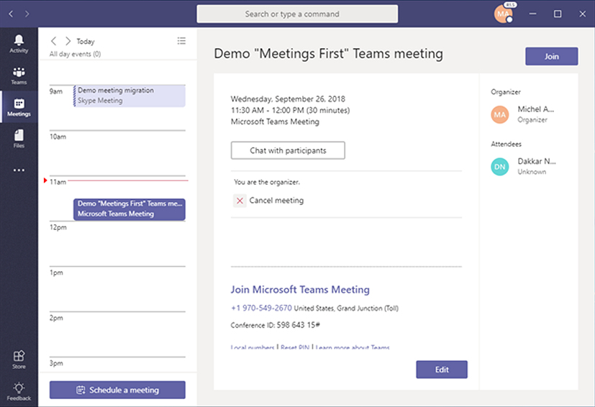
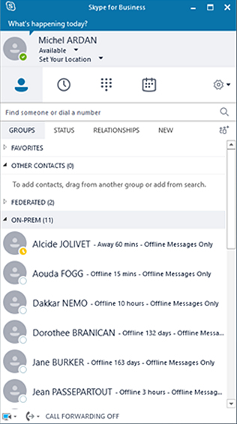
Meetings First: move meetings workload to Teams first
  Skype for Business Server for Chat and Calling
  Address meetings, then Enterprise Voice and Chat
  Simplifies and streamlines a meetings-centric Teams experience
  Teams for Meetings
  Provides richest meetings experience
  Includes meeting rooms, devices, and services (Cloud Video Interoperability)
  Skype and Teams co-exist
  Teams and Skype for Business clients play nice with each other
  Skype for Business meetings are now Teams meetings
  IT benefits include ease with provisioning and reporting in a single location
Notes:
Transitioning meetings workloads first (Meetings First) enables on-premise organizations to benefit from Teams meeting functionality in the event they are not yet ready to move calling to the cloud.

Slide 15
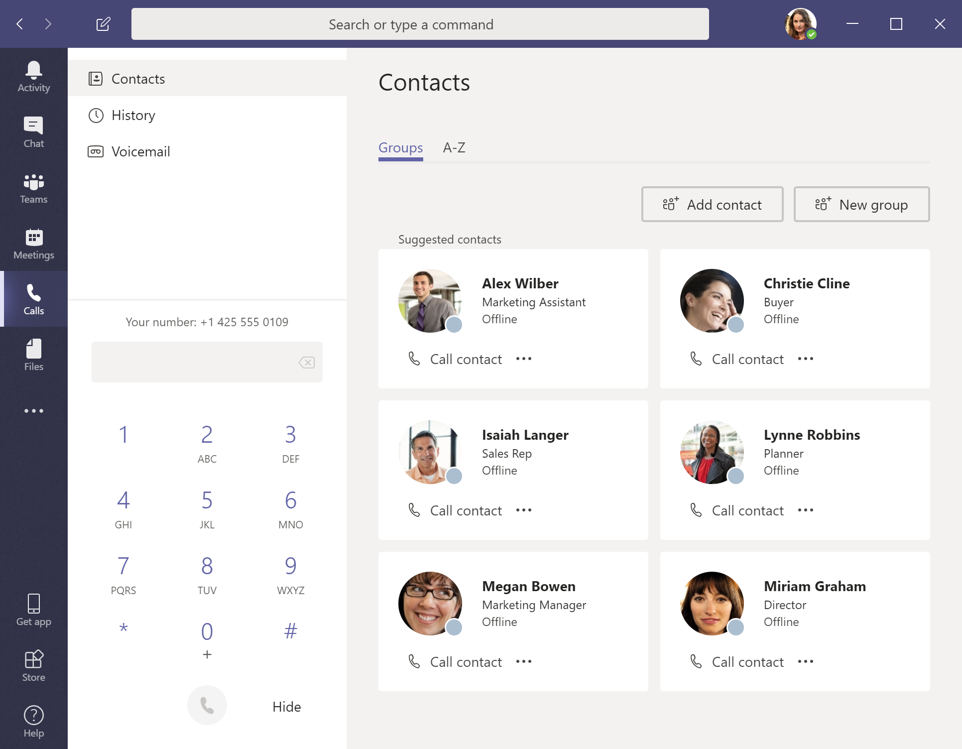
Teams Only mode: Teams is used for everything
  Chat and Calling
    Receive and initiate all chats and calls in Teams
    Interop (IM/call) with any Skype for Business user
    Redirects to Teams if users try to sign in to Skype for Business.
    Meetings
    Newly scheduled meetings take place in Teams
    Previously scheduled Skype for Business meetings still happen in Skype for Business
    Data that gets migrated
    Existing contacts from Skype for Business including federated
    Existing meetings
Notes:
In Teams Only mode, teams is used for everything, from Chat and Calling to Meetings, to Collaboration in Teams and Channels.

Slide 16
Upgrade support.

Slide 17
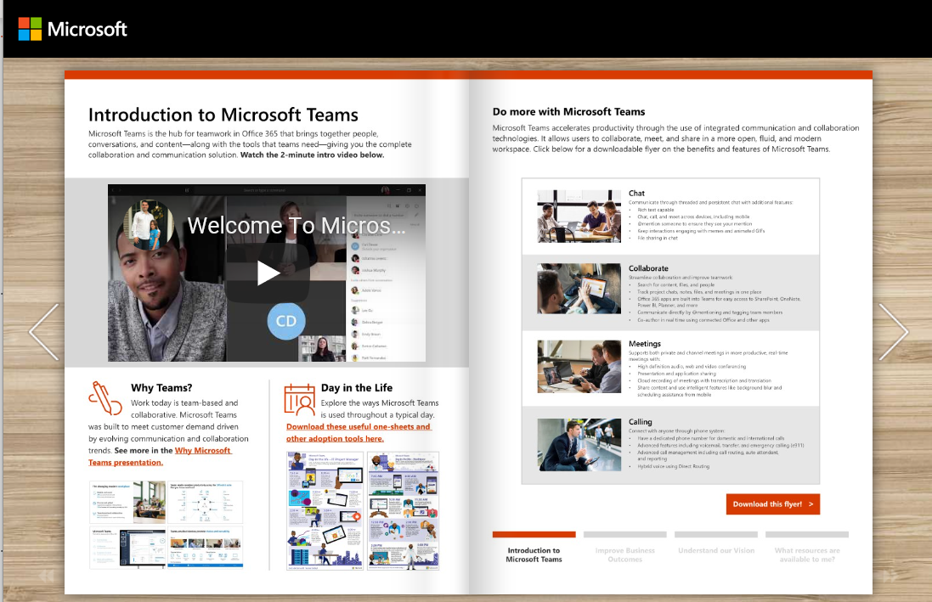
Upgrade Guidance
Teams adoption and upgrade support
Programs and resources to enable your success
Start planning your upgrade
aka.ms/SkypeToTeams
  Upgrade planning and guidance from Microsoft
    Microsoft will help you design a strategic plan based upon a proven change management framework and the specific needs of your organization¹
    Access upgrade tools, guidance, planning workshops, blocker mitigation, and monitoring
    We’re here to help you with your upgrade
Teams Training
Learn with free, live, online training
aka.ms/TeamsLiveTraining
Teams Roadmap
  Teams Adoption Toolkit
Understand business outcomes, best practices and real-world use cases for Teams
Download assets to onboard your Helpdesk
Evaluate your needs relative to Teams capabilities and timing
aka.ms/TeamsRoadmap
Teams Knowledge
Explore technical documentation, rollout and adoption resources
aka.ms/TeamsToolkit
aka.ms/SuccessWithTeams
¹ All customers have access to online tools and training. FastTrack-led engagements available for qualifying customers.

Slide 18

Let’s plan your journey.

Slide 19
Thank you!

Slide 20
Additional resources.

Slide 21



Additional Teams upgrade resources
Plan your journey to Teams with our guidance, training, and resources
Onboard users and begin using Teams to explore the possibilities for your organization
Drive Teams adoption for collaboration, meetings, and calling
Fully upgrade to Teams and accelerate business value realization
  Upgrade Guidance
  aka.ms/SkypeToTeams
  Skype to Teams Upgrade – Get Started
  docs.microsoft.com/en-us/MicrosoftTeams/upgrade-start-here
  Upgrade Success Kit
aka.ms/UpgradeSuccessKit
  Teams Upgrade FAQ
  aka.ms/SkypeToTeams-FAQ
  Coffee in the Cloud Skype to Teams Overview Videos
  youtube.com/watch?v=lAoqEG777d8
  Instructor-Led Teams Training
  aka.ms/TeamsLiveTraining
  On-Demand Teams Training for Admins
  docs.microsoft.com/en-us/microsoftteams/itadmin-readiness
  On-Demand Teams Training for End Users
  docs.microsoft.com/en-us/microsoftteams/enduser-training
  Teams Success Kit
aka.ms/TeamsSuccessKit
Teams Adoption Guide
aka.ms/TeamsToolkit
  Drive Operational Excellence with Teams
aka.ms/SkypeToTeams-Operate
Tech Community Teams Blog
techcommunity.microsoft.com/t5/Microsoft-Teams-Blog/bg-p/MicrosoftTeamsBlog

