Slide 1
Modernize sales productivity Unlock productivity in the digital era

Slide 2
Cost of distraction
Age of distraction
59%
59% of sellers say they have too many sales tools¹
14%
50%
50% of workers don’t know what’s expected of them²
Distractions reduce seller’s performance by 14%¹
64%
% of time spend on non-selling activities³
¹ Accenture
² Gallup
³ Pace Productivity
Notes:
One of the consequences of living in the digital era is that we are bombarded with information, short on attention, and driven to distraction. And sellers are not immune. They have to navigate data, processes, and tools while making sense of conflicting or unclear expectations. In fact, 59% of sellers say they have too many sales tools, and 50% of workers don’t know what’s expected of them. And non-selling activities consume 64% of a seller’s time, leaving only 36% of their time for selling. According to Accenture’s analysis, distractions reduce sellers’ performance by 14%, a significant cost to organizations.

Slide 3
And there’s more complexity
External
Internal
10
97%
60%
70%
# of people involved in a purchase decision¹
Buying decision took 97% longer than expected²
Companies lacking a well-defined sales process³
Likelihood that workers will spend more time on collaboration platforms⁴
¹ Gartner
² Gartner
³ TOPO
⁴ Deloitte
Notes:
In addition to distractions, sellers face increasing complexity in today’s sales environment. Sellers have to juggle an average of 10 stakeholders for every purchase decision. It’s no wonder the buying decisions took 97% longer than expected. Yet 60% of companies lack a well-defined process, further contributing to the long sales cycles. In addition, the need to work with different functions and people requires more collaboration, adding to the complexity of the sales process.
What can sales leaders do to drive sales productivity in an environment filled with distractions and complexity?

Slide 4
A simple way to modernize sales productivity
Easy setup
Familiar user experience
+
Anywhere, anytime access
Office 365
Dynamics 365
Flexible and extensible platform
Insights and analytics
Notes:
Slide:
Modernize sales productivity with a SFA solution that helps sellers do less, not more. Dynamics 365 for Sales Professional works seamlessly with Office 365 so sellers can easily and intuitively manage customer relationships and close deals using the tools they already have.
Speaker notes:
The way to achieve sales productivity in the modern environment is not to give sellers more disconnected tools. As we saw earlier, sellers already feel they have too many disjointed tools. What they need are solutions that work with tools they are already comfortable and familiar with. This way, sellers can gain new capabilities without the burden and distractions that come with adding new, dis-connected tools - time wasted in training, ramping up, reconciling data between systems, entering duplicate data in multiple systems, and flipping back and forth between tools.
Microsoft helps SMB organizations modernize sales productivity with a streamlined SFA solution that enables sellers to do less, not more. Dynamics 365 for Sales Professional works seamlessly with Office 365 so sellers can easily and intuitively manage customer relationships and close deals using the tools they already have.

Slide 5
Modernize sales productivity
Focus on what’s most important
Streamline seller workflows
Do less, not more
Start with what you need
Notes:
Microsoft Dynamics 365 helps organizations modernize sales productivity in the face of these challenges. With Dynamics 365, sellers can do less, not more:
By focusing on what’s most important
With streamlined workflows
With sales tools tailored to just what they need
As a result, sellers can overcome the distractions and complexity to regain focus and sales momentum.

Slide 6
Focus on what's most important
Tailor interactions with customers
Get guidance toward optimal outcomes
Get actionable insights to increase performance
Notes:
Focus on what’s important
Let’s take a look at how Dynamics 365 helps sellers focus on what’s most important.
1) Tailor interactions with customers (see embedded video play automatically in presentation mode)
As sellers juggle an increasing number of stakeholders, it gets harder to tailor and personalize interactions. Working seamlessly with Outlook, Dynamics 365 for Sales Professional provides a holistic, 360-degree view of the customer’s interactions across the company and sales activities. Without switching apps, sellers have the context, knowledge and status needed to personalize every interaction with buyers.
Dynamics 365 app for Outlook surfaces customer engagement records, sales insights and alerts from within Outlook on the desktop, web or phone.
2) Get guidance toward optimal outcomes (see embedded video play automatically in presentation mode)
To prevent distractions, organizations need to narrow down the optimal choices for sellers. With Dynamics 365, sellers get guidance toward optimal outcomes while working in Dynamics 365 for Sales Professional, Outlook, or, as shown, within Microsoft Teams. Directly inside the sales records they are working on, sellers see the specific steps needed to move the deal forward, helping to close deals faster.
Dynamics 365 app for Microsoft Teams enables a business group to easily work with Dynamics 365 customer information and share files directly from Microsoft Teams. This helps them to be more productive and get the business done more effectively.
3) Get actionable insights to increase performance (see embedded video play automatically in presentation mode)
Many sellers are unclear of what’s expected of them. Is it just to close deals? Is it to build pipeline? Is it to acquire new customers, or retain existing customers? Frequently, goals conflict, creating distractions for sellers. Dynamics 365 provides contextual, real-time dashboards for sellers and leaders so the entire sales team knows what metrics to focus on and can take coordinated action toward the organization’s specific goals.
The Dynamics 365 app for Teams allows sales teams to access interactive dashboards from Microsoft Teams, without needing to switch between apps. This helps them to be more productive and get the business done more effectively.

Slide 7
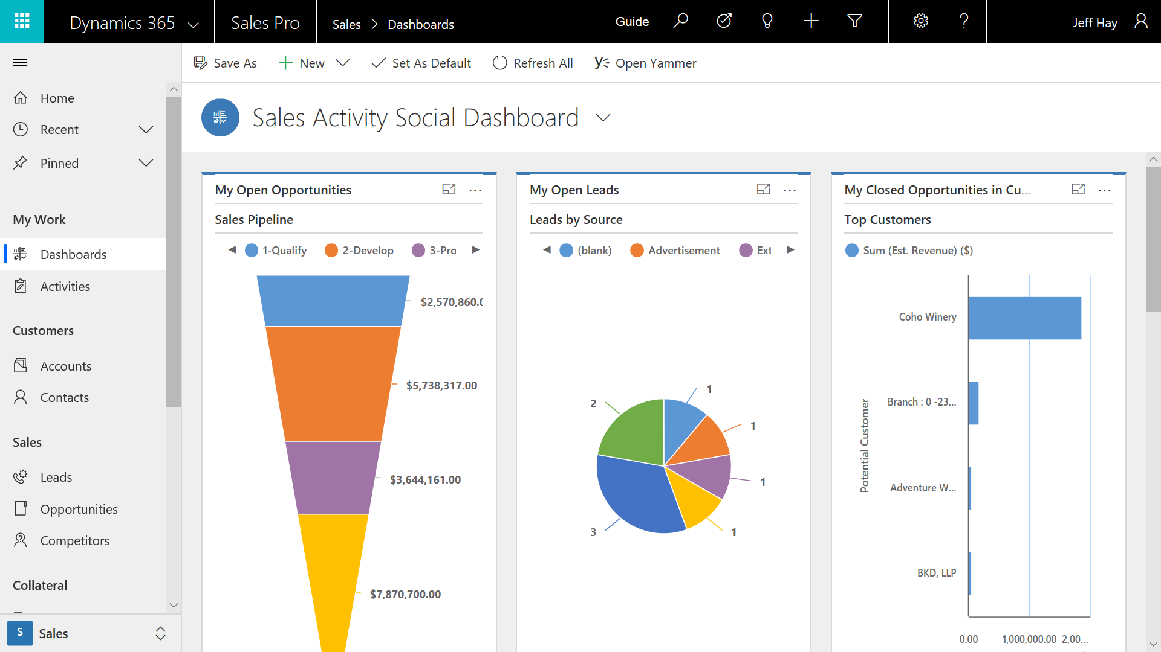
Streamline seller workflows
Collaborate on deals in
a modern workspace
Create, edit, and share sales documents
Work on the go with mobile application
Notes:
Streamline seller workflows
Next let’s take a look at how Dynamics 365 streamlines seller workflows.
1) Collaborate on deals in a modern workspace (see embedded video play automatically in presentation mode)
Sellers and sales managers can collaborate on deals across functions and geography with customer information and document sharing directly from Microsoft Teams—the hub for team collaboration.
The Dynamics 365 app for Teams embeds Dynamics 365 customer records, sales content, reports and updates—all within a modern hub for chat, meetings, notes and documents. For example, teams can share a sales presentation, then easily schedule a review meeting or chat with a few clicks, without switching applications.
2) Create and share sales documents (see embedded video play automatically in presentation mode)
Dynamics 365 app for Teams allows users to store and access sales documents in one place, right within Microsoft Teams. Sellers can collaborate and personalize sales documents with embedded Office 365 tools that fit the way sellers work, all in one place.
3) Work on the go (see embedded video play automatically in presentation mode)
Today’s sellers work on the go. Modern sales tools need to support this contemporary mode of work.
Dynamics 365 enables sellers to work anytime, anywhere with the mobile application across web, smartphone, and tablet. Sellers stay productive with mobile-optimized capabilities like voice-enabled commands, contextual news, and task flows that make it quick to conduct sales activities while on the road.

Slide 8
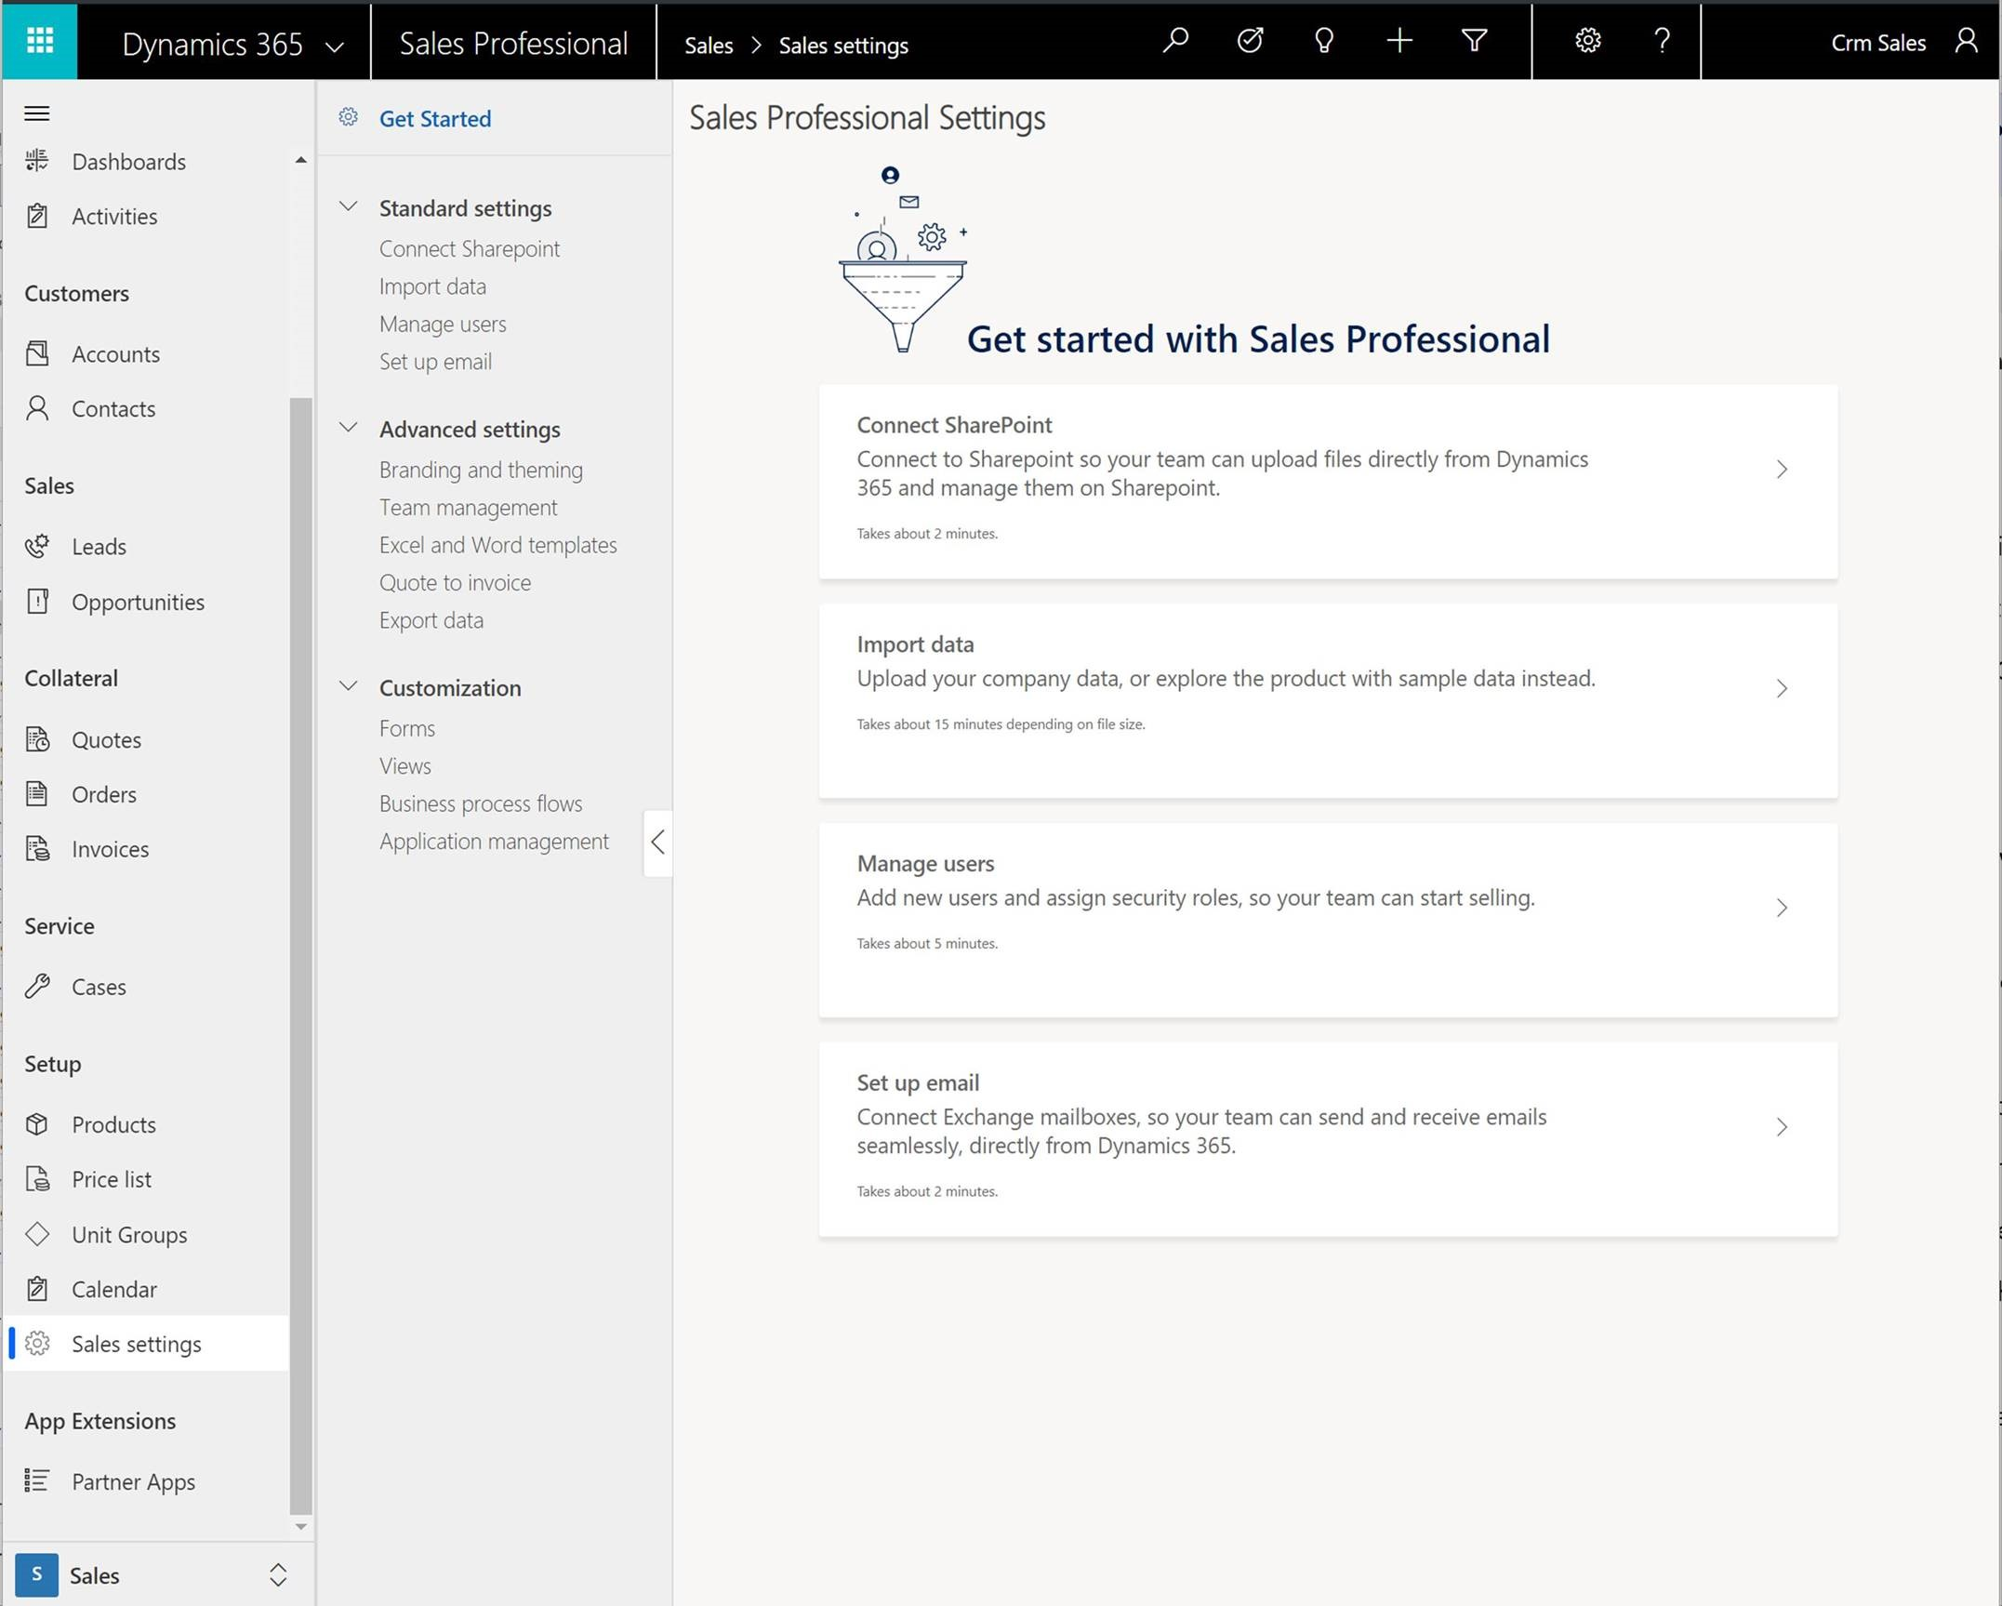
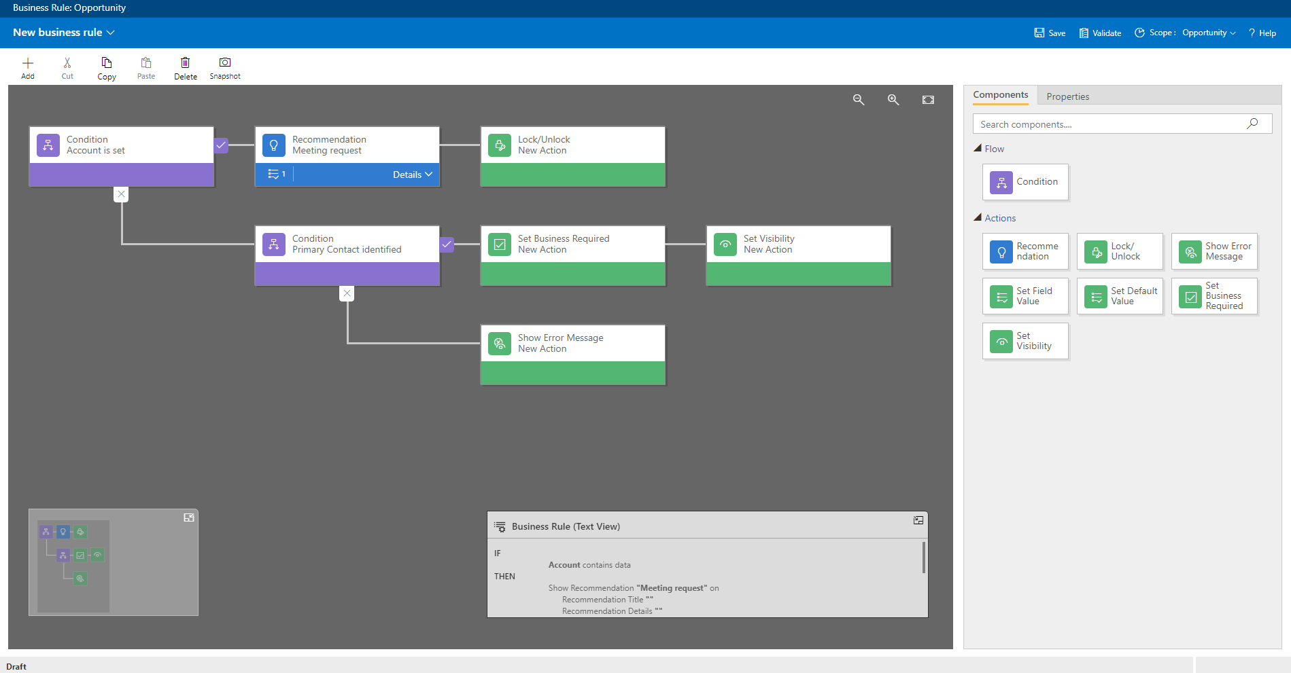
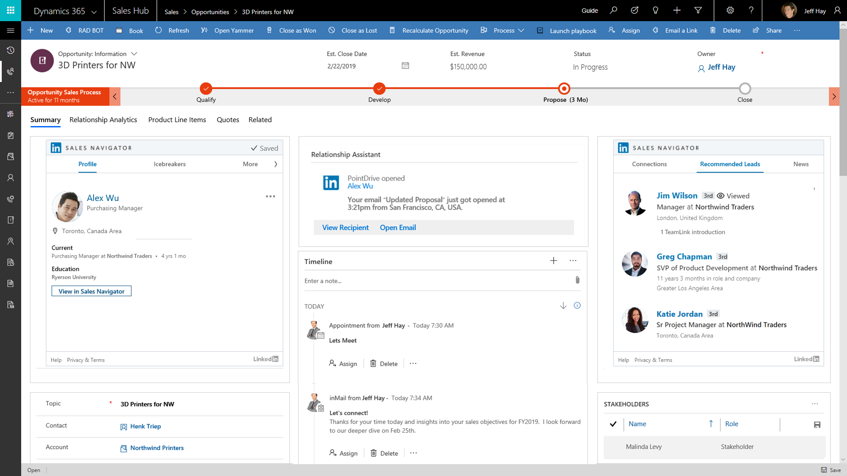
Start with what you need
Get up and running quickly
Configure the application for your specific sales processes
Count on a platform that grows with your business
Notes:
With Dynamics 365, you can start simple – with just the capabilities your sales teams need now – and support additional business needs as the business grows. A pre-package application with role-based set-up and easy configuration lets you get up and running quickly, without the need to spend extra time and money setting up and deploying capabilities you don’t need right now. You can also configure the sales application for your specific sales processes, without technical resources. With Dynamics 365, you can count on a platform that meets your needs today and scales and adapts to your needs in the future. When your sales organization is ready, you can add more advanced capabilities in sales and beyond, from predictive lead scoring to LinkedIn to marketing to customer service.

Slide 9
Microsoft – a leader in seller productivity
Forrester Wave: Sales Force Automation Solutions
“Dynamics 365 brought a heightened focus on seller productivity, with deep integrations into Office 365 and Outlook.”
“Microsoft delivers on intelligent seller productivity.”
“Microsoft is a best fit for companies looking to capitalize on the productivity gains of their other Microsoft cloud investments, namely Office 365, and those companies that are bullish and looking to disrupt their peers with AI and machine learning.”
The Forrester Wave™ is copyrighted by Forrester Research, Inc. Forrester and Forrester Wave™ are trademarks of Forrester Research, Inc. The Forrester Wave™ is a graphical representation of Forrester's call on a market and is plotted using a detailed spreadsheet with exposed scores, weightings, and comments. Forrester does not endorse any vendor, product, or service depicted in the Forrester Wave. Information is based on best available resources. Opinions reflect judgment at the time and are subject to change.
Notes:
Forrester positions Microsoft as a Leader in their new Forrester Wave: Sales Force Automation Solutions. Forrester stressed in the report that today’s solutions focus on productivity AND seller empowerment.
The report placed Microsoft in the LEADER ripple, tied at the top for “current offering” combined with a perfect score on product vision in the “strategy” section. It is important to note that Microsoft leads all vendors in product vision as well. Microsoft received perfect scores in six different categories, the most among companies in the report. In addition to the strong placement, the write-up puts an emphasis on Dynamics 365’s strength in productivity and intelligence. Forrester concludes: "Microsoft is a best fit for companies looking to capitalize on the productivity gains of their other Microsoft cloud investments, namely Office 365, and those companies that are bullish and looking to disrupt their peers with AI and machine learning."

Slide 10
“As an organization we need to evolve and transform our operations so we are best placed to take all of the goodness that we offer and distribute it to those most in need.”
Aldo Travia, Executive Manager Information Services, Wesley Mission
Equip staff to deliver more compassionate care with secure client information and data
Automate reporting and measurement processes to understand clients better and allocate resources accordingly
Ramp up quickly, focus on the business, and streamline business processes
Notes:
There are many organizations which put their customers first; but it takes on a more critical meaning at Wesley Mission. With over 2,000 staff, 4,000 volunteers and dozens of services offered for people struggling with homelessness, addiction, mental health, and financial and domestic challenges, keeping the needs of clients front and center is critically important – but no mean feat.
Wesley Mission is not guided by profits, but it does exist to help and support as many people as it can. As such – it is faced with the same challenges facing businesses, ensuring that the most number of people have access to its services.
Dynamics 365 for Sales has enabled Wesley Mission to help and support as many people as possible:
Equip staff to deliver more compassionate care with secure client information and data
Automate reporting and measurement processes to understand clients better and allocate resources accordingly
Ramp up quickly, focus on the business, and streamline business processes
https://customers.microsoft.com/en-us/story/wesley-mission-nonprofit-dynamics-365

Slide 11
“Partnering with Microsoft and adopting all of the new innovations that have come out has made our jobs so much easier.”
Rick Spielman: Executive Vice President & General Manager, Minnesota Vikings
Simplify process of video reviews, report creation, and sales proposal generation with a mobile cloud-based solution.
Collaborate anywhere with Microsoft Office 365
Gain greater visibility into sales operations and reveal new opportunities for business growth
Notes:
A lot has changed since the Minnesota Vikings played their first season in 1961. But one thing stays constant—when the team hits the field, they do it as a cohesive unit, always putting the team ahead of the individual. The Minnesota Vikings devote tremendous effort toward taking care of fans and recruiting the most qualified talent. Processes like college scouting, which require reviewing countless hours of video footage, can be long and arduous.
Dynamics 365 for Sales has enabled the Minnesota Vikings to keep the ball rolling by:
Simplifying the process of video reviews, report creation, and sales proposal generation with a mobile cloud-based solution.
Collaborating anywhere with Microsoft Office 365
Gaining greater visibility into sales operations and reveal new opportunities for business growth
https://customers.microsoft.com/en-us/story/vikings-sports-azure-d365-surface

Slide 12
“I was able to use CRM’s workflows and business rules to create a tool for our sales team that adds value by making it easier for them to do their job.”
Tom Faillace Senior IT Generalist, Luck Companies
Deployed Microsoft Dynamics 365 and Office 365 to boost sales productivity and track sales performance
Each seller and sales leader saved approximately 3 hours per week with the solution
Achieved ROI of 308% and payback in 7.2 months
Notes:
Virginia-based Luck Stone is one of the largest providers of crushed stone, sand, and gravel in the US. After restructuring its sales strategy around a customer-centric model, Luck Stone deployed Microsoft Dynamics 365 to give its sales team the tools they needed to succeed. Deploying Dynamics 365 kicked off a transformation that improved data capture, increased productivity, and improved sales performance. Luck Stone further improved sales effectiveness by linking Dynamics 365 to Microsoft Office 365 and Microsoft Power BI, which lets the sales staff communicate, collaborate, and view sales dashboards from within Dynamics 365.
With Dynamics 365 for Sales, each seller and sales leader saved approximately 3 hours per week with the solution, and the organization achieved ROI of 308% and payback in 7.2 months.
https://customers.microsoft.com/en-us/story/luckstone

Slide 13
Learn how to modernize sales productivity with Dynamics 365 for Sales
Watch how customers are modernizing sales productivity with Dynamics 365
Dive in and learn more about the latest capabilities here
Visit the website to learn more

Slide 14
Thank you

Slide 15
Appendix

Slide 16
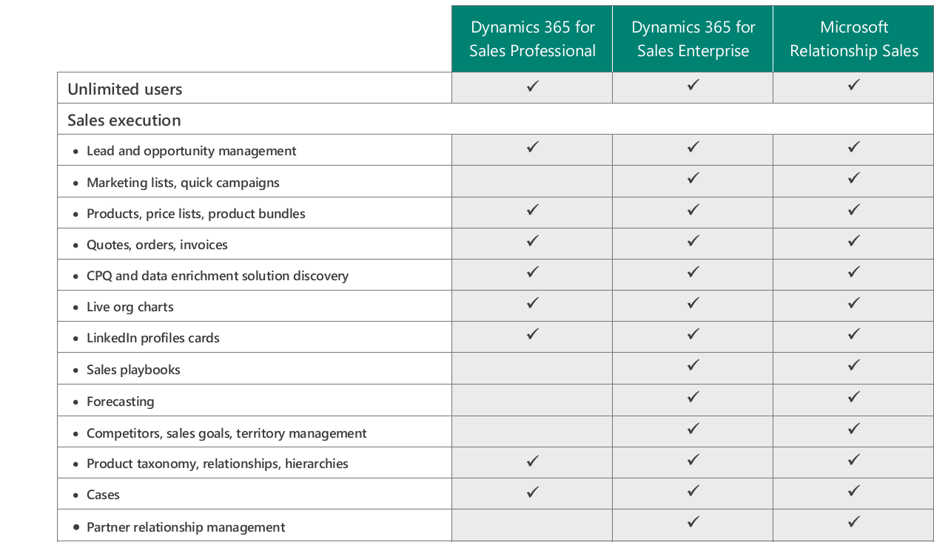
Professional & Enterprise comparison

Slide 17
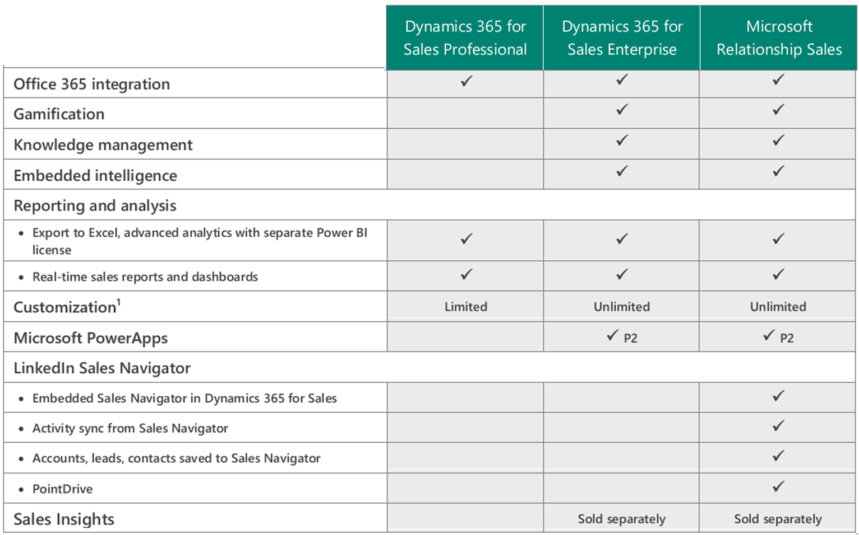
Professional & Enterprise comparison

