Slide 1
How to Sell D365 Sales
…and why your customers want this
Capture the Cloud
April 20, 2021

Slide 2
SYNNEX STELLR
SYNNEX STELLR
Who am I
SLIDE TITLE
INTRODUCTION
…an introduction
Blake Cheek – D365 Design Sales Engineer
Licensing expert and D365 evangelist
Decades of experience in customer service, technical support, and sales for SMB and enterprise customers
Dynamics is my passion! Your success = my success

Slide 3
SYNNEX STELLR
The CRM Advantage
What are the Benefits of CRM?
Improve Customer Service
Increase Sales
Retain More Customers
Better Analytics
Higher Efficiency
Better Knowledge Management
More Transparency
The CRM Advantage

Slide 4
CRM: Fast Facts
Multi-Billion Dollar Industry
Double Digit YoY Growth
Triple Digit ROI
Increased Revenue/Decreased Overhead
There are a lot of choices. The landscape can be confusing.

Slide 5
SYNNEX STELLR
Dynamics from 30,000 feet
A high level overview
Dynamics isn’t just one product; it is a product line!
The Dynamics product line can generally be divided into two categories:
Customer Relationship Management (CRM)
Sales, Customer Service, Marketing, Field Service, etc.
Enterprise Resource Planning (ERP)
Finance, Supply Chain Management (SCM), Human Resources, Business Central, etc.
It is very modular. Build the solution that you need!
Runs on Azure for unparalleled security and seamless integration with Microsoft Office 365.
OVERVIEW

Slide 6
SYNNEX STELLR
Why D365 Sales?
Why CRM gets me excited and why it just makes sense.
A good CRM system helps businesses stay in touch with their customers better, provide better experiences, and sell more.
The best tools for any business are the ones that provide a positive ROI.
The best tools are simple and easy to use.
D365 Sales provides native integration into your Microsoft ecosystem.
D365 Sales also seamlessly integrates with other Dynamics products such as Customer Service, Marketing, and Business Central to provide a complete solution without searching out multiple software vendors or researching compatibility.
WHY D365 SALES

Slide 7
SYNNEX STELLR
The D365 Advantage
What are the benefits of Dynamics 365?
Office Integration
Word, Excel, Teams, etc.
Actionable Insights
Customer Service Insights, Customer Voice, Power BI
Secure
Built on the security of Microsoft Azure, role-based security, MFA
Flexible/Scalable
Start small and grow
The Microsoft Advantage
Investment in growth, updates, and success
The D365 Advantage

Slide 8
SYNNEX STELLR
SYNNEX STELLR
Why SYNNEX for D365?
We have a dedicated Dynamics team to help answer product and licensing questions.
Our Dynamics team stays up-to-date on the latest in-market promotions.
We are the D365 licensing experts.
Not sure what D365 SKU your customer needs? No problem. We are here to help!
Why SYNNEX for D365

Slide 9
SYNNEX STELLR
D365 In A Box
All you need to close a D365 Deal
When you choose P2P, you choose simplicity:
YOU:
Identify and prequalify opportunities (BANT)
SYNNEX/Azamba will:
Validate the opportunity and help you close the deal
Implement the project professionally with the highest degree of customer satisfaction
Provide training and support to the end users
YOU:
Collect licensing revenue
Get N% of implementation (services) revenue as an incentive to go P2P
KEEP AND MAINTAIN THE EXISTING CLIENT RELATIONSHIP
D365 In a Box

Slide 10
SYNNEX STELLR
FY21 Partner Incentives
How to earn back-end rebates and other
co-op dollars
Indirect Resellers can receive, on top of their SYNNEX margin, rebate dollars and co-op funds for qualifying D365 SKUs
~14.75% total back end for D365 Sales Professional & Power Apps
~9.75% total back end for Dynamics Business Central
Earnings are split 60% rebate & 40% co-op
Visit https://aka.ms/partnerincentives to learn more
Partner Incentives

Slide 11
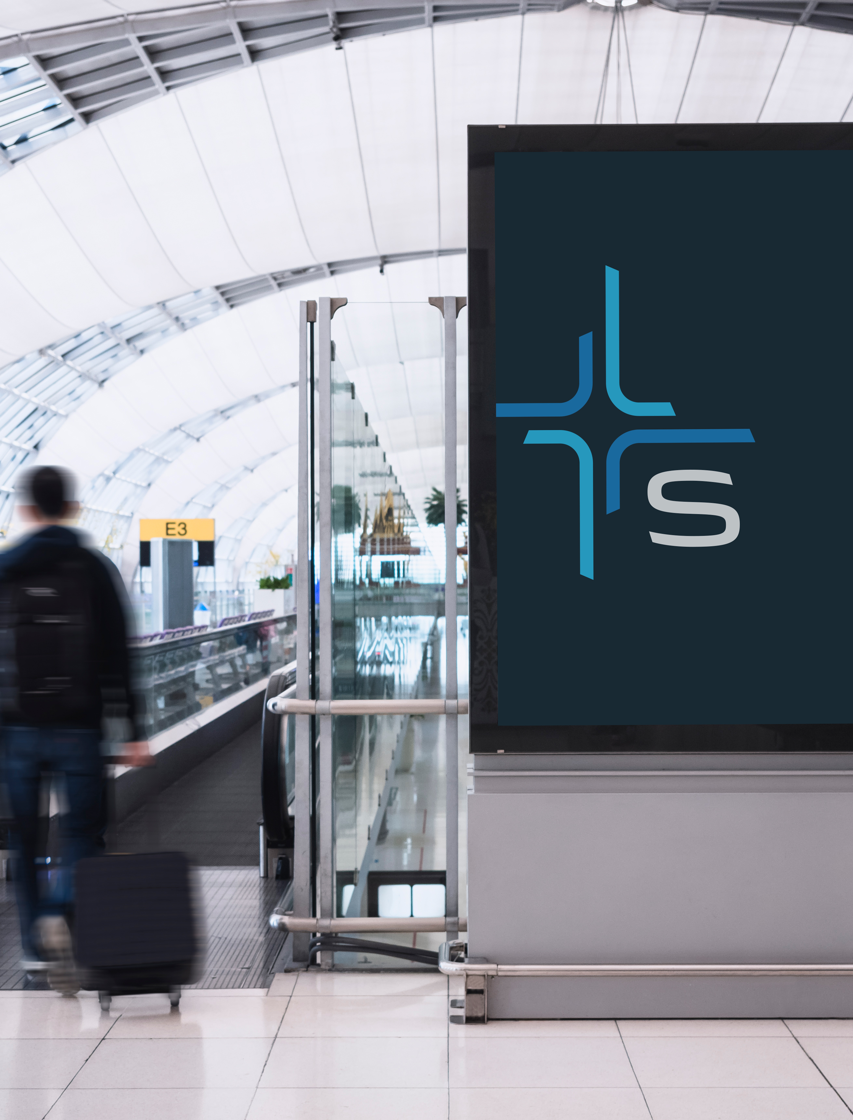
SYNNEX STELLR
SYNNEX STELLR
Let’s Recap
Microsoft Dynamics is your next big bet.
There’s a huge opportunity to capture additional revenue
ASK/LISTEN for potential D365 opportunities (QuickBooks, need for a CRM solution, etc.)
SYNNEX is your Dynamics partner.
Let us be your experts
We making selling D365 easy
Let us help you win and close more deals
We have D365 Services partners to help seal the deal.
You don’t have the be the expert if you leverage SYNNEX
SLIDE TITLE
Recap

Slide 12
Contact
Your SYNNEX Account Manager or ISR (if you don’t have a SYNNEX AM)
-or-
Blake Cheek – blakec@synnex.com
Don’t forget to follow me on LinkedIn: linkedin.com/in/blakecheek

Slide 13
https://aka.ms/d365sales/salestools
Want some incredible collateral?
SLIDE TITLE

Slide 14
SLIDE TITLE
Thank You

