Slide 1
MICROSOFT DYNAMICS 365
Business Central
Partner strategy and programs overview
Notes:
This module…..insert language

Slide 2
86% of CEOs consider Digital their #1 priority
CEOs believe technology will transform their business more than any other global trend
Source: PWC CEO Survey
1
Digital services are transforming customer engagement
2 Billion
active social
media accounts
3 Billion
active Internet users
2
Every employee can and
should be more empowered
2.4 Billion
smart devices
by 2018
80 Billion
connected IoT devices by 2025 from 11 billion today
3
The Internet of Things
cannot be ignored
4
Customer experience will
eclipse product and price
Within 10 years, we will see the number
of devices connected to Internet jump to 152K/Minute vs 4,800 today.
5
Customer engagement is
an ongoing commitment
Notes:
The statement that the “Customer is King” is older than most of us have been alive. But in years past, we didn’t always know our and had to guess about what they want, how they’ll react and what they’ll buy . Today, we know things about our customers even before they do. And that means we, collectively, must transform our businesses to be more valuable to our business customers. Consider these 5 points:
1.1. 2 billion active social media accounts
3 billion active Internet users
2.4 billion smart devices by 2018
80 billion connected IoT devices by 2025 from 11 billion today (IDC)
Within 10 years, we will see # of devices connected to Internet jump to 152k/MINUTE vs 4,800 today.
Source: http://www.forbes.com/sites/michaelkanellos/2016/03/03/152000-smart-devices-every-minute-in-2025-idc-outlines-the-future-of-smart-things/#30565b369a71

Slide 3
SMB / Dynamics 365 Business Central addressable market
CAGR over 4 years between 21% and 24%
SMB Market Opportunity
FY19 SMB SaaS Opportunity
$10.5B
Notes:
http://www.marketsandmarkets.com/PressReleases/project-portfolio-management-software.asp

Slide 4

“Our industry does not respect tradition,
it only respects innovation”
Satya Nadella
CEO, Microsoft

Slide 5
Digital transformation
Engage your customers
Empower your employees
Transform your products
Optimize your operations
Notes:
Let’s talk about digital transformation. Digital transformation is not simply about technology—it’s a business strategy that requires leaders to re-envision existing business models and embrace a different way of bringing together people, data, and processes to create value for their customers and capture new opportunities for their organizations.
Digital transformation means re-envisioning how you:
Engage your customers
Empower your employees
Optimize your operations
And Transform your products
To enable digital transformation strategies – so organizations can grow, evolve and meet the changing needs of customers, as well as capture new business opportunities, companies need intelligent business applications… and that’s where Microsoft Dynamics 365 comes in.

Slide 6



Microsoft Dynamics 365 Business Central
Intelligent business applications in the cloud
Microsoft AppSource
Power BI
Cortana
Intelligence
MICROSOFT DYNAMICS 365
Business Central
Azure IoT
Common application platform: PowerApps, Microsoft Flow, Common Data Service
Multiple deployment options: On-premise, Hybrid, Cloud
Notes:
Dynamics 365 Business Central is Microsoft’s next generation of intelligent business applications in the cloud.
What makes Dynamics 365 unique is that it harnesses the power of One Microsoft.
Deep integration between Dynamics 365 and Office 365 brings together the two worlds of business process and personal productivity. We surface familiar tools like Excel and Word within the context of business processes, significantly increasing productivity and decreasing context switching.
Power BI and Cortana Intelligence are natively embedded into Dynamics 365 business applications for predictive insights, prescriptive advice and actionable next steps. Additionally, Azure IoT brings device data to enable preemptive action in business functions like field service.
Businesses can also adapt and innovate in real-time with a common data model and an extensible business application platform, including PowerApps, Flow and Power BI Embedded.
We have also introduced Microsoft AppSource so business users to easily find and evaluate line of business SaaS applications from Microsoft and our partners, across Dynamics 365, Office 365, Cortana Intelligence and the Azure platform.

Slide 7
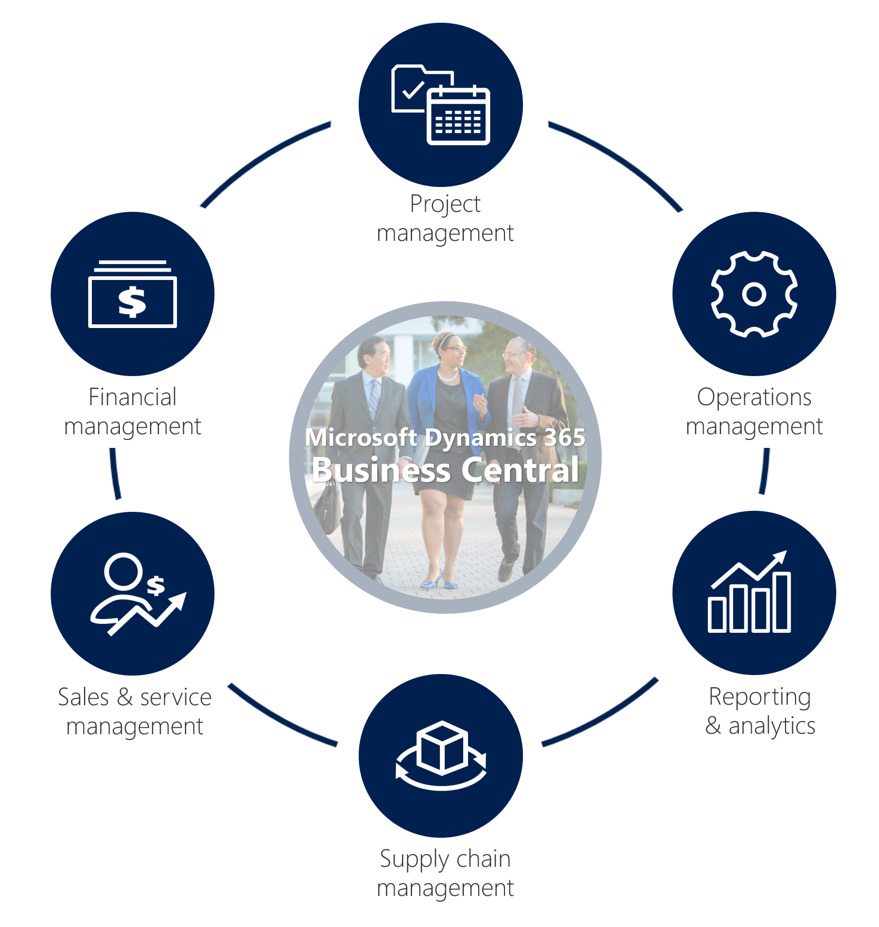








Dynamics 365 Business Central
Project
management
Microsoft Dynamics 365
Business Central
Financial
management
Operations
management
Sales & service
management
Reporting
& analytics
Supply chain
management

Slide 8



Dynamics 365 Business Central
Connect your business
Make smarter decisions
Start and grow easily

Slide 9
Product evolution
Fall 2017
Spring 2018
Fall 2018
Dynamics 365
for Financials,
Business edition
Dynamics 365 for
Financial and Operations,
Business edition
Dynamics 365 for
Finance and Operations,
Business edition
Dynamics 365
Business Central
Dynamics 365 Business Central (Cloud)
Dynamics 365
Business Central
Dynamics 365
Business Central
Dynamics NAV 2016
Dynamics NAV 2017
Dynamics NAV 2018
Dynamics NAV 2018
updates
Dynamics 365 Business Central
(on-premises/hosted)

Slide 10





What’s top of mind for business leaders?
Finance
Sales
Marketing
IT
Real-time
business insights
Focus on customers, not technology
Personalized and relevant offers
Technology for
business growth
My team has to use many different tools to accomplish daily administrative tasks
We need simple and intelligent tools to focus more on the customer and the business
I need the insights to react quickly to changes and new opportunities
I need a cost-effective, easy-to-deploy and easy-to-scale solution

Slide 11




6 key benefits of Dynamics 365 Business Central
Simplifies
financial management and analysis
Empowers employees to
provide outstanding service
Unifies
business
processes
across channels
Company Dashboard
$
Stores
Web
Mobile
0
1
1
0
1
0
0
1
0
1
0
1
0
1
0
1
0
1
0
1
0
1
0
1
0
0
1
0
0
0
1
0
0
0
1
0
0
0
1
0
0
0
0
1
0
1
0
0
1
0
1
0
1
0
1
Call
Center
Social
0
1
0
0
1
1
0
1
Integrates
supply
chain management
Streamline
daily
operations
Strengthens inventory management and purchasing
Business Central
Inventory analytics
My tasks
Welcome
Inventory
Orders

Slide 12

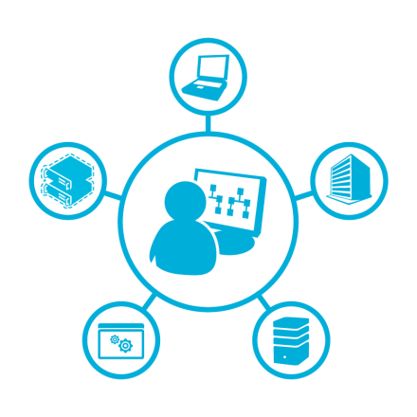

Dynamics 365 Business Central
Why is it different?
End-to-End Solution for Small and Midsize Businesses
Easy and faster deployment than other
ERP Systems
Consistent and secure experience across Windows, iOS and Android
Ability to connect with ERP and Financial tools already in place
Great
user experience
and deep integration
with Office 365
Business insights through analytics
Integrating with other Apps in Eco-system
Modern
Intelligent
Unified
Adaptable
Powered by the Microsoft Cloud

Slide 13
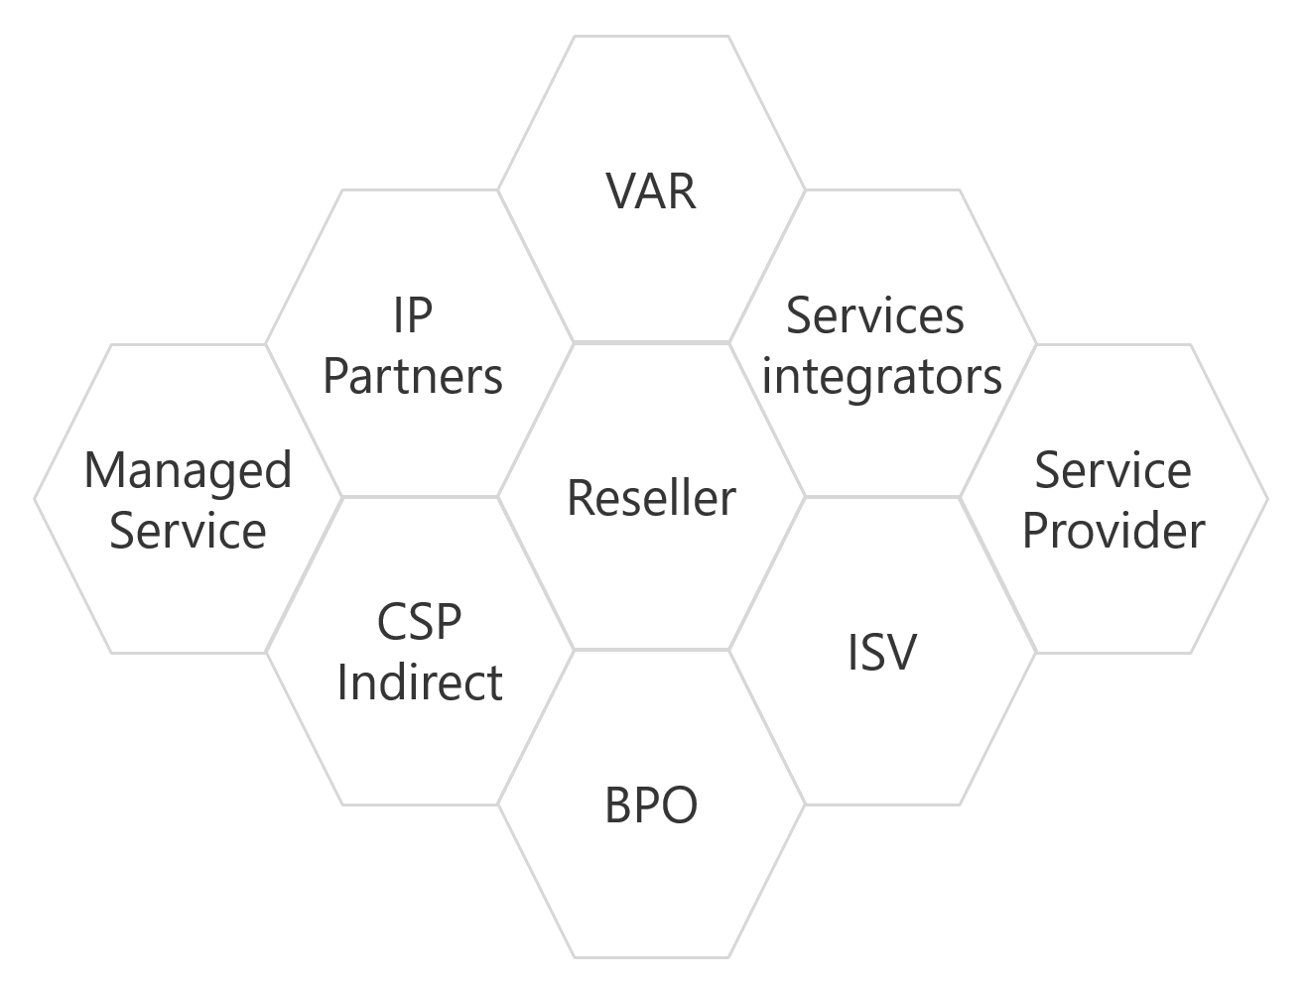
The expanding and evolving channel
MICROSOFT DYNAMICS 365
Business Central
Partner
VAR
Moving beyond core industry focus
IP
Partners
Services
integrators
Expanding Operating Models
Managed
Service
Reseller
Service
Provider
CSP
Indirect
ISV
Expanding across multiple Business Apps
BPO
Enhanced value through partnerships
Innovation
Economics
Expertise
Partnering
Customer success
Our foundation for your success
Notes:
Many Dynamics Partners (in the past) have been always focused on particular industries/domains and have been identified either as Sis’, or ISV’s, or Resellers or providers of “Managed Services”
This slide completes the transition from the previous slide and illustrates the ongoing changes in the partner eco system, where many Partners are expanding their classic business to take advantage of the possibilities of the Microsoft Cloud and Dynamics 365.
Example: Elements like AppSource are now enabling SI’s to better capture their IP and provide it to other partners as a “productized” offering (App) – and as Licensing got simplified Partners can now sell and deliver solutions to their customers and generate additional revenue streams by allowing other partners to take advantage of their learnings and IP via AppSource.
It allows Partners to:
Moving beyond core industry focus
Expanding Operating Models
Expanding across multiple Business Apps
Enhanced value through partnerships
However, we were not making it easy…
It sounds basic… but the fact is that the separation in data and processes, and bringing together standalone systems together to optimize business processes in new ways is not as easy as it should be.
Our pricing and licensing models simply reflected the delineation.
Different pricing models
Different licensing models
Inconsistent depth of integration
Silos focused on product categories
Products not optimized for growing businesses

Slide 14


Innovate
Innovation
Economics
Expertise
Partnering
Customer success
Develop cutting edge solutions and solve customer problems
Access to Microsoft’s leading technologies, products, services, and expertise
Deliver insightful customer data
Take advantage of Microsoft’s innovations in areas like IoT, Machine Learning/AI, AR/VR, etc.
Notes:
Access broad technology solutions and services across Dynamics and Azure, incl. the common application platform consisting of PowerApps, Flow, CDS and PowerBI
Accelerate through rapid application development and agility in the cloud
Simplify data management and integration across applications and business processes
Gain actionable insights through correlated customer data
Integrate new and emerging technologies (like IoT, AI, etc.) to allow your customers to maximize the impact of digital transformation on their business
Capitalize on deep data insights from the Microsoft Graph, Dynamics, and Common Data Service footprints

Slide 15
The Cloud Solution Provider (CSP) program
Innovation
Economics
Expertise
Partnering
Customer success
Microsoft continues to expand the CSP program to more partners with access
to new cloud services, more markets
and new capabilities
Partners own the end-to-end customer lifecycle with direct provisioning, billing and support of Microsoft cloud services
Partners combine their own services and IP with Microsoft solutions, set the total price and terms with their customers
Dynamics 365
Enterprise edition
Sell integrated offers and services
Own and control the billing
Provision, manage and support
Dynamics 365
Business Central
Enterprise
Mobility Suite
Office
365
Microsoft
Azure
Notes:
We feel like this program was tailor made for Dynamics 365. This is a great fit and strategic long-term program for our partners because selling, implementing and supporting packaged business solutions is what Microsoft Dynamics 365 Partners have been doing for 20+ years! CSP positions the Dynamics 365 partner as the primary provider of solutions to end customer, from solution definition through ongoing support and consulting services.
CSP provides partners with access to new cloud services, more markets, and great platform capabilities to more easily demo, sell, install, manage and upgrade their combined solutions.

Slide 16
Pricing
Innovation
Economics
Expertise
Partnering
Customer success
Read and approve
Run all reports
Employee self-serve
$8
Team Member
Invoicing
Purchasing
Opportunity management
Budgets
Finance
Fixed assets
Purchasing order management
Resource management
Workflow
Contact management
Simple inventory
Advanced sales
Advanced inventory
Distribution
Warehouse management
Project management
$70
Essentials
Service management
Manufacturing
$100
Premium
Available in Cloud Solution Provider (CSP)
Includes cloud platform, Microsoft PowerApps and Microsoft Flow
Partners can determine end-customer pricing
*All pricing subject to change. Please consult price list for actual pricing
Notes:
New content: Build out boxes in the end – incentive, rebate / margins … rebate: additional 8% of suggested user price
Add: Warehouse management, Project management .. in “essential”
User types are licensed at the organizational level, customers are not allowed to mix and match Essential and Premium users.

Slide 17
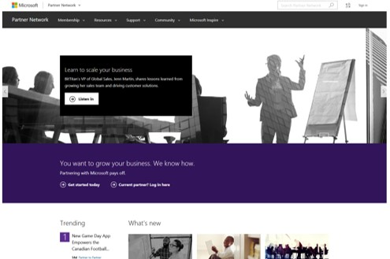
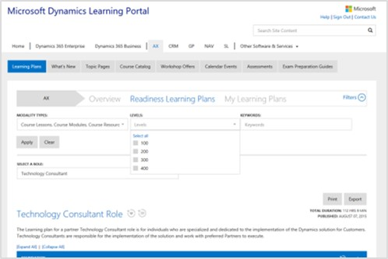
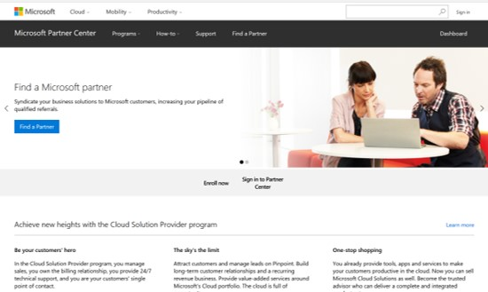
Enablement resources for partners
Innovation
Economics
Expertise
Partnering
Customer success
Extend your competencies and capabilities to grow your business with the cloud
Microsoft provides enablement programs tailored to your needs
TOPICS
ROLES
LEVELS (100-400)
MODALITIES
→
Overall Partner Info & Readiness MPN
→
Dynamics 365 Learning Portal Link
→
Microsoft Partner Center Link

Slide 18

Partnering for success
Innovation
Economics
Expertise
Partnering
Customer success
MICROSOFT DYNAMICS 365
Business Central
Connect
with community
Expand competencies
Market
your IP
Partner
Programs
Access valuable resources, including training
Subscribe to developer tools, support, training, and software
Deliver rich solutions via AppSource
Take advantage of your program benefits

Slide 19

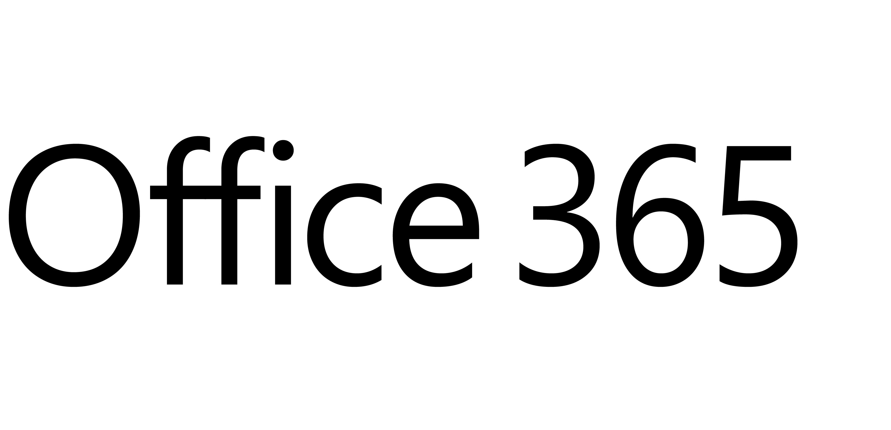
Partner annuity revenue opportunity
Innovation
Economics
Expertise
Partnering
Customer success
Partner-
owned IP
3rd party apps revenue via AppSource
AppSource
Annuity based managed services
ANNUITY REVENUE
Microsoft Dynamics 365 revenue
Microsoft
Office 365 revenue
Notes:
Dynamics revenue
Microsoft apps revenue via AppSource
Having your own IT – selling software
Annuity based managed services
Bottom: office 365 revenue
Partner Annuity Revenue

Slide 20
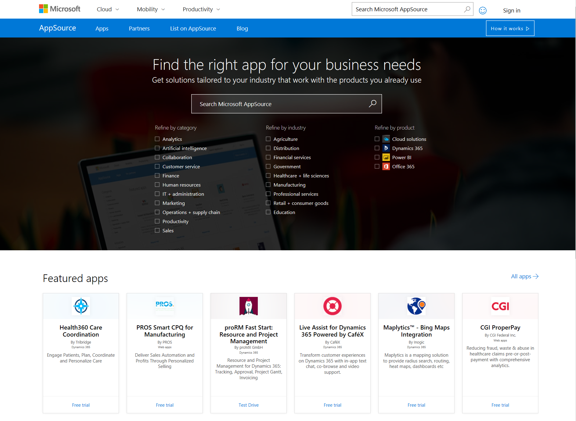
Microsoft AppSource
Innovation
Economics
Expertise
Partnering
Customer success
One destination for customer BDM’s to discover, trial, and acquire line-of-business SaaS apps
Simplifies the discovery, trial, and acquisition of line-of-business apps
An ecosystem to help business users get started using apps faster
Helps business users do more with their existing Microsoft Apps
Allows Dynamics Partners to easily market their Apps/IP @scale
Notes:
Microsoft AppSource provides a modern discovery and provisioning system for Dynamics 365 solutions.
For customers, Microsoft AppSource is your destination to easily find and evaluate the apps from Microsoft and our partners that drive your business.
For ISVs, Microsoft AppSource is your destination to market line-of-business (LoB) SaaS apps to business users.
Drive discoverability and usage of your apps within an existing global network of business customers through co-marketing opportunities, lead generation and the support of Microsoft’s worldwide ecosystem and sales force.

Slide 21

Partner best practices
Be successful: Do what the current top Partners do!
Differentiate
Up-sell and cross-sell
Customer lifecycle
Combine your vertical expertise, your overall competencies and your IP (e.g. Apps) to express your unique value.
Identify the areas where your IP and Microsoft’s Platform and Services (like Machine Learning/ AI, BI, IoT etc.) allows you to extend your business.
Managing the customer on an ongoing basis to ensure ongoing annuity and capturing cross sell and up sell opportunities.
Service capabilities
Sales and
marketing efficiency
Service margin+
Consistency increases efficiency and reduces the dependency on high cost technical staff.
Subject matter expertise adds value to services and solution recommendation, justifying a higher wallet share.
Identify and target customers and prospects using you differentiation; repetition in process and pitch improves win rates and requires lower cost resources.
Notes:
Successful Partners have evolved and do understand how to build the right App/IP on top of the Microsoft Platform and how to use modern ways to market and deliver solutions to customers.
And by making customers successful, they become a longtime partner and trusted advisor.

Slide 22

Call to action
ENGAGE
with Partner
Development Managers
SELL
your solutions – expand your opportunities (e.g. via AppSource), fully leverage Microsoft
CREATE
a Next-Gen
business plan
HELP
our joint customers to realize their full potential
BUILD
new IP using Dynamics platforms, PowerApps, etc. to deepen relevance and differentiation to prospects and customers
REALIZE
sustainable
hyper growth
Notes:
Practical first steps to get engaged….

Slide 23
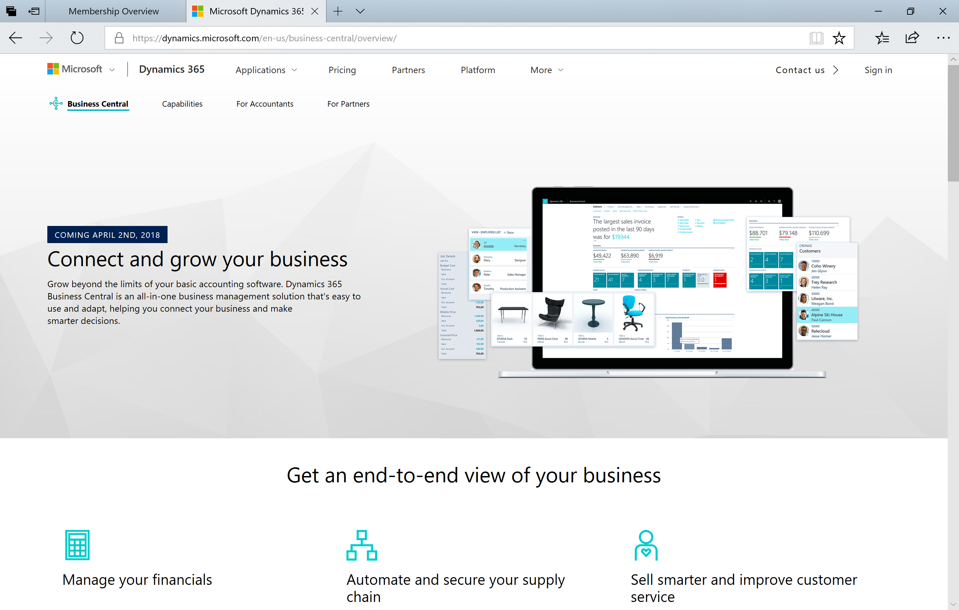
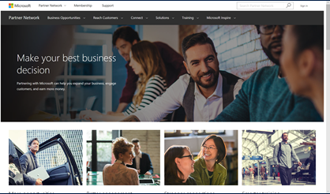
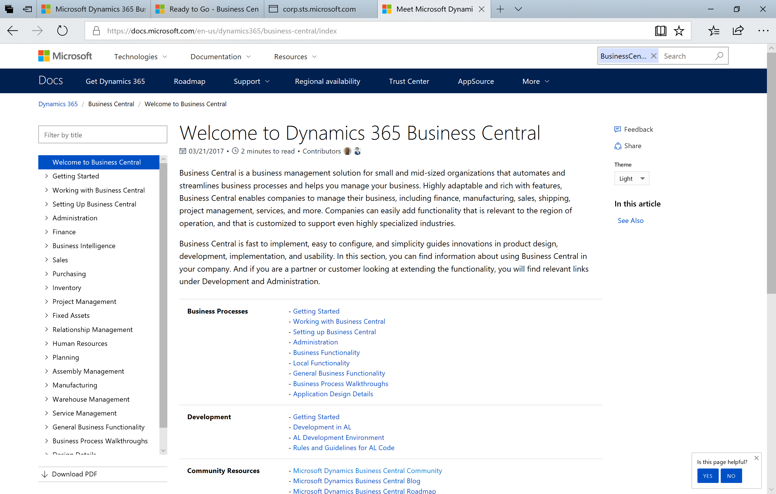
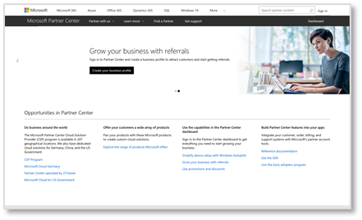
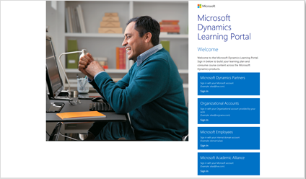
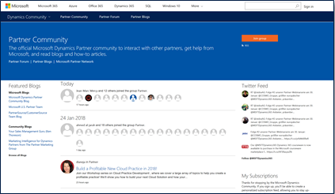
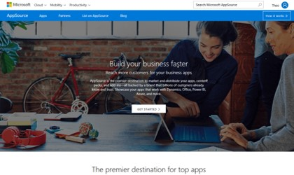
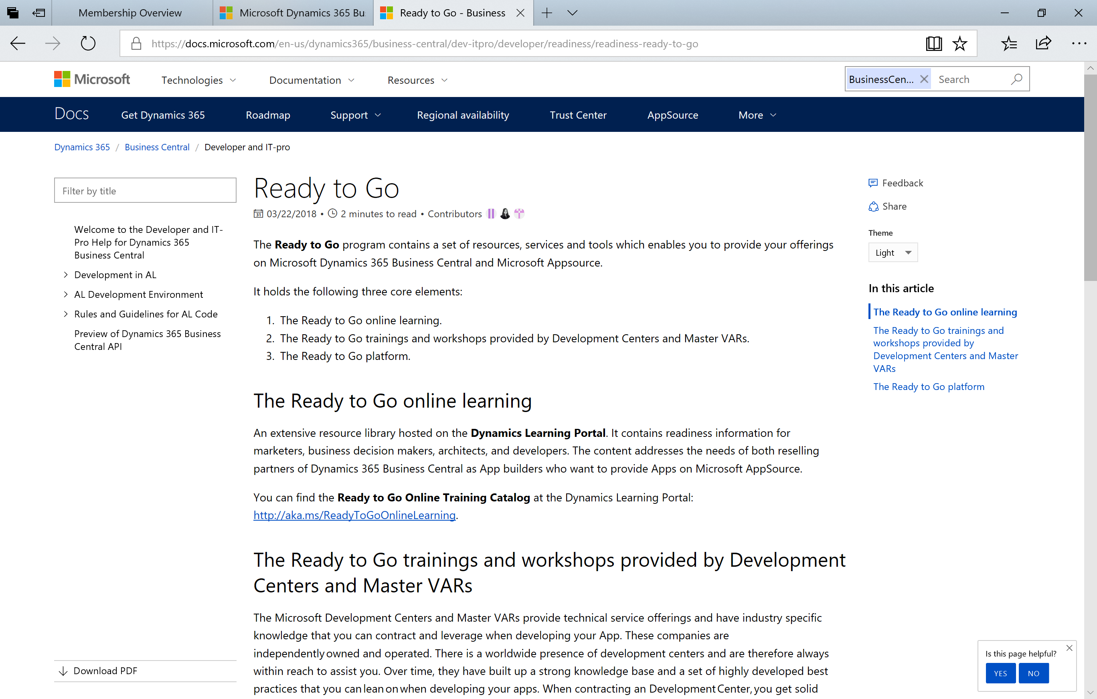
Key resources
MICROSOFT DYNAMICS 365
Business Central
→
Microsoft.com Business Central Link
→
Overall Partner Info & Readiness MPN
→
Overall Info about Business Central Link
→
Microsoft
Partner Center Link
→
Dynamics 365 Learning Portal Link
→
Microsoft Partner Community Link
→
AppSource
Link
→
Ready to Go
Link

Slide 24
Thank you
No better time to be a Dynamics partner

