Slide 1
Get Modern
Opportunity for Partners
Offer best-in-class productivity apps on a new
Windows 10 device to replace end-of-support solutions

Slide 2
Build your business with SMB practices
Acquire: Teamwork
Bring new customers to the cloud with business-class email and Teams.
Upsell: Get Modern
Offer best-in-class productivity apps on a new Windows 10 device to replace end-of-support solutions.
Maximize: Advanced Security
Maximize recurring revenue by helping SMBs protect against threats.
Marketing and sales content available @ aka.ms\mwsmb
Notes:
Microsoft has created three marketing kits for partners that want support to grow their business. Depending on the market segment the partner wants to approach, partners can use Teamwork or Get modern play kits to acquire customers.
The Get Modern play offers opportunity to retain customers on legacy solutions and get them set up for additional services.
TEAMWORK
This play is perfect for customers new to Microsoft. You can help customers make work better. Use play kit to move customers off freemium products to business class email and a chance to try out Office 365.
“Me” product: OneDrive (syncing, sharing, simultaneous co-authoring)
“We” products: Microsoft Teams (new approach to collaboration and data management) that leverages Sharepoint capabilities
GET MODERN
This play is aimed at customers running legacy products reaching end of support by 2020, including Windows 7 and Office 2010. Use play kit to offer modern applications with high customer value, that provide both an online and offline experience.
Email: cost savings, simplified management, and increased capabilities.
Bundle Migration: in a single bill through the CSP Program
Device refresh opportunity
SECURITY
Help valued customers protect themselves against cyberthreats and improve compliance. The 2018 Ponemon study found that 58% of breaches took place at small businesses. Help protect customers against malware and phishing with advanced security offerings built in Microsoft 365 Business.
Add additional value with security training and monitoring services. Use Microsoft Secure Score tool. Tasks that you can perform on behalf of your customers to ensure they are secure. Reporting and conversation starter to improve their security and compliance status.

Slide 3
Many SMBs continue to choose cloud services
43%
of SMB workloads run in public
cloud¹
75%
of cloud migration
and modernization revenue comes
from SMBs²
Reasons SMBs consider cloud services³
Cost savings
Improved security
Easy access to documents and applications from multiple locations.
Top SMBs business challenges³
Managing costs
Finding new customers
Keeping current on technology
1 RightScale® STATE OF THE CLOUD REPORT from Flexera™
2. Microsoft
3. Supporting SMB Plays, Bredin for Microsoft, March, 2019
Notes:
We see SMB technology decision makers moving away from a strategy of squeezing every spark of life out of IT assets toward a more strategic approach to technology adoption. As a result, Microsoft partners can capitalize on growing IT budgets and accelerated refresh cycles.
IDC, in its trends report in late 2018, expects SMBs to continue shift emphasis from traditional 2nd Platform hardware (PC, server, and network) to 3rd Platform (social, mobile, cloud, and big data) resources and software solutions.
Rightscale’s 2019 state of cloud report finds that SMBs surveyed (330 quantity) are running ¾ of their workloads in the cloud, with 43% using public cloud.

Slide 4


Use end of support deadlines to spur action
Deadlines offer a compelling moment to help SMBs continue to modernize the way they work
69%
Windows 7
January 2020
of SMBs are not aware or only slightly aware of the end of support dates.
Office 2010
October 2020
Office 2013 and earlier
Office 365 connectivity
October 2020
Help customers avoid security risks caused by unsupported solutions
Start early to retain customers that are ripe for change
Source: TechAisle SMB PC Study for Microsoft, July 2018
Notes:
Sellers understand the value of compelling moments – contract renewals or end of support deadlines are opportunities to help customers think through next steps that help them break with the past.
The big compelling moment ahead is end of support for Windows 7 and Office 2010, which will affect millions of customers.
You owe it to customers to alert them to end of support before your competition does and start the planning process. Getting off Windows 7 is a big step, and you can help your customers use the Windows 10 migration process to modernize the way they deploy and manage PCs in the organization.
Support for Windows 7 will end on January 14, 2020.
This means Microsoft will no longer provide security updates or technical support for devices running Windows 7 operating systems. For customers who need more time, Microsoft will offer paid per-device Windows 7 Extended Security Updates (ESU) through January 2023.
In October 2020, extended support for Office 2010 also comes to an end.
Furthermore, starting in October 2020, connection to commercial Office 365 services will no longer be supported through Office 2010 and 2013.
After October 2023, commercial connection will no longer be supported through Office 2016 or previous versions.
Customers on Windows 7 and/or Office 2010, 2013, or 2016 will need to migrate to a supported version/edition of Windows and/or Office before these dates in order to ensure they remain secure and compliant.

Slide 5
Massive opportunity: Use EOS to shift SMBs
Office 365 Business Client
Windows 10
Office perpetual
licenses, including Office 2010
Other Windows,
including Windows 7
Shift perpetual licenses, including Office 2010,
to Office 365 Business Premium
Shift other Windows versions, including Windows 7,
to Windows 10
Notes:
Workplaces are moving toward a continually connected and updated experience.
Most SMBs are running versions of Office that are nearing end of support are on perpetual licenses. These customers are missing the benefits of that connectedness: increased mobile worker productivity, increased collaboration, reduced down-time and use of third-party software.
Partners can use end of support for Office 2010 to move these customers to a modern desktop with Office 365 ProPlus.
Likewise, the immense success of Windows 7 means many laptops and desktops will need to be replaced or updated.

Slide 6
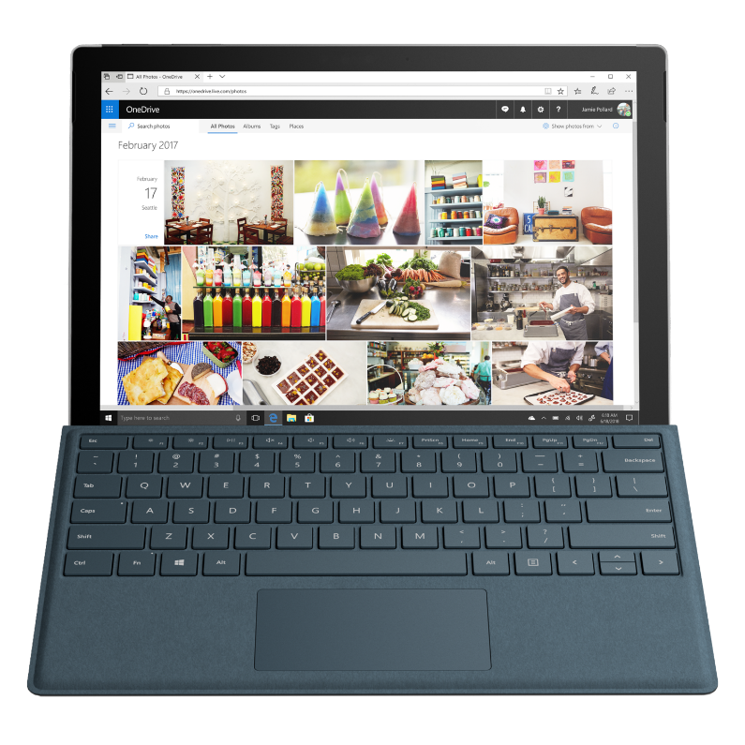
Many SMBs also need newer hardware
More than
50%
of SMB customers
run older versions
of Windows on
their PCs.¹
The total cost of owning
a 4+ year old PC is
$2,379 US
more than the cost of a newer PC.¹
New Windows 10 Pro devices help SMBs boost performance, improve security.
¹Source: TechAisle SMB PC Study for Microsoft, July 2018.
Notes:
In recent years, we’ve seen cost-conscious SMBs upgrade PCs only when productivity suffers. Aging hardware and software are now holding back many SMBs, including the large volume running Windows 7 and Office 2010. The total cost of ownership of these old systems is more than the cost of a new PC. SMBs appear to be acknowledging this, with a majority saying they will be buying new PCs in the year. A 2018 TechAisle SMB PC Study for Microsoft showed that 70% of the smaller SMBs state purchase intent and the number increases to 74% for the larger SMBs.
When SMBs do upgrade to Microsoft 365, they typically do so because they want the benefits of file sharing, remote access, and data security. SMBs who upgrade to Microsoft 365 cite multiple benefits, including ~45 hours of increased mobile worker productivity per mobile worker, 17% reduction on time spent on decision making, increased collaboration, reduced down-time and use of third-party software.
Many SMBs are also concerned about their ability to protect their business from cyberattacks and keep their data safe—but lack basic protection against the most common threats. A recent Microsoft survey of SMBs and found that 71 percent feel vulnerable to a cyberattack, jumping to 87 percent for businesses that have already experienced a breach. The advanced security features in Microsoft 365 offer a comprehensive solution to protect SMBs from cyberthreats and safeguard sensitive information.

Slide 7
Help SMBs get modern by offering solutions, expertise
.
Best-in-class tools helps SMB evolve
Help SMBs gain cloud experience as they continue to use familiar productivity tools, including online and offline work options. Apps are always up-to-date.
Simplified security for productivity
One solution to deploy and
manage that is continuously up to date and enabled with multi-factor authentication.
Unmatched collaboration tools
Enable collaboration with chat, shared docs, and online meetings that help SMBs team up with remote workers, customers, coworkers, and suppliers.
.
1
2
3
​
Offer solution to a known pain point for customers based on EOS deadlines and a stepping stone to service offerings.
Get customers protected ASAP. No complicated integration work.
Add teamwork services to deployment services that can help SMBs reduce cost, improve the way they work.

Slide 8
Help SMBs Get Modern
How will this help
your customers?
What does this
mean for you?
What to do next
Notes:
So what are we doing to help accelerate the transformation for you and your customers?

Slide 9
What’s holding customers back?
Backward compatibility
Will the macros we created earlier continue to work? Do we need to rewrite apps for Office 365 or Windows 10?
Third-party add-ins
Do my third party/ISV
add-ins work with Office 365? How do I verify that?
Assessment tools
We don’t have the tools to assess compatibility with Windows 10 or Office 365
Ongoing assistance
What if we have app-compatibility issues after a future update to Windows 10 or Office 365?
¹Source: TechAisle SMB PC Study for Microsoft, July 2018.
Notes:
These are top concerns voiced by customers

Slide 10
Microsoft compatibility promises and findings
Backward compatibility
Object model unchanged from Office 2013. 99% of third-party add-ins are compatible with Office 365
Only 0.16%* of apps we have encountered are not compatible with Windows 10
Third-party add-ins
Proactively monitor add-in health and work with developers through ready for modern desktop page
Assessment tools
Do analysis of existing Office and Windows environments with
Office readiness toolkit
and Windows Analytics
Ongoing assistance
Desktop app assure and FastTrack support**
* Based on Microsoft analysis of Windows 7 apps through Desktop app assure program
**For customers over 150 users
Notes:
Besides backward compatibility, here are the commitments:
Monitor health of 3rd party add-ins: Microsoft continue to proactively monitor app and add-in health, We remediate detected incompatibilities or engage with developers when needed. Ready for modern desktop is a great resource for you to verity the compatibility of the add-ins
Assessment Tools : Microsoft will provide tools and resources like Office readiness toolkit, desktop analytics & ready for modern desktop to help with your compatibility assessment along with guidance.
Assistance: Microsoft will continue providing assistance to help you with your transition to Office 365 through programs to assure ongoing compatibility assistance.

Slide 11
Always up to date, enriched with new apps and features
Office 365
Office 2019
Morph & Zoom | 2D Maps | Funnel Charts | New Excel Functions | Focused Inbox | Black Theme | Focus Mode (Mac) | Accessibility Checker | Click to Run
Office 2016
Treemap | Sunbursts | Tellme | Smart Lookup | Office 365 Groups | One-click forecasting | Weather forecast (Mac) | Outlook Recent Items
Office 2013
Templates | Presentation mode | Object zoom | Quick Analysis | Flashfill | Chart | Recommendations | Expand and Collapse
Office 2010
MRU | File tab | Backstage | Sparklines | Protected view | Trusted | Documents
Notes:
Key Points
Office 365 has all the apps SMBs know and love, with the latest features and functionality, across web, mobile, PC and Mac
Compared to Office 2019, the latest released perpetual version of Office, there is a huge gap in functionality with Office 365
Every version of Office has added great functionality and value on top of what was already available before…
Office 365 has all of that and more – Intelligence, Collab, Security and Accessibility, TCO
And what is important to understand – Microsoft keeps adding even more value to Office 365 month after month – it really is the best version of Office ever

Slide 12
Office Perpetual
Office 365 Business Premium
One PC
Static features
Per User
Always up-to-date
Microsoft Teams
Real-time collaboration
Comprehensive security
Mobile + PC + Mac + browser
+
+
+
+

Slide 13

Office 365 Business Premium
A modern device powered by Office 365 gives customers a more productive, secure experience, helping SMBs save money and gain peace of mind.
Get more done
Get the latest Office apps and features in Windows to maximize productivity, including both online and desktop apps.
Work better together
Collaborate, share, and communicate with flexible tools that go where your team goes.
Protect data with enterprise-grade security
Help protect customers against cyberthreats with built-in security and compliance tools.
New Windows 10 devices help SMBs boost performance, improve security.
Notes:
Remember the opening of this deck, which listed reasons SMBs consider cloud services? Key reasons are:
Cost savings
Improved security
Easy access to documents and applications from multiple locations.
Office 365 is a solution that offers improved security and teamwork capabilities that maps to key SMB challenges.
And of course, refreshing laptops is part of the process in moving customers to modern.
When you are talking with SMBs, you will have more success if you address their deep concerns with high transition effort, low quality, and cost. Education on the benefits of Windows 10 is also needed. BDMs in small companies lack the IT support structure that would be more attuned to the benefits and therefore do not understand the key differences between Windows 10 and their current OS.
Many at smaller orgs say they would be motivated to upgrade only if they had no other choice and it was required.
Most respondents feel happy with their current situation or do not see how Windows 10 can increase productivity.
This audience is especially curious about new features, compatibility, and cost.
Messaging for mid-size organizations should highlight key security and productivity benefits, while highlighting ways to save on costs. Many ITDMs/BDMs are unaware of what kind of technology/security improvements Windows 10 can offer.
Medium orgs like the idea of ease of use with improved functionality. However, most do not cite increased productivity as a motivating factor to update.
Price also plays a role in medium orgs.
However, some still state that they are worried that Windows 10 is not as strong a product and need further persuasion.

Slide 14

Security features built into
Office 365 Business Premium
Office 365 includes built-in security protections:
Multi-factor authentication to access Office 365 data
Mobile device management (MDM) for extra security on mobile devices
Encryption of data at rest and in transit
Continuous data backup via replication to geo-redundant servers
Robust spam and virus filtering, including capabilities such as zero-hour auto purge (ZAP)
“Red team” that tries to break in to our servers to improve security
$1 billion a year investment in R&D to drive security innovation

Slide 15
Windows 7
BitLocker / Device Encryption
Secure / Trusted Boot
Windows Firewall
Smartscreen
Windows Update
TPM
Remote Desktop
Domain Join / Group Policy
Security Features & Functionality
Management & Deployment / Productivity & User Experience
Notes:
These are the Security features included with Windows 7

Slide 16
Windows 10 Professional
Windows Analytics
Windows Autopilot
Windows Device Health Attestation Service
Windows Information Protection
Assigned Access / Kiosk
Cortana for Work
Windows Hello Companion Devices
Auto VPN
Windows Update for Business
Windows Defender AV
Secure / Trusted Boot
Windows Hello for Business
Windows Store for Business
Remote Desktop
BitLocker / Device Encryption
Mobile Device Management
Mobile Device Management
Microsoft Edge
BitLocker / Device Encryption
Secure / Trusted Boot
Enterprise State Roaming in Azure AD
Azure AD Join/MDM Management
Windows Firewall
Smartscreen
Client Hyper-V
Dynamic Provisioning
Windows Update
TPM
Remote Desktop
Domain Join / Group Policy
Security Features & Functionality
Management & Deployment / Productivity & User Experience
Notes:
Animation:
Starts with the Windows 7 Features.
First click: These are the Security and Functionality Features added when you upgrade to Windows 10 Pro
Second Click: And these are the Management and Productivity features added

Slide 17
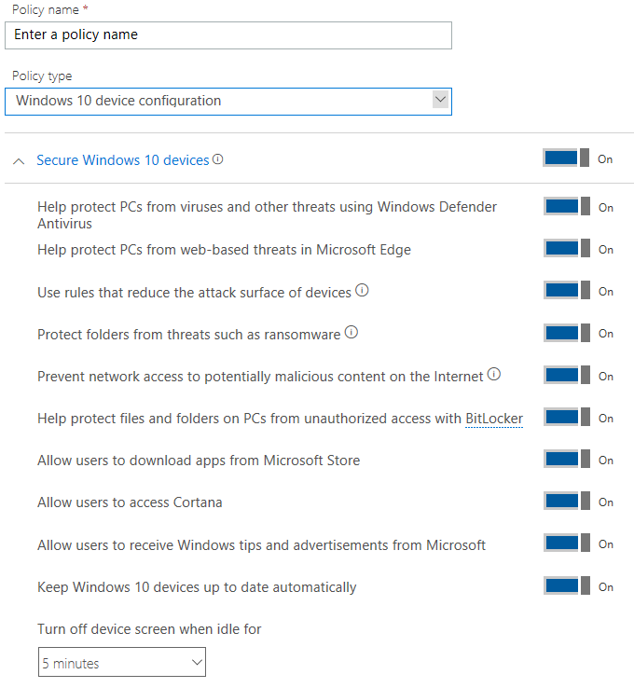
Advantages of moving to Windows 10 Pro
Windows Defender Antivirus & Windows Defender Exploit Guard
Where we started
What we’ve added
Windows Defender Antivirus
Attachment scanning & ML detection to catch
suspicious attachments
Link Scanning/Checking to prevent users from
clicking suspicious links
Windows Defender SmartScreen
  Block and prevent malicious and suspicious apps and websites from loading or running
Windows Defender Exploit Guard
  Preventing devices from ransomware and malicious websites at device end points
  Attack surface reduction
  Pre-defined rules that block actions and apps typically used by malware to infect devices
  Controlled folder access
  Block ransomware from encrypting files in protected folders, and block suspicious or malicious programs from making changes to protected files
  Network protection
  Prevent network connections to Internet locations that could host phishing scams, exploits or other malicious content
BitLocker
Encrypt data on devices to protect data if device is lost or stolen

Slide 18
Why Windows Defender is powerful for security
Protection: Windows Defender Antivirus (Windows Defender AV) maintains consistently high scores in the Protection category. But we protect further with Windows Defender Exploit Guard, SmartScreen, and Application Control.
1
Independent tests can help assess a security solution’s capabilities and protections.
However, antivirus
tests are only one part
of a complete quality assessment.
2
Usability (false positives): Samples that Windows Defender AV incorrectly classified (false positives) during tests are both rare and not commonly seen in businesses.
3
Performance: We optimize Windows Defender AV performance for high-frequency actions (e.g. application run) to decrease performance impacts.
Microsoft Secure blog Adding transparency and context into industry AV test results May 24, 2018

Slide 19
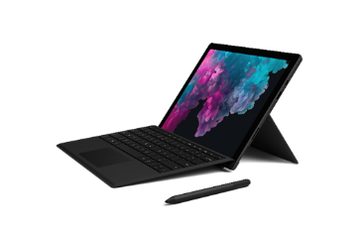
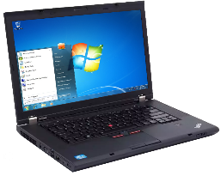
Choose a modern device for the best customer experience
Legacy devices
Modern devices
28%
33%
2.5X
65%
3X
3X
Faster startup time
Less security incidents
Better performance
Better multi-tasking
Longer battery life
Less repairs
¹Source: TechAisle SMB PC Study for Microsoft, July 2018.
Notes:
The best experience is on a modern device and for many customers, the fastest way to get to Windows 10 is via a new device.
Most modern devices with Windows 10 support touch, pen, voice and gesture inputs and many new devices also feature Windows Hello, allowing users to move beyond passwords and login with biometrics such as face and fingerprints.
Compared to a four year old laptop, new devices start up faster, are more secure, have better performance, better multitasking and all-day battery life.
And new devices can save money by being cheaper to maintain than a four-year old clunker.
*PCs older than 4 years are 3x as likely to need repairs, resulting in 128 hours of lost productivity—a cost of both time and money; SMB PC Study, Techaisle, 2018
**Password free sign in; Windows Hello with biometrics specialized hardware, a fingerprint reader, illuminated IR sensor, or other biometric sensor is required. Hardware-based protection of the Windows Hello credential/keys requires TPM 1.2 or greater. If no TPM exists or is configured, credentials/keys protection will be software-based.
1 28% faster start up time; Testing conducted by Principled Technologies in July 2015 in a closed lab environment using OEM factory default images on a representative sample of Windows 7 devices. Each boot test was run 10 times and the averages compared. Average improvement in startup was 28%;
2 33% reduction is security incidents; Forrester, The Total Economic Impact™ Of Microsoft Windows
3 2.5x better performance; Performance of 6th Gen Intel® Core™ processors in Windows 10 devices, based on measured SYSmark 2014, Comparisons based on Intel® Core™ i5-6200U vs. Intel® Core™ i5-520UM on Windows 10 PC;
4 65% faster at multi-tasking; As measured by SEG562, an office productivity and multitasking workload using Microsoft Word* (save to PDF), Excel* (recalc), PowerPoint* (slide sort), and NXPowerLite Desktop* (to shrink contents with office documents, kind of like compression), all while playing video in the background (simulating the watching of a business training or webcast.
5 3x longer battery life than a 5-year-old PC; Performance of 6th Gen Intel® Core™ processors in Windows 10 devices, estimated based on Windows 8.1 Local HD Video Playback Power, Comparisons based on Intel® Core™ i5-6200U vs. Intel® Core™ i5-520UM
“…”
Key points to land
Text
Text
Text

Slide 20
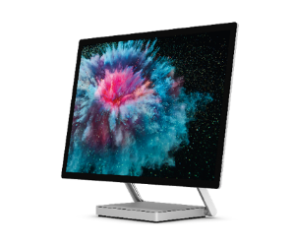
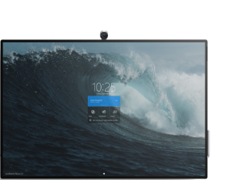
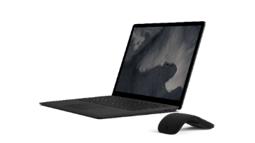
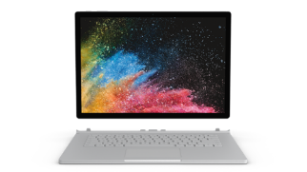
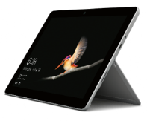
Microsoft Surface is the SMB modern device
A broad portfolio to chose from to upgrade ageing PC’s to a modern Windows 10 experience
Surface Go
Portable power
For those who want
to bring the best of Microsoft to life on
our smallest, lightest Surface yet
Surface Pro
Ultra-light and versatile
For those who want the ultimate in versatility and mobility without sacrificing performance
Surface Laptop
Style and speed
For those who want the laptop form factor, with the perfect balance of style, security, and manageability
Surface Book
Powerhouse performance
For those who want
the ultimate in performance, plus versatility and innovative design on the go
Surface Studio
The ultimate creative studio
For those who want
to combine the power of a desktop and the versatility of a drafting table to create the ultimate workspace
Surface Hub
Move beyond meetings, to true teamwork
For teams that want the best way to connect, create, and brainstorm with others regardless of their location
The users who love our products span across roles and industries LEARN MORE
Notes:
This is the current Surface for Business device lineup—a portfolio of personal and collaborative devices to fit the needs of nearly any business user.
It starts with Surface Go, the smallest of our devices targeted for business users. As the smallest and lightest device in our lineup, Surface Go is the ultimate mobility solution. Targeted toward first line workers and K-8 students, Surface Go is easy to carry anywhere. Just like with Surface Pro, Surface Go will feature LTE SKUs—coming later this year.
Next up is the Surface Pro, our most popular device and the biggest driver of revenue across the portfolio. Surface Pro is the ultimate 2-in-1 device for the mobile worker. Surface Pro possesses the power customers need to run their apps with the versatility to work from anywhere. We are currently in our sixth generation of the Surface Pro line, and have released LTE SKUs in the last year for even greater mobility.
The Surface Laptop represents our more traditional laptop form factor. Surface Laptop 2 for Business is now a key addition to the business portfolio with Windows 10 Pro standard, Advanced Exchange service, and Alcantara covered keyboards. Surface Laptop comes in a number of colors, and celebrates a style and personalization narrative for business users.
The Surface Book 2 boasts powerhouse performance in a 2-in-1 form factor. Designed for power users like engineers and creatives, the Surface Book lineup is among the most performant devices in the portfolio. Book also is able to detach from its keyboard for use as a fully functional Windows 10 tablet. Surface Book 2 is the latest model in the line.
Surface Studio 2 is our take on a more versatile desktop PC. With high-end processors, graphics cards, a lot of RAM, a 28” display, and 4K resolution, Surface Studio is the Surface desktop solution for power users and creative types. The Zero-Gravity hinge enables users to lower the device from the traditional desktop mode into “drafting” mode which allows users to draw on the Surface Studio screen with Surface Pen, just like they would on a drafting board.
Finally, we get to the Surface Hub 2S—the ultimate device for team work. The original Surface Hub is a large screen, collaboration device that comes in two form factors: 55” and 84”. Now, we have announced the Surface Hub 2S which will be available in calendar year 2019 Q2. Surface Hub 2S will provide new user and collaborayion experiences in a more dynamic set of display and modalities, all on a 50.5”, 4K+ display. Surface Hub 2S will be available in 2020.

Slide 21
Help SMBs Get Modern
How will this help
your customers?
What does this
mean for you?
What to do next
Notes:
So what are we doing to help accelerate the transformation for you and your customers?

Slide 22
Get Modern helps partners build their profitability by $15.75*/ user/ month
Migration and set up
Device refresh
Adoption services
Add project-based deployment services by helping SMBs migrate email and files to the cloud and extend to help them set up Microsoft Teams
Drive transaction and deployment revenue through refreshing aging PCs with modern devices
Add basic adoption and change management services for key SMB customer scenarios.
1
2
3
​
Enable your customers to modernize their business seamlessly through offering extensive deployment services
Monetize base deployment with new devices and associated ongoing management
Continue to engage customers and ensure that they get value with training services, both on-site and remote
*“The Microsoft 365 Partner Opportunity”. Forrester Consulting. July 2019.

Slide 23

On-premises to cloud migration
Minimize friction
Services | Description
Migrate to cloud | Help SMBs start their journey in the cloud through migrating email, files and identity to the cloud
Set up Teams | Standardize the organization on Teams for collaboration. Establish Teams template and move files to channels
Integrate other services | Integrate other Microsoft services into Teams experience, including Yammer, Planner, To Do
Notes:
Managed services help SMB partners stay engaged with customers. Many customers will not want to manage their Teams environment. According to one partner quoted in the July 2019 Forrester TEI survey on Teamwork”
“During deployment they ask, ‘Can you just operate the whole thing for me?’”
From July 2019 Forrester TEI survey on Teamwork
Managed services opportunities have grown for partners in both the SMB and enterprise spaces. This can include anything from basic user support to outsourced IT management of teamwork solutions to white-glove meeting room management services. This is becoming more important as many partners deliver value as services and attempt to create longer-lasting, more strategic relationships with customers. Managed services can provide better margins than project-based work once scale is achieved. It also delivers predictable, recurring revenues, which make it easier to invest in the business.

Slide 24
Device refresh
Upgrade productivity and security with a new Windows 10 device
 | Deployment services
Device refresh | Refresh older devices with new productive hardware for the organization
Simplify deployment | Simplify deployment of new devices with Autopilot
Accessory and warranty attach | Monetize through attaching high margin accessories and warranties to new devices

Slide 25
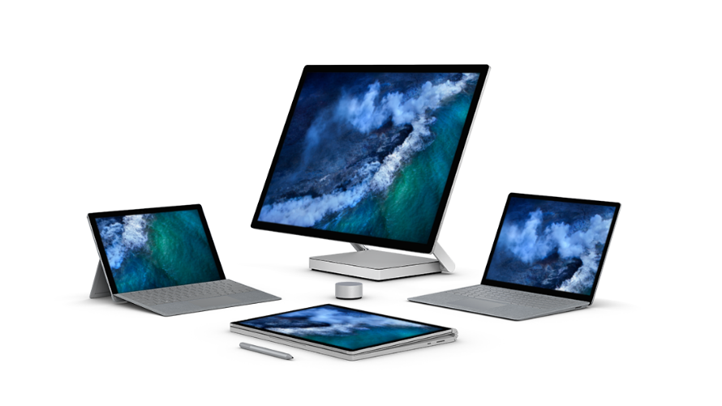
Device refresh with Surface
Provide the services and support to business customers
Value added services
Asset tagging
24-hour replacement
Etching
Kitting
Buy and hold
Imaging
Deployment services
Windows AutoPilot
Transactional support
Pre-sales technical support
Warranty and accessory attach
3rd party or Microsoft white-labeled services offerings
Financing
Ease of purchase
Credit offerings
Subscription
After-sale support
Post-sales technical support
end-user training
Notes:
Partners can offer a number of critical services and bring additional value to Surface for Business deals.
Beyond widening the breadth of customers we can touch with Surface, channel partners offer a number of additional services that provide a whole product solution for customers. This is especially true for enterprise customers who often require more complex services and transactional support. Note that the End Customer Investment Funds (ECIF) budget can be used to invest in these services, and drive acceleration and customer satisfaction.
Value added services:
Asset tagging, 24 hour replacement, etching, kitting, buy and hold, imaging
Transactional support
Pre-sales technical support, warranty and accessory attach, 3rd party or Microsoft white-labeled services offerings
Financing
Ease of purchase, credit offerings, subscription
Deployment services
Windows AutoPilot and Microsoft 365 deployments
After-sale support
Post sales technical support, end-user training

Slide 26





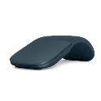
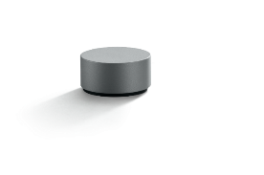


Growing device refresh revenue
Revenue ($)
Example: 50-unit sale
WARRANTIES
Sale | Average attach | Cost per unit | Revenue at 100% attach
Surface Pro i5, 256GB |  | $1,299 | $64,950
Type covers | 88% | $130 | $6,499
Pen | 44% | $100 | $4,999
Dock | 43% | $200 | $9,999
Business Warranty | 36% | $150 | $7,499
Total of Additions |  | $580 | $28,998
Total Revenue |  | $1,879 | $93,950
ACCESSORIES
Extended Hardware Service
DEVICES
Pens
Complete for
Business
Mice
Dial
Complete for
Business Plus
Takeaways
Headphones
Complete for
Education
Selling Surface additions increases the revenue by over 180% when attaching 100% accessories and warranties to the deal.
On average we only attach 43 docks to 100 devices—i.e. we are leaving money at the table 57% of the time. See our average attach rates in the left column.
Type Covers, etc.
Complete for Enterprise
Source: Microsoft examples
Notes:
Here is a specific example of how adding accessories and warranties can help you retire quota more quickly.
The key takeaways are:
Selling Surface additions increases the revenue by over 40% when attaching 100% accessories and warranties to the deal.
On average we only attach 43 docks to 100 devices – i.e. we are leaving money at the table 57% of the time. See our average attach rates in the left column.

Slide 27

Adoption and change management
Accelerate end-user adoption and value with value-added one-time and ongoing services
Services | Description
Provide in-person onboarding | Offer in-person workshops for management and end users to get familiar with Office 365
Keep users engaged | Create digital learning paths for end users with on-demand training resources and ongoing webinars
Track adoption | Agree on metrics and track usage to refine offerings and recommend next steps
Notes:
When partners sell teamwork, they are increasingly attaching adoption and change management (ACM) services, according to a July 2019 Forrester TEI survey on Teamwork. This is because deploying the technology is no guarantee of adoption, when people first need to change the way they work. Adding people-oriented services can help customers use technology to work better.
ACM services are typically a combination of customer self-directed activities and partner services, both one-time and ongoing. ACM is important to factor into teamwork programs from the very beginning, and partners often begin by understanding how users are currently working and the company culture. A person-based approach makes ACM planning and success easier.
For SMBs, change management typically involves user training and other related business consulting opportunities. These include selling some training days and providing a training portal where users could learn more about how to use the teamwork solutions.
(For larger companies, ACM activities are very heavy initially and often include ongoing services to monitor usage and change how solutions are configured. Managed services of many different kinds are put in place as solutions go live to ensure that users and IT organizations are properly supported and the teamwork solutions deliver the promised value.)

Slide 28
Bringing it together: Moving SMBs to modern technology
+ $180
+$310
Deepen relationships
Standardize on Teams and grow the lifetime value of the customer relationship with services that set you apart.
$1,450
Attach services
Add high-value, easy-to-sell
services based on deployment
of Office 365 Business Premium
+
Win the foundation
  Transition to Office 365 Business Premium and new Windows 10 PCs
+
  Standardize collaboration on Teams
  Move intranets to SharePoint Online
  Change management workshop
  Security assessment for upsell
  Continuing services
  24*7 support
  Ongoing education to drive adoption
  Migrate email to cloud
  Migrate files to OneDrive
  Introduce Teams
  Establish meetings on Teams
  Introduce fully outsourced support
  Device refresh and Windows 10 rollout
  Automate delivery, set up with AutoPilot
  Set up cloud identity with AAD
  Deploy Office 365 MFA
3-6 months
6-12 months
Three-year average revenue per SMB seat from Office 365 Business Premium and a new Window 10 Pro Device
Source: The Microsoft 365 Partner Opportunity, A Forrester Total Economic Impact™ Study Commissioned By Microsoft, July, 2019
Notes:
The SMB landscape and Microsoft are shifting toward cloud services – this is an opportunity to move both your business and your customers toward a modern workplace.
Managed services is the area where partners see the greatest opportunity and are making their largest investments. Managed services provide partners with recurring, predictable revenue which makes longer-term planning and investing possible. Partners also feel that the managed services margins are, or will be, higher than those for project consulting engagements.
Most of these partners are experiencing sizeable upticks in the number of leads and opportunities they are receiving from the SMB space as a result of their Microsoft solutions and go-to-market programs.
1-Win. Stage 1, which includes licenses and associated deployment and project services brings in standard margins.
2-Grow. Pull-through project offerings vary significantly across partners, but generally fall into three categories: security and compliance; business intelligence and analytics; and change management and adoption. Engagement sizes range from $5,000 to $20,000 and see attach rates of between 20% and 35% of license deals. Partners can build margin on these projects.
3-Differentiate with managed service and IP services. Given the need for simplicity and pricing transparency within the SMB space, partners are rapidly creating robust portfolios of managed services tiers to meet the diverse business needs of SMB customers. SMB partners report that SMB customers are very receptive to outsourcing IT support, solution updates, training, and security monitoring, management, and remediation to a trusted third-party partner, particularly since many have limited or no IT staff within their own organizations. These services build the bottom line and deepen relationships.
Microsoft’s most advanced partners are building out resalable and proprietary software solutions aimed at common vertical or horizontal business challenges identified across their customer bases. Partners resell these proprietary offerings to their SMB clientele, with some horizontal solutions, such as packaged SharePoint intranet solutions, achieving attach rates as a high as 50% to 60%.

Slide 29
Partner example:
United Kingdom
Cobweb uses 3-stage approach to help customers transform
Get them to cloud
Sell the vision of the future of work. Offer: USD $2,500 for an identity discovery package that results in recommendations and roadmap. Migrate customer from on-premises into Office 365 or Microsoft 365 and other products. Pricing: Starts at USD $35/person for email migration. SharePoint and Teams set up starts at USD $2,000/day.
Conduct training and adoption
Teach them a new way of working Pricing: One-day onsite end-user training at USD $1,500. Partner with companies offering webinars. Example: Cliff Training. $1/ user/month,
Add ongoing cloud support
Offer three levels of support Free option is phone only and provides basic issue identification services. Two paid options at $ 2.50-3.00/user/month Premium – Diagnosis and incident response plus service requests like policy changes. Priced at 18% of license fees. Premium Plus – End-user support plus service requests. Priced at 25% of license fees.

Slide 30
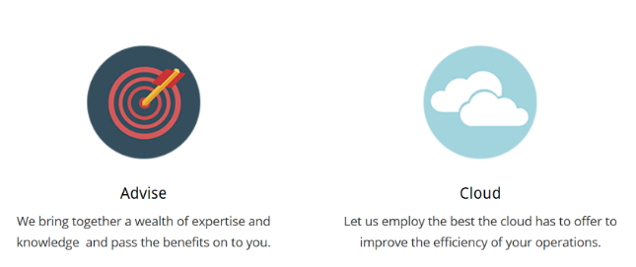

Partner example:
Australia
Focusing on relationships versus transactions
Approach
Address end-of-support opportunities with advice versus fear-mongering around potential security issues. Attack conversations from a productivity and performance basis based on device and OS age and warranty. Educate customers about local Australian regulations (similar to GDPR) and risk of non-compliance. Offer in-person demonstrations of the Office 365/Microsoft 365 platform and ‘modern computing' focusing on relatable real-world situations.
Offers
Free consulting and education sessions. EOS business review and strategic planning to include Line of Business software Bulk discounts if partner upgrades fleet instead of individual machines Managed services Helpdesk Security Monitoring Business solutions Bring together data, voice, video Integrated communications services Smart storage Print and imaging solutions
Results
Rodin has moved 75 percent of its 125-customer customer base to Windows 10 and Office 365 or Microsoft 365.
“We keep our discussions honest and real. We build the relationship and trust, advising on what the client needs to reach a goal, and avoid it being about a transaction.”
-Aaron Jacobs, General Manager, Rodin

Slide 31

Partner example:
Australia
Limit customer choices for cloud migration to keep things simple, faster, cheaper
Customer challenges
Customer issues include aging on-premises hardware and a lack of connectivity between the apps they use every day.
Results
75% of managed customers purchased plan, 10% left, and 15% are not yet at end of existing contract. Nearly doubled Microsoft 365 revenue since 2017. Moved 60 managed customers to Microsoft 365 Business or E3. Increased managed service revenue from 30% to 45% of total revenue as part of transition away from break-fix/ad-hoc work. Increased profit margins from 10% to 50% per user by bundling Microsoft 365 Business with partner offerings.
      “Solutions to issues can be as simple as making sure email and files are available across devices,
      to helping customers automate business processes via APIs.
      As customers move to the cloud, they are able to switch to modern identities and services like Azure AD
      and Microsoft 365, and enjoy the associated security and productivity benefits.”
      -Elliot Munro, partner, GCITS
Approach
By making call downs to customers before yearly renewal, team can lay out pending end-of-support risks and offer a plan. Team insists on Microsoft 365 Business as a minimum for new customers. Typical solution includes an automated rollout of Windows 10 with Azure AD sign in.

Slide 32
Help SMBs Get Modern
How will this help
your customers?
What does this
mean for you?
What to do next
Notes:
So what are we doing to help accelerate the transformation for you and your customers?

Slide 33
Target SMBs on legacy apps and operating systems
 | Acquire new-to-cloud customers
Target audience | On-premises customers on legacy products based on end-of-support dates (see below)
Customer opportunity | Approximately 50% of Microsoft SMB customers are using either Office 2010 or Windows 7 | Millions of SMB customers on Exchange Online
Compelling events | End of support for Windows 7 (January 2020) End of support for Office 2010 (October 2020) Expanding remote/mobile workforce | Cloud adoption Exchange Online users seeking cloud-based collaboration capabilities
Conversation starters | Understand plans to address end-of support deadlines. Outdated tools lead to security and compliance risk; without regular security updates, organizations are more vulnerable to breaches. Difficulty sharing information with unsecured file sharing– especially hard for mobile and remote workers | Fragmented solutions, multiple log-ins. Different solutions for files, meetings, surveys, planning, and separate security solutions Too much email with no centralized place to collect team input or collaborate in real-time
GTM tools (see detail in next few slides) | Microsoft 365 for Partners site for marketing and sales assets Offer builder Windows Analytics to assess device readiness | Office Readiness Toolkit to help identify compatibility issues with Microsoft Visual Basic for Applications macros and add-ins that your customer uses with Office
1. Bredin, an SMB market research and content marketing agency.
Notes:
SMB partners find they have the most success in professional services: financial services, legal, consulting, healthcare and manufacturing.
Look for SMBs using perpetual license Office products and those using freemium productivity tools.
3. Win the pitch with these customers by associating your pitch with compelling events that are top of mind for the customer.
Scenarios:
--Help SMBs gain cloud experience as they continue to use familiar productivity tools, including online and offline work options. Apps are always up-to-date.
--Simplified security​ for productivity.One solution to deploy and manage that is continuously up to date and enabled with multi factor authentication.
--Unmatched collaboration tools ​support chat, shared docs, and online meetings to help SMBs team up with remote workers, customers, coworkers, and suppliers.
Approach:
Listen and learn through business discovery. Earn the right to advise them.
Propose a solution that’s right for them. Balance addressable pain points with their cloud comfort.
Focus on how the solution will help their everyday work. Address concerns with empathy and facts
Spend time validating their concerns in easy-to-understand language.
Build and present an example offer using the Offer builder tool.
Discuss managed services based on SMB needs. Emphasize regular reporting that will help justify business value.

Slide 34
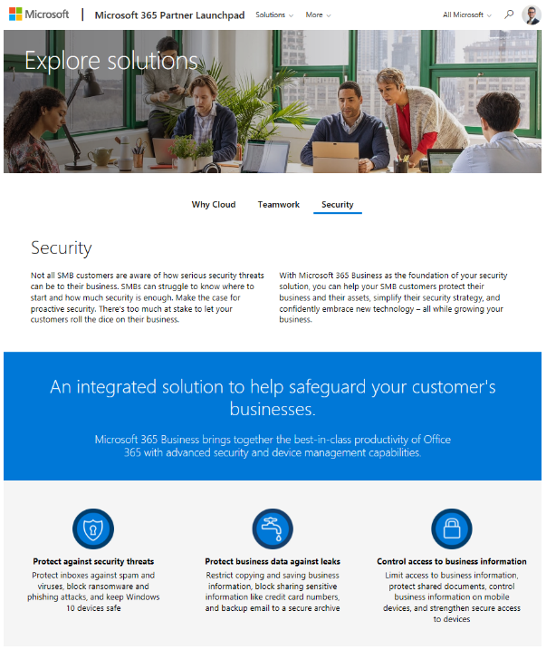
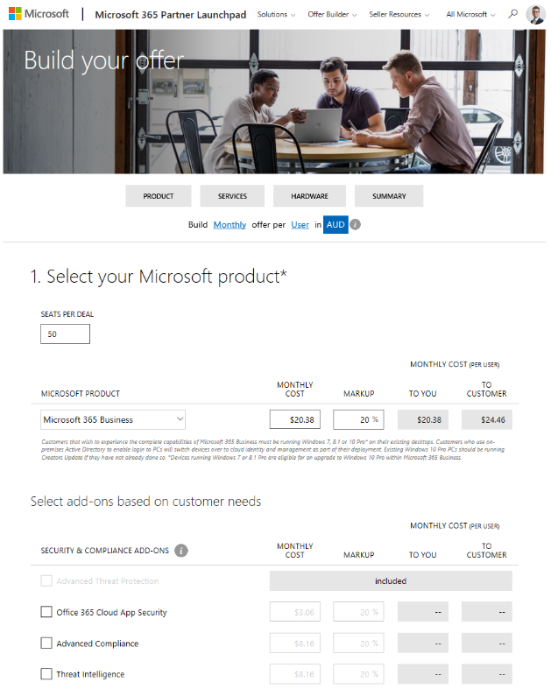
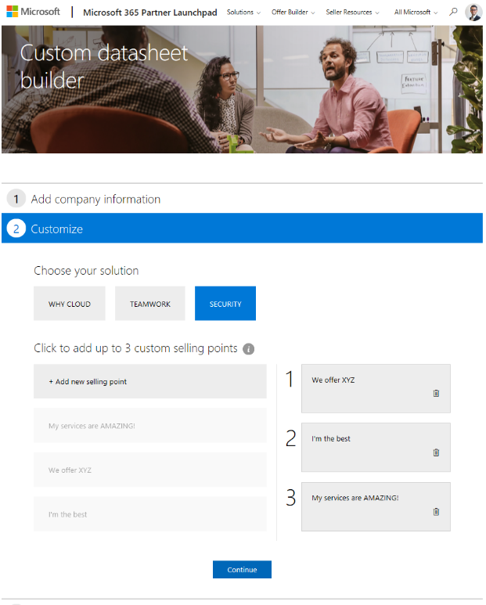
Build holistic SMB offers
Price and build offers using the tool on Partner Launchpad.
Insert license details and add your own services.
Bring example offer to your first meeting.
Build custom sales assets to close the deal.
Available @ aka.ms/partnerlaunchpad
Notes:
Launchpad offers information and tools to help you understand the key scenarios that can help you sell into customers.
Use new Launchpad tool to build an example offer to get customers interested.
Insert license details and your own services.

Slide 35
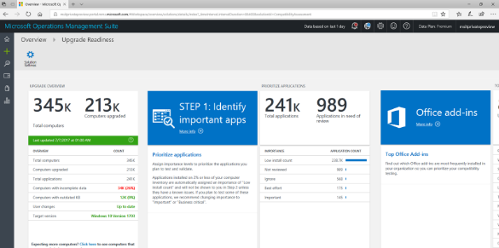
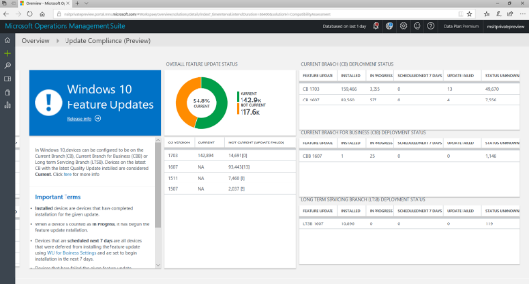
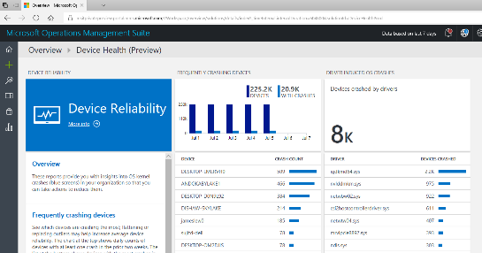
Windows Analytics
A suite of tools to reduce deployment and support costs
Upgrade readiness
Update compliance
Device health
Plan upgrades by identifying devices that are ready and identify and resolve top app/driver compatibility blockers
Ensure update and antimalware compliance with timely reports for all your devices (even those on the road)
Reduce support costs by proactively identifying and remediating top
end-user impacting issues
Notes:
Windows Analytics. Windows Analytics is a tool that combined the inventory of your devices with the Ready for Windows data and the known list of compatibility information to give you a single view showing you all of your devices and whether they're ready for this Windows 10 feature update or not. That's the Upgrade Readiness piece. It helps you plan the deployment process for each of these feature updates.
We also have two other components, Update Compliance and Device Health which focus on different areas of proactive insights. On the Update Compliance side, we want to make sure you're fully patched and if you're not fully patched that you understand why you're not fully patched. On the Device Health front we want to be able to identify things that going wrong in your environment and tell about some actions you may need to take in response to slow login or boot times, app crashes, and other things that negatively affect user’s Windows experiences, before they even think to call the helpdesk. Troubleshooting a collection of issues to fix them all once is much easier handling a large group of support calls.

Slide 36
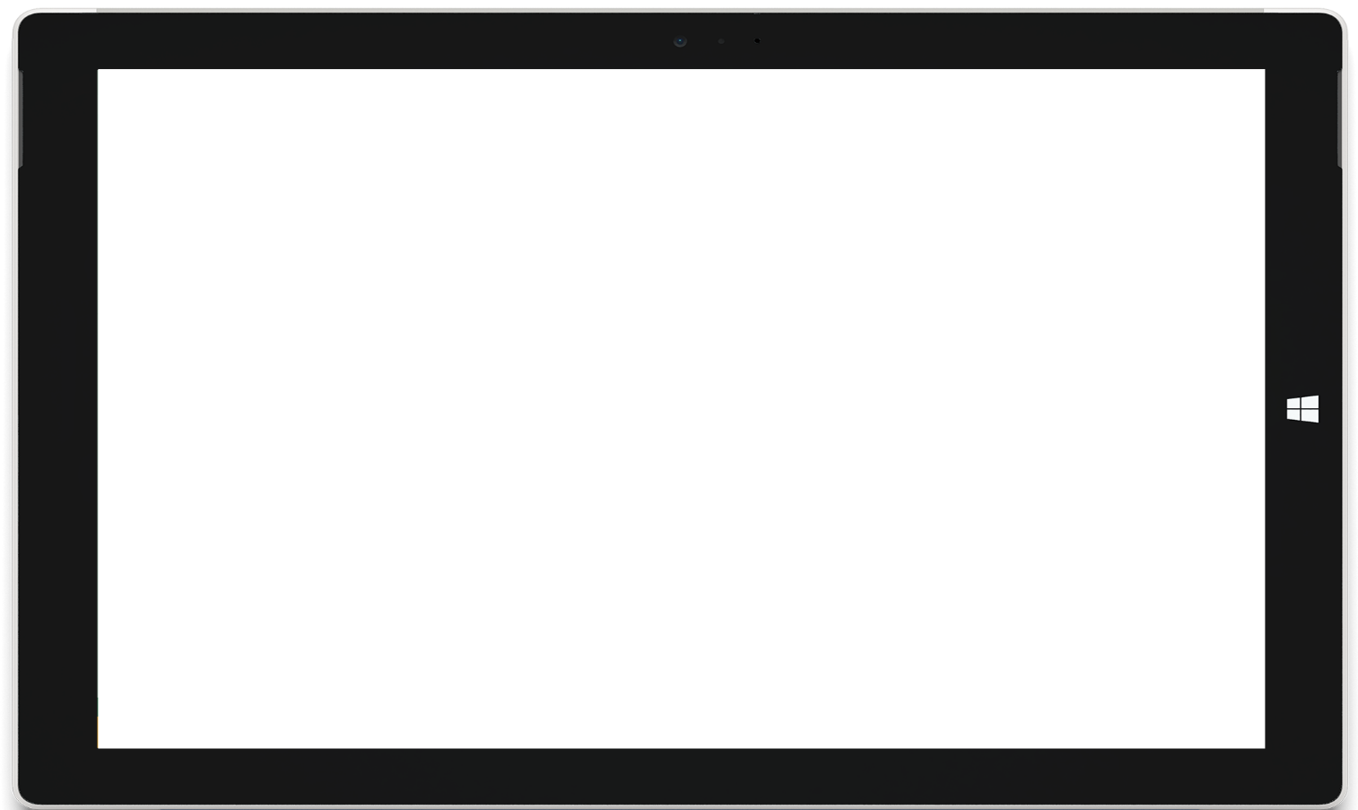
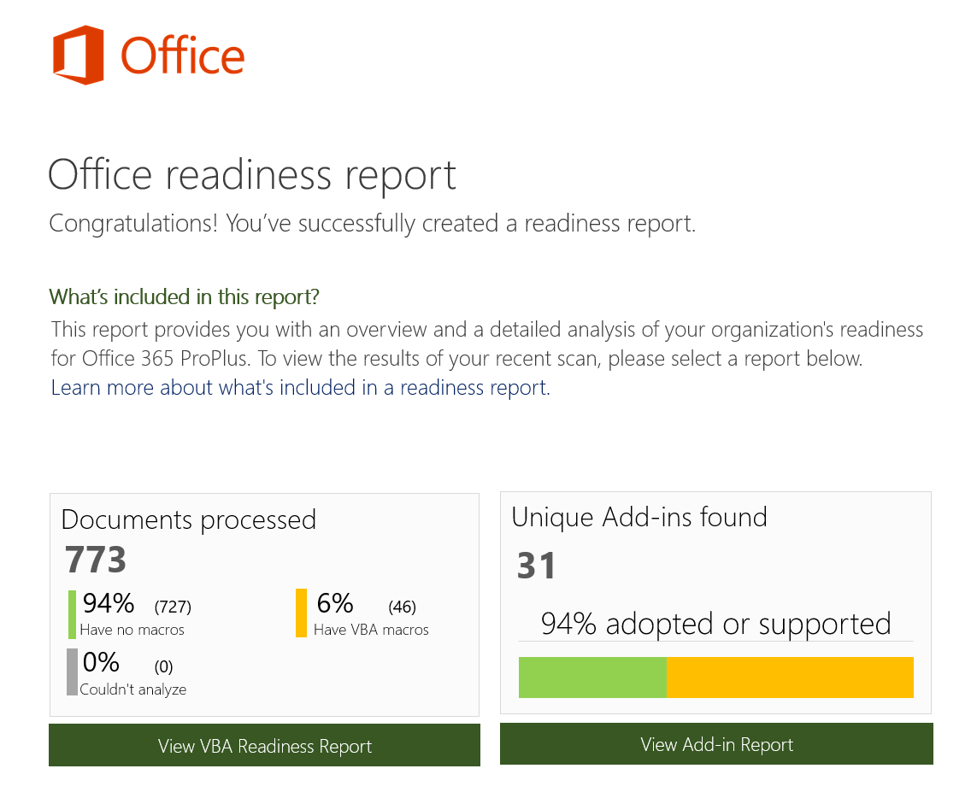
Office Readiness Toolkit
Assess impact across the organization
  VBA macro and add-in inventory with adoption information
Identify compatibility issues
  Potential macro issues, including 64-bit
  Add-in readiness information
Plan with readiness report creator
  Remediation recommendations
Available @ Microsoft Download Center

Slide 37
Build sales readiness with Get Modern resources
Learn
Market
Sell
Deploy
Get Modern play card
Microsoft 365 demos
Guided tour
Email kit
Day-in-the-life infographic
Social assets kit
Flyers
Offer builder
Conversation guide
Customer pitch deck
SOW and Proposal
Deployment centre
Set up Office 365
Productivity Library
Market and Sell content available @ aka.ms\mwsmb
Notes:
Working with SMBs is a not a one-and-done operation, it’s a continuous cycle of learning, marketing, pitching, and selling. Get Modern practice assets from Microsoft help you engage with customers to help them modernize their workplace.
Use the multi-channel, multi-touch assets to build top down and bottom up awareness for businesses to update their software and hardware together and to move from on-premises or freemium solutions to an always updated experience powered by the cloud.
Examine Learn assets to help prepare yourself to sell Teamwork solutions. Marketing campaign assets help you focus on what customers gain when the adopt new technology, with benefits clearly outlined and sales motions that align to SMB customers needs. Additional resources help you Sell and Deploy with confidence.

Slide 38
Get started building your business with Get Modern
Identify your customers running Office 2010 and Windows 7 and understand their concerns
Enable Windows Analytics to collect extensive data about the state of devices and assess device readiness.
Try Office Readiness Toolkit to help identify compatibility issues with Microsoft Visual Basic for Applications macros and add-ins that your customer uses with Office.
Learn more about moving to Windows 10 and Office 365 through the desktop deployment center.
Educate customers to upcoming deadlines with Office 2010 end of support webpage and Windows 7 end of support webpage.

Slide 39
Thank you
© Copyright Microsoft Corporation. All rights reserved.

