Slide 1
Microsoft SMB Advanced Security Opportunity for Partners
Maximize recurring revenue by helping SMBs protect against threats

Slide 2
Build your business with SMB practices
Acquire: Teamwork
Bring new customers to the cloud with business-class email and Teams.
Upsell: Get Modern
Offer best-in-class productivity apps on a new Windows 10 device to replace end-of-support solutions.
Maximize: Advanced Security
Maximize recurring revenue by helping SMBs protect against threats.
Marketing and sales content available @ aka.ms\mwsmb
Notes:
Microsoft has created three marketing kits for partners that want support to grow their business. Depending on the market segment the partner wants to approach, partners can use Teamwork or Get modern play kits to acquire customers.
The Security play offers opportunity for maximizing the value of a customer relationship.
TEAMWORK
This play is perfect for customers new to Microsoft. You can help customers make work better. Use play kit to move customers off freemium products to business class email and a chance to try out Office 365.
“Me” product: OneDrive (syncing, sharing, simultaneous co-authoring)
“We” products: Microsoft Teams (new approach to collaboration and data management) that leverages Sharepoint capabilities
GET MODERN
This play is aimed at customers running legacy products reaching end of support by 2020, including Windows 7 and Office 2010. Use play kit to offer modern applications with high customer value, that provide both an online and offline experience.
Email: cost savings, simplified management, and increased capabilities.
Bundle Migration: in a single bill through the CSP Program
Device refresh opportunity
SECURITY
Help valued customers protect themselves against cyberthreats and improve compliance. The 2018 Ponemon study found that 58% of breaches took place at small businesses. Help protect customers against malware and phishing with advanced security offerings built in Microsoft 365 Business.
Add additional value with security training and monitoring services. Use Microsoft Secure Score tool. Tasks that you can perform on behalf of your customers to ensure they are secure. Reporting and conversation starter to improve their security and compliance status.

Slide 3
Small businesses are most vulnerable
a
$163K ^{CAD}
62%
58% of breaches
take place at small businesses.¹
average cost of a SMB data breach.²
62% lack the skills in-house to deal with security issues.³
¹ Verizon 2018 Data Breach Investigations Report
² Kapersky Lab study, 2018
³ Underserved and Unprepared: The State of SMB Cyber Security in 2019, Vanson Bourne for Continuum
Notes:
Most of the headlines talking about cyber attacks are about big, well-known businesses. You probably understand that there is a chance that smaller businesses could be targeted, but you may not have the time or expertise to really evaluate the risk. The annual Verizon Data Breach report in 2018 found that 58 percent of all breaches in the past year occurred at small businesses – exceeding those at large corporations.
The threat is real and discounting the threat can lead to inadequate security protections. Hackers continuously monitor the entire market for areas of vulnerabilities and often target smaller companies precisely because they know those businesses have underinvested in cybersecurity.
Converted to CAD 6/15/2020

Slide 4
Today’s SMB IT environment is challenging
Once a firewall, PC antivirus, email filtering, and backup
were enough to protect your business
Internet
More mobile devices
Email filtering
Employees working from more places
Firewall
Antivirus
Backup
Phishing
Ransomware
Social engineering
With data moving to the cloud, increased mobile access, and cybercriminals getting more and more sophisticated, times have changed.
Notes:
Years ago, having an internet firewall, PC antivirus, and email filtering were sufficient to protect your business.
But many things have changed since those simpler days:
Data is in the cloud, rather than all being inside your location
That’s good news for users, who have easier options for getting things done wherever they go
But it also means you have more points of risk to think about
They’re using more mobile devices – that they can lose
They’re working from home, from coffee shops, airports, airplanes.
Cybercriminals are going after your users in increasingly sophisticated ways
Phishing attacks that are getting harder and harder to recognize
Ransomware that twists the power of encryption to work against you; taking critical files hostage
Social engineering attacks that take advantage of people being busy
Cybercriminals have upped their game. You need to up your game too. But you don't have time to become a cybersecurity expert. You don't have time to STAY a cybersecurity expert because of how threats change month to month.

Slide 5
Build your business around cloud security
How will this help
your customers?
Why add Advanced
Security services?
What to do next
Notes:
So what are we doing to help accelerate the transformation for you and your customers?

Slide 6

Microsoft is a scale security provider
Securing SMBs with unique insights, informed by trillions of signals
Shared threat data from partners, researchers, and law enforcement worldwide
OneDrive
5B
threats detected on devices every month
Outlook
470B
emails
analyzed
6.5T
threat signals analyzed daily
200+
global cloud consumer
and commercial
services
Botnet data from Microsoft Digital Crimes Unit
Windows
Enterprise security for 90% of Fortune 500
Azure
Microsoft
accounts
18B+ Bing web pages scanned
Bing
630B
monthly
authentications
1B+
Azure user accounts
Xbox Live
Notes:
Microsoft is now a serious security vendor. We have a ton of experience in this space and deal security on a scale not seen in any other company. The center piece of our investment in intelligence is the Microsoft Intelligent Security Graph. This is how we describe the way that we synthesize a vast amount of data from a huge variety of sources. 400 billion emails get analyzed by our Outlook.com and Office 365 email services every month.
1.2 billion devices are updated monthly. The 1.2B includes ~750M Windows 10 monthly active devices which we receive telemetry, the balance is Win8/7/Vista/XP which communicate with Windows Update on a monthly basis. 400 Billion emails analyzed monthly.
We operate 200-plus global cloud, consumer, and commercial services. Everything from outlook.com to Xbox Live to Office 365 to Azure, and so on. And with all of those services, we have a tremendous amount of surface area that we defend.
And so, we see more attacks than most other companies on any given day. We get a lot of information from defending against those attacks.
1 Billion plus Azure user accounts give us tremendous insight into how people authenticate to Azure. And that, combined with the 450 billion monthly authentications that we do with Azure Active Directory and Microsoft Account, really give us some tremendous insight into what is normal behavior when it comes to sign-ins and authentications, and what is abnormal behavior, and how often is it that someone has the right password, but they're not the person they say they are. We learn a lot about defending that really important control point, the identity, by looking across that set of data.
Bing scans about 18 billion web pages every month, giving us really great insight into what people are doing with web scripting technologies when it comes to attacks and phishing campaigns. And we have a great way to look at that and understand how we should help customers defend based on that information.
On top of all of that we layer shared threat data that we get from our partners, from the researchers here at Microsoft who are part of our 3,500-plus people that are full time on security, and law enforcement agencies that we partner with worldwide through our digital crimes unit, as well as botnet data that we collect through the digital crimes unit. All of that intelligence makes up the Intelligent Security Graph.
And why is it a graph? It's a graph because what's really important is connecting these pieces of intelligence, so that these signals are not just individual points of information. The graph brings them together as something that we can draw patterns across. We can learn from one point of data to influence how we interpret another point of data.
So, the Intelligent Security Graph is something that we are very, very heavily invested in at Microsoft. It's something that we feel is unique to us in this industry

Slide 7
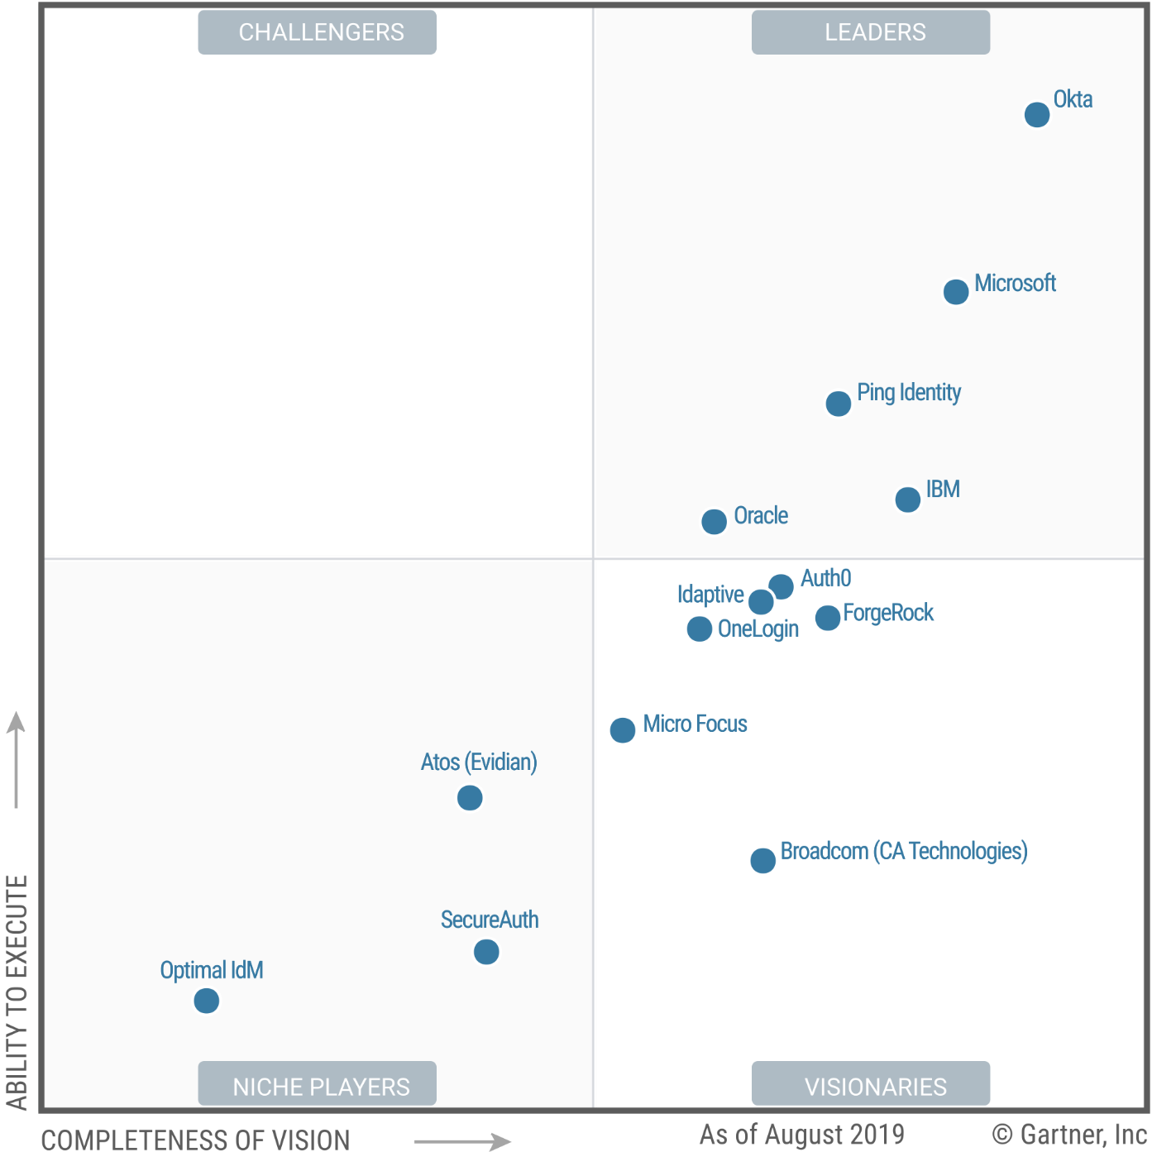
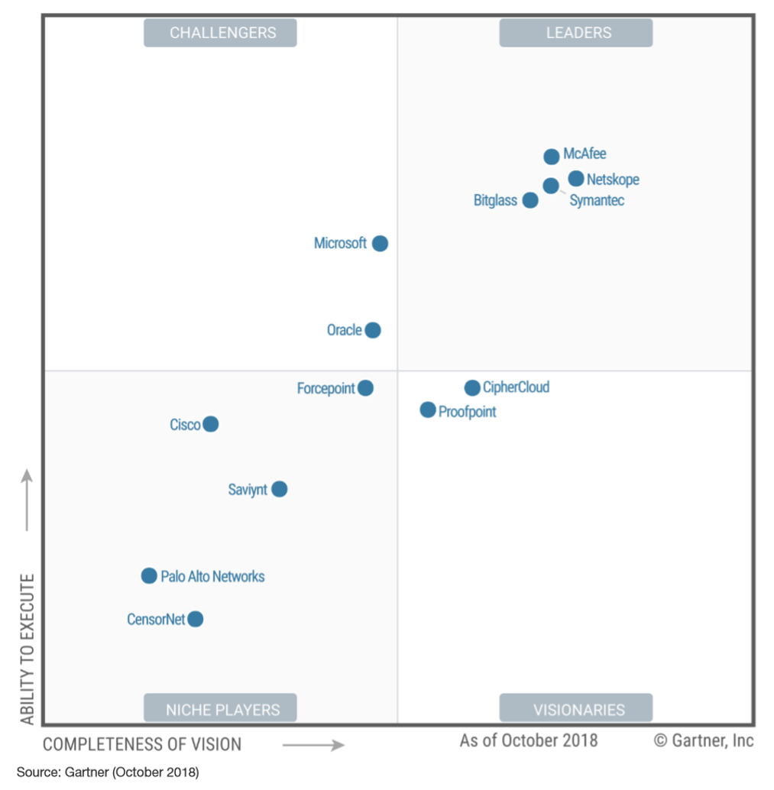
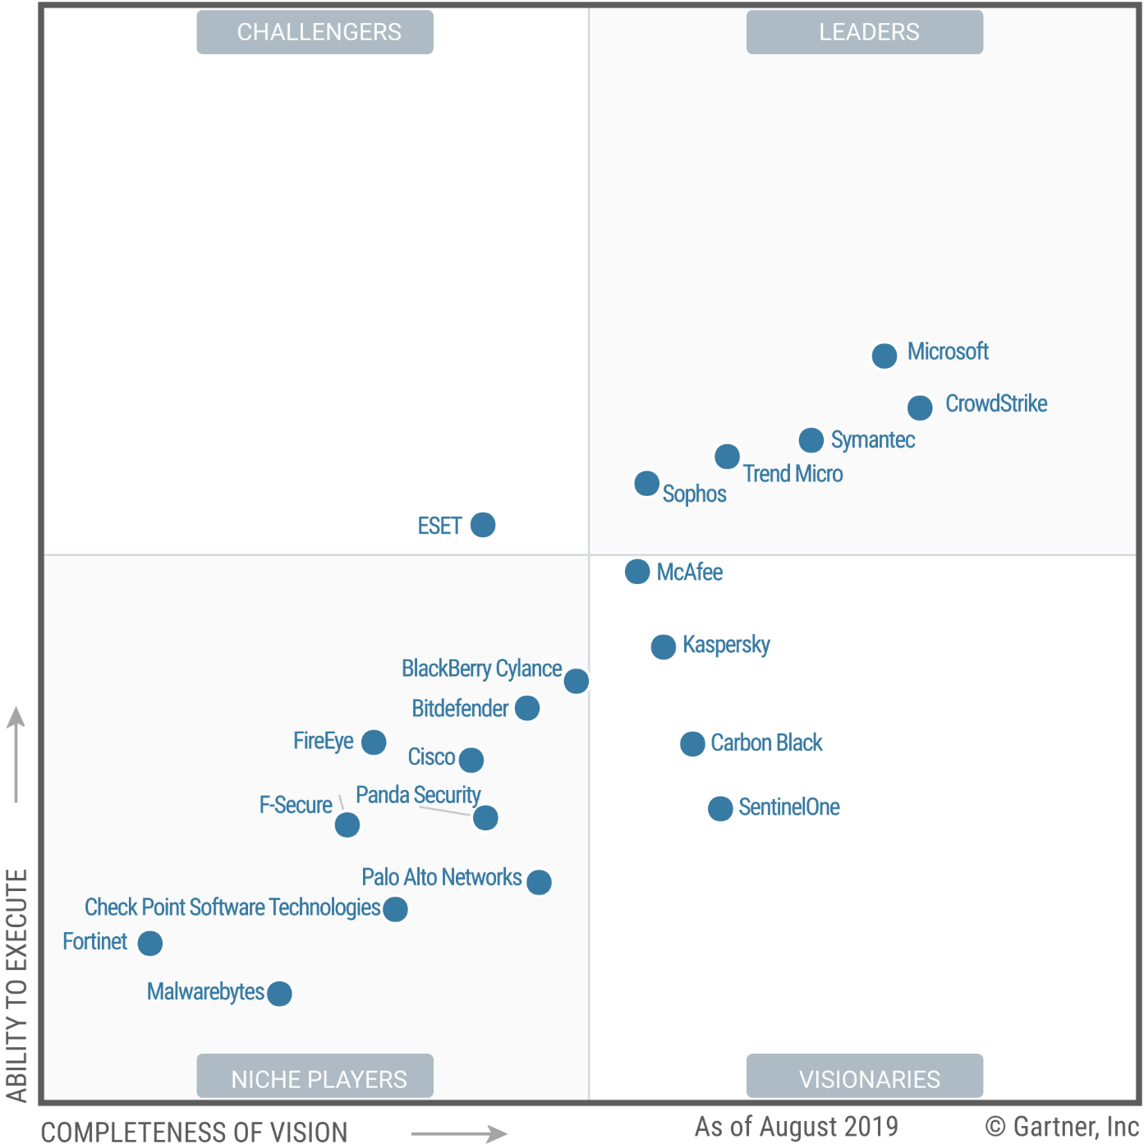
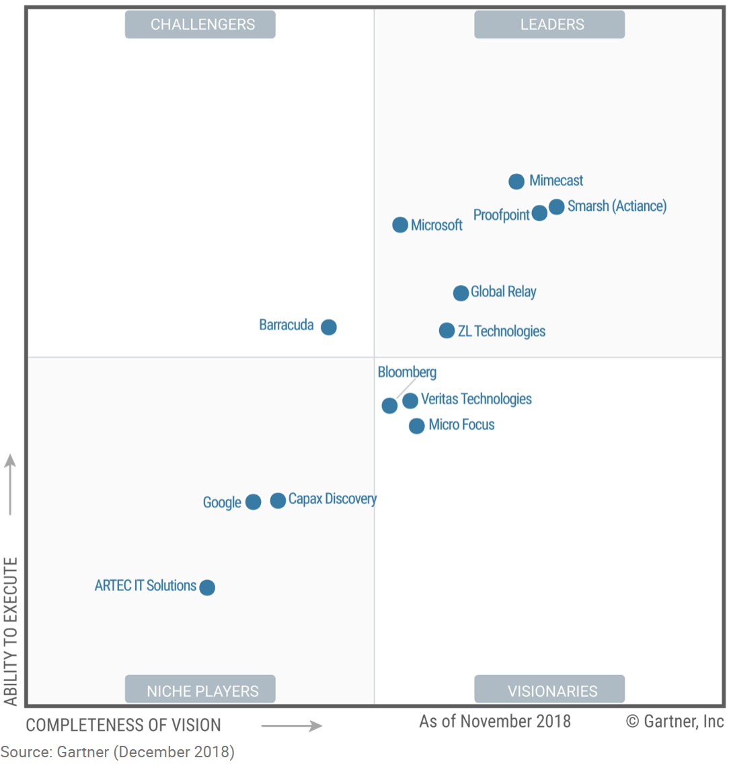
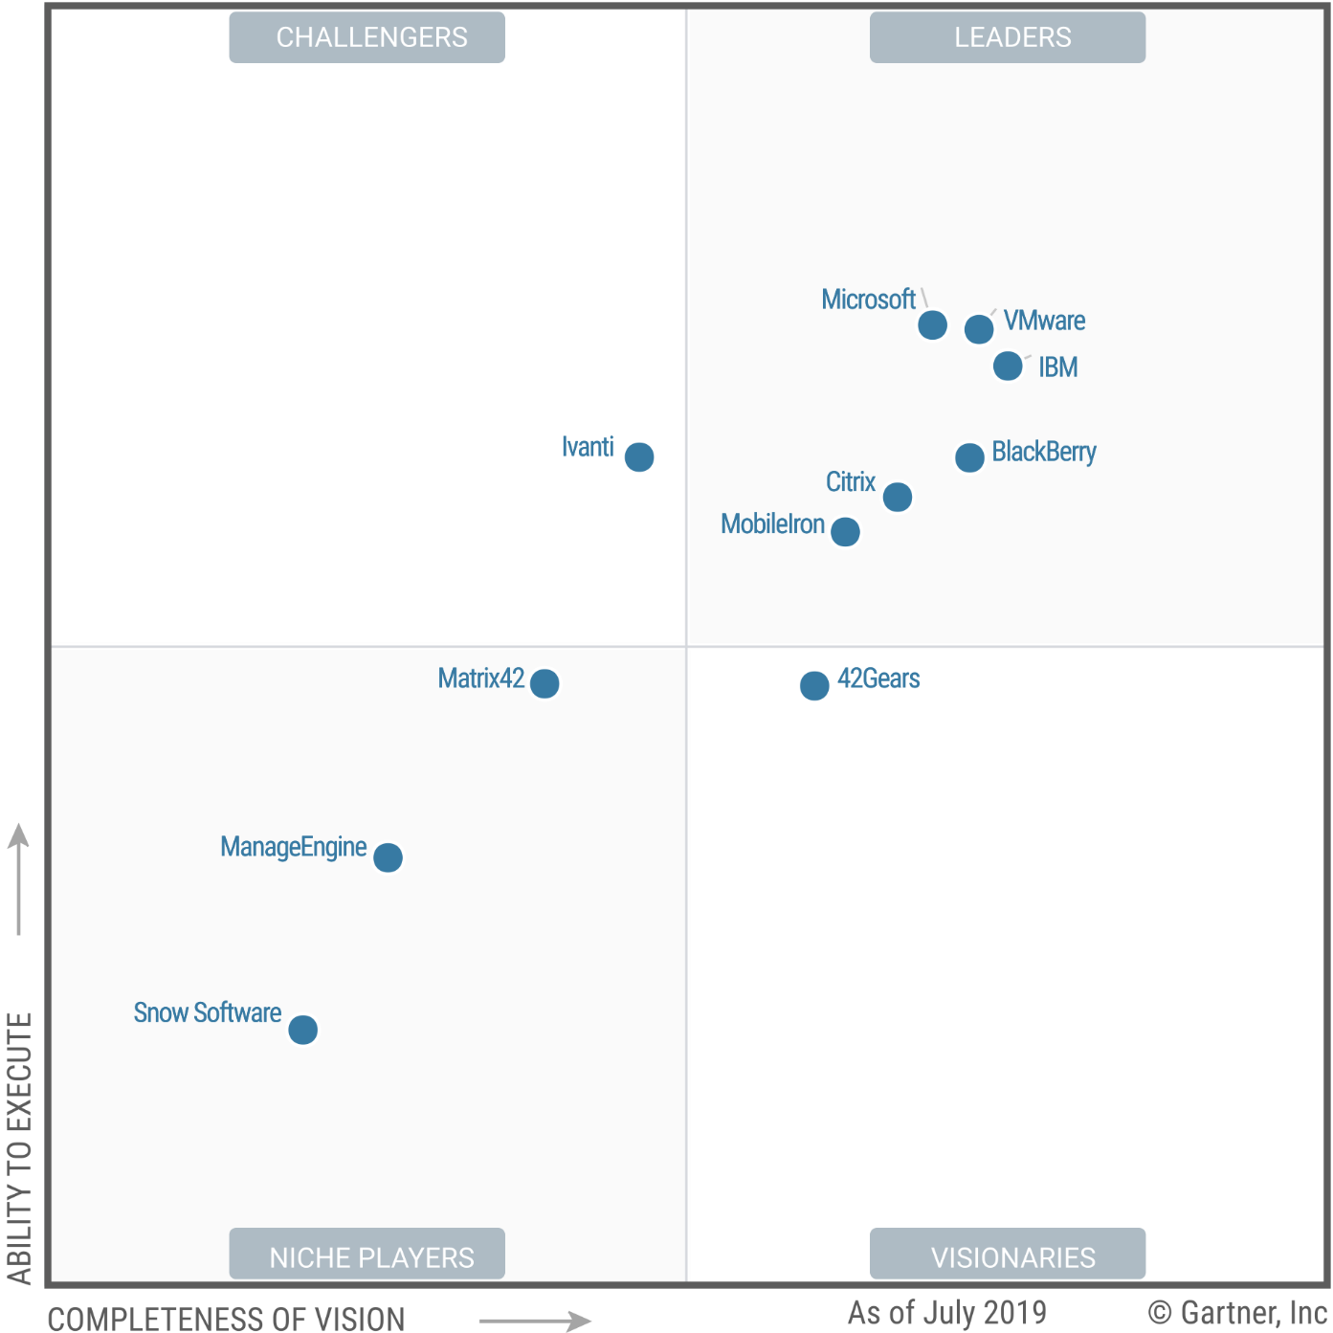
Gartner Security & Compliance Magic Quadrants
ACCESS MANAGEMENT
CLOUD ACCESS SECURITY BROKERS
ENDPOINT PROTECTION PLATFORMS
Full Report Links:
Access Management
Enterprise Information Archiving
Unified Endpoint Management Tools
Endpoint Protection Platforms
Cloud App Security Brokers
ENTERPRISE INFORMATION ARCHIVING
UNIFIED ENDPOINT MANAGEMENT TOOLS
This graphic was published by Gartner, Inc. as part of a larger research document and should be evaluated in the context of the entire document. The Gartner document is available upon request from Microsoft.
Gartner does not endorse any vendor, product or service depicted in its research publications, and does not advise technology users to select only those vendors with the highest ratings or other designation. Gartner research publications consist of the opinions of Gartner’s research organization and should not be construed as statements of fact. Gartner disclaims all warranties, expressed or implied, with respect to this research, including any warranties of merchantability or fitness for a particular purpose.
Notes:
Other Magic Quadrant reports related to Security that feature Microsoft. We do not have reprint rights for the reports below so cannot include the graphics. You can share the names however.
Magic Quadrant for Identity Governance & Administration

Slide 8
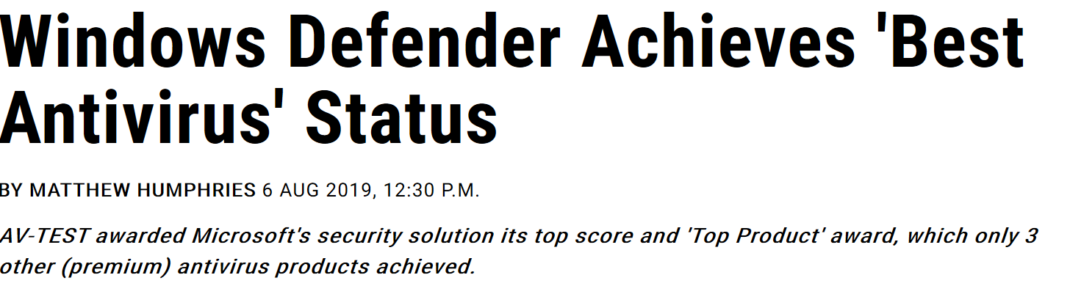
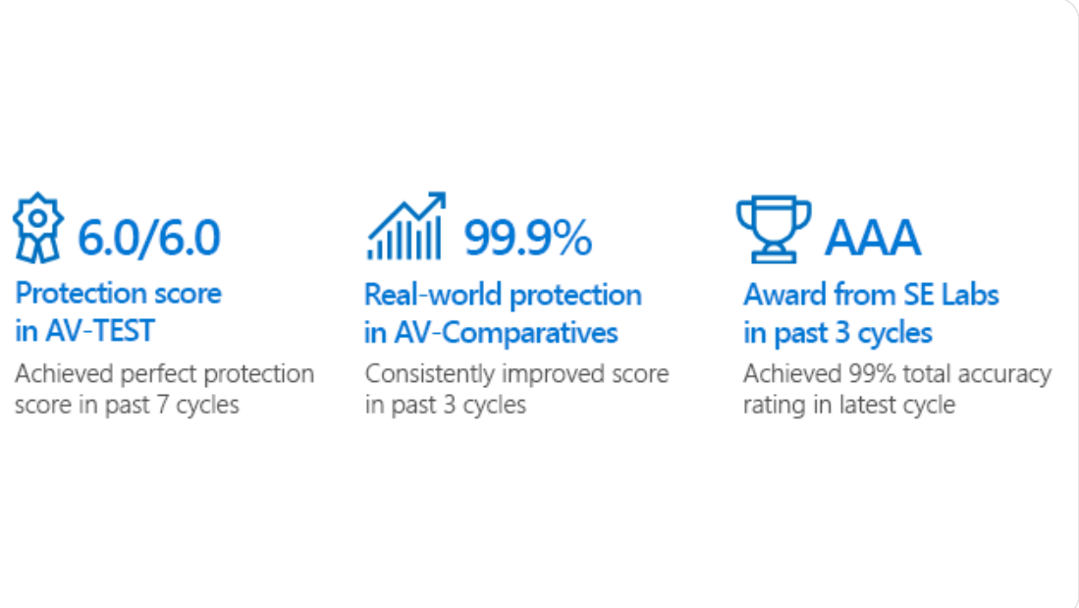
Microsoft Defender consistently rated top AV
1
AV-TEST: Protection score of 6.0/6.0 in the latest test
2
AV-Comparatives: Protection rating of 99.9% in the latest test
3
SE Labs: AAA award in the latest test
4
MITRE: Industry-leading optics and detection capabilities
https://docs.microsoft.com/en-us/windows/security/threat-protection/intelligence/top-scoring-industry-antivirus-tests

Slide 9
What is Microsoft 365 Business?
A comprehensive security solution that is integrated with Office 365
+
+
Defend against cyberthreats
Protect
business data
Secure
your devices
All the capabilities of Office 365 Business Premium, plus
advanced cybersecurity, data protection, and device management
Notes:
When your customers step up to Microsoft 365 Business, they can quickly implement a cloud-based security solution that stays current and protects them from the latest threats in phishing, ransomware, and malware.
Microsoft 365 Business is a single, integrated solution, that brings together the best-in-class productivity of Office 365 with advanced security to help SMB customers with less than 300 employees securely run and grow their business. Microsoft 365 Business was built specifically for small and medium size business, and is designed to help keep company data secure, while ensuring employees are their most productive, whether in the office, or on the go.
Microsoft 365 Business gives peace of mind by helping to safeguard your customer’s business. And it does this three ways:
First, you get protection from sophisticated external cyber threats hidden in email attachments and links, and get cutting-edge defenses against phishing and spoofing attacks, ransomware, and other advanced malware attempts.
Second, you gain more control over your company data and documents. Protection from data leaks helping you prevent sensitive information like SSNs and customer credit card numbers from being shared outside your business, and control access to documents, even after those documents have been shared outside your company.
Third, you can manage the apps, data, and documents on devices that access your company data. Regardless of the device type or operating system, iOS, macOS, android, or Windows. Microsoft 365 Business helps you manage these devices.
These capabilities draw upon Microsoft’s overall security investments ($1B+ annually) and are built on enterprise products like Intune and Azure Information Protection. Microsoft has been adding capabilities and further simplifying the offering each quarter as customers and partners give feedback, and as the threat landscape changes. It’s a key benefits of having a cloud hosted and subscription based security solution.
Note: Microsoft 365 Business includes everything in Office 365 Business Premium, plus additional security-related features.

Slide 10
Provide comprehensive security against advanced cyberthreats with Microsoft 365 Business
“
We don’t wait for customers to talk about security, we lead with it as something that’s critical.
We don’t use fear-mongering, though. Our approach is to ask ‘Have you thought about these things? Here’s what could happen, and our recommendation.‘
Jason Fox
Product Architect, Rackspace
Defend against threats
Check links at time of click to combat advanced phishing
Detect malware with sandbox analysis of email attachments
Enable anti-phishing policies that use machine learning
Enable advanced multi-factor authentication
Enforce features that help protect Windows 10 devices
Protect business data
Encrypt sensitive emails
Block sharing of sensitive information like credit card numbers
Restrict copying and saving of business information
Enable unlimited cloud archiving
Secure your devices
Control which devices and users can access business information
Apply security policies to protect data on iOS and Android devices
Keep company data within approved apps on mobile devices
Remove business data from lost or stolen devices with selective wipe
“
Notes:
One approach to data protection is to try to find a monolithic app that does everything. Or, you can assemble a solution from of collection of tools from different vendors, which may overlap in functionality and not integrate easily.
We offer a platform approach. Our suite of technologies works together, and with a vibrant ecosystem of partner tools, to provide comprehensive data protection.
Our platform helps you protect information at the identity level and at the document level. We also have technologies that help you identify advanced threats and recover quickly when you’re attacked.
The platform helps you protect sensitive data across devices and apps, in the cloud or on-premises.
Best option is Microsoft 365
-Office ATP
Phishing protection
Ransomware
Mobile device security
Identify AAD
Once you’ve established the foundation with Microsoft 365, continue to build your business and margin with monthly managed services.
Assessments
Secure score-based monitoring services – we watch the watchers, etc.

Slide 11
Simplify SMB technology investment
Microsoft 365 Business Premium
Comprehensive security against advanced cyberthreats
Security
Cloud identity management
$4.07
Information rights management
$2.71
Email anti-virus and DLP
~$4
Device management
$5.77
Productivity
$26 CAD monthly
Productivity apps and file storage
$10.85
Chat-based workspace, meetings
$18.32
Surveys and forms
$10.85
Team planner
$13.57
Monthly cost of
3rd party solutions
> CAD $67
Layer under existing point solutions from Microsoft security partners
Notes:
Microsoft 365 Business can help you consolidate some of the point solutions across productivity and security that create risk for your customer and complexity for you, enabling them to reserve more budget for high margin services
Cloud identity management -- Jumpcloud $3
Azure Information Protection $2.00/mo/user for Information Rights Management
Barracuda Essentials at $2.63/mo/user for email anti virus and DLP
Airwatch Express at $4.25/mo/user for the endpoint management system for SMB.
Adjusted to CAD 6/15/200

Slide 12
Build your business around cloud security
How will this help
your customers?
Why add Advanced
Security services?
What to do next
Notes:
So what are we doing to help accelerate the transformation for you and your customers?

Slide 13
 | Lack of expertise in the face of sophisticated cyber threats
 | Not enough resources to identify, assess, and mitigate security risks
 | Less familiar with security best practices and little time to educate employees
 | Overwhelmed with available offerings
SMB security challenges
Partners can help
plug gaps
?
?
Notes:
Many SMBs think that security is too complex and requires staff and expertise they don’t have. They also aren’t always up to date on best practices. While this signals opportunity, this also means that many competitors will be offering up expertise and solutions. It’s potentially overwhelming.

Slide 14
Security helps partners build their profitability by CAD $21.37/ user/ month
01 | Secure your customers
Elevate your customer’s security profile by upselling Microsoft 365 Business. Earn differentiated partner incentives through selling premium product
02 | Reduce operational cost
Reduce deployment, management and support cost with a seamless security solution that can build on top of your existing practice
03 | Monetize with advanced service offerings
Transition to high-margin consulting and managed services that are focused on assessment, monitoring, alerts & compliance to become your customers outsourced security team
​
Notes:
We understand that in this audience you may all be in various stages of transitioning into an Security MSP and we want to lay out a roadmap for your security practice journey & profitability
So first, if you are still in a transactional practice and you’re selling BP + a few security addons, with M365B you can elevate your customer’s security profile by upselling to M365B and doing basic deployment with a few clicks. You can show value by using the easy enablement of security features in M365B
While the first helps you get the foot in the door and gets you into basic deployment, you can use the other parts of M365B to drive deeper customer engagement. You can drive regular engagements focusing on assessments and use the features in M365B to drive deeper customer engagement going beyond basic support. For example here you may be doing a Identity management project for the customer – put simply in this phase you are becoming the security advisor for the customer –use story of AirWatch compete and how that was thwarted because of the customer credibility built up and that setup a device management project
The third phase is essentially where you are acting as an outsourced security team and doing what a security team would do like Monitoring, alerting, remediation, compliance services.
Switched to CAD 6/15/2020

Slide 15
Secure and grow your customer base
Value Prop | Description
Comprehensive | Add new customers by helping SMB’s protect themselves across vectors
Complementary | Complement existing security practice using integration with key security providers
Rewarding | Increase incentives with differentiated CSP rebates through the strategic product accelerator
“Nearly 90% of small- to midsized businesses (SMBs) would consider hiring a new managed services provider (MSP) if they offered the right cybersecurity solution.”
The State of SMB Cybersecurity in 2019- Vanson Bourne
Office 365 Business CSP rebate | vs | Microsoft 365 Business CSP rebate*
CAD $3.26 ($2.71 margin; $.54 rebate) |  | CAD $7.87 ($5.43 margin, $2.44 rebate)
*Based on FY20 Microsoft CSP incentives
Notes:
Converted to CAD 6/15/2020

Slide 16
Reduce operational cost
Value Prop | Description
Easy to manage | Manage your productivity and security tools from one location
Seamless to activate | Reduced set up time with streamlined activation for common scenarios
Reduced support cost | Reduced support calls as it’s built for Windows and Office and doesn’t overload system resources
“Microsoft 365 Business is a great combination for us. It's a fundamental security platform…you get more value out of O365 without bolting on a ton of stuff.”
Nathan Taylor, Director, MachineLogic

Slide 17
Increase your services revenue
Value Prop | Description
Monetize assessments | Start with SecureScore and go deeper with CSAT from QSSolutions to build a roadmap for customers
Start with monitoring | Start offering security managed services with remote monitoring and management using Defender
Move into identity | Help customers modernize their identity through offering IAM and device policy management
Provide advanced services | Finalize through offering or partnering to offer remediation or compliance services for customers
“Our fully outsourced managed service offering for SMB includes helpdesk, onsite support, updates management, security and usage monitoring, and ongoing maintenance. It sells for CAD $163 per user per month.”
Forrester TEI Study, 2019

Slide 18
Bringing it together with Advanced Security services
+$461^{CAD}
+$421^{CAD}
Monetize with services
Grow the lifetime value of the
customer relationship with
services that set you apart.
$977^{CAD}
Drive assessment
Add high-value, easy-to-sell
services based on deployment
of Microsoft 365.
+
Secure your customers
Sell Microsoft 365 Business
  Monitoring and alerting
  IAM policy management
  Device policy management
  Threat remediation (P2P)
  Compliance as a service (P2P)
+
  Cloud security assessment
  Hybrid security assessment (CSAT)
  Implement compliance features
End-user security readiness
  Licensing sale
  Base security feature deployment
  Supplement on-prem AD with AAD
  Reduce operational cost
Three-year average revenue per SMB seat from Microsoft 365 Business
Source: The Microsoft 365 Partner Opportunity, A Forrester Total Economic Impact™ Study Commissioned By Microsoft, July 2019
Notes:
Converted to CAD from USD 6/15/2020
The Microsoft 365 security stack is more robust, and this is creating many opportunities for partners, according to Forresters July 2019 TEI Study, the Microsoft 365 Partner Opportunity study.
Given the complexity of the security landscape, companies of all sizes are looking for partners that can handle the complex security landscape for them, according to a second Forrester study also from July 2019, The Microsoft 365 Managed Services Opportunity. Partners are finding success with clients who cannot or don't want to build out their own security operations center (SOC). Partners handle configuration of the security environment – configuring Windows Defender ATP, Intune, and other components of the Microsoft security stack. From there, partners would handle the monitoring and analysis of security alerts. Several partners reported layering their own custom solutions on top of the Microsoft security stack to reduce the number of false positives. More advanced partners are also providing security vulnerability resolution services.
From The Microsoft 365 Partner Opportunity study:
Matt – where do you get the $720 (CAD 977) and the $340 (CAD 461) ? Also the $310 (CAD 421) is for more than just security. See below.
Deployment
Partners said that work usually started with properly setting up ‘identity’ at smaller companies. Modern desktop deployments were down overall with activities like email migrations and moving core solutions to the cloud largely complete, but partners were still doing assessments, planning workshops and deploying other desktop management solutions. Most new deployments were around Teams setup and SharePoint migrations with the necessary identity setup and modern desktop components. Deployment services cost $310 per user over three years, which equates to $8.60 per user per month. The anticipated revenue opportunity with current attach rates was $8.60 per user per month.
Managed Services
Managed services were the single biggest revenue area and the one in which partners were making the most investments and focusing on for future growth. Smaller companies usually lack the internal resources to fully support IT solutions and users. These companies want to focus on day-to-day operations which create outsourcing opportunities for Microsoft partners. These offering ranged from single dollar security monitoring all the way up to full outsourcing contracts worth more than $100 per user per month. Outsourcing contracts covered three-tier user support, security monitoring and remediation, solution deployment, and device management. Many partners were developing full MSSP offerings.
According to Forrest, the more advanced partners are offering more outsourced IT and security services built on top of Microsoft security services, e.g., Secure Score, and solutions.

Slide 19

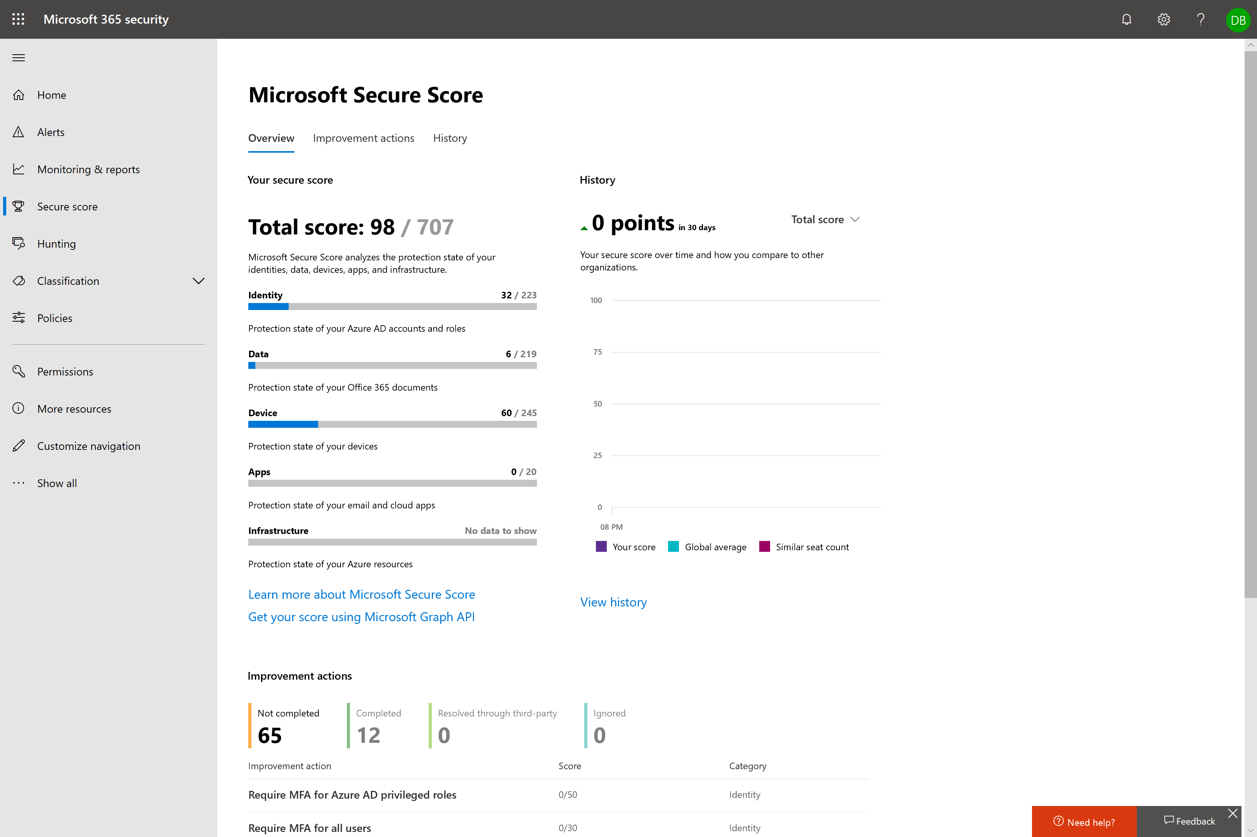
A
Secure your customers with a few clicks
Transition from selling licenses to Business Outcomes
Security Services: Show value & improve margins with Base security feature deployment
  Use Secure Score for basic assessment:
  Show customers their current security posture across identity, data, device, apps and infrastructure
  Secure Score helped one partner increase quotes from cold calls by 5X
  Deploy Basic security features in M365B
  to protect customers from cyberthreats
M365B Capability | Deploy
Advanced Threat Protection
Microsoft Defender (setup wizard)
Intune MAM (setup Wizard)
MFA (baseline policies)
O365 Message Encryption (enabled by default)
Data Loss Prevention
Intune MDM
Azure Information Protection
Conditional Access
Archiving & Retention Policies
Notes:
So we want to talk about how you can go from transacting licenses to showing value with business outcomes
Now there are a lot of you that may be wondering security is hard and dauting and we want to show that you don’t need deep security expertise to show that value
We have a secure score tool that helps you do basic assessment and you can use the M365B setup wizard to unlock key security value

Slide 20

B
Drive deeper customer engagements
Become the security advisor through high value services
  Develop High Value services
  around vulnerability assessments
  Use tools to do a comprehensive security assessment for customers on a regular basis:
  Cloud security assessment
  Hybrid security assessment (CSAT)
  Driving continuous improvement – drive quarterly assessments – not quite at the point where the customers give you keys to the kingdom
  Use M365B to transition into advanced security services deployment projects
M365B Capability | Deploy
Advanced Threat Protection
Microsoft Defender (setup wizard)
BYOD Mobile Policies (setup Wizard)
MFA (baseline policies)
O365 Message Encryption (enabled by default)
Data Loss Prevention
Full Intune Mobile Device Management
Azure Information Protection
Conditional Access
Archiving & Retention Policies
Notes:
Help SMBs secure customers from cyberthreats – with one solution
Add new security practice to complement collaboration practice
Extend your existing security practice using a layered security approach, backed by Microsoft’s partnerships with other security providers

Slide 21
C
Monetize with advanced service offerings
Transition into Customer’s outsourced security team
  Build on M365B and Offer High Value Managed Services
  Offer proactive monitoring, alerting & remediation services through WD ATP E5, ATP P2, AADP P2 and MCAS to block viruses, malware, ransomware, phishing and spam attacks
  Develop & refine security policies for Identity, Device and Application Management
  Provide compliance services to customers, focused on specific regulation needs.
  Create custom training portals for employee training and SharePoint workflows for effective customer data management
  Transition into Customer’s outsourced security team
M365B Capability | Deploy
Advanced Threat Protection
Microsoft Defender (setup wizard)
Intune MAM (setup Wizard)
MFA (baseline policies)
O365 Message Encryption (enabled by default)
Data Loss Prevention
Intune MDM
Azure Information Protection
Conditional Access
Archiving & Retention Policies
Add-Ons | Deploy
O365 Advanced Threat Protection P2
Microsoft Defender ATP (Win E5)
Microsoft Cloud App Security
Azure AD Premium P2
Notes:
Enterprise add-ons or 3rd party add-ons

Slide 22

Build IP with SecureScore
4
  Secure Score API
  Show customers their current security posture across identity, data, device, apps and infrastructure
  Partner Smart Office
  Aggregate Secure Score information into a single repository for all customers (OpenSource)
Learn more at aka.ms/securescoreguide
Notes:
Use a Secure Score to help customers understand potential issues and next steps.
Partners can build complementary offerings around the service using Microsoft APIs.
Build a system that collects all their customers secure score details.
- Monitor whether the customer score is low or if it has changed.
- Offer it as a value add or use it as a reason to call your customer.

Slide 23
Build your business around cloud security
How will this help
your customers?
Why add Advanced
Security services?
What to do next
Notes:
So what are we doing to help accelerate the transformation for you and your customers?

Slide 24
Target SMBs that need Advanced Security services
 | Upsell
Target audience (in order of prioritization) | Existing Office 365 Business Premium customers in your base SMB customers considering Office 365 E3 SMB customers currently using EM+S and/ or third-party security solutions to converge technology investment Customers on end-of-support Office and Windows should have a roadmap to get to Microsoft 365 Business
Customer opportunity | Millions of SMB customers on the Office 365 Business SKUs that are ready to move to Microsoft 365 Business 50% of SMB’s would pay at least 20% more for the right security solution from a new MSP
Compelling events | Security breach event End of support for: Office 2010, Windows 7 | Device refresh Regulatory requirements such as GDPR
Conversation starters | Cybercriminals can get employee passwords, steal money, and take your important files hostage Data can be accidentally leaked, deleted, or accessed by someone not authorized | Phones, tablets, and laptops with your company data can be lost or stolen
GTM tools (see detail in next few slides) | Microsoft 365 Launchpad for offer creation, pricing, profitability analysis and customized sales asset creation SecureScore for Office 365 security assessment and monitoring | Cyber Security Assesment Tool (CSAT) for more comprehensive, hybrid security assessment Microsoft 365 Deployment Kit for standardized deployment of Microsoft 365 Business security technology
Notes:
1. Important to target high propensity customers first to gain momentum, focusing on medium size SMBs in professional services. Value prop is enterprise-level protections that satisfy stringent regulatory requirements, plus ability to converge technology investments with a single solution.
2. Win the pitch with these customers through associating your pitch with compelling events that are top of mind for the customer.
Scenarios:
Security breach event
End of support for: Office 2010, Windows 7
Device refresh
Regulatory requirements such as GDPR
Approach:
Lead with security assessment. Either layer Microsoft 365 protections under existing point solutions or recommend replacing disparate productivity and security solutions with a single integrated solution with email, file storage, and collaboration workspace.
Talk about how other SMB customers are transforming the way they work in teams to move faster and support transparency.
Discuss ability to protect customers ASAP with no complicated integration work.

Slide 25
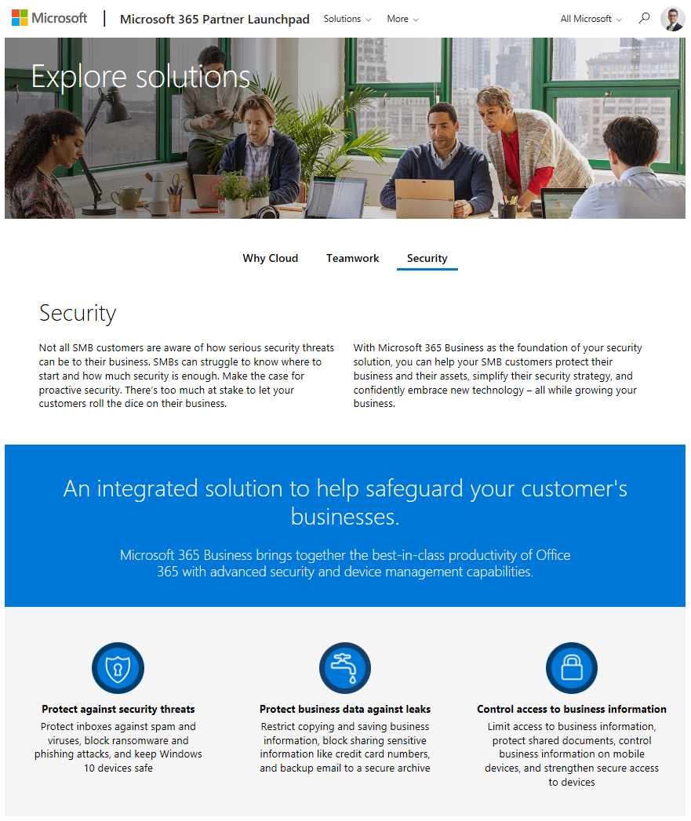
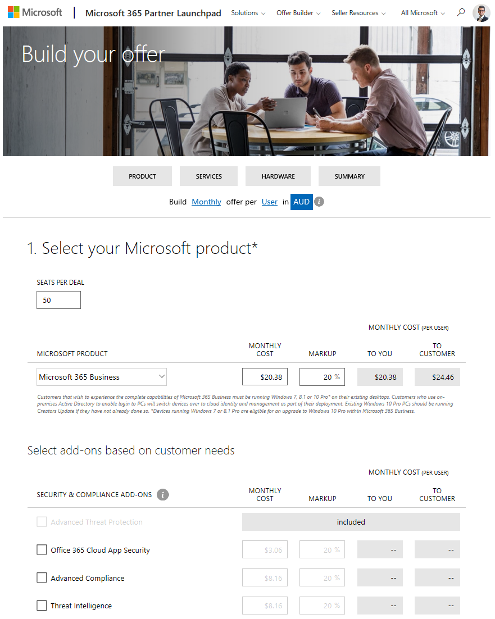
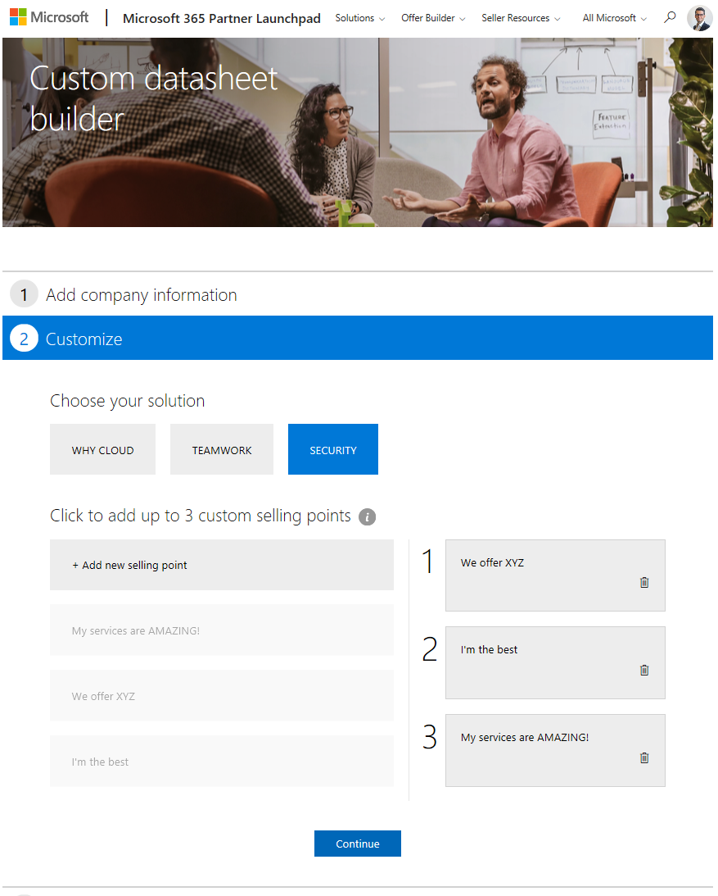
Build holistic SMB offers
Price and build offers using the tool on Partner Launchpad.
Insert license details and add your own services.
Bring example offer to your first meeting.
Build custom sales assets to close the deal.
Available @ aka.ms/partnerlaunchpad
Notes:
Launchpad offers information and tools to help you understand the key scenarios that can help you sell into customers.
Use new Launchpad tool to build an example offer to get customers interested.
Insert license details and your own services.

Slide 26
Start the conversation with SecureScore
And continue to monitor progress over time
  Secure Score API
  Show customers their current security posture across identity, data, device, apps and infrastructure
  Compare their score to others of similar size
  Show history to monitor progress
  Integrate data into compliance or cybersecurity apps
  Partner Smart Office
  Aggregate Secure Score information into a single repository for all customers (OpenSource)
  Optimized for partners
Resources
Partner Smart Office
Using the Secure Score API (TechNet)
Secure Score Deep Dive (Video)
Notes:
Use a Secure Score to help customers understand potential issues and next steps.
Partners can build complementary offerings around the service using Microsoft APIs.
Build a system that collects all their customers secure score details.
- Monitor whether the customer score is low or if it has changed.
- Offer it as a value add or use it as a reason to call your customer.

Slide 27


Understand SMB’s current security position with CSAT
Intake and preparation
15 minutes
Interview and Installation
2.5 hours
Run the scan
30 minutes
Presentation of the report
15 minutes
Send welcome email for onboarding process and include system requirements and URL for questionnaire to be answered before the call.
CSAT server recommended requirements:
Conduct interview questionnaires and discuss with IT oﬃcer or business Unit manager.
Collect relevant data includes:
Endpoint scan: accounts, ﬁrewall rules, applications installed, OS/services pack, shares and the registry.
Active Directory Domain System.
CSAT scanning logs (no password or credentials).
Conduct presentation and discussion of ﬁndings, conclusions and recommendations.
Establish a secure remote desktop session by using other software (e.g. Team Viewer).
Advise on urgent actions and quick wins.
OS | Windows 10 Windows 8 Windows server 2016 Windows server 2012
CPU | 2 cores
Memory | 4GB 40GB
HDD
Install and conﬁgure CSAT on a client machine during the interview.
Send “Final report” and “QS solutions letter of confirmation POE” for signing oﬀ.
Available @ https://cybersecurityassessmenttool.com
Notes:
Help your customer check its security status quickly and simply. The Cyber Security QuickScan provides insight into a customer’s current cyber security status (on premises and cloud) and potential vulnerabilities through automated scans and analyses of your customer’s infrastructure. You get fact-based recommendations and an action plan to improve your security and support compliance needs. .

Slide 28

Standardize deployment with
Microsoft 365 Business Secure Deployment Kit
Advanced, comprehensive workshop from security assessment to deployment
Assess the current security situation
Remediate high priority security concerns
Deploy Microsoft 365 Business
Configure advanced security features
Identify and protect sensitive data
Provide ongoing services
Duration: 1-2 days
Available @ aka.ms/bsecure
Notes:
The Microsoft 365 Business Secure Deployment Toolkit combines structured planning and implementation guidance. Use it to quickly launch a workshop to help take the customer from assessment through deployment. Customize it to combine your unique offers with this toolkit.

Slide 29
Bring it all together with Advanced Security resources
Learn
Market
Sell
Deploy
Advanced Security play card
Product service description
Product technical content
Product technical readiness
SMB guided product tour
Demo platform
Certification
Conversation guide
Email kit
Day-in-the-life infographic
Social assets kit
Flyers
Offer builder
Cyber Security Assessment
Microsoft security assessment
Customer pitch deck
SOW and Proposal
Partner Smart Office
SecureScore
Technical training
Adoption library
Microsoft 365 Deployment Kit
Market and Sell content available @ aka.ms\mwsmb
Notes:
Working with SMBs is a not a one-and-done operation, it’s a continuous cycle of learning, marketing, pitching, and selling. Advanced security practice assets from Microsoft help you engage with customers to help them modernize their workplace.
Use the multi-channel, multi-touch assets to build top down and bottom up awareness for businesses to update their software and hardware together and to move from on-premises or freemium solutions to an always updated experience powered by the cloud.
Examine Learn assets to help prepare yourself to sell security solutions. Market campaign assets help you focus on what customers gain when the adopt new technology, with benefits clearly outlined and sales motions that align to SMB customers needs. Additional resources help you Sell and Deploy with confidence.

Slide 30


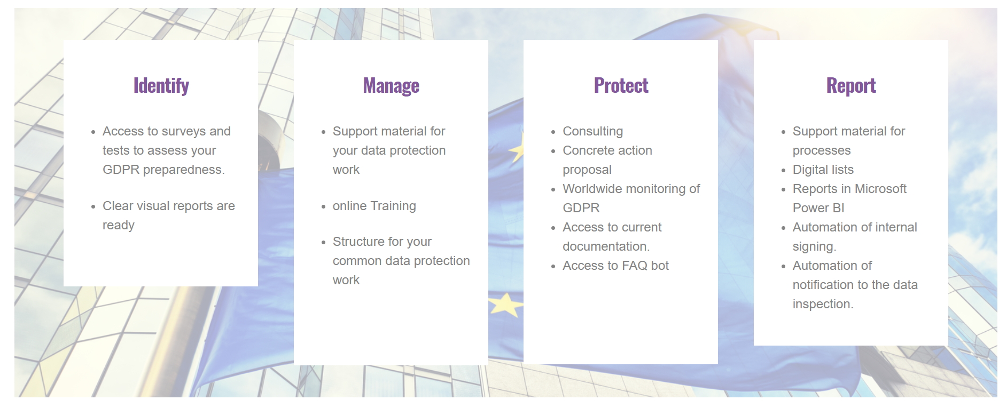
Partner example:
Sweden
The GDPR Hub provides structure, control and overview of your data protection work
“We could never have attracted the larger customers we’re seeing now without Microsoft 365 Business and our IP and services.“
Pe Liljenberg, Founder WeSafe IT
Why GDPR Hub?
The GDPR hub provides a long-term solution for the mapping, handling and documentation of personal data you are processing. You will have access to the structure, expertise, support material and processes to continuously manage the four key areas of GDPR:
Identify, Manage, Protect, Report.
What is included?
Tests, analyzes & reports
Support materials
Processes, flows & automation
Business intelligence
Advice & action suggestions
The solution by WeSafe IT
Utilize Microsoft 365 Business as the baseline for compliance
Ensure effective identity security through enforcing MFA and device management policies
Bundled with business solution “GDPR Hub”
Process
Start with a heavy content and webinar investment to drive end user education
Pull customer in with security assessment to show current stature
Standardize onboarding and deployment of security stack
Ongoing engagement through managed service
Real results
100% revenue growth
45% margin growth
50% average customer size growth
Access to surveys and tests to assess your GDPR readiness
Ready-to-go visual reports
Support material to protect your data
Online training
Templates and work flows to protect your data
Consulting
Advice and solution proposal
Worldwide monitoring of GDPR
Access to current documentation
Access to FAQ bot
Support material on pre-built processes
Digital lists
Reports in Microsoft Power BI
Automated internal sign-in
Automated notification to data inspection
https://www.wesafe.se/

Slide 31

Path to success
  Use Smart Partner Office to consolidate all your customers SecureScore. Have a conversation 3 of your customers about their current score
  Identify 3 high propensity security customers and use the hybrid Cyber Security Assesment Tool (CSAT) for a more comprehensive security assessment
  Win the deal and effectively deploy MFA, ATP and DLP to get started using the Microsoft 365 Business Deployment Kit
  Start to monetize through developing a monitoring practice that you sell to all your customers
  Develop an inhouse practice or partner with others to deliver remediation and compliance services
Notes:
All in all, having a fully integrated, cross-platform solution for you to sell to small businesses is very exciting for Microsoft, and we hope for you too.
We’re excited because we see the potential for you to create so much more value for our shared customers, in a way that increases your profit margins, captures recurring revenue for the long term and allows you to scale to more customers around the world.
We anticipate much excitement amongst small businesses when they find out that they can leverage the same solutions and infrastructure that the world’s largest organizations use today.
Microsoft 365 Business will help you simplify your sales cycle, increase your profitability, expand your services and retain your customers.
So get started today!

Slide 32
Thank you
© Copyright Microsoft Corporation. All rights reserved.

