Slide 1
Windows Server & SQL Server on Azure Solution Play Sales Guidance

Slide 2
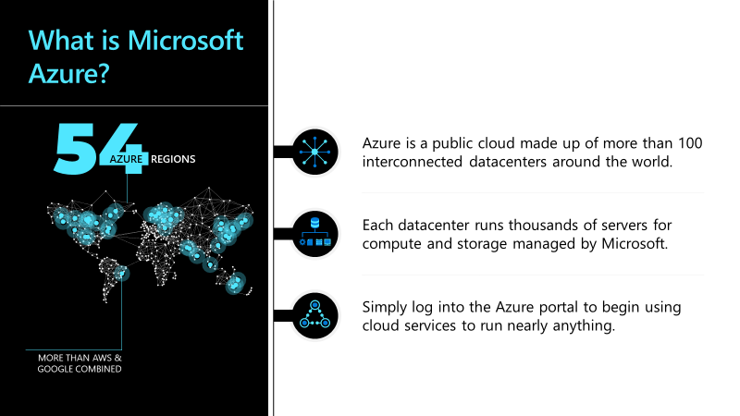
Windows Server & SQL Server on Azure: Opportunity
Gartner predicts the worldwide public cloud service market will grow from $182.4B in 2018 to $331.2B in 2022.
2020 pandemic accelerates cloud demand and spending
Unexpected shift in resources
Sudden rise in remote working – businesses need to be support to stay alive
Likely shortage of servers and data center equipment later in 2020 – due to lags in the supply chain, drop in semiconductor production, tariffs and borders between trading partners remaining closed
Cloud services provide an alternative for customers in need of compute capacity
Retooling for the aftermath
Digital business accelerated during 2020 due to pandemic-influenced spending
Expect change in business direction as companies exit lockdown and strive to get out of downturn.
Original 2023-24 cloud spending projections could start appearing in 2022
With limited cash for change, businesses will look to the cloud for retooling
Source
Gartner:
Statista:
“[The pandemic is] bringing the future forward“
“Cloud spending is forecast to expand 3.8% in 2020 – the only segment in the global IT industry to still show growth in 2020“

Slide 3
Windows Server & SQL Server on Azure: Value proposition
With cost savings and efficiency top of mind, migrating to Windows Server & SQL Server on Azure provides you the most cost-effective, frictionless way to move to the Cloud.
Intelligent security and performance features mean consistent and predictable workload performance, and you can get the lowest cost of ownership by combining unique pricing options and extended security updates. Fully-managed infrastructure and services take the pressure of management off your teams and free you up to spend more time creating.
Modernize digital processes and stay relevant by using Microsoft Azure SQL Server to ensure data security, optimize operational processes, and improve profitability
Innovation for your data applications – reimagine your business offerings and operations by modernizing SQL apps in Azure
Flexible and open cloud destinations – maximize your SQL investments by migrating to the only cloud with end-to-end hybrid infrastructure
Limitless scale and unmatched performance – guarantee performance at limitless scale with industry-leading SLAs and built-in high availability
Layers of security and leading compliance – protect your data with the most comprehensive set of compliance and security offerings in public cloud
Best total cost of ownership – save money in Azure by leveraging your existing licenses and free upgrades
On Azure Virtual Machines
Best TCO – pay up to 84% less than AWS
Industry-leading database – an enterprise-grade unified data platform
High performance on any operating system – leading performance on Linux or Windows
Built-in security and manageability – automatic security updates and built-in availability
Multiple ways to use Azure
Infrastructure as service
SQL Server on Azure virtual machines: Best for complete SQL Server and OS control
Platform as a service
Azure SQL Managed Instance: Best for a fully managed SQL Instance
Azure SQL Database: Best for modern cloud applications

Slide 4
Windows Server & SQL Server on Azure: Solution overview
Azure SQL Server | For structured or unstructured data. Query and analyze using the data platform with industry-leading performance and security. | Get the combined performance, security, and analytics of SQL Server, backed by the flexibility, security, and hybrid connectivity of Azure.
Azure Cosmos DB | Database designed for modern mobile and web applications. Delivers consistently fast reads and writes, schema flexibility, and the ability to easily scale a database up and down on demand. | Also, Database-as-a-service – fully managed by Microsoft Azure.
Azure SQL Data Warehouse | Based on the proven SQL Server relational database engine. Gives petabyte scalability with massive parallel-processing architecture that enables distributed processing to handle the rigors of modern data realities. | The industry’s first enterprise-class cloud data warehouse that can grow, shrink, and pause in seconds. Independently scales compute and storage in seconds.
Azure Data Lake | For data management and analytics at scale. Composed of three parts: Azure Data Lake Store, Azure Data Lake Analytics, and HD Insight. | Together with these products, you can store big data of any size and type and analyze it with familiar open-source tools – all while getting a leading, enterprise-class SLA.
Power BI | Microsoft’s fully managed intelligent, big data and advanced analytics offering in the cloud. Designed to help transform data into intelligent action. | Comprehensive suite that brings together technologies throughout Microsoft. It provides fast and flexible deployment.

Slide 5
Windows Server & SQL Server on Azure: Customers
Customers large and small trust Azure
Fortune 500 companies
Small and medium organizations

