Slide 1
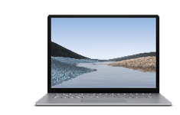
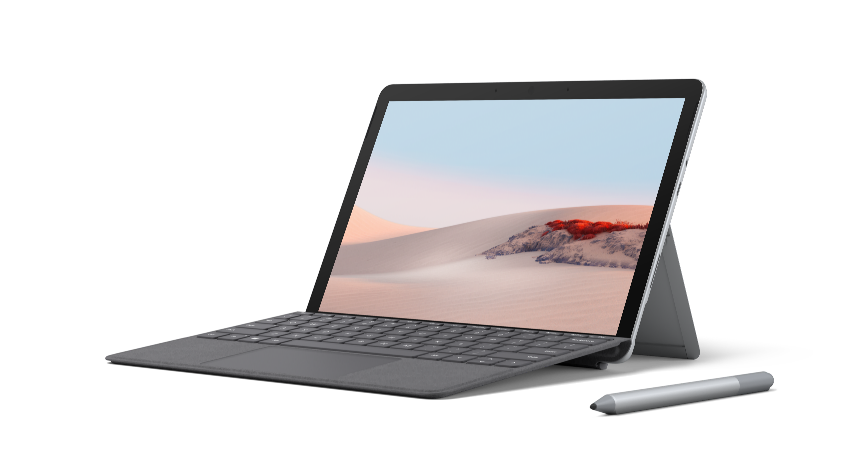
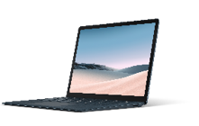
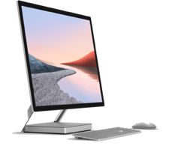
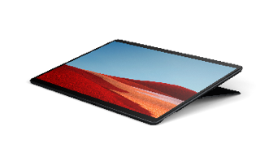
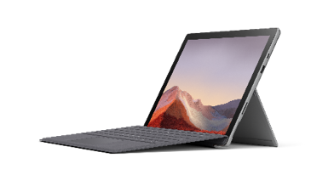
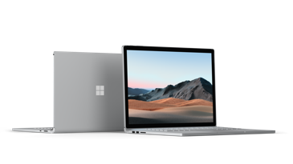
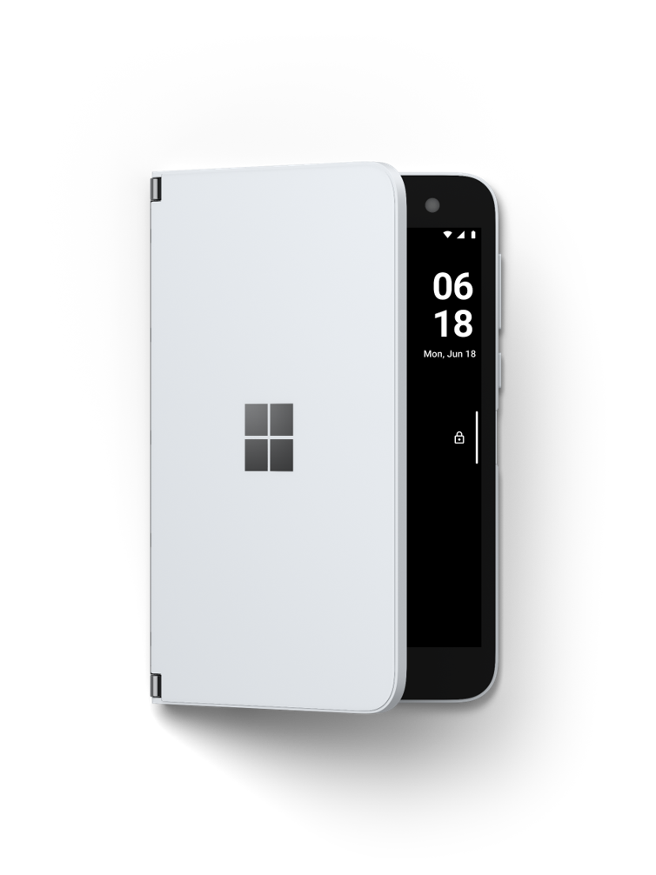
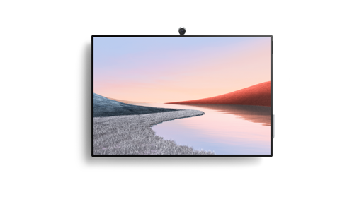
Surface devices for every role
Surface Laptop 3
Surface Go 2
Surface Studio 2
Available with LTE Advanced.
Roaming customer service
Field servicer
Mobile sales representatives
Customer relationship managers
Information workers
Executives
Engineers, designers, researchers
Branch work
Nurses
Shop floor operations
Retail floor workers
Students
Mobile care workers
Field technicians
Case workers
First responders
Facilities operators
Pharmaceutical sales reps
Assistant district attorneys
Wealth advisors
Insurance adjustors
Physicians
Retail store managers
Athletics directors
Sr. managers
Consultants
Office workers
Financial directors
Legislative staff
Principals
School admins
Professors
Investment analysts
Product designers
Surface Pro X
With LTE Advanced Pro
Surface Pro 7
Surface Book 3
Surface Duo
Surface Hub 2S
Notes:
Key points
Optional slide to use to articulate how we map user types to devices
Sample talk track
The Surface portfolio is designed to support the needs of workers, educators, and students. Here is a representative sample of the roles we have positioned the portfolio with.
Roaming Customer Service
Renault: https://customers.microsoft.com/en-us/story/809461-renault-automotive-surface-pro-en-us (Surface Pro)
Renault understands the frustration customers can feel when they bring their car to a dealer service center and have to repeat information they already shared when they set up the appointment. It also knows too well how repeated manual data entry falls prone to error. The company wanted to find a way to improve the customer service experience and build a simpler, more modern approach to dealer service operations.
“We were looking for a tool to create value for the customer that could reduce various administrative tasks requiring staff to reenter information,” says Frédéric Bouillier, Director of Project Deployment at Groupe Renault.
To resolve this and other challenges to customer loyalty, Groupe Renault launched the R-Book Service using Microsoft Surface Pro devices. With R-Book Service, the service advisor is already familiar with the vehicle’s complete service history and the type of service the customer seeks—before the customer arrives at the dealership for their service appointment.
Field Servicer
Willmott Dixon: https://customers.microsoft.com/en-us/story/820692-willmott-Dixon (Surface Go)
Willmott Dixon is seen as a leading organisation in the construction industry for sustainability, innovation, and the legacy it leaves in the community. Common to most construction companies, it found a lot of its staff were travelling to lots of different sites, carrying lots of different kit. Recognising the need to streamline devices and enhance productivity, it embraced Microsoft 365 and the Surface Go LTE devices.
"People wanted a robust device that would stand up to the rigours of working on site" says James Ibbotson, Enterprise Architect at Willmott Dixon. "The Surface Go LTE with built in modem has the power and the grunt to run the applications, whether you're standing by a crane or in the site cabin. Nothing else we found could compare.“
Renault: https://customers.microsoft.com/en-us/story/809461-renault-automotive-surface-pro-en-us (Surface Pro, Surface Pen)
R-Book Service is a touch-sensitive app installed on a service advisor’s Surface Pro, compatible with Surface Pen and connected to Renault service department resources including customer and vehicle history. The service advisor uses a Surface device to understand the service request and perform a complete inspection, with the customer, at the vehicle. The advisor updates the customer’s history in real time, notes related technical specs, and confirms any work orders for the vehicle—all directly on the Surface Pro.
Service advisors no longer have to repeatedly ask customers for the same information or reenter the data when they switch from one system to another. They carry the Surface Pro with them for most of the day and appreciate the modern user interface, sturdy yet lightweight design, long-lasting battery charge, and powerful connectivity. With offline functionality, they can work in R-Book Service far out on the lot or on an inspection drive with the customer. And with the Type Cover, they easily transition to using Surface Pro at their desks. “Once docked, the device connects to a keyboard and monitor, and Surface Pro becomes a desktop computer for use by the service advisor,” says Bouillier.
“Surface Pro is an excellent tool for staying connected, even when it is far from hotspots,” says Christophe le Boulanger, Dealer Service Advisor at Groupe Renault. “It has a long-lasting charge, and it is a powerful machine—you can feel the power under the hood.”
Mobile Sales Representatives
Carhartt: https://customers.microsoft.com/en-us/story/809027-carhartt-retail-surfacehub-office365-onedriveforbusiness-powerbi-en (Surface Book)
The Carhartt sales team found a modern opportunity for mobile engagement with the Surface Book.
“Usually the sales team is last to embrace a change in technology, but now they’re our champions,” Hill states. By taking Surface into the field, Carhartt’s sales professionals can communicate directly with the corporate office as needed, while having the entirety of Carhartt’s product knowledge stored in their hands. This will reduce the need to carry so many samples and other product documentation, and it creates an entire digital product catalog that customers can use to demo Carhartt’s latest lines.
“We are also improving the productivity of our sales reps,” Hill adds. “Instead of travelling in for all-day meetings, they can dial in for that fifteen or thirty minutes and keep people cross-functional with supporting documents. They’re able to really focus on discussions around the specific challenges that may be happening in a particular region.”
Whether it’s working alongside a supplier or maintaining relationships with a national retailer, with Surface and Power BI, Carhartt can make smarter decisions and stronger partnerships. “I’m a big believer in having a few good, solid relationships with suppliers…if that partner has a good product and a good value proposition, then we’ll figure out how to make it work.” Hill explains, “I’d rather make big bets with key providers, and that is what we have done with Microsoft.”
Customer Relationship Managers
Francfranc: https://customers.microsoft.com/en-us/story/811777-francfranc-retail-surface-en-us (Surface Go, Surface Studio, Surface Pro, Surface Laptop)
Francfranc introduced Surface not just for branding reasons, but also to increase employee efficiency and improve customer experience. The company uses four types of Surface devices in its stores and back-end operations. Store staff use the lightest devices in the series, Surface Go, for customer reception. To present interior design options to customers, they use the 28-inch integrated display of Surface Studio 2, stationed on a dining table. For register terminals, employees use Surface Laptop 2. Area managers use Surface Pro for high-performance mobility.
Store Manager Kota Tomori of the MODERN WORKS store at Minato Mirai Tokyu Square says he’s seen a significant effect on the customer experience.
“Customers like Surface because they find it visually pleasing and easy to interact with,” he says. “We use Surface Go when guiding customers around the store, and Surface Studio 2 when customers sit with us to go over interior design options. We use Surface to show customers products that are available but not in stock at that store. When a customer brings in a floor plan of their home, we use our 3D simulation app to visualize where products might go and how they’d look. It leads to purchases of whole groups of items. Before, with paper catalogs, we were limited in demonstrating this. Now that we have introduced Surface, we don’t just sell products; we provide total customized coordination for each customer.”
Osaki agrees, saying, “We provide personalized service anywhere in the store, whenever customers need answers or want to see product choices displayed. We carry our Surface devices everywhere, to make business decisions and manage inventory in seconds, freeing time to spend with customers.”
Information Workers
Warwickshire Council: https://customers.microsoft.com/en-us/story/820776-Warwickshire (Surface Pro)
Local government is under increasing pressure to make resources go as far as possible, at a time when demand for services continues to rise. In order to work as efficiently as possible, Warwickshire Council made the bold decision to give each of its 4,500 staff a Surface Pro and migrate to Microsoft Office 365.
The combination of the Surface Pro devices and Office 365 has transformed work behaviors. "Users can work from any desk in any location and have a full office environment," explains Craig Cusack, Assistant Director for Enabling Services. "Now, we're able to sit face to face with citizens and share information far easier, to interact and collaborate by passing the pen and the device backwards and forwards. It does change how council colleagues deliver services."
With the desire to move at pace, Warwickshire Council engaged Microsoft Services as well as Windows Autopilot. The result was a rapid roll out of devices and that minimised setup for the IT team and meant users were ready to start working the moment they received their device.
“In just 3 months we migrated 4,500 staff to Microsoft 365 and Surface Pro. And less than 1% of users raised any issue with that at all. We could not have achieved this without partnership with Microsoft.” - Craig Cusack: Assistant Director for Enabling Services, Warwickshire Council
Carhartt: https://customers.microsoft.com/en-us/story/809027-carhartt-retail-surfacehub-office365-onedriveforbusiness-powerbi-en (Surface Hub)
What initially began as a conference room enhancement quickly transformed into an opportunity for revolution. With the Surface Hub, Hill and his team replaced their bulky and expensive telecommunication infrastructure with a modern solution that further united their productivity and analytic resources.
As more and more teams embrace the Surface Hub adoption, the more opportunities Hill and Walker discover within their new solution. With the Surface Hub, Carhartt’s leadership team has replaced its archaic telecom solution with an efficient, interactive communication experience.
Walker explains, “It makes it much easier to utilize our tools. From simply creating a meeting around the Surface Hub, including the Skype call-in information, and having all the information, any documents associated with the event are available for when you walk in the room.”
The Hub slots into Carhartt’s existing Office 365 service to sling presentations, images, and documents directly from its own SharePoint directory or OneDrive account. It also hones many common meeting tasks like dialing in or recording (and sorting) calls, and provides easy call-in for off-site employees with Skype for Business. Remote opportunities not only cut down on travel costs, but allow for improvised cross-country collaboration—Hill and his team can quickly jump in and out of conversations at no extra cost.
Executives
NHS: https://customers.microsoft.com/en-us/story/731848-microsoft-surface-for-the-nhs-how-surface-impacts-operations (Surface Hub)
The top end of the Surface family – Surface Hub – has also been a game changer when it comes to linking up different NHS sites.
“The travel time between some of our sites is over one and half hours which has a real impact on a clinicians day when travelling to meetings. We have Surface Hubs installed in meeting rooms on our core and outlying sites to allow staff to jump onto a Skype call. The devices are also a valuable aid to our Training & Development team who are now able to deliver key courses via Skype for Business to meeting rooms across the trust.” Revell Cornell: Infrastructure Manager, Northumberland, Tyne and Wear NHS Foundation Trust
NHS: https://customers.microsoft.com/en-us/story/731848-microsoft-surface-for-the-nhs-how-surface-impacts-operations (Surface general)
With thousands of Surface devices across NHS Trusts already, the active use case is proving itself in the field. From consultants right through to junior doctors, medical professionals are building Surface into their daily ward rounds; encouraging a fully-connected, agile communications environment.
Surface devices are becoming the de facto endpoint for both desk work and meetings; either on Trust premises or at home. The wide rollout across some Trusts has proved an endeavor which has kickstarted the mobile working ethic. Andre de Araujo explains, “Being mobile workers, [staff] can now go anywhere on-site, or off-site completely, and just take the device with them and hook up to either the clinical information system or whatever systems they need – instantly – without having to print off notes, write them on paper, then come back and capture information, updating that separately… they can just do it, straight away.”
The remote meeting advantages of Surface and Teams have also enhanced Trust staff collaboration, with in-person conferences – and the travel time and calendar admin it took to organise them – vastly reduced with Surface technology in so many hands.
“We used to have sometimes 30 people all going to one of the sites to discuss ward rounds for the week and this could involve two hours’ travel, and half an hour for some people to find a meeting place. Now what they do is they just meet [online], have a conference wherever they are, go through the ward round, which is on a shared Excel spreadsheet normally, then off they go, and it’s only 20 minutes, instead of two-and-a-half hours.” - Andre de Araujo: Head of ICT, Greater Manchester Mental Health NHS Foundation Trust
Engineers, Designers, Researchers
Super 78: https://customers.microsoft.com/en-us/story/758299-super78-surface-media-and-entertainment (Surface Studio)
Super 78 has become a leader in real-time animation, an advanced system used to bring 3D characters to life. To offer novel experiences, excite and entertain audiences, and drive production efficiencies, Super 78 developed its own proprietary real-time animation software called Geppetto.
Now, Super 78 uses Microsoft Surface Studio devices to run Geppetto as a classic animation desk and transform every stage of the animation process.
The studio combines its proprietary Geppetto software with Surface Studio touchscreen, Surface Pen, and other tools to help marry digital power to creative genius. Animation has always thrived on innovation. With Surface, Super 78 reduces costs, saves time, builds a competitive advantage, wins awards—and revolutionizes animation.
“With Surface Studio, we can give ourselves permission to follow our gut and try something again; that’s a little revolutionary.” - Brent Young: Creative Director and Cofounder, Super 78

