Slide 1
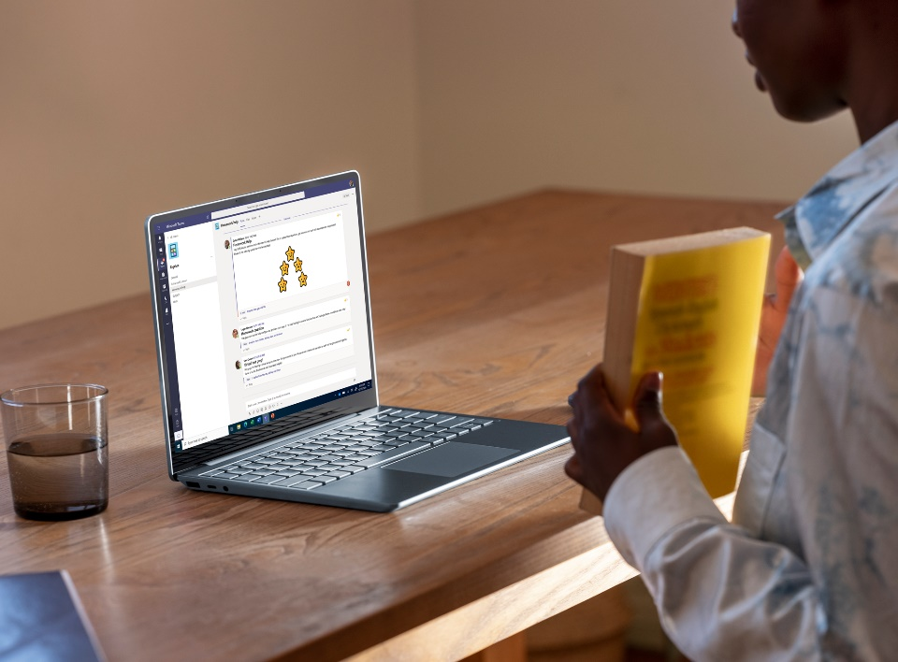
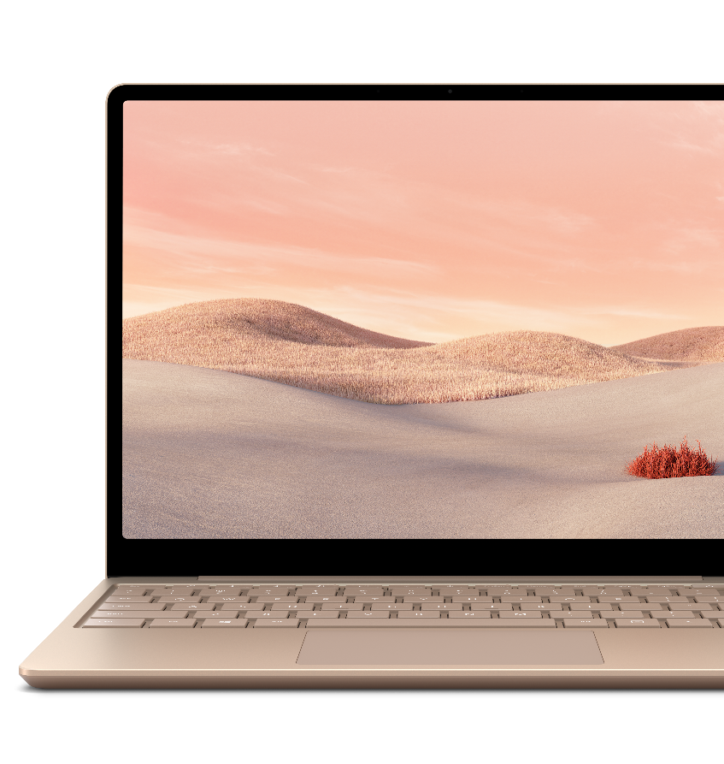
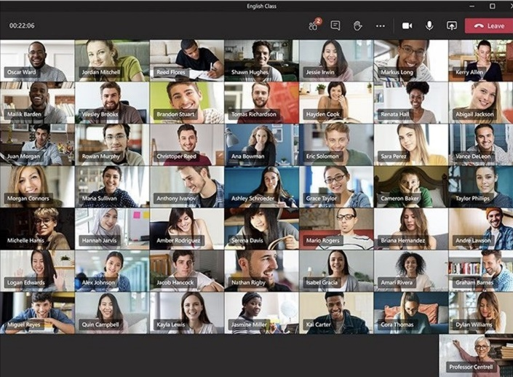
Partner Logo
Empower students and teachers with a laptop they’ll love
Meet the new Surface Laptop Go for Education
Get high marks for style
and durability
Create a safe, manageable environment from anywhere
Lightweight, modern design with the premium Surface experience at an affordable price.
Join class remotely and see, hear and share more with a 12.4”1 touchscreen, Omnisonic speakers and studio mics. ​
An everyday laptop that’s lighter than most textbooks at just 2.4 lb.
Choose from Platinum, Ice Blue, or Sandstone² that compliment your style and depend on a keyboard finish that lasts.
Industry-leading typing comfort on a full-size keyboard with tamper-resistant keys, and a precise trackpad for easy navigation and Instant On to get back to work faster.
Power through a day of schoolwork, from classroom assignments to homework with battery life up to 13 hours³ and Fast Charging – up to 80% in just over an hour.⁴
Full-featured, student-ready devices that are easy to deploy and manage remotely
Keep devices secure with updates via Microsoft Endpoint Manager,* restrict access to only the apps students need, and find custom-designed accessories for every task.
Make the most of your technology investments with devices that optimize the Microsoft 365* experience, including Windows, Windows Hello, Office, Minecraft*: Education Edition, and more.
Reduce downtime with Advanced Exchange, an expedited replacement service, at no additional cost.³
Privacy you should expect: safe searches and no student re-targeting.
Windows 10 Pro delivers the security IT teams trust.​
Secondary Education (Grade 6-12)
Keep student data safe and reduce headaches for IT with zero-touch remote deployment, one-click device management, and protection from Microsoft. Upgrading your classroom technology doesn’t have to bust the budget. You believe students need modern and sophisticated tools to make the most of their 6th through 12th grade educations that are easy to repair and durable enough to handle even the toughest critics.​
Higher Education
Unlock new ways of learning and collaborating by equipping students with a laptop that’s powerful enough to handle their essential apps, portable enough to carry everywhere, and stylish enough to excite young minds. Great devices shouldn’t come at a crippling price – now students can spark creativity and improve readiness for college and career while appreciating the durability and modern design.​
Reach out to your partner today to learn more.

Slide 2
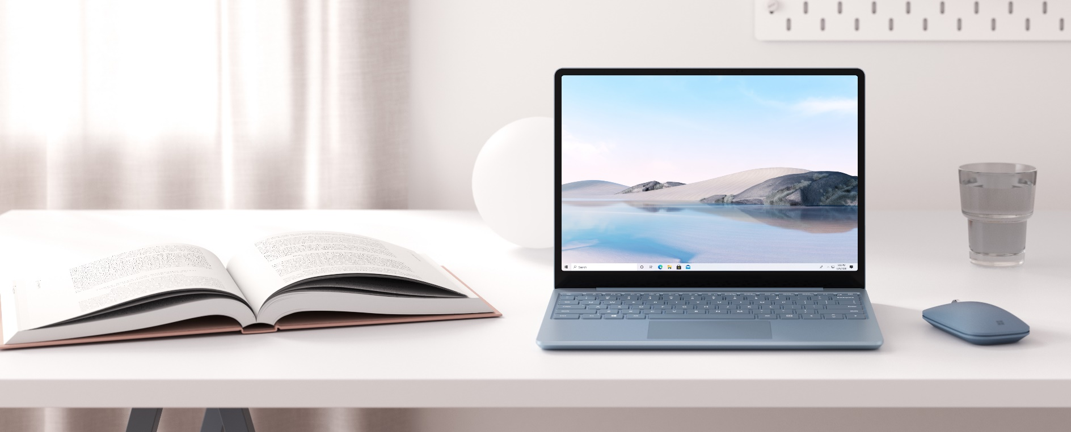
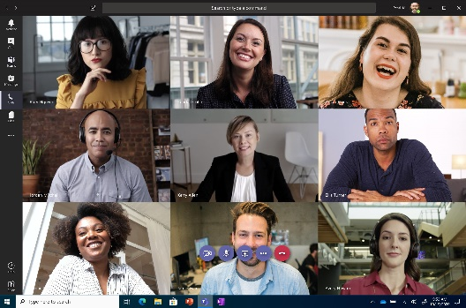
Technical specifications
Dimensions | 10.95” x 8.10” x 0.62” (278.18mm x 205.67mm x 15.69mm)
Display | Screen: 12.4” PixelSense™ Display⁷ Resolution: 1536 x 1024 (148 PPI) Aspect ratio: 3:2 Touch: 10 point multi-touch
Memory | 8GB or 16GB LPDDR4x in Memory
Processor | 10th Gen Intel® Core™ i5-1035G1 Processor
Security | Discrete hardware TPM Enterprise-grade protection with Windows Hello sign-in One Touch sign in with Fingerprint Power Button
Software | Windows 10 Pro
Sensors | Ambient light sensor
What’s in the box | Surface Laptop Go 39W Power Supply Quick Start Guide Safety and warranty documents
Weight | 2.45 lb (1,110 g)
Storage⁸ | Solid-state drive (SSD) options: 128GB, 256GB
Battery life¹ | Up to 13 hours of typical device usage¹
Graphics | Intel® UHD Graphics
Connections | 1 x USB-C® 1 x USB-A 3.5 mm headphone jack 1 x Surface Connect port
Cameras, video, and audio | 720p HD f2.0 camera (front-facing) Dual far-field Studio Mics Omnisonic Speakers with Dolby® Audio™ Premium
Wireless | Wi-Fi 6: 802.11ax compatible Bluetooth® Wireless 5.0 technology
Exterior | Top: Aluminum Base: Polycarbonate composite resin system with glass fiber and 30% post-consumer recycled content Colors⁶: Ice Blue, Sandstone, and Platinum
Warranty⁹ | 1-year limited hardware warranty
*Sold separately.
¹ Surface Laptop Go battery life: Up to 13 hours of battery life based on typical Surface device usage. Testing conducted by Microsoft in September 2020 using preproduction software and preproduction configurations of Surface Laptop Go Intel® Core™ i5, 128GB, 8 GB RAM Microsoft Surface® Edition devices. Testing consisted of full battery discharge with a mixture of active use and modern standby. The active use portion consists of (1) a web browsing test accessing 8 popular websites over multiple open tabs, (2) a productivity test utilizing Microsoft Word, PowerPoint, Excel and Outlook, and (3) a portion of time with the device in use with idle applications. All settings were default except screen brightness was set to 150nits with Auto-Brightness disabled. Wi-Fi was connected to a network. Battery life varies significantly with settings, usage and other factors.
² Go from low battery to full fast--80% in just over an hour. Testing conducted at Microsoft in September 2020 using pre-production devices and Software. Tested with the inbox SurfLink 39W PSU under controlled conditions with device in hibernate or off state. Device was powered on to desktop screen with default display brightness settings. Actual charge time will vary based on operating conditions. Measured at typical office ambient temperature of 23C.
⁴ Surface Go and Surface Go 2 use a third-party UEFI and do not support DFCI. DFCI is currently available for Surface Laptop Go, Surface Book 3, Surface Laptop 3, Surface Pro 7, and Surface Pro X. Find out more about managing Surface UEFI settings.
⁵Advanced Exchange Service is available at no additional charge with the following Surface for Business products: Surface Laptop Go, Surface Book 3, Surface Go 2, Surface Laptop 3, Surface Pro 7, Surface Pro X, Surface Pro 6, and Surface Laptop 2. Advanced Exchange is only available in supported markets. Restrictions apply. See Surface for Business warranty page for AES terms and conditions and list of supported markets.
⁶ Available colors may vary by market
⁷ Surface Laptop Go display has rounded corners within a standard rectangle. When measured as a standard rectangular shape the screen is 12.45” diagonally (actual viewable area is less).
⁸ System software and updates use significant storage space. Available storage is subject to change based on system software updates and apps usage. 1 GB= 1 billion bytes. See Surface.com/Storage for more details.
⁹ Microsoft’s Limited Warranty is in addition to your consumer law rights.

